Slide 1

ELEMENTARY MATH PROJECT
GRADE 2 PRACTICE QUESTIONS
NUMBER SENSE

Slide 2
GRADE 2 NUMBER SENSE:
CLOSED QUESTIONS: COUNTING
ELEMENTARY MATH PROJECT
1. Count by 2s starting at 6. What are the next 5 numbers?

Slide 3
GRADE 2 NUMBER SENSE:
CLOSED QUESTIONS: COUNTING
ELEMENTARY MATH PROJECT
2. Count backward by 5s from 75.
What are the next 4 numbers?

Slide 4
GRADE 2 NUMBER SENSE:
CLOSED QUESTIONS: COUNTING
ELEMENTARY MATH PROJECT
3. What number is 4 jumps of 10 more than 23?

Slide 5
GRADE 2 NUMBER SENSE:
CLOSED QUESTIONS: COUNTING
ELEMENTARY MATH PROJECT
4. A skip-counting pattern is: 15, _______, 25, 30.
Fill in the blank.

Slide 6
GRADE 2 NUMBER SENSE:
CLOSED QUESTIONS: COUNTING
ELEMENTARY MATH PROJECT
5. Count backwards by 10s starting at 47.
What are the next 4 numbers?

Slide 7
GRADE 2 NUMBER SENSE:
OPEN QUESTIONS: COUNTING
ELEMENTARY MATH PROJECT
6. Start at 13. Count by 2s. Stop when you pass 30.
What patterns do you notice?

Slide 8
GRADE 2 NUMBER SENSE:
OPEN QUESTIONS: COUNTING
ELEMENTARY MATH PROJECT
7. Skip-count backward from 92 by 10s.
What patterns do you notice?

Slide 9
GRADE 2 NUMBER SENSE:
OPEN QUESTIONS: COUNTING
ELEMENTARY MATH PROJECT
8. Create your own skip-counting pattern starting at 7.
What rule did you use?

Slide 10
GRADE 2 NUMBER SENSE:
OPEN QUESTIONS: COUNTING
ELEMENTARY MATH PROJECT
9. A counting pattern starts at 2 and ends at 32.
What numbers could you be counting by? How do you know?

Slide 11
GRADE 2 NUMBER SENSE:
OPEN QUESTIONS: COUNTING
ELEMENTARY MATH PROJECT
10. Can you find a number that you say when you skip-count by 2s and by 5s?
Any others? What pattern do you notice?

Slide 12
GRADE 2 NUMBER SENSE:
OPEN QUESTIONS: COUNTING
ELEMENTARY MATH PROJECT
11. Create a number pattern using natural materials.
Explain the rule.

Slide 13
GRADE 2 NUMBER SENSE:
CLOSED QUESTIONS: COMPARING, ORDERING, BENCHMARKS
ELEMENTARY MATH PROJECT
1. Circle the number that is closest to 50:
42, 38, 55, 64

Slide 14
GRADE 2 NUMBER SENSE:
CLOSED QUESTIONS: COMPARING, ORDERING, BENCHMARKS
ELEMENTARY MATH PROJECT
2. Order these numbers from least to greatest:
67, 25, 89, 54

Slide 15
GRADE 2 NUMBER SENSE:
CLOSED QUESTIONS: COMPARING, ORDERING, BENCHMARKS
ELEMENTARY MATH PROJECT
3. Draw an open number line with the given endpoints.
Include useful benchmarks.
0 to 10
0 to 20
0 to 100

Slide 16
GRADE 2 NUMBER SENSE:
CLOSED QUESTIONS: COMPARING, ORDERING, BENCHMARKS
ELEMENTARY MATH PROJECT
4. Which number is halfway between 50 and 100?

Slide 17
GRADE 2 NUMBER SENSE:
CLOSED QUESTIONS: COMPARING, ORDERING, BENCHMARKS
ELEMENTARY MATH PROJECT
5. Which is larger?
63 or 36
Explain how place value helps to answer this question.

Slide 18
GRADE 2 NUMBER SENSE:
CLOSED QUESTIONS: COMPARING, ORDERING, BENCHMARKS
ELEMENTARY MATH PROJECT
6. Which is closer to 100?
87 or 78

Slide 19
GRADE 2 NUMBER SENSE:
CLOSED QUESTIONS: COMPARING, ORDERING, BENCHMARKS
ELEMENTARY MATH PROJECT
7. Is 38 closer to 25 or 50?

Slide 20
GRADE 2 NUMBER SENSE:
CLOSED QUESTIONS: COMPARING, ORDERING, BENCHMARKS
ELEMENTARY MATH PROJECT
8. On a number line, what number comes halfway between 10 and 50?

Slide 21
GRADE 2 NUMBER SENSE:
OPEN QUESTIONS: COMPARING & ORDERING
ELEMENTARY MATH PROJECT
9. Which is closer to 100? How do you know?
91 or 87

Slide 22
GRADE 2 NUMBER SENSE:
OPEN QUESTIONS: COMPARING & ORDERING
ELEMENTARY MATH PROJECT
10. Find two numbers that add close to 100 but not more than 100. Can you find more examples?

Slide 23
GRADE 2 NUMBER SENSE:
OPEN QUESTIONS: COMPARING & ORDERING
ELEMENTARY MATH PROJECT
11. Which is a better estimate for a handful of jellybeans? Why?
20 or 80

Slide 24
GRADE 2 NUMBER SENSE:
OPEN QUESTIONS: COMPARING & ORDERING
ELEMENTARY MATH PROJECT
12. Is 61 closer to 0 or to 100?
How do you know?

Slide 25
GRADE 2 NUMBER SENSE:
OPEN QUESTIONS: COMPARING & ORDERING
ELEMENTARY MATH PROJECT
13. You are thinking of a number greater than 60 but less than 80. What could it be? What clues can you give a friend to guess it?

Slide 26
GRADE 2 NUMBER SENSE:
OPEN QUESTIONS: COMPARING & ORDERING
ELEMENTARY MATH PROJECT
14. Draw an open number line from 0–100. Pick 2 numbers and explain or show how far apart they are. Show any benchmark numbers that helped you to do this.

Slide 27
GRADE 2 NUMBER SENSE:
OPEN QUESTIONS: COMPARING & ORDERING
ELEMENTARY MATH PROJECT
15. A friend says that 62 is greater than 71 because 2 is bigger than 1. How would you explain their mistake?

Slide 28
GRADE 2 NUMBER SENSE:
OPEN QUESTIONS: COMPARING & ORDERING
ELEMENTARY MATH PROJECT
16. Choose two numbers. Can you prove that one is greater without counting by 1s?

Slide 29
GRADE 2 NUMBER SENSE:
OPEN QUESTIONS: COMPARING & ORDERING
ELEMENTARY MATH PROJECT
17. How are 26 and 62 the same?
How are they different?

Slide 30
GRADE 2 NUMBER SENSE:
OPEN QUESTIONS: COMPARING & ORDERING
ELEMENTARY MATH PROJECT
18. Choose one of the options below…
Option 1: Use a number line to show whether 13 is closer to 0 or 20.
Option 2: Use a number line to show whether 43 is closer to 0 or 100.

Slide 31
GRADE 2 NUMBER SENSE:
CLOSED QUESTIONS: PLACE VALUE, DECOMPOSING, & VALUE OF DIGITS
ELEMENTARY MATH PROJECT
1. What is the value of the 7 in 74?

Slide 32
GRADE 2 NUMBER SENSE:
CLOSED QUESTIONS: PLACE VALUE, DECOMPOSING, & VALUE OF DIGITS
ELEMENTARY MATH PROJECT
2. Write 62 as tens and ones.

Slide 33
GRADE 2 NUMBER SENSE:
CLOSED QUESTIONS: PLACE VALUE, DECOMPOSING, & VALUE OF DIGITS
ELEMENTARY MATH PROJECT
3. What number has 5 tens and 3 ones?

Slide 34
GRADE 2 NUMBER SENSE:
CLOSED QUESTIONS: PLACE VALUE, DECOMPOSING, & VALUE OF DIGITS
ELEMENTARY MATH PROJECT
4. Circle the number that has 4 tens and 7 ones:
74, 47, 84

Slide 35
GRADE 2 NUMBER SENSE:
CLOSED QUESTIONS: PLACE VALUE, DECOMPOSING, & VALUE OF DIGITS
ELEMENTARY MATH PROJECT
5. Which number has a digit worth 80?
89 or 98

Slide 36
GRADE 2 NUMBER SENSE:
CLOSED QUESTIONS: PLACE VALUE, DECOMPOSING, & VALUE OF DIGITS
ELEMENTARY MATH PROJECT
6. On a hundreds chart, what number is directly below 26?

Slide 37
GRADE 2 NUMBER SENSE:
CLOSED QUESTIONS: PLACE VALUE, DECOMPOSING, & VALUE OF DIGITS
ELEMENTARY MATH PROJECT
7. How many tens are in 95?
What number is that?

Slide 38
GRADE 2 NUMBER SENSE:
CLOSED QUESTIONS: PLACE VALUE, DECOMPOSING, & VALUE OF DIGITS
ELEMENTARY MATH PROJECT
8. I show you base-ten blocks with 3 tens and 6 ones.
What number is it?

Slide 39
GRADE 2 NUMBER SENSE:
CLOSED QUESTIONS: PLACE VALUE, DECOMPOSING, & VALUE OF DIGITS
ELEMENTARY MATH PROJECT
9. 67 = 5 tens + _______ ones

Slide 40
GRADE 2 NUMBER SENSE:
CLOSED QUESTIONS: PLACE VALUE, DECOMPOSING, & VALUE OF DIGITS
ELEMENTARY MATH PROJECT
10. 82 = _______ tens + 22 ones

Slide 41
GRADE 2 NUMBER SENSE:
CLOSED QUESTIONS: PLACE VALUE, DECOMPOSING, & VALUE OF DIGITS
ELEMENTARY MATH PROJECT
11. 34 = 2 tens + _______ ones

Slide 42
GRADE 2 NUMBER SENSE:
OPEN QUESTIONS: PLACE VALUE & DECOMPOSITION
ELEMENTARY MATH PROJECT
12. Show 53 in three different ways using tens and ones.

Slide 43
GRADE 2 NUMBER SENSE:
OPEN QUESTIONS: PLACE VALUE & DECOMPOSITION
ELEMENTARY MATH PROJECT
13. How we say a number often tells us about the place value of its digits.
For example, we say “fifty three” for 53, showing us that 53 is fifty and three.
Give another example of a number where this works.
Give an example where this does not work.

Slide 44
GRADE 2 NUMBER SENSE:
OPEN QUESTIONS: PLACE VALUE & DECOMPOSITION
ELEMENTARY MATH PROJECT
14. If I say “seven tens and something,” what numbers could I mean?

Slide 45
GRADE 2 NUMBER SENSE:
OPEN QUESTIONS: PLACE VALUE & DECOMPOSITION
ELEMENTARY MATH PROJECT
15. Show different ways to represent 64 using pictures or materials.

Slide 46
GRADE 2 NUMBER SENSE:
OPEN QUESTIONS: PLACE VALUE & DECOMPOSITION
ELEMENTARY MATH PROJECT
16. Can a number have 3 tens and still be more than 40? Explain.

Slide 47
GRADE 2 NUMBER SENSE:
OPEN QUESTIONS: PLACE VALUE & DECOMPOSITION
ELEMENTARY MATH PROJECT
17. Show a number less than 50 that is made with more ones than tens.

Slide 48
GRADE 2 NUMBER SENSE:
CLOSED QUESTIONS: EVEN AND ODD
ELEMENTARY MATH PROJECT
1. List the odd numbers in order starting at 1 and ending at 19.

Slide 49
GRADE 2 NUMBER SENSE:
CLOSED QUESTIONS: EVEN AND ODD
ELEMENTARY MATH PROJECT
2. Is 39 an even or odd number? How do you know?

Slide 50
GRADE 2 NUMBER SENSE:
CLOSED QUESTIONS: EVEN AND ODD
ELEMENTARY MATH PROJECT
3. Circle all the even numbers:
18, 35, 42, 67, 50

Slide 51
GRADE 2 NUMBER SENSE:
CLOSED QUESTIONS: EVEN AND ODD
ELEMENTARY MATH PROJECT
4. What is the next odd number after 71?

Slide 52
GRADE 2 NUMBER SENSE:
CLOSED QUESTIONS: EVEN AND ODD
ELEMENTARY MATH PROJECT
5. Is the sum of two odd numbers always odd? Try 5 + 7.

Slide 53
GRADE 2 NUMBER SENSE:
CLOSED QUESTIONS: EVEN AND ODD
ELEMENTARY MATH PROJECT
6. Which number is not like the others? (Hint: even or odd)
26, 44, 53, 88

Slide 54
GRADE 2 NUMBER SENSE:
CLOSED QUESTIONS: EVEN AND ODD
ELEMENTARY MATH PROJECT
7. I have a number between 40 and 50. It is even. The digit in the tens place is the same as in the ones place.
What is the number?

Slide 55
GRADE 2 NUMBER SENSE:
OPEN QUESTIONS: EVEN & ODD
ELEMENTARY MATH PROJECT
8. What happens when you add an even number and an odd number? Try some and explain.

Slide 56
GRADE 2 NUMBER SENSE:
OPEN QUESTIONS: EVEN & ODD
ELEMENTARY MATH PROJECT
9. What happens when you add an even and even? Odd and odd?

Slide 57
GRADE 2 NUMBER SENSE:
OPEN QUESTIONS: EVEN & ODD
ELEMENTARY MATH PROJECT
10. Think of 3 odd numbers between 30 and 50.
What do they have in common?

Slide 58
GRADE 2 NUMBER SENSE:
OPEN QUESTIONS: EVEN & ODD
ELEMENTARY MATH PROJECT
11. Is 0 even or odd? Why do you think that?

Slide 59
GRADE 2 NUMBER SENSE:
OPEN QUESTIONS: EVEN & ODD
ELEMENTARY MATH PROJECT
12. Can a number be both even and odd? Why or why not?

Slide 60
GRADE 2 NUMBER SENSE:
OPEN QUESTIONS: EVEN & ODD
ELEMENTARY MATH PROJECT
13. Which numbers between 1 and 20 are odd and make you think of something in nature?

Slide 61
GRADE 2 NUMBER SENSE:
OPEN QUESTIONS: EVEN & ODD
ELEMENTARY MATH PROJECT
14. I’m thinking of a number. It has 6 tens. The ones digit is odd. What could it be?

Slide 62
GRADE 2 NUMBER SENSE:
OPEN QUESTIONS: EVEN & ODD
ELEMENTARY MATH PROJECT
15. I’m thinking of a number. It has 6 tens. The ones digit is odd. What could it be?

Slide 63
ELEMENTARY MATH PROJECT
GRADE 2 PRACTICE QUESTIONS
COMPUTATIONAL FLUENCY

Slide 64
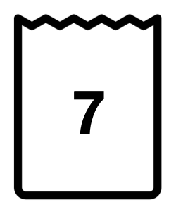

GRADE 2 COMPUTATIONAL FLUENCY:
CLOSED QUESTIONS: ADD/SUBTRACT TO 20
ELEMENTARY MATH PROJECT
1. Seven marbles are in the bag. Three marbles are next to the bag. How many marbles are there all together?

Slide 65
GRADE 2 COMPUTATIONAL FLUENCY:
CLOSED QUESTIONS: ADD/SUBTRACT TO 20
ELEMENTARY MATH PROJECT
2. Use near doubles to add. Show your thinking.
a. 6 + 7 = | b. 9 + 8 =
c. 4 + 6 = | d. 7 + 8 =
e. 5 + 6 = | f. 3 + 5 =

Slide 66
GRADE 2 COMPUTATIONAL FLUENCY:
CLOSED QUESTIONS: ADD/SUBTRACT TO 20
ELEMENTARY MATH PROJECT
3. Use 10 to add. Show your thinking.
a. 9 + 7 = | b. 9 + 8 =
c. 8 + 6 = | d. 7 + 8 =
e. 5 + 9 = | f. 8 + 5 =

Slide 67
GRADE 2 COMPUTATIONAL FLUENCY:
CLOSED QUESTIONS: ADD/SUBTRACT TO 20
ELEMENTARY MATH PROJECT
4. Use 10 to subtract. Show your thinking.
a) 12 - 5 = | b) 11 - 8 =
c) 14 – 6 = | d) 15 - 8 =
e) 17 – 9 = | f) 12 – 3 =

Slide 68
GRADE 2 COMPUTATIONAL FLUENCY:
CLOSED QUESTIONS: ADD/SUBTRACT TO 20
ELEMENTARY MATH PROJECT
5. Subtract by breaking apart numbers. Show your thinking.
a) 19 - 5 = | b) 18 - 13 =
c) 14 – 6 = | d) 15 - 8 =
e) 17 – 9 = | f) 12 – 3 =

Slide 69
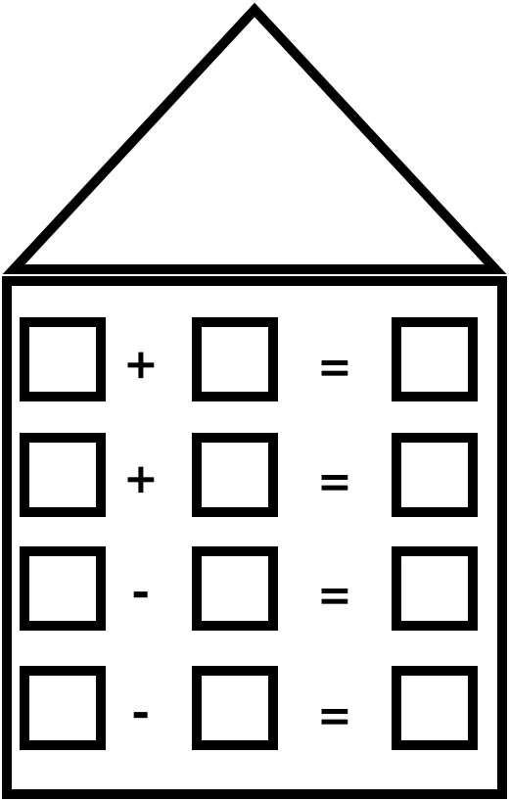
GRADE 2 COMPUTATIONAL FLUENCY:
CLOSED QUESTIONS: ADD/SUBTRACT TO 20
6. Write four fact family equations using these numbers: 3, 4, 7.
ELEMENTARY MATH PROJECT
6. Write four fact family equations using these numbers:
3, 4, 7.

Slide 70
GRADE 2 COMPUTATIONAL FLUENCY:
CLOSED QUESTIONS: ADD/SUBTRACT TO 20
6. Write four fact family equations using these numbers: 3, 4, 7.
ELEMENTARY MATH PROJECT
7. Show how you could use addition to solve 15 − 12.

Slide 71
GRADE 2 COMPUTATIONAL FLUENCY:
CLOSED QUESTIONS: ADD/SUBTRACT TO 20
6. Write four fact family equations using these numbers: 3, 4, 7.
ELEMENTARY MATH PROJECT
8. Use a number line to show that 14 - 8 is like saying “How far away from 8 is 14?”

Slide 72
GRADE 2 COMPUTATIONAL FLUENCY:
CLOSED QUESTIONS: ADD/SUBTRACT TO 20
6. Write four fact family equations using these numbers: 3, 4, 7.
ELEMENTARY MATH PROJECT
9. A dog, a duck, and a spider walk into a room.
How many legs are there all together?

Slide 73
GRADE 2 COMPUTATIONAL FLUENCY:
OPEN QUESTIONS: ADD/SUBTRACT TO 20
ELEMENTARY MATH PROJECT
10. Find three numbers that form a fact family: 2, 3, 5, 8. Show how you know.

Slide 74
GRADE 2 COMPUTATIONAL FLUENCY:
OPEN QUESTIONS: ADD/SUBTRACT TO 20
ELEMENTARY MATH PROJECT
11. Show how you know 3 + 4 is the same as 4 + 3

Slide 75
GRADE 2 COMPUTATIONAL FLUENCY:
OPEN QUESTIONS: ADD/SUBTRACT TO 20
ELEMENTARY MATH PROJECT
12. Show or explain how you could use a making 10 strategy to add 8 + 7?

Slide 76
GRADE 2 COMPUTATIONAL FLUENCY:
OPEN QUESTIONS: ADD/SUBTRACT TO 20
ELEMENTARY MATH PROJECT
13. How can you show that 18 is more than 13?

Slide 77
GRADE 2 COMPUTATIONAL FLUENCY:
OPEN QUESTIONS: ADD/SUBTRACT TO 20
ELEMENTARY MATH PROJECT
14. Without finding the answer, why is 8 + 8 more than 5 + 9?

Slide 78




GRADE 2 COMPUTATIONAL FLUENCY:
OPEN QUESTIONS: ADD/SUBTRACT TO 20
ELEMENTARY MATH PROJECT
15. Organize the following circles to help you see how many there are in total.

Slide 79
GRADE 2 COMPUTATIONAL FLUENCY:
OPEN QUESTIONS: ADD/SUBTRACT TO 20
ELEMENTARY MATH PROJECT
16. What are some different ways to make the number 12 using addition? Show different combinations.

Slide 80
GRADE 2 COMPUTATIONAL FLUENCY:
OPEN QUESTIONS: ADD/SUBTRACT TO 20
ELEMENTARY MATH PROJECT
17. What is your favourite way to find the sum of 6 and 9? Show your thinking

Slide 81
GRADE 2 COMPUTATIONAL FLUENCY:
OPEN QUESTIONS: ADD/SUBTRACT TO 20
ELEMENTARY MATH PROJECT
18. Which of the following statements is incorrect? Explain your thinking.
a. 12 take away 7 leaves 5.
b. 12 is 5 more than 7.
c. 12 - 7 = 5 and 5 + 12 = 7 are part of a fact family.
d. 7 + 5 = 12 is the same as 5 + 7 = 12

Slide 82
GRADE 2 COMPUTATIONAL FLUENCY:
OPEN QUESTIONS: ADD/SUBTRACT TO 20
ELEMENTARY MATH PROJECT
19. Show what you think is the best way to add 4 + 8 + 6.

Slide 83
GRADE 2 COMPUTATIONAL FLUENCY:
OPEN QUESTIONS: ADD/SUBTRACT TO 20
ELEMENTARY MATH PROJECT
20. Why does it make sense that 8 + 5 = 10 + 3? Why is knowing that useful?

Slide 84
GRADE 2 COMPUTATIONAL FLUENCY:
OPEN QUESTIONS: ADD/SUBTRACT TO 20
ELEMENTARY MATH PROJECT
21. How do you know that 10 - 3 and 11 - 4 HAVE to have the same answer even without getting the answer?

Slide 85
GRADE 2 COMPUTATIONAL FLUENCY:
CLOSED QUESTIONS: ADD/SUBTRACT TO 100
ELEMENTARY MATH PROJECT
1. Draw a diagram that shows why 54-17 is the same as 54-10-10+3

Slide 86
GRADE 2 COMPUTATIONAL FLUENCY:
CLOSED QUESTIONS: ADD/SUBTRACT TO 100
ELEMENTARY MATH PROJECT
2. How can base ten blocks be used to model 37 – 25?

Slide 87
GRADE 2 COMPUTATIONAL FLUENCY:
CLOSED QUESTIONS: ADD/SUBTRACT TO 100
ELEMENTARY MATH PROJECT
3. Use compensation strategy to add. Show your thinking.
a) 19 + 32 | b) 39 + 28
c) 59 + 15 | d) 17 + 49
e) 16 + 39 | f) 34 + 29

Slide 88
GRADE 2 COMPUTATIONAL FLUENCY:
CLOSED QUESTIONS: ADD/SUBTRACT TO 100
ELEMENTARY MATH PROJECT
4. If you start the year with 34 pencils and then you lose 6 of them, how many are you left with?

Slide 89
GRADE 2 COMPUTATIONAL FLUENCY:
CLOSED QUESTIONS: ADD/SUBTRACT TO 100
ELEMENTARY MATH PROJECT
5. Use a hundreds chart to solve the following questions:
a. 75 – 23
b. 84 - 12
c. 55 - 18
d. 63 – 31

Slide 90
GRADE 2 COMPUTATIONAL FLUENCY:
CLOSED QUESTIONS: ADD/SUBTRACT TO 100
ELEMENTARY MATH PROJECT
6. What is the difference between 87 and 13? Solve using a hundreds chart.

Slide 91
GRADE 2 COMPUTATIONAL FLUENCY:
CLOSED QUESTIONS: ADD/SUBTRACT TO 100
ELEMENTARY MATH PROJECT
7. What is 72 - 38? Use an open number line to show your thinking .

Slide 92
GRADE 2 COMPUTATIONAL FLUENCY:
CLOSED QUESTIONS: ADD/SUBTRACT TO 100
ELEMENTARY MATH PROJECT
8. I need 100 beads to make a special bracelet for my friend. I only have 25 beads. Using a number line, can you find out how many more beads I need?

Slide 93
GRADE 2 COMPUTATIONAL FLUENCY:
OPEN QUESTIONS: ADD/SUBTRACT TO 100
ELEMENTARY MATH PROJECT
9. The answer is 25. What is the question?

Slide 94
GRADE 2 COMPUTATIONAL FLUENCY:
OPEN QUESTIONS: ADD/SUBTRACT TO 100
ELEMENTARY MATH PROJECT
10. How does knowing 25 + 25 help you to find 26 + 26?

Slide 95
GRADE 2 COMPUTATIONAL FLUENCY:
OPEN QUESTIONS: ADD/SUBTRACT TO 100
ELEMENTARY MATH PROJECT
11. You add a number to itself. The answer is more than 20. What might the number be? Why?

Slide 96
GRADE 2 COMPUTATIONAL FLUENCY:
OPEN QUESTIONS: ADD/SUBTRACT TO 100
ELEMENTARY MATH PROJECT
12. Write a story problem that could be figured out using 40 counters and the concept of addition.

Slide 97
GRADE 2 COMPUTATIONAL FLUENCY:
OPEN QUESTIONS: ADD/SUBTRACT TO 100
ELEMENTARY MATH PROJECT
13. Show at least 3 different ways you can break down the number 50 using addition.

Slide 98
GRADE 2 COMPUTATIONAL FLUENCY:
OPEN QUESTIONS: ADD/SUBTRACT TO 100
ELEMENTARY MATH PROJECT
14. How can you show which statement is more correct?
a. 66 is closer to 70
b. 66 is closer to 60

Slide 99
GRADE 2 COMPUTATIONAL FLUENCY:
OPEN QUESTIONS: ADD/SUBTRACT TO 100
ELEMENTARY MATH PROJECT
15. A jar can hold 100 jellybeans. In a pile of jellybeans, there are 31 red, 26 green, and 47 yellows. Will they all fit in the jar? How do you know?

Slide 100
GRADE 2 COMPUTATIONAL FLUENCY:
OPEN QUESTIONS: ADD/SUBTRACT TO 100
ELEMENTARY MATH PROJECT
16. Show two or more ways to calculate 37 + 49.

Slide 101
ELEMENTARY MATH PROJECT
GRADE 2 PRACTICE QUESTIONS
PATTERNS

Slide 102
GRADE 2 GRADE 2 PATTERNS:
CLOSED QUESTIONS
ELEMENTARY MATH PROJECT
1. Continue the next 3 steps in each of the patterns below:
START OF THE PATTERN | WHAT COMES NEXT?
3, 6, 9, 12
2, 5, 8, 11
1, 4, 7, 10

Slide 103
GRADE 2 PATTERNS:
CLOSED QUESTIONS
ELEMENTARY MATH PROJECT
2. Can you identify the pattern rules from question 1?
PATTERN | PATTERN RULE
3, 6, 9, 12
2, 5, 8, 11
1, 4, 7, 10

Slide 104
GRADE 2 PATTERNS:
CLOSED QUESTIONS
ELEMENTARY MATH PROJECT
3. What are the next 3 shapes in this pattern?
🔺🔺⚫️🔺🔺⚫️🔺🔺 _____ _____ _____

Slide 105
GRADE 2 PATTERNS:
CLOSED QUESTIONS
ELEMENTARY MATH PROJECT
4. Which pattern has an ABB rule?
a. 🚗🚗🚙🚗🚗🚙🚗🚗🚙
b. 🚗🚙🚙🚗🚙🚙🚗🚙🚙
c. 🚙🚗🚙🚙🚗🚙🚙🚗🚙
d. 🚗🚙🚗🚗🚙🚗🚗🚙🚗

Slide 106
GRADE 2 PATTERNS:
CLOSED QUESTIONS
ELEMENTARY MATH PROJECT
5. Can you fill in the table below using the patterns from question 4?
Original Pattern | Pattern Rule | Continue the Pattern (6 more cars)
a. 🚗🚗🚙
b. 🚗🚙🚙
c. 🚙🚗🚙
d. 🚗🚙🚗

Slide 107
GRADE 2 PATTERNS:
CLOSED QUESTIONS
ELEMENTARY MATH PROJECT
6. How many tiles will be in the 5th step of this pattern?
Step 1: 🔳
Step 2: 🔳🔳
Step 3: 🔳🔳🔳
Step 4: 🔳🔳🔳🔳
Step 5:

Slide 108
GRADE 2 PATTERNS:
CLOSED QUESTIONS
ELEMENTARY MATH PROJECT
7. Which of the following is a growing pattern?
a. 🌼🌱🌼🌱🌼🌱🌼🌱🌼🌱🌼🌱🌼
b. 🍎🍎🍏🍎🍎🍏🍎🍎🍏🍎🍎🍏🍎🍎🍏🍎🍎🍏
c. 🏀🏈🏀🏀🏈🏈🏀🏀🏀🏈🏈🏈🏀🏀🏀🏀🏈🏈🏈🏈
d. 🍕🍔🍕🍔🌭🍕🍔🍕🍔🌭🍕🍔🍕🍔🌭

Slide 109
GRADE 2 PATTERNS:
OPEN QUESTIONS
ELEMENTARY MATH PROJECT
8. I’m thinking of a pattern that uses 2 shapes and follows an AAB rule.
What could my pattern look like?

Slide 110
GRADE 2 PATTERNS:
OPEN QUESTIONS
ELEMENTARY MATH PROJECT
9. I’m thinking of a pattern that uses 3 shapes and follows an ABBC rule.
What could my pattern look like?

Slide 111
GRADE 2 PATTERNS:
OPEN QUESTIONS
ELEMENTARY MATH PROJECT
10. Can you create a growing pattern using only 2 shapes?

Slide 112
GRADE 2 PATTERNS:
OPEN QUESTIONS
ELEMENTARY MATH PROJECT
11. There is a mistake in this pattern:
2, 4, 6, 9, 10, 12
What is the mistake and how do you know?
What can you change to correct the pattern?

Slide 113
GRADE 2 PATTERNS:
OPEN QUESTIONS
ELEMENTARY MATH PROJECT
12. I’m thinking of a pattern that counts by 5s but doesn’t start at 5.
What could the pattern be? How do you know it follows the rule?

Slide 114
GRADE 2 PATTERNS:
OPEN QUESTIONS
ELEMENTARY MATH PROJECT
13. Here’s a number pattern:
1, 2, 4, 7, 11, ___
What could the next number be? Explain how you figured it out.

Slide 115
GRADE 2 PATTERNS:
OPEN QUESTIONS
ELEMENTARY MATH PROJECT
14. There is a mistake in this pattern:
10, 20, 30, 50, 60
What do you think the mistake is? Could there be more than one way to fix it?

Slide 116
ELEMENTARY MATH PROJECT
GRADE 2 PRACTICE QUESTIONS
DATA

Slide 117
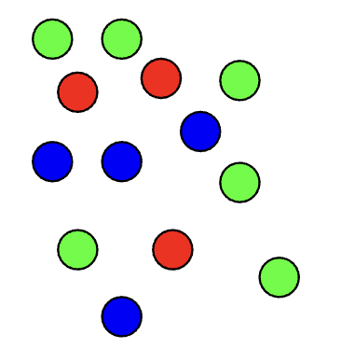
GRADE 2 DATA:
CLOSED QUESTIONS
ELEMENTARY MATH PROJECT
1. Count the different coloured balls using a tally chart. Record your counting.
Colour | Tally
Green
Red
Blue

Slide 118
GRADE 2 DATA:
CLOSED QUESTIONS
ELEMENTARY MATH PROJECT
2. Use two-colour counters or Unifix cubes to represent how many pineapples and strawberries there are.
🍍🍓🍏🍓🍓🍓🍍🍏🍍🍍🍍🍓🍍🍓🍓🍏🍓

Slide 119
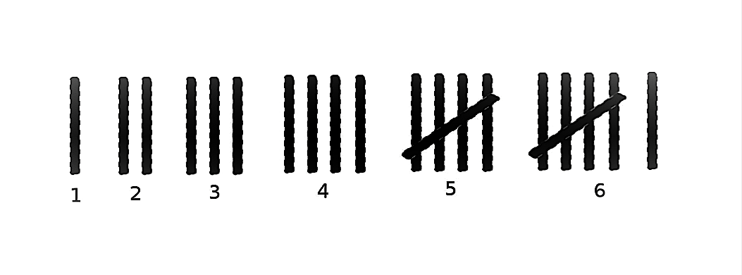
GRADE 2 DATA:
CLOSED QUESTIONS
ELEMENTARY MATH PROJECT
3. Look at the following tally chart. Create a Bar Graph or a Concrete Graph using the data. Include all the important labels and a title.
Student pets in Div.15 | Tally
Dogs
Cats
Fish
Tigers

Slide 120
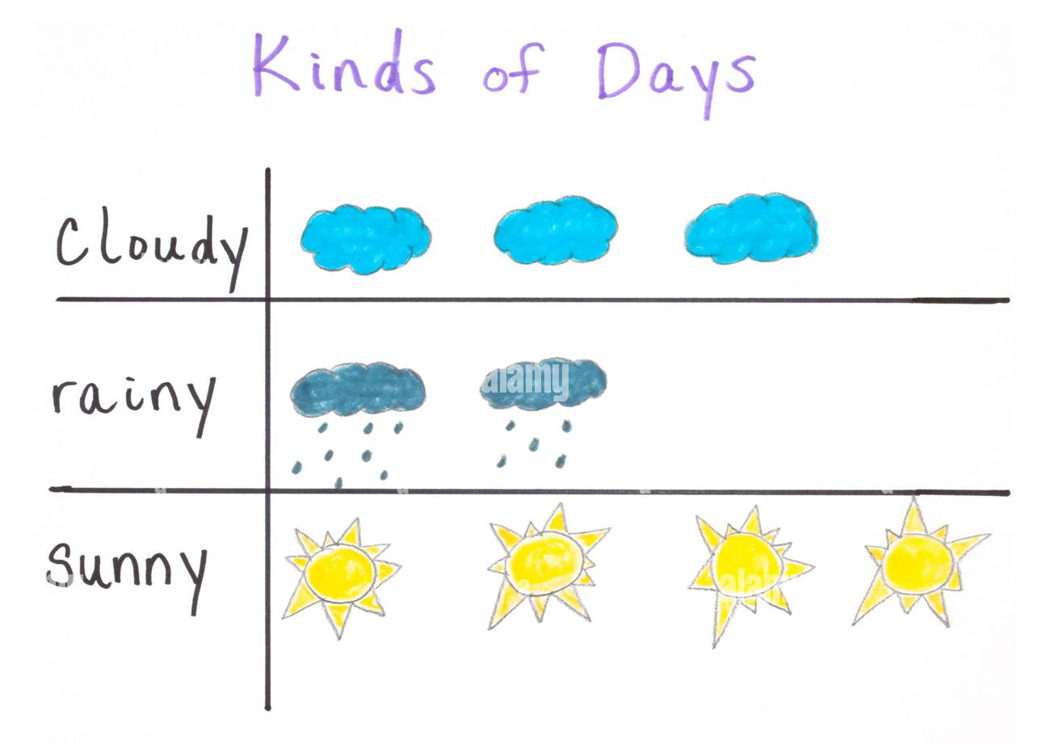
GRADE 2 DATA:
CLOSED QUESTIONS
ELEMENTARY MATH PROJECT
4. Look at the following pictograph.
Use it to answer the following questions:
How many total days did the students collect data?
How many sunny days were there?
Were there more days with cloud or sun?

Slide 121
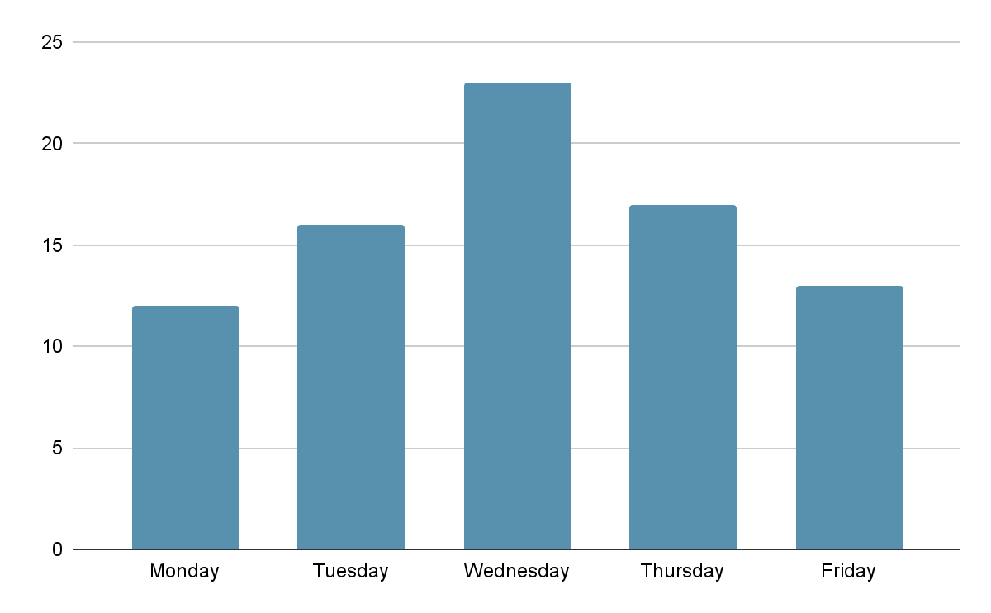
GRADE 2 DATA:
OPEN QUESTIONS
ELEMENTARY MATH PROJECT
5. Describe what you think this graph could be trying to tell us and give some reasons why.

Slide 122
GRADE 2 DATA:
OPEN QUESTIONS
ELEMENTARY MATH PROJECT
6. Look at the following tally chart. What are some questions you could ask using the data?
Student pets in Div.15 | Tally
Dogs
Cats
Fish
Tigers

Slide 123
GRADE 2 DATA:
OPEN QUESTIONS
ELEMENTARY MATH PROJECT
8 |  | 🌮
7 |  | 🌮
6 |  | 🌮
5 | 🌭 | 🌮
4 | 🌭 | 🌮
3 | 🌭 | 🌮 | 🥪
2 | 🌭 | 🌮 | 🥪
1 | 🌭 | 🌮 | 🥪
 | Hot dogs | Tacos | Sandwiches
7. For the pictograph to the left, what are some things that you can’t say about the data?

Slide 124
GRADE 2 DATA:
OPEN QUESTIONS
ELEMENTARY MATH PROJECT
8. Collect data in your class about something you can see. (It could be the types of coloured pencils, or who is wearing boots or shoes...)
Use a tally chart to record your data. Use that tally chart to make a bar graph.

Slide 125
ELEMENTARY MATH PROJECT
GRADE 2 PRACTICE QUESTIONS
PROBABILITY

Slide 126
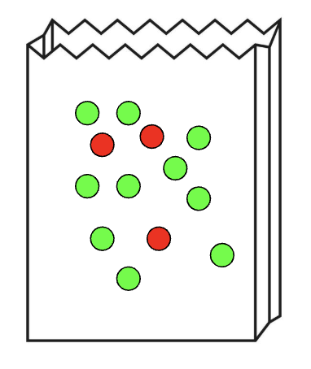
GRADE 2 PROBABILITY:
CLOSED QUESTIONS
ELEMENTARY MATH PROJECT
1. There are 10 green candies and 3 red candies in a bag. If you pick one without looking, explain which colour you are more likely to get.

Slide 127
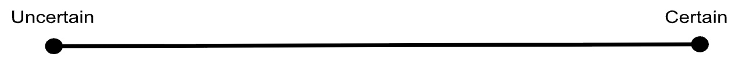
GRADE 2 PROBABILITY:
CLOSED QUESTIONS
ELEMENTARY MATH PROJECT
2. Use the scale on the line to put down how certain or uncertain you are of these things happening tomorrow:
a. We will have recess.
b. It will rain.
c. We will have Music class.
d. Someone will wear a red shirt.
e. I will see the principal.

Slide 128
GRADE 2 PROBABILITY:
CLOSED QUESTIONS
ELEMENTARY MATH PROJECT
3. When you walk to school, which of these things are you more likely to see? Explain why.
 | More Likely | Less Likely | Why?
Dog or lion
Car or Airplane
Tree or Cactus

Slide 129
GRADE 2 PROBABILITY:
CLOSED QUESTIONS
ELEMENTARY MATH PROJECT
4. Write down something you think you will never see walking to school.

Slide 130
GRADE 2 PROBABILITY:
OPEN QUESTIONS
ELEMENTARY MATH PROJECT
5. Explain what it means if two things are “equally likely” to happen. Give an example.

Slide 131
GRADE 2 PROBABILITY:
OPEN QUESTIONS
ELEMENTARY MATH PROJECT
6. Look outside. Explain why you think it will be “More Likely,” “Less Likely”, or “Equally Likely” to rain tomorrow.

Slide 132
GRADE 2 PROBABILITY:
OPEN QUESTIONS
ELEMENTARY MATH PROJECT
7. In this bag there is a coloured marker. How certain are you that it is green? Tell me why you think that?

Slide 133
GRADE 2 PROBABILITY:
OPEN QUESTIONS
ELEMENTARY MATH PROJECT
8. You are sitting at your desk at school. Explain what days of the week are you certain it is not? What days of the week are you certain it could it be?

Slide 134
ELEMENTARY MATH PROJECT
GRADE 2 PRACTICE QUESTIONS
GEOMETRY

Slide 135
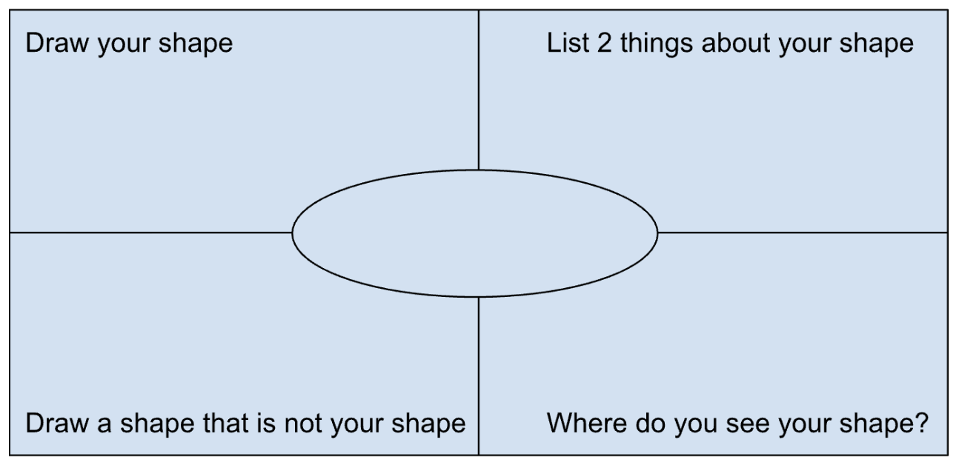
GRADE 2 GEOMETRY:
CLOSED QUESTIONS
ELEMENTARY MATH PROJECT
1. Choose one of the shapes below. Write the name in the middle. Answer the questions in each of the 4 corners for your shape.
Circle
Triangle
Square
Rectangle

Slide 136

GRADE 2 GEOMETRY:
CLOSED QUESTIONS
ELEMENTARY MATH PROJECT
2. Look at this image. Circle 3 shapes you see. How do you know what shapes they are?

Slide 137
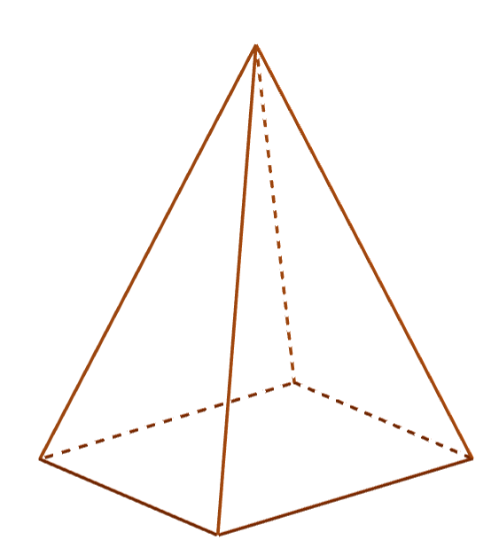
GRADE 2 GEOMETRY:
CLOSED QUESTIONS
ELEMENTARY MATH PROJECT
3. Explain what shapes you would need to build a pyramid.

Slide 138

GRADE 2 GEOMETRY:
CLOSED QUESTIONS
ELEMENTARY MATH PROJECT
4. Choose 3 or more shapes from your tangram set. Put them together to form a new shape. Draw (or trace) the shape. Can you show the original smaller shapes?

Slide 139
GRADE 2 GEOMETRY:
CLOSED QUESTIONS
ELEMENTARY MATH PROJECT
5. What would you need to measure to show if this is a square?

Slide 140
GRADE 2 GEOMETRY:
CLOSED QUESTIONS
ELEMENTARY MATH PROJECT
6. Choose one of the shapes below. Find that shape in the classroom. Draw a picture of it.
Circle Triangle
Square Rectangle

Slide 141
GRADE 2 GEOMETRY:
OPEN QUESTIONS
ELEMENTARY MATH PROJECT
7. What smaller shapes could you cut from this rectangle? Use the materials provided to help. Write the name of shape on each of the pieces you cut. (Provide rectangles and scissors)
How many shapes could you cut?

Slide 142

GRADE 2 GEOMETRY:
OPEN QUESTIONS
ELEMENTARY MATH PROJECT
8. This is one face of a 3-D object. What could the rest of the object look like?

Slide 143
GRADE 2 GEOMETRY:
OPEN QUESTIONS
ELEMENTARY MATH PROJECT
9. Draw 3 shapes that all have the same number of sides, but look different. Explain how they are different.

Slide 144
GRADE 2 GEOMETRY:
OPEN QUESTIONS
ELEMENTARY MATH PROJECT
Original 3-D Shape | New Half Shape
10. Draw a 3-D shape. Cut it in half. Draw and describe the new shape.

Slide 145
ELEMENTARY MATH PROJECT
GRADE 2 PRACTICE QUESTIONS
MEASUREMENT

Slide 146
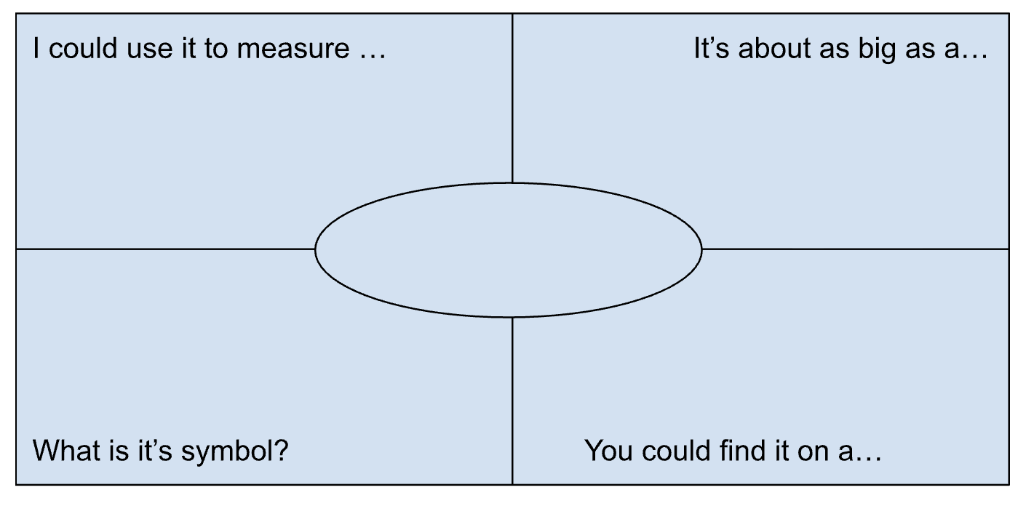
GRADE 2 MEASUREMENT
CLOSED QUESTIONS
ELEMENTARY MATH PROJECT
1. Choose one of the measurements below. Write the name in the middle. Answer the questions in each of the 4 corners for your measurement.
millimeter
Centimeter
meter
kilometer

Slide 147
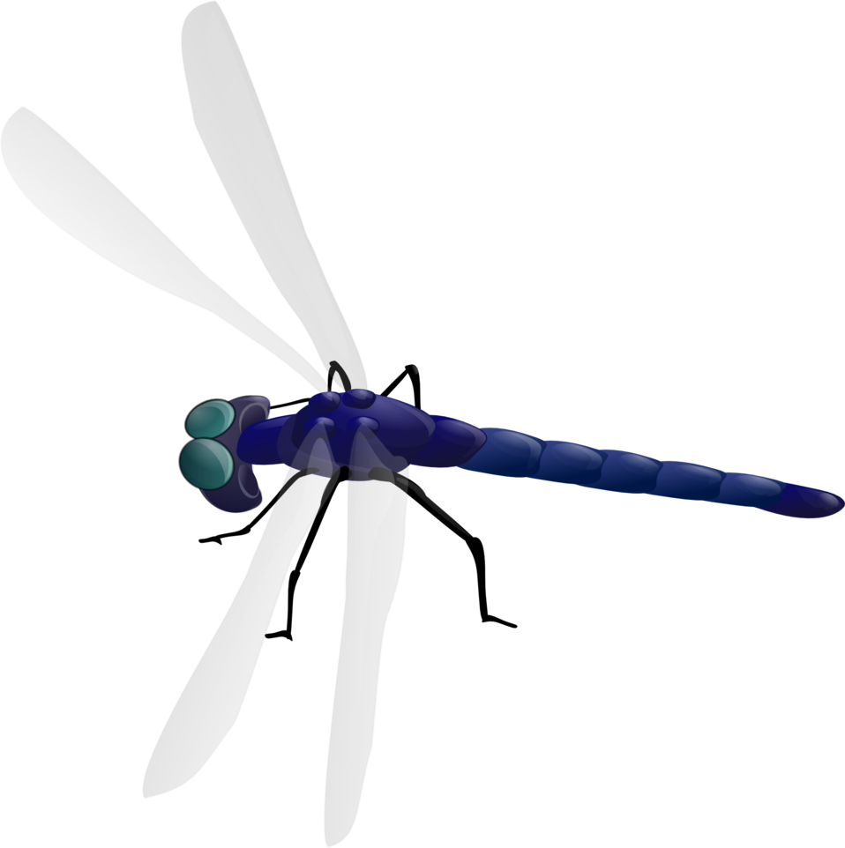
GRADE 2 MEASUREMENT
CLOSED QUESTIONS
ELEMENTARY MATH PROJECT
2. Use a ruler to measure how long (from head to tail) this dragonfly is in centimeters (cm)

Slide 148
GRADE 2 MEASUREMENT
CLOSED QUESTIONS
ELEMENTARY MATH PROJECT
3. Without measuring, what do you think the length of a tissue box is?
Smallest possible length | My estimate for length | Biggest possible length

Slide 149
GRADE 2 MEASUREMENT
CLOSED QUESTIONS
ELEMENTARY MATH PROJECT
4. Use a piece of string or rope to help you figure out about how far it is around a tree.

Slide 150
GRADE 2 MEASUREMENT
CLOSED QUESTIONS
ELEMENTARY MATH PROJECT
5. Describe how the shapes are related to each other using the following words:
Left Right
Up Down
Above Below
Inside Outside

Slide 151
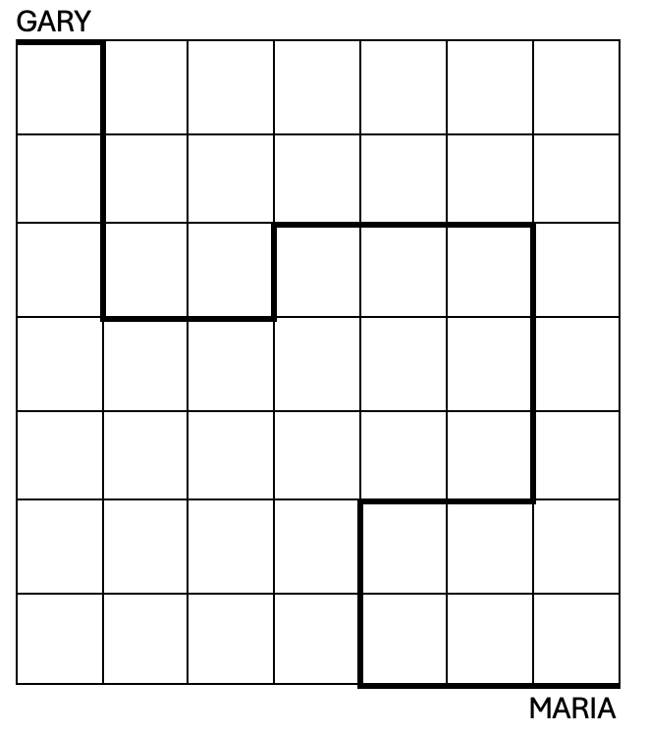
GRADE 2 MEASUREMENT
CLOSED QUESTIONS
ELEMENTARY MATH PROJECT
6. Use the cm grid to explain how Gary could walk to Maria.

Slide 152
GRADE 2 MEASUREMENT
OPEN QUESTIONS
ELEMENTARY MATH PROJECT
7. Measure a part of your body (length of a finger, fingertip to elbow, width of a hand).
a. Use that body part to estimate the width of your desk
b. Use that body part to estimate the width of a whiteboard or tackboard

Slide 153
GRADE 2 MEASUREMENT
OPEN QUESTIONS
ELEMENTARY MATH PROJECT
8. Find an object in your classroom. Using a ruler, measure the length, width and height in millimeters or centimeters.

Slide 154
GRADE 2 MEASUREMENT
OPEN QUESTIONS
ELEMENTARY MATH PROJECT
9. Explain how one person could measure something and get a really big number, and a different person could measure something and get a small number.

Slide 155
GRADE 2 MEASUREMENT
OPEN QUESTIONS
ELEMENTARY MATH PROJECT
10. Explain how you could measure the length of a halfway at school if all you had was a 30cm ruler

Slide 156
ELEMENTARY MATH PROJECT
GRADE 2 PRACTICE QUESTIONS
ALGEBRA

Slide 157
GRADE 2 ALGEBRA
CLOSED QUESTIONS
ELEMENTARY MATH PROJECT
1. Can you solve the equations (number sentences) below?
EQUATION | SOLUTION
a. 🍓+ 4 = 9 | 🍓=
b. 3 + 🐶= 10 | 🐶=
c. 12 = 🌵+ 6 | 🌵=
d. 11 - 🐻= 6 | 🐻=
e. 🍄- 10 = 15 | 🍄=

Slide 158
GRADE 2 ALGEBRA
CLOSED QUESTIONS
ELEMENTARY MATH PROJECT
2. Fill in the blank:
5 + ⬜ = 10
⬜ = ______

Slide 159
GRADE 2 ALGEBRA
CLOSED QUESTIONS
ELEMENTARY MATH PROJECT
3. Which of these number sentences is correct (balanced)?
a. 6 + 2 = 7
b. 4 + 3 = 8
c. 5 + 5 = 10
d. 3 + 3 = 5

Slide 160
GRADE 2 ALGEBRA
CLOSED QUESTIONS
ELEMENTARY MATH PROJECT
Questions | Answers
⬜+ 3 = 12 | 2
4 + ⬜ = 6 | 4
10 + ⬜ = 15 | 3
⬜ - 3 = 7 | 9
14 - ⬜ = 10 | 8
⬜+ 8 = 11 | 6
19 - ⬜= 11 | 10
14 + ⬜ = 20 | 5
4. Can you match the unknowns in each of the questions in the left column with an answer from the right column? Draw lines to show your matches.

Slide 161
GRADE 2 ALGEBRA
CLOSED QUESTIONS
ELEMENTARY MATH PROJECT
5. What number makes this true?
⬜ – 3 = 4
⬜= _____

Slide 162
GRADE 2 ALGEBRA
CLOSED QUESTIONS
ELEMENTARY MATH PROJECT
6. Which equation shows the same total as 7 + 2?
a. 8 + 2
b. 6 + 3
c. 5 + 1
e. 4 + 2

Slide 163
GRADE 2 ALGEBRA
CLOSED QUESTIONS
ELEMENTARY MATH PROJECT
7. What number makes this true?
8 = 5 + ⬜
⬜ = _____

Slide 164
GRADE 2 ALGEBRA
OPEN QUESTIONS
ELEMENTARY MATH PROJECT
8. Look at this equation:
4 + ⬜ = 9
What number belongs in the box?
Can you show how you figured it out?

Slide 165
GRADE 2 ALGEBRA
OPEN QUESTIONS
ELEMENTARY MATH PROJECT
9. What are two different ways to make the number 8 using addition?
Can you show both with pictures or tools?

Slide 166
GRADE 2 ALGEBRA
OPEN QUESTIONS
ELEMENTARY MATH PROJECT
10. Look at this equation: 6 + 🐰= 9
If I told you that 🐰= 2, that answer would be wrong.
How can you show that 🐰does not equal 2?

Slide 167
GRADE 2 ALGEBRA
OPEN QUESTIONS
ELEMENTARY MATH PROJECT
11. I had 4 red apples 🍎. I picked some green apples 🍏 and I had 9 apples in total.
How many green apples did I pick? Can you draw a diagram to answer this question?

Slide 168
GRADE 2 ALGEBRA
OPEN QUESTIONS
ELEMENTARY MATH PROJECT
12. There’s a mistake in this number sentence:
6 + 3 = 10
What might the mistake be? How would you fix it?

Slide 169
ELEMENTARY MATH PROJECT
GRADE 2 PRACTICE QUESTIONS
FINANCIAL LITERACY

Slide 170
GRADE 2 FINANCIAL LITERACY
CLOSED QUESTIONS
ELEMENTARY MATH PROJECT
1. You have 4 quarters.
How much money do you have?
a. $1 b. $2 c. $3 d. $4

Slide 171
GRADE 2 FINANCIAL LITERACY
CLOSED QUESTIONS
ELEMENTARY MATH PROJECT
2. Which of these is worth the most?
a. 4 quarters
b. 3 dimes and 2 nickels
c. 5 nickels
d. 1 loonie

Slide 172
GRADE 2 FINANCIAL LITERACY
CLOSED QUESTIONS
ELEMENTARY MATH PROJECT
3. You bought a snack for $3 and gave the cashier a $5 bill.
How much change should you get back?

Slide 173
GRADE 2 FINANCIAL LITERACY
CLOSED QUESTIONS
ELEMENTARY MATH PROJECT
4. You have $5. You buy a book for $3 and a pencil for $1.
How much money do you have left?

Slide 174
GRADE 2 FINANCIAL LITERACY
CLOSED QUESTIONS
ELEMENTARY MATH PROJECT
5. Which coin is worth 10 cents?
a. Penny b. Dime c. Nickel d. Quarter

Slide 175
GRADE 2 FINANCIAL LITERACY
CLOSED QUESTIONS
ELEMENTARY MATH PROJECT
6. How many quarters do you need to make $1?

Slide 176
GRADE 2 FINANCIAL LITERACY
CLOSED QUESTIONS
ELEMENTARY MATH PROJECT
7. I have 4 toonies. How much money do I have?

Slide 177
GRADE 2 FINANCIAL LITERACY
OPEN QUESTIONS
ELEMENTARY MATH PROJECT
8. There are many ways to make $1.00.
Can you draw or write two different ways using coins?

Slide 178
GRADE 2 FINANCIAL LITERACY
OPEN QUESTIONS
ELEMENTARY MATH PROJECT
9. What do you think costs more? Explain your thinking.
a. A house or a car?
b. A cake or a cupcake?
c. A box of pencil crayons or a stapler?
d. A burger or a pizza?

Slide 179
GRADE 2 FINANCIAL LITERACY
OPEN QUESTIONS
ELEMENTARY MATH PROJECT
10. Take a look at this menu
ITEM | PRICE
Apple 🍎 | $1
Juice Box 🧃 | $2
Sandwich 🥪 | $3
Cookie 🍪 | $1
Banana 🍌 | $1
Crackers 🍘 | $2
a. What is the least expensive item on the menu?
b. What is the most expensive item on the menu?
c. You want to buy a sandwich and a juice box. How much will that cost?

Slide 180
GRADE 2 FINANCIAL LITERACY
OPEN QUESTIONS
ELEMENTARY MATH PROJECT
10. Take a look at this menu
ITEM | PRICE
Apple 🍎 | $1
Juice Box 🧃 | $2
Sandwich 🥪 | $3
Cookie 🍪 | $1
Banana 🍌 | $1
Crackers 🍘 | $2
d. How much would it cost to buy everything on the menu?
e. If I gave you $3, what would you choose to buy?
Describe why you would make that choice.

Slide 181
GRADE 2 FINANCIAL LITERACY
OPEN QUESTIONS
ELEMENTARY MATH PROJECT
11. You see two shopping lists.
List A: cookie, banana, juice
List B: sandwich, apple
Which list costs more? Explain how you figured it out.

Slide 182
GRADE 2 FINANCIAL LITERACY
OPEN QUESTIONS
ELEMENTARY MATH PROJECT
12. You spent $3 and got $2 back.
What could you have bought?
List two different options.

Slide 183
GRADE 2 FINANCIAL LITERACY
OPEN QUESTIONS
ELEMENTARY MATH PROJECT
13. You and 2 friends are buying treats.
A box of cookies with 6 cookies costs $10.
A box of cupcakes with 3 cupcakes also costs $10.
Which treat would you choose? Why would you make that choice?

Slide 184
ELEMENTARY MATH PROJECT
GRADE 2 PRACTICE QUESTIONS
MIXED REVIEW

Slide 185
GRADE 2 MIXED REVIEW
ELEMENTARY MATH PROJECT
1. I want to buy three board games. They cost: $48, $24 and $13 (including tax). I have a $100 bill. Is that enough to buy all three games?​

Slide 186
GRADE 2 MIXED REVIEW
ELEMENTARY MATH PROJECT
2. You’re celebrating your birthday with 6 friends. Will baking 12 cookies be enough for you and your guests? Explain. Is that enough to buy all three games?​

Slide 187
GRADE 2 MIXED REVIEW
ELEMENTARY MATH PROJECT
3. A student says 100 – 46 = 64. Does this answer make sense?

Slide 188
GRADE 2 MIXED REVIEW
ELEMENTARY MATH PROJECT
4. The distance from New Westminster to Vancouver is 29 km. If you walk 10 km every hour, about how many hours will it take to get to Vancouver?

Slide 189
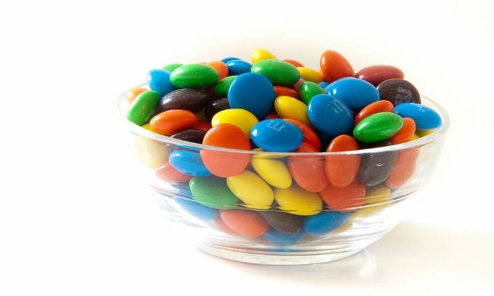
GRADE 2 MIXED REVIEW
ELEMENTARY MATH PROJECT
5. About how many candies are in the candy bowl?

Slide 190
GRADE 2 MIXED REVIEW
ELEMENTARY MATH PROJECT
6. Continue the pattern. What is the pattern rule?
1, 2, 4, 8, 16, ___, ___, ___

Slide 191
GRADE 2 MIXED REVIEW
ELEMENTARY MATH PROJECT
7. I’m thinking of a 3D shape that has rectangular faces. What shape could it be?

Slide 192
GRADE 2 MIXED REVIEW
ELEMENTARY MATH PROJECT
8. Estimate the value letters A, B, and C below:

Slide 193
GRADE 2 MIXED REVIEW
ELEMENTARY MATH PROJECT
9. If I’m counting up by 10s starting at 42, will I say 80?

Slide 194
GRADE 2 MIXED REVIEW
ELEMENTARY MATH PROJECT
10. A video game costs $79. If you pay with a $100 bill, how much change would you get back?

Slide 195
GRADE 2 MIXED REVIEW
ELEMENTARY MATH PROJECT
11. How many ways can you make 35 cents using nickels, dimes, and quarters?

Slide 196
GRADE 2 MIXED REVIEW
ELEMENTARY MATH PROJECT
12. True or False? 3 Tens + 3 ones = 20 + 13. Explain.

Slide 197
GRADE 2 MIXED REVIEW
ELEMENTARY MATH PROJECT
13. What numbers come next? What’s the pattern rule?
21, 33, 45, 57, __, __, __,

Slide 198
GRADE 2 MIXED REVIEW
ELEMENTARY MATH PROJECT
14. Mental Math:
26 + 70=
88 – 40 =

Slide 199
GRADE 2 MIXED REVIEW
ELEMENTARY MATH PROJECT
15. Calculate. Hint: How does question 14 help?
26 + 76 = 88 – 46 =

Slide 200
GRADE 2 MIXED REVIEW
ELEMENTARY MATH PROJECT
16. What numbers come next…
43, 45, 47, ___, ___, ___
63, 73, 83, ___, ___, ___
17, 22, 27, 32, ___, ___, ___

Slide 201
GRADE 2 MIXED REVIEW
ELEMENTARY MATH PROJECT
17. What strategies do you use to recall:
4 + 8 = 15 – 6 =

Slide 202
GRADE 2 MIXED REVIEW
ELEMENTARY MATH PROJECT
18. How does thinking about 74 as 60 + 14 help us to calculate 74 – 37? When do you use this idea?

Slide 203
GRADE 2 MIXED REVIEW
ELEMENTARY MATH PROJECT
19. How are 8 + 4 and 12 – 8 similar? How are they different?

Slide 204
GRADE 2 MIXED REVIEW
ELEMENTARY MATH PROJECT
20. Count forward by 10s starting at 37.

Slide 205
GRADE 2 MIXED REVIEW
ELEMENTARY MATH PROJECT
21. Fill in the blank:
1 foot = ___ inches
___ feet = 1 yard
___ cm = 1 m
1 km = ___ m (bonus!)

Slide 206
GRADE 2 MIXED REVIEW
ELEMENTARY MATH PROJECT
22. Would you measure the length of your bedroom in centimetres, feet, or metres? Why?

Slide 207
GRADE 2 MIXED REVIEW
ELEMENTARY MATH PROJECT
23. How many kinds of 2D shapes and 3D solids do you see from where you are right now? Name them.

Slide 208
GRADE 2 MIXED REVIEW
ELEMENTARY MATH PROJECT
24. Continue the pattern: 2, 7, 12, 17, 22, …

Slide 209
GRADE 2 MIXED REVIEW
ELEMENTARY MATH PROJECT
25. Skip count by 2s starting at 31 beyond 50

Slide 210
GRADE 2 MIXED REVIEW
ELEMENTARY MATH PROJECT
26. Which is greater: 36 + 25 or 81 – 18? How do you know?

Slide 211
GRADE 2 MIXED REVIEW
ELEMENTARY MATH PROJECT
27. How many ways can you make 10? Show using number bonds or equations.

Slide 212
GRADE 2 MIXED REVIEW
ELEMENTARY MATH PROJECT
28. How many ways can you make 44 using 10s and 1s?

Slide 213
GRADE 2 MIXED REVIEW
ELEMENTARY MATH PROJECT
29. Which One Doesn’t Belong? Justify your choice.
48 37 73 84

Slide 214
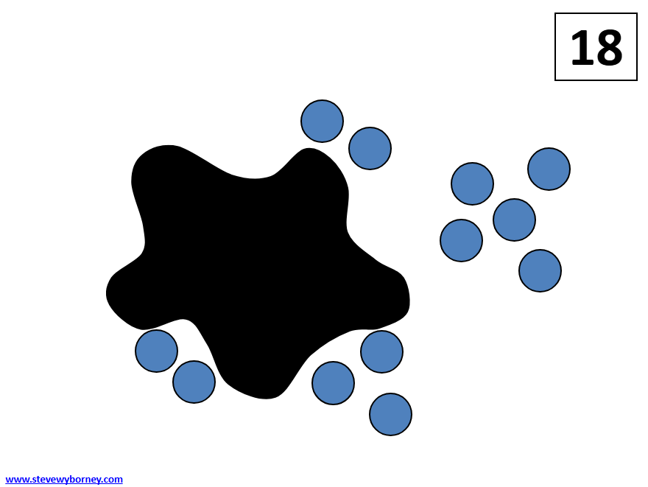
GRADE 2 MIXED REVIEW
ELEMENTARY MATH PROJECT
30. How many blue circles are hiding under the “splat” if there are 18 circles all together? How do you know? How else do you know?

Slide 215
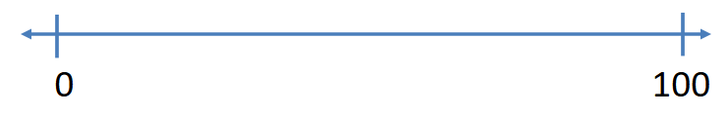
GRADE 2 MIXED REVIEW
ELEMENTARY MATH PROJECT
31. Where would you place the number 27 on the number line below? Explain your strategy.

Slide 216
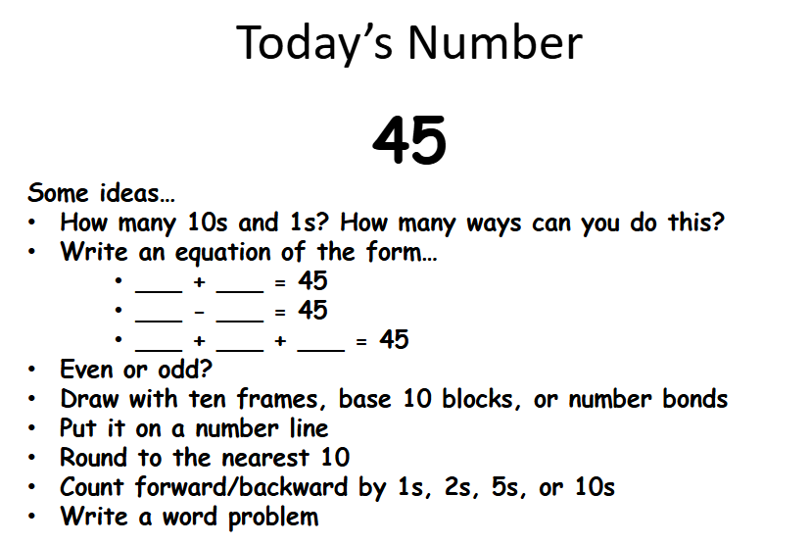
GRADE 2 MIXED REVIEW
ELEMENTARY MATH PROJECT
32. Show me everything you know about the number 45 using pictures, numbers, symbols, and words.

Slide 217
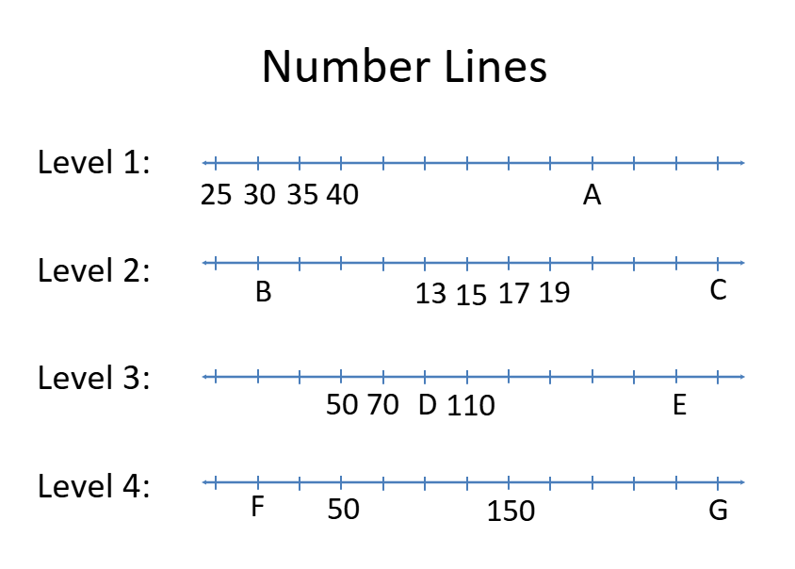
GRADE 2 MIXED REVIEW
ELEMENTARY MATH PROJECT
33. Number Line Game. Which level can you solve? How did you solve it?

Slide 218
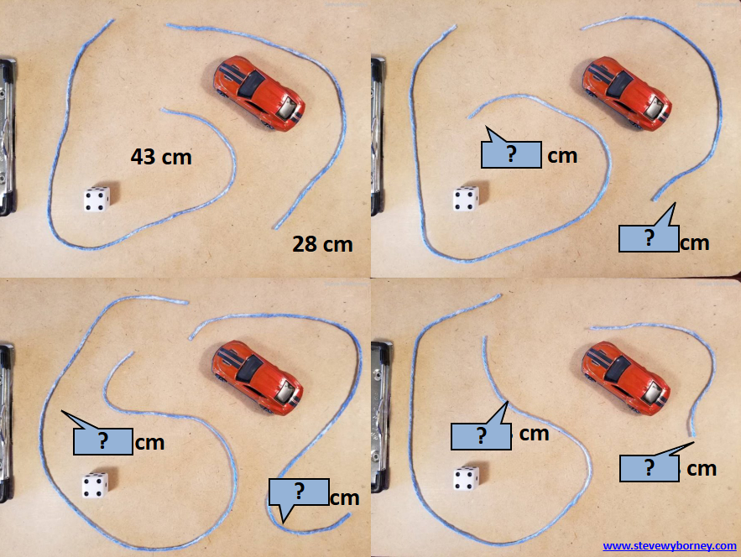
GRADE 2 MIXED REVIEW
ELEMENTARY MATH PROJECT
34. Estimate the lengths of the strings in the picture below. Explain how you did this.

