Slide 6

GRADE 3 PROBABILITY
CLOSED QUESTIONS
ELEMENTARY MATH PROJECT
1. A bag hides five marbles. How many of each colour are there if the following is true:
You are more likely to draw a red marble than a blue marble.
You are less likely to draw a blue marble than a yellow marble.
Two of these colours are equally likely.
2. What is the probability of rolling each outcome using a regular 6-sided die?
Four
An even number
A 3 or a 5
A number greater than 4
Seven
GRADE 2 NUMBER SENSE
CLOSED QUESTIONS

Slide 7
GRADE 3 PROBABILITY
CLOSED QUESTIONS
ELEMENTARY MATH PROJECT
3. A spinner has 4 equal sections:
red, red, blue, yellow.
Are you more likely, less likely, or equally likely to spin red compared to blue? Why?
4. Use the word certain or uncertain to describe the likelihood of each event:
The sun will set today.
I will eat pizza for dinner.
I am in grade 3.
It will rain on my next birthday.
The passing of time.
GRADE 2 NUMBER SENSE
CLOSED QUESTIONS

Slide 8
GRADE 3 PROBABILITY
CLOSED QUESTIONS
ELEMENTARY MATH PROJECT
5. Always, sometimes, never true…
Games of probability use dice.
Games with dice involve chance.
Games of strategy involve probability.
Games based only on probability are unfair.
GRADE 2 NUMBER SENSE
CLOSED QUESTIONS

Slide 9
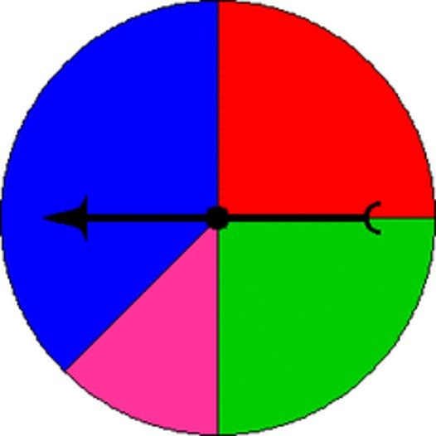
GRADE 3 PROBABILITY
OPEN QUESTIONS
ELEMENTARY MATH PROJECT
6. Four students are playing a game. They each pick a colour at random. If the spinner lands on their colour, they win. If not, they lose. Is this a fair game? Why or why not?
7. A coin has two sides: heads and tails. If you toss the coin 10 times, what is one possible outcome (i.e., how many heads and how many tails)? Will this always happen? Why or why not?
GRADE 2 NUMBER SENSE
CLOSED QUESTIONS

Slide 10
GRADE 3 PROBABILITY
OPEN QUESTIONS
ELEMENTARY MATH PROJECT
8. You roll two dice and find the sum. Give an example of a sum that you think is more likely and one that you think is less likely. Explain your reasoning.
9. Design a game where one outcome is very likely and another is very unlikely.
Describe your game and explain why the outcomes have those probabilities.
GRADE 2 NUMBER SENSE
CLOSED QUESTIONS

