Slide 1

GRADE 3 FINANCIAL LITERACY
CLOSED QUESTIONS
ELEMENTARY MATH PROJECT
1. How many of the same kind of coin do you need to make $1?
Quarter
Dime
Nickel
2. Describe three different ways that someone can make a payment for a good or service.
3. A family from one Nation trades 3 items for another 3 items with a different Nation. Is trading an equal number of items always a fair trade? Why or why not?

Slide 2
GRADE 3 FINANCIAL LITERACY
CLOSED QUESTIONS
ELEMENTARY MATH PROJECT
4. Find all possible ways to make 35¢. How do you know you found all the ways?
5. What is the least number of Canadian coins and bills you would need to make $99.95?

Slide 3
GRADE 3 FINANCIAL LITERACY
OPEN QUESTIONS
ELEMENTARY MATH PROJECT
6. Imagine two kids want to trade items instead of using money—similar to First Peoples bartering traditions. Describe a trade that would be fair, and explain why it is fair.
7. You want to buy some new fish for your fish tank. Describe two or more ways to earn money. Explain which one you think would be the easiest or most fun, and why.
8. A toy costs $17.89. What combination of bills and coins could you use to give the exact payment?

Slide 4
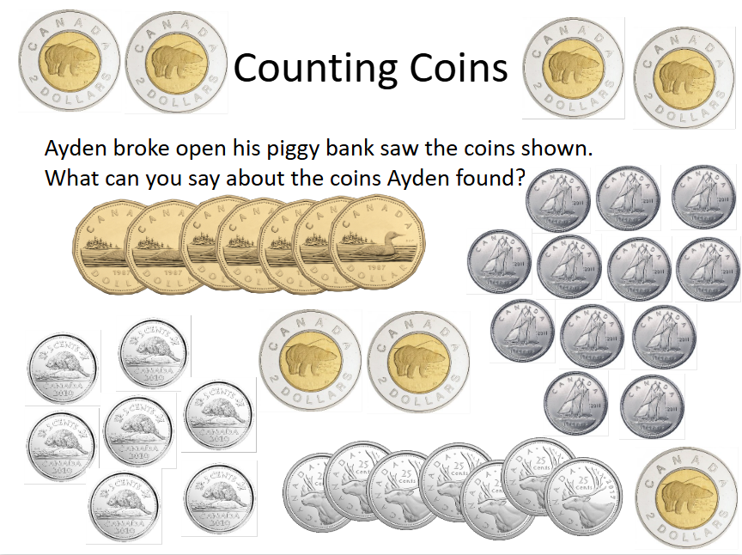
GRADE 3 FINANCIAL LITERACY
OPEN QUESTIONS
ELEMENTARY MATH PROJECT
9. A book set costs $48. List two different ways someone could pay a cashier using bills. (You do not need to give the exact amount--the cashier can give you change!)
10.

