Slide 1

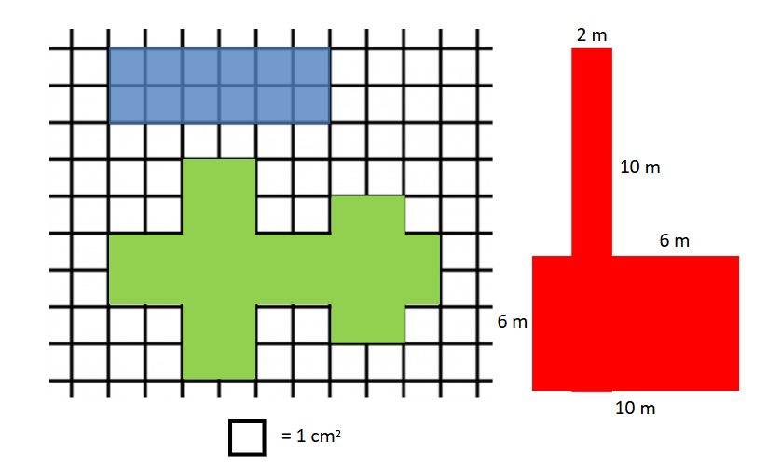
GRADE 3 MEASUREMENT
CLOSED QUESTIONS
ELEMENTARY MATH PROJECT
1. Pick one of the shapes (blue, green, or red). Find its area and perimeter.
2. About how many cans of pop are in a 2 litre bottle of pop? Justify your thinking.
GRADE 2 NUMBER SENSE
CLOSED QUESTIONS

Slide 2
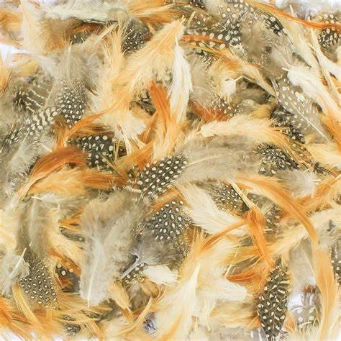
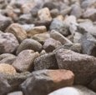
GRADE 3 MEASUREMENT
CLOSED QUESTIONS
ELEMENTARY MATH PROJECT
3. Which weighs more?
A 1000 gram bag of feathers
A 1 kilogram bag of rocks
Justify your thinking.
4. Use a ruler. Draw each of the following shapes.
A 3 cm square
A rectangle that is 8 cm long and 5 cm wide
A triangle with a square corner and side lengths: 3 cm, 4 cm, 5 cm
Challenge: A circle with a circumference as close to 20 cm as you can get!
GRADE 2 NUMBER SENSE
CLOSED QUESTIONS

Slide 3

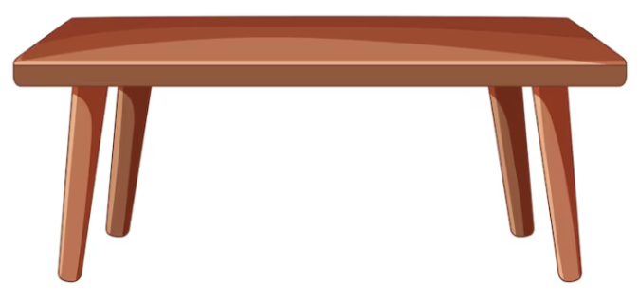
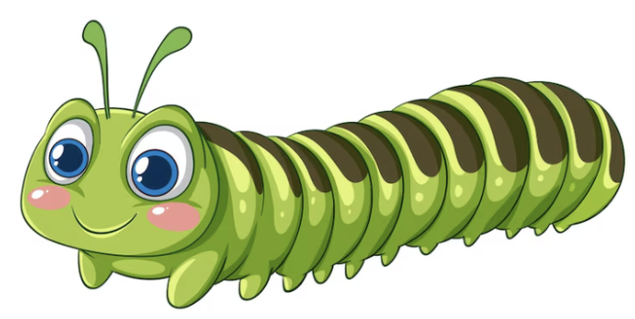
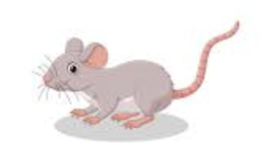
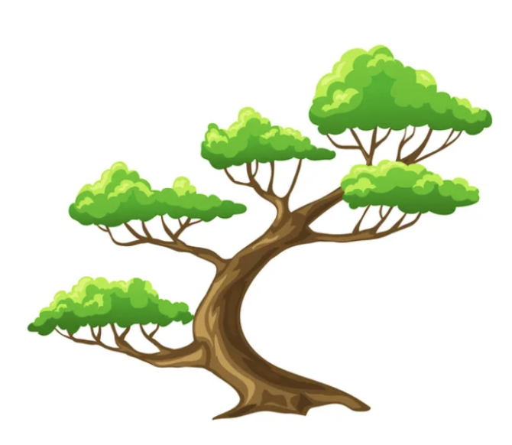
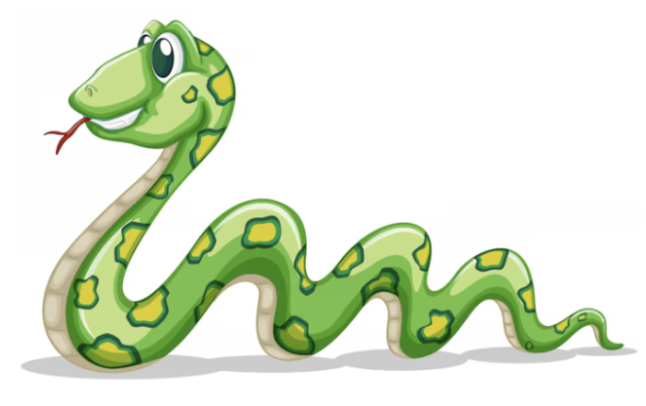
GRADE 3 MEASUREMENT
CLOSED QUESTIONS
ELEMENTARY MATH PROJECT
5. Measure the height and length of each item using centimetres.
GRADE 2 NUMBER SENSE
CLOSED QUESTIONS

Slide 4
GRADE 3 MEASUREMENT
OPEN QUESTIONS
ELEMENTARY MATH PROJECT
6. Exploring Linear Measurement.
Millimetre
Centimetre
Metre
Kilometre
Symbol | What is a good referent? | I can use it to measure…
Symbol | What is a good referent? | I can use it to measure…
GRADE 2 NUMBER SENSE
CLOSED QUESTIONS
Symbol | What is a good referent? | I can use it to measure…
Symbol | What is a good referent? | I can use it to measure…

Slide 5
GRADE 3 MEASUREMENT
OPEN QUESTIONS
ELEMENTARY MATH PROJECT
7. a) Describe or show a strategy for measuring the distance around a circle or curved object like a cylinder.
b) Find some objects that are curved to measure (water bottle, tree trunk, your head).
Write them in the chart below. Estimate the distance around them. Then measure them. How close did you get (find the difference between your estimate and measurement)?
GRADE 2 NUMBER SENSE
CLOSED QUESTIONS
Curved Object | Estimate | Measurement | Difference

Slide 6
GRADE 3 MEASUREMENT
OPEN QUESTIONS
ELEMENTARY MATH PROJECT
8. Explain how one person could measure something and get a big number, and a different person could measure the same thing and get a small number. Use a specific example to support your thinking.
9. Use a balance scale and weights. Find two very different objects that have almost the same mass. How can you tell if they have the same mass? How close in mass were the two objects?
GRADE 2 NUMBER SENSE
CLOSED QUESTIONS

Slide 7
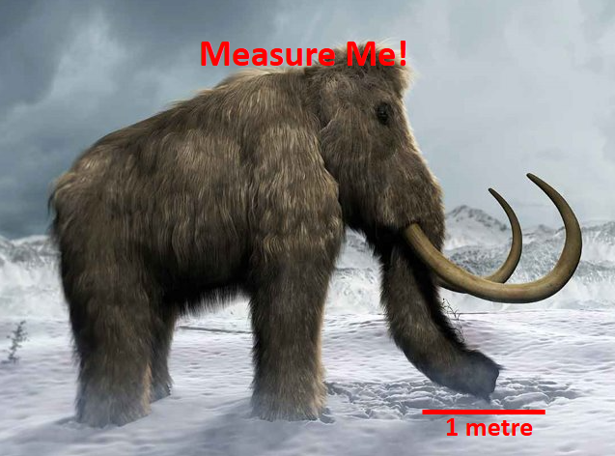
GRADE 3 MEASUREMENT
OPEN QUESTIONS
ELEMENTARY MATH PROJECT
10. In Canada, we have to be familiar with both the Metric System and the Imperial System. Make a pro/con list for each system. Then decide which one you think is better using your pro/con lists to justify your choice.
11. Estimate the length of the wholly mammoth in the picture using the referent for 1 metre. Explain your process and how you know your estimate is reasonable.
Metric System |  | Imperial System
Pro | Con | Pro | Con
GRADE 2 NUMBER SENSE
CLOSED QUESTIONS

Slide 8
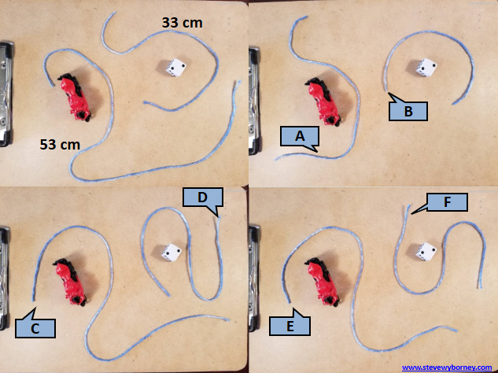
GRADE 3 MEASUREMENT
OPEN QUESTIONS
ELEMENTARY MATH PROJECT
11. Estimation Clipboard. Use the first image (top, left) to estimate the lengths of the strings labelled A through F. Justify your estimates.
Visually list the strings in order from shortest to longest. Do your number estimates agree with the order of your letters? Adjust your estimates if you need to.
GRADE 2 NUMBER SENSE
CLOSED QUESTIONS

Slide 9
GRADE 3 GEOMETRY
CLOSED QUESTIONS
ELEMENTARY MATH PROJECT
1. Provide a set of 3D solids. How many faces, edges, vertices do each have?
Cube
Rectangular prism
Rectangular pyramid
Tetrahedron
Triangular prism
GRADE 2 NUMBER SENSE
CLOSED QUESTIONS

Slide 10
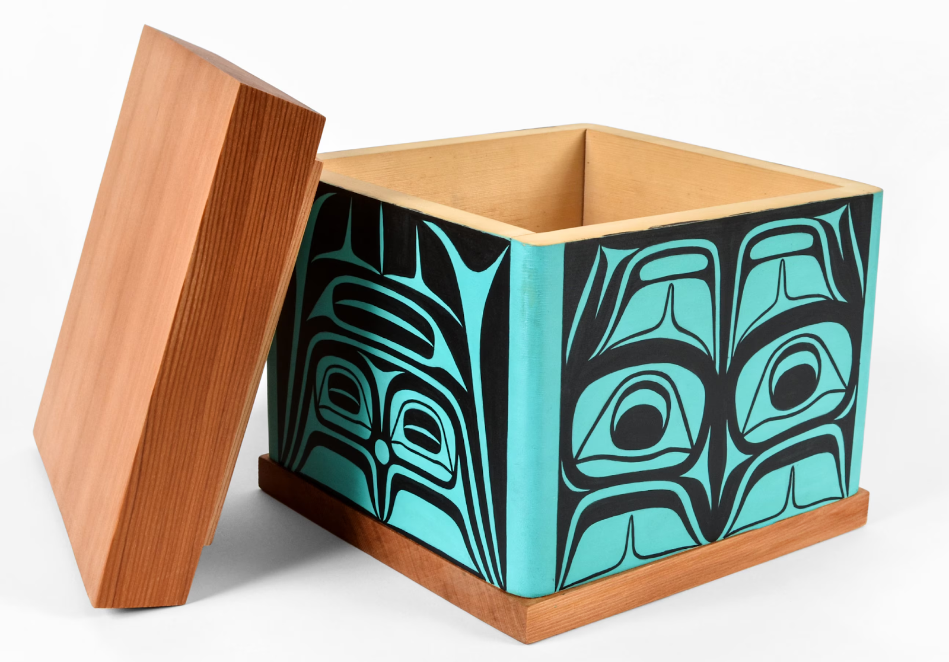
GRADE 3 GEOMETRY
CLOSED QUESTIONS
ELEMENTARY MATH PROJECT
2. What 2D shapes are in a hexagonal prism? How about a hexagonal pyramid?
3. What shapes do you see in a bentwood box?
GRADE 2 NUMBER SENSE
CLOSED QUESTIONS

Slide 11
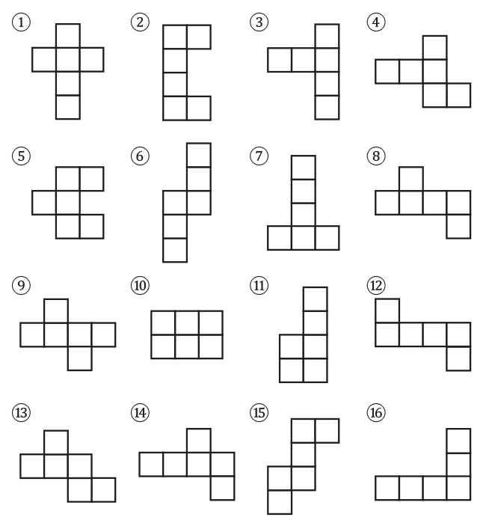
GRADE 3 GEOMETRY
CLOSED QUESTIONS
ELEMENTARY MATH PROJECT
4. Investigate. Cut out the following nets. Which of them can fold into a cube? Which cannot? Challenge: Can you predict which nets will work before you cut them out?
GRADE 2 NUMBER SENSE
CLOSED QUESTIONS

Slide 12
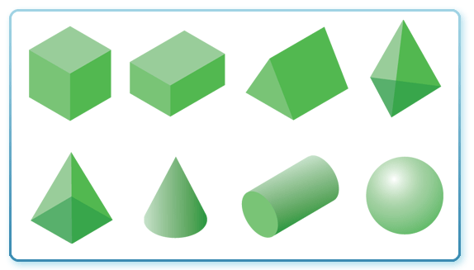
GRADE 3 GEOMETRY
CLOSED QUESTIONS
ELEMENTARY MATH PROJECT
5. Name the 3D solids in the image below.
GRADE 2 NUMBER SENSE
CLOSED QUESTIONS

Slide 13
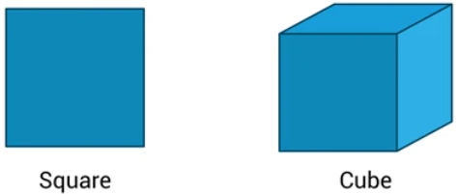
GRADE 3 GEOMETRY
OPEN QUESTIONS
ELEMENTARY MATH PROJECT
6. Consider a square and a cube. How are they similar? How are they different?
7. How many different ways can you draw a quadrilateral? Name them if you can!
GRADE 2 NUMBER SENSE
CLOSED QUESTIONS

Slide 14
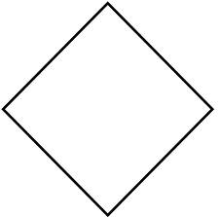
GRADE 3 GEOMETRY
OPEN QUESTIONS
ELEMENTARY MATH PROJECT
8. Lucy says the shape below is a diamond. Samuel says it’s a square. Who do you agree with? Justify your thinking.
9. a) Identify three different kinds of prisms. Name them. What gives a prism its name?
b) Identify three different kinds of pyramids. Name them. What gives a pyramid its name?
c) How are prisms and pyramids similar? How are they different?
GRADE 2 NUMBER SENSE
CLOSED QUESTIONS

Slide 15
GRADE 3 GEOMETRY
OPEN QUESTIONS
ELEMENTARY MATH PROJECT
10. Platonic Solids investigation. Using multiple copies of a single shape, how many different 3D shapes can you make? How do you know you have found all the ways?
GRADE 2 NUMBER SENSE
CLOSED QUESTIONS

