Slide 1

GRADE 3 MIXED PRACTICE
ELEMENTARY MATH PROJECT
1. I want to buy three board games. They cost: $48, $24 and $13 (including tax). I have a $100 bill. Is that enough to buy all three games?​ Show your thinking.
2. You’re celebrating your birthday with 12 friends. Will baking 20 cookies be enough for you and your guests? Explain.​
3. A student says 1000 – 246 = 864. Does this answer make sense?​ Why or why not?

Slide 2
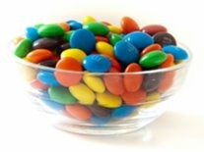
GRADE 3 MIXED PRACTICE
ELEMENTARY MATH PROJECT
4. The distance from New Westminster to Kelowna is 372 km. If you drive 100 km every hour, about how many hours will it take to get to Kelowna?​
5. About how many candies are in the candy bowl?​ How do you know this is a reasonable estimate?
6. Why is area measured in square units (ex. cm2) while perimeter is measured in linear units (ex. cm)?​ Show your thinking using specific examples.

Slide 3
GRADE 3 MIXED PRACTICE
ELEMENTARY MATH PROJECT
7. Draw a net for a triangular prism.​ Is this the only way to make the net? Explain or show your reasoning.
8. Estimate the numerical value of letters A, B, and C on the number line below. Justify your answer.

Slide 4
GRADE 3 MIXED PRACTICE
ELEMENTARY MATH PROJECT
9. Which months have exactly 30 days?
10. A bike costs $389 in total. If you pay with a $1000 bill, how much change would you get back?
​
11. 786 = ____ hundreds + ____ tens + ____ ones​
How many ways can you fill in the blanks so that the equation is true?​

Slide 5
GRADE 3 MIXED PRACTICE
ELEMENTARY MATH PROJECT
12. Calculate: 923 – 289 ​
Show your strategy. How can you check that your answer is reasonable?
13. How are the “equal groups” and “fair share” meanings of division similar? How are they different? Use an example to support your answer.​
14. Round 327 to the nearest 100 and nearest 10. Explain or show your reasoning.
100
10​

Slide 6
GRADE 3 MIXED PRACTICE
ELEMENTARY MATH PROJECT
15. If you count forward by 10s starting at 324, will you eventually say the number 444? Explain.​
16. Fill in the blank: 678 = ______ tens + 8 ones​
17. Is 356 closer to 250 or 500?​ Justify your thinking.
18. A friend always forgets 6 + 8 = 14. What strategy could you share to help them remember?​

Slide 7
GRADE 3 MIXED PRACTICE
ELEMENTARY MATH PROJECT
19. Living in Canada, we need to be familiar with both the metric system and Imperial measures.
How many inches are in a foot?​
How many centimetres are in a metre?​
How many millilitres are in a cup?
How many millilitres are in a litre?
20. Which is greater: 432 + 555 OR 1000 – 256
Explain your reasoning.

Slide 8
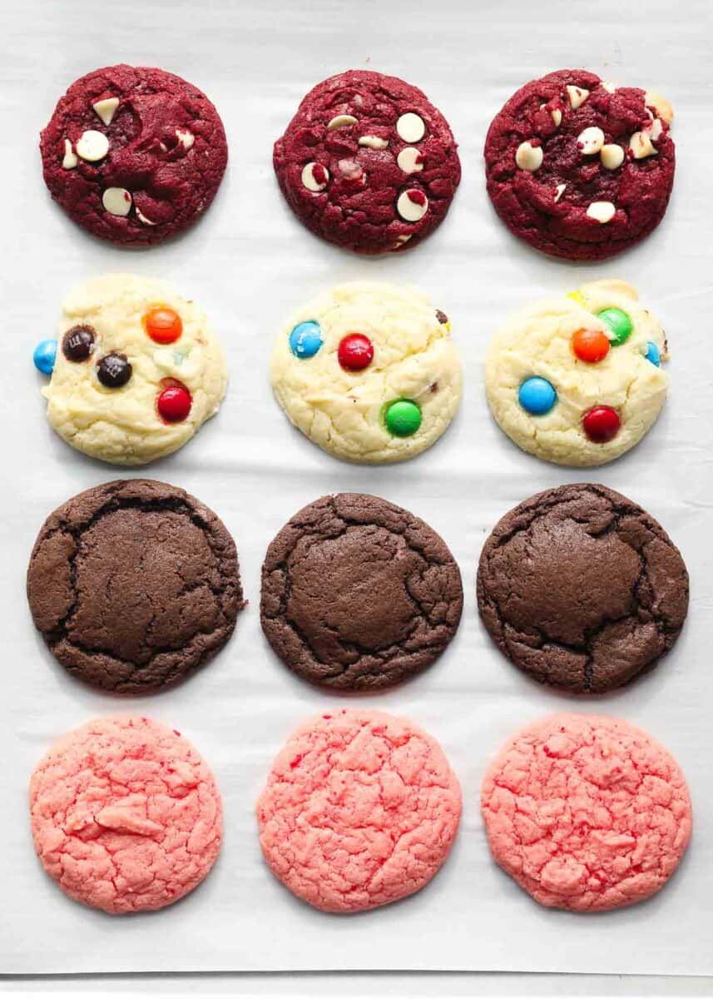
GRADE 3 MIXED PRACTICE
ELEMENTARY MATH PROJECT
21. What fraction of the cookies are pink?
22. Represent the fraction ¾ using three different models. How does each model help you to understand ¾ in a different way?
23. What does the top number in a fraction (numerator) mean?
What does the bottom number in a fraction (denominator) mean?
Use pictures, numbers, words to explain your thinking.

Slide 9
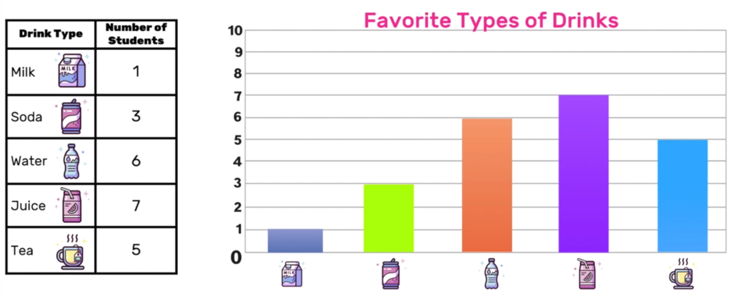
GRADE 3 MIXED PRACTICE
ELEMENTARY MATH PROJECT
24. How would you explain what 3 × 4 means to a student in a younger grade?
Use at least one model in your explanation.
25. What information do the table and graph tell you? How are the two representations similar? How are they different? Which do you prefer and why?

Slide 10
GRADE 3 MIXED PRACTICE
ELEMENTARY MATH PROJECT
26. Musa and River are A/B partners. They are looking for a random way to decide who will be Partner A and who will be Partner B. How can they do this fairly?
27. Fill in the blanks:
1 minute = _____ seconds
1 hour = _____ minutes
1 day = _____ hours
1 week = _____ days
1 year = _____ months
28. Pick one:
a) How are addition and subtraction related?
b) How are multiplication and division related?
Explain using specific examples.

Slide 11
GRADE 3 MIXED PRACTICE
ELEMENTARY MATH PROJECT
29. Use grid paper or square tiles. Is it possible to make a shape that has a perimeter of 12 units AND an area of 12 square units? Justify your answer.
30. Write a story problem that can be represented by the equation ☐ + 8 = 12.

