Slide 1

GRADE 3 NUMBER SENSE + COMPUTATIONAL FLUENCY
CLOSED QUESTIONS
ELEMENTARY MATH PROJECT
1. Consider the set of numbers: 602, 125, 999, 500, 941
Decompose each number by place value (e.g., 256 = 200 + 50 + 6).
Put the set of numbers in order from least to greatest. How did decomposing each number by place value help you to order them?
2. Consider the number 531.
What number is 2 more? What number is 2 less?
What number is 5 more? What number is 5 less?
What number is 10 more? What number is 10 less?
What number is 100 more? What number is 100 less?
Record all nine numbers in order from least to greatest.
GRADE 2 NUMBER SENSE
CLOSED QUESTIONS

Slide 2
GRADE 3 NUMBER SENSE + COMPUTATIONAL FLUENCY
CLOSED QUESTIONS
ELEMENTARY MATH PROJECT
3. A dime is a tenth of a dollar (100 cents) and a quarter is one-fourth of a dollar.
Use coins (or draw them) to count by tenths to 200 and then by quarters to 200.
Write out how you counted using fraction symbols (e.g., 1/10, 2/10, 3/10, …)
4. Print the numbers counting backwards by 3s from 60 to 0. Describe any patterns that make it easier to complete this task.
5. Raul counted a sack of marbles by 2s and made groups of 10 as he went. When he counted out 10 groups of 10, he grouped them into a pile of 100. He continued this way until he counted 347 marbles. Draw a picture of how he might have organized his marbles. Is this how you would have counted them? Explain.
GRADE 2 NUMBER SENSE
CLOSED QUESTIONS

Slide 3
GRADE 3 NUMBER SENSE + COMPUTATIONAL FLUENCY
CLOSED QUESTIONS
ELEMENTARY MATH PROJECT
6. Print the first ten numbers for each of the following:
Counting up by 2s starting at 85.
Counting back by 4s starting at 312.
Counting forwards by 3s starting at 25.
Counting backwards by 5s starting at 178.
Counting forward by 10s starting at 723.
GRADE 2 NUMBER SENSE
CLOSED QUESTIONS

Slide 4
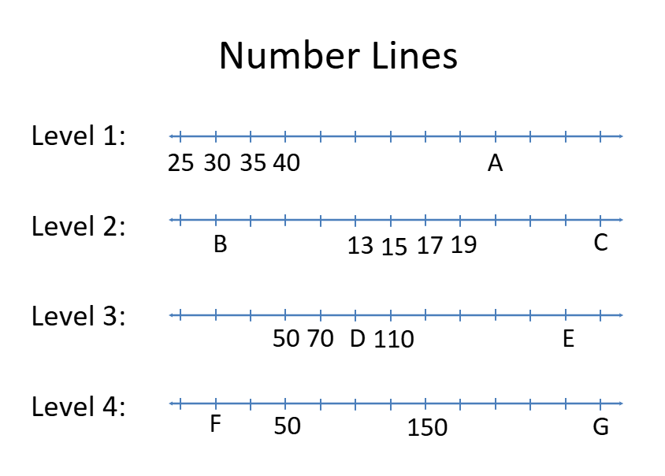
GRADE 3 NUMBER SENSE + COMPUTATIONAL FLUENCY
CLOSED QUESTIONS
ELEMENTARY MATH PROJECT
7. Determine which numbers would replace the letters A through G.
GRADE 2 NUMBER SENSE
CLOSED QUESTIONS

Slide 5
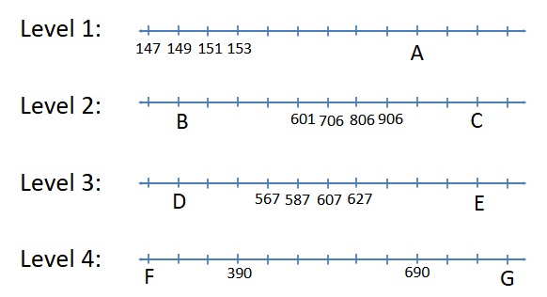
GRADE 3 NUMBER SENSE + COMPUTATIONAL FLUENCY
CLOSED QUESTIONS
ELEMENTARY MATH PROJECT
8. Determine which numbers would replace the letters A through G.
GRADE 2 NUMBER SENSE
CLOSED QUESTIONS

Slide 6
GRADE 3 NUMBER SENSE + COMPUTATIONAL FLUENCY
CLOSED QUESTIONS
ELEMENTARY MATH PROJECT
9. Use materials or draw pictures. Represent each fraction below three ways: As part of a region, a set, and on a number line.
a) ½ b) ¾ c) ⅖ d) ⅝
GRADE 2 NUMBER SENSE
CLOSED QUESTIONS

Slide 7
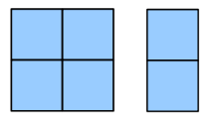
GRADE 3 NUMBER SENSE + COMPUTATIONAL FLUENCY
CLOSED QUESTIONS
ELEMENTARY MATH PROJECT
10. True or False: A fraction is a number. How do you know?
11. If you eat half of a pizza and your friend eats a third of what's left, how much pizza remains uneaten? Show your reasoning by drawing a picture or using fraction materials.
12. The image below represents ⅖ of a serving of graham crackers. What does one serving look like? How do you know?
GRADE 2 NUMBER SENSE
CLOSED QUESTIONS

Slide 8
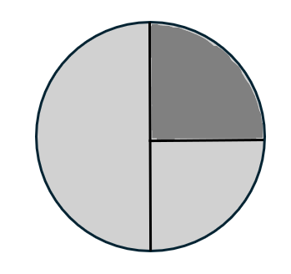
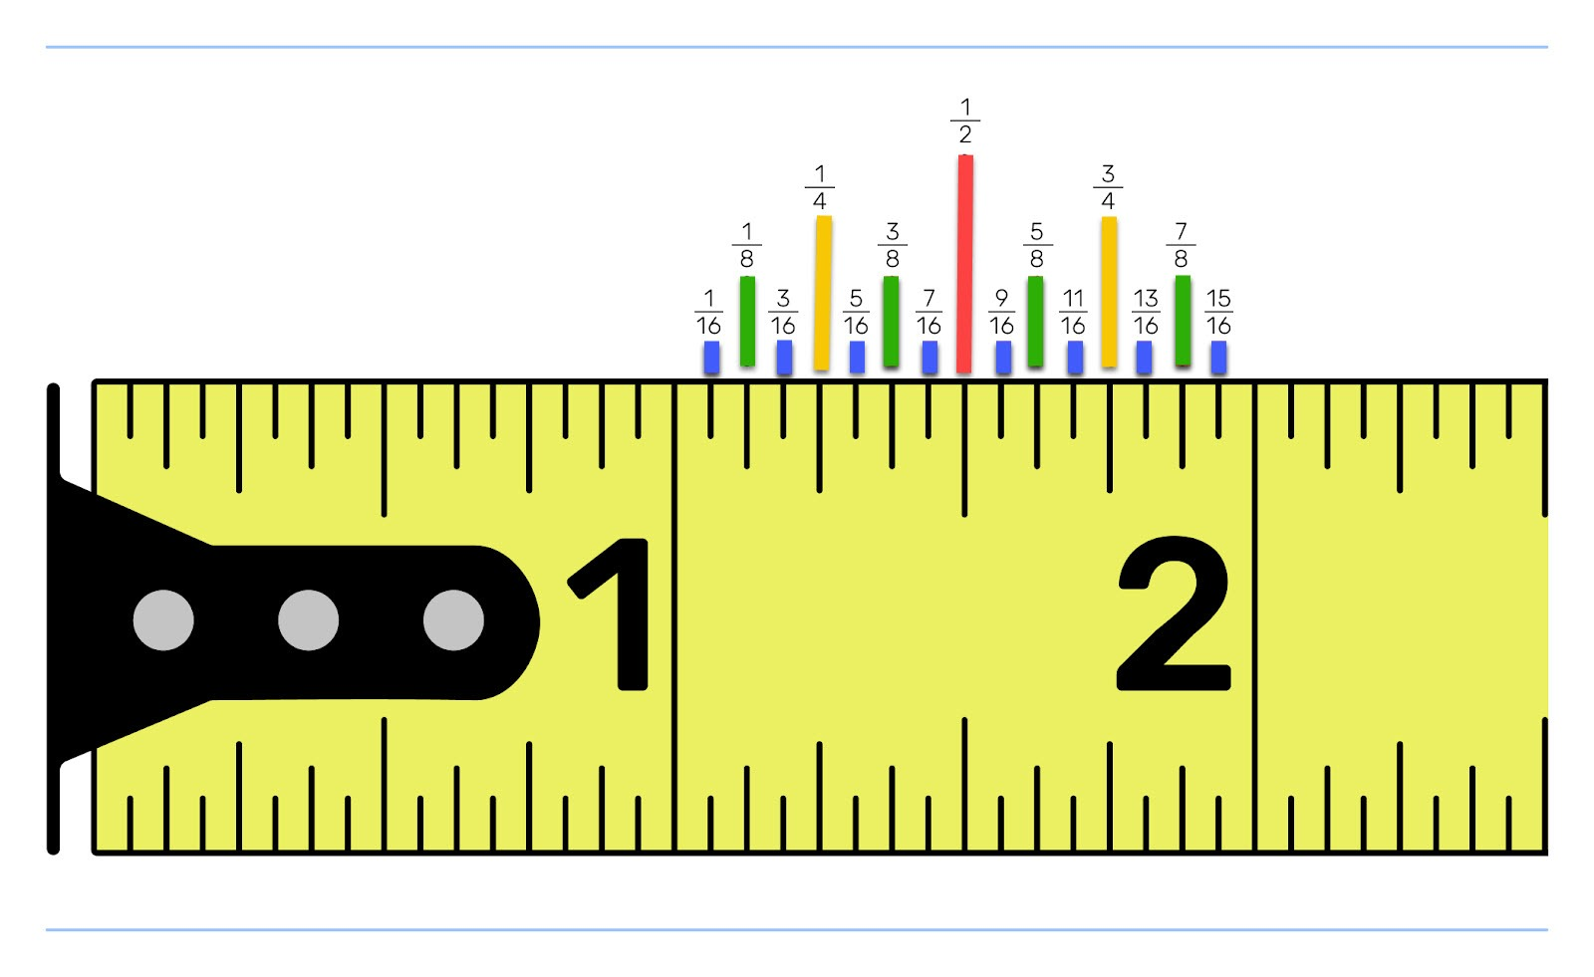
GRADE 3 NUMBER SENSE + COMPUTATIONAL FLUENCY
CLOSED QUESTIONS
ELEMENTARY MATH PROJECT
13. Brin drew a picture of ⅓ but Danica says it’s not correct. What mistake did Brin make and how can she fix it?
14. Look at the image of the measuring tape below. Notice the different sized benchmark lines. These represent multiple number lines laid on top of one another. What fraction are the gaps in each of these number lines going up by? Skip count by fractions for each of these number lines. Label each benchmark with a fraction.
GRADE 2 NUMBER SENSE
CLOSED QUESTIONS

Slide 9
GRADE 3 NUMBER SENSE + COMPUTATIONAL FLUENCY
CLOSED QUESTIONS
ELEMENTARY MATH PROJECT
15. Look at a metric ruler.
Use fractions to describe how 1 mm is related to 1 cm.
16. You are skip counting forward by 25s starting at 125.
a) What are the next three numbers?
b) If you keep going, will you land on 300 exactly?
c) Explain why or why not.
17. A number is covered on a hundreds chart. You can see:
The number above it is 362.
The number to the right of it is ???
The number below it is 382.
What is the missing number? What is the number to the right of it? Is the hidden number even or odd?
GRADE 2 NUMBER SENSE
CLOSED QUESTIONS

Slide 10
GRADE 3 NUMBER SENSE + COMPUTATIONAL FLUENCY
CLOSED QUESTIONS
ELEMENTARY MATH PROJECT
18. You have the number 748.
Write 748 in expanded form.
b) How many tens would you have if you traded all the hundreds for tens?
c) What is 748 – 300?
19. Put the numbers in order from least to greatest:
307, 370, 703, 730
a) Write the correct order.
b) Reverse each number.
c) Which original number changes the most in value when reversed?
GRADE 2 NUMBER SENSE
CLOSED QUESTIONS

Slide 11
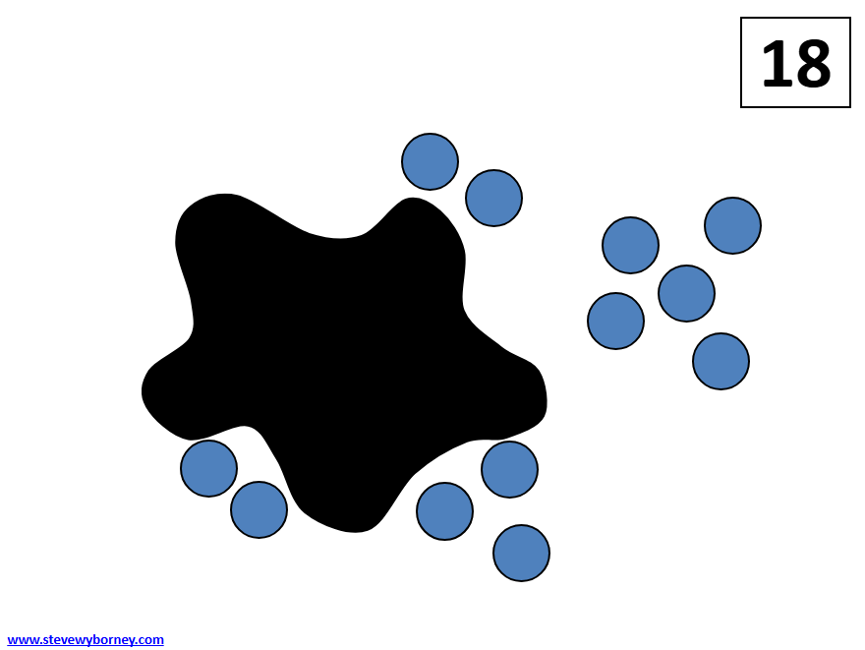
GRADE 3 NUMBER SENSE + COMPUTATIONAL FLUENCY
CLOSED QUESTIONS
ELEMENTARY MATH PROJECT
20. Use counters or draw pictures. You have 12 berries.
a) What is 1/2 of the berries?
b) What is 1/3 of the berries?
c) If you ate 1/4 of the berries, how many berries would be left?
21. Here is a Splat! problem to solve. If there are 18 blue dots altogether, how many are hiding under the splat? Show or explain your thinking. Can you write the several related equations that connect to this image? Hint: think “fact family”
GRADE 2 NUMBER SENSE
CLOSED QUESTIONS

Slide 12
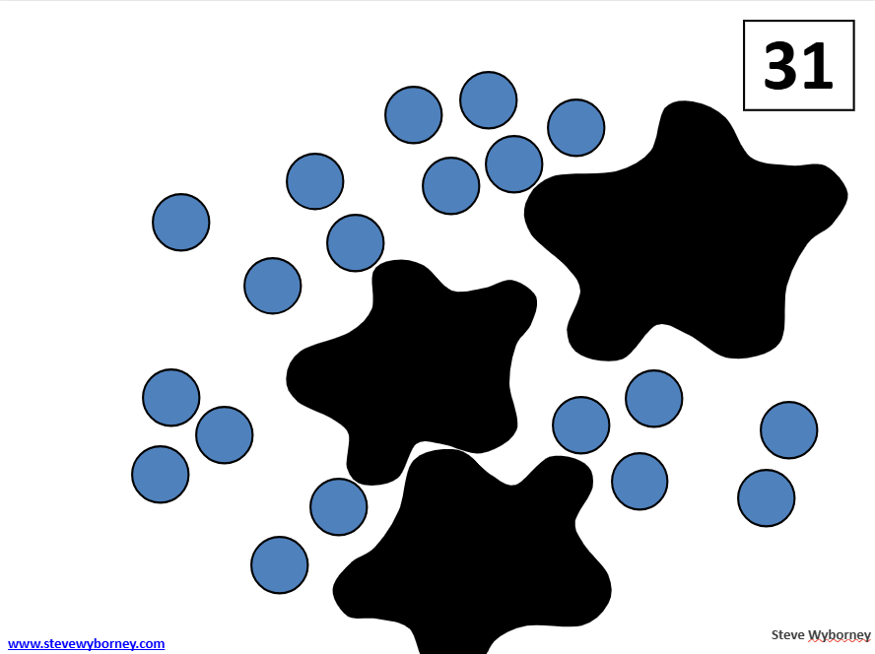
GRADE 3 NUMBER SENSE + COMPUTATIONAL FLUENCY
CLOSED QUESTIONS
ELEMENTARY MATH PROJECT
22. Here is a Splat! problem to solve. Multiple splats have the same number of blue dots hiding under them. If there are 31 blue dots altogether, how many are hiding under each splat? Show or explain your thinking. Can you write several different equations that connect to this image?
23. Solve using a make-10 strategy:
GRADE 2 NUMBER SENSE
CLOSED QUESTIONS
a) 8 + 6 | b) 9 + 7
c) 5 + 8 | d) 6 +9

Slide 13
GRADE 3 NUMBER SENSE + COMPUTATIONAL FLUENCY
CLOSED QUESTIONS
ELEMENTARY MATH PROJECT
24. Solve using near doubles:
25. Solve using think addition:
a) 6 + 7 | b) 8 + 9
c) 5 + 6 | d) 9 + 10
GRADE 2 NUMBER SENSE
CLOSED QUESTIONS
a) 15 – 7 | b) 14 - 9
c) 13 – 6 | d) 17 -8

Slide 14
GRADE 3 NUMBER SENSE + COMPUTATIONAL FLUENCY
CLOSED QUESTIONS
ELEMENTARY MATH PROJECT
26. Order the sums from least to greatest:
11 + 4, 9 + 8, 7 + 6, 5 + 2
27. Add using friendly numbers:
a) 198 + 7 | b) 299 + 16
c) 495 + 146 | d) 398 + 297
GRADE 2 NUMBER SENSE
CLOSED QUESTIONS

Slide 15
GRADE 3 NUMBER SENSE + COMPUTATIONAL FLUENCY
CLOSED QUESTIONS
ELEMENTARY MATH PROJECT
28. Subtract using compensation:
a) 58 – 29 | b) 356 - 97
c) 402 - 198 | d) 503 - 299
GRADE 2 NUMBER SENSE
CLOSED QUESTIONS

Slide 16
GRADE 3 NUMBER SENSE + COMPUTATIONAL FLUENCY
CLOSED QUESTIONS
ELEMENTARY MATH PROJECT
29. Use a place-value strategy to add:
a) 58 + 21 | b) 157 + 32
c) 345 + 221 | d) 507 + 132
GRADE 2 NUMBER SENSE
CLOSED QUESTIONS

Slide 17
GRADE 3 NUMBER SENSE + COMPUTATIONAL FLUENCY
CLOSED QUESTIONS
ELEMENTARY MATH PROJECT
30. Solve:
a) 465 + 390 | b) 372 + 539
c) 620 – 430 | d) 703 - 256
GRADE 2 NUMBER SENSE
CLOSED QUESTIONS

Slide 18
GRADE 3 NUMBER SENSE + COMPUTATIONAL FLUENCY
CLOSED QUESTIONS
ELEMENTARY MATH PROJECT
31. Fill in the blank. Show your thinking. How can you check your answer is correct?
327 + ___ = 400
___ − 250 = 175
600 = 480 + ___
32. Draw an array model for each. Write the multiplication sentence that matches.
a) 2 rows of 5 b) 4 rows of 3
GRADE 2 NUMBER SENSE
CLOSED QUESTIONS

Slide 19
GRADE 3 NUMBER SENSE + COMPUTATIONAL FLUENCY
CLOSED QUESTIONS
ELEMENTARY MATH PROJECT
33. Complete the repeated addition sentence:
a) 4 × 3 = ___ + ____ + ____ + ____
b) 5 × 2 = ___ + ____ + ____ + ____ + ____
34. Show an equal groups model for each.
a) 2 × 6 b) 5 × 3
35. Count by 3s starting at 3. Write the first five numbers. How does this connect to multiplication?
GRADE 2 NUMBER SENSE
CLOSED QUESTIONS

Slide 20
GRADE 3 NUMBER SENSE + COMPUTATIONAL FLUENCY
CLOSED QUESTIONS
ELEMENTARY MATH PROJECT
36. Use a model to show that 3 × 4 and 4 × 3 give the same answer. Explain how the model shows this.
37. Share 24 counters equally among 4 people. How many does each person get?
Next, make groups of 4 using the 24 counters. How many groups can you make?
How are these two tasks similar? How are they different?
38. Write the related facts (i.e., “fact family”) for 4 × 6 = 24
GRADE 2 NUMBER SENSE
CLOSED QUESTIONS

Slide 21
GRADE 3 NUMBER SENSE + COMPUTATIONAL FLUENCY
CLOSED QUESTIONS
ELEMENTARY MATH PROJECT
39. Fill in the missing number and share how you figured it out:
a) 30 ÷ ___ = 5
b) ___ ÷ 4 = 3
40. Match the description on the left with the correct number sentence on the right. The number sentences can be used more than once.
GRADE 2 NUMBER SENSE
CLOSED QUESTIONS
18 cookies shared among 3 friends | 3 + 18
I have $3. You have $18. What is the total? | 18 − 3
I have 18 cookies. I give you 3 of them. | 3 × 18
3 groups of 18 items | 18 ÷ 3
3 rows of 18 items
I have $18. You have $3. How many more dollars do you have?
I’ve got 18 cookies. I give each friend 3 cookies. How many friends get cookies?

Slide 22
GRADE 3 NUMBER SENSE + COMPUTATIONAL FLUENCY
CLOSED QUESTIONS
ELEMENTARY MATH PROJECT
41. Which one doesn’t belong and why?
42. Which two equations are related? How do you know?
5 x 4 | 20 ÷ 4
20 ÷ 5 | 15 + 5
3 × 7 = 21 | 7 − 3 = 4
21 − 7 = 14 | 21 ÷ 3 = 7

Slide 23
GRADE 3 NUMBER SENSE + COMPUTATIONAL FLUENCY
CLOSED QUESTIONS
ELEMENTARY MATH PROJECT
43. Harnoor says 4, 6, and 10 are in the same fact family.
Manu says it’s 4, 6, and 24.
Who is correct? Could they both be right? Explain.
44. Which statement is true and why?
4 × 5 means 5 + 5 + 5 + 5
4 × 5 means 4 + 4 + 4 + 4 + 4

Slide 24
GRADE 3 NUMBER SENSE + COMPUTATIONAL FLUENCY
CLOSED QUESTIONS
ELEMENTARY MATH PROJECT
45. Show how you can use skip counting to find the answer to:
a) 5 x 7 | b) 9 x 2
c) 6 x 3 | d) 8 x 4

Slide 25
GRADE 3 NUMBER SENSE + COMPUTATIONAL FLUENCY
CLOSED QUESTIONS
ELEMENTARY MATH PROJECT
46. Solve. Show your strategy.
a) 240 + 360 | b) 560 – 240
c) 7 × 4 | d) 32 ÷ 4

Slide 26
GRADE 3 NUMBER SENSE + COMPUTATIONAL FLUENCY
CLOSED QUESTIONS
ELEMENTARY MATH PROJECT
47. True or false. If false, explain why and make it true.
a) 9 + 8 = 20 − 3
b) 6 × 4 = 24 ÷ 1
c) 2 + 2 + 2 = 6 + 4 = 10
48. Estimate to find the larger amount. Show or explain your reasoning.
a) 297 + 408 or 812 − 289
b) 2 × 12 or 100 ÷ 2

Slide 27
GRADE 3 NUMBER SENSE + COMPUTATIONAL FLUENCY
CLOSED QUESTIONS
ELEMENTARY MATH PROJECT
49. Which expression gives a result closest to 200?
50. Show 5 × 6 three ways:
Repeated addition
Equal groups
Array model
a) 215 − 18 | b) 182 + 49
c) 310 − 140 | d) 190 + 23

Slide 28
GRADE 3 NUMBER SENSE + COMPUTATIONAL FLUENCY
CLOSED QUESTIONS
ELEMENTARY MATH PROJECT
51. Show 24 ÷ 6 three ways:
Fair share
Equal groups
Repeated subtraction

Slide 29
GRADE 3 NUMBER SENSE + COMPUTATIONAL FLUENCY
OPEN QUESTIONS
ELEMENTARY MATH PROJECT
52. Choose two numbers: 48, 72, 139, 471, 684
What different ways can you represent them? Consider using drawings, base ten blocks, symbols, ten frames, tally marks, etc.
53. Choose a number: 25, 99, 250, 860
What different ways can you decompose it? Decompose means break into parts (e.g., 30 can be decomposed into 15 + 15 or 20 + 5 + 5 and many other ways).
How will you show your thinking?

Slide 30
GRADE 3 NUMBER SENSE + COMPUTATIONAL FLUENCY
OPEN QUESTIONS
ELEMENTARY MATH PROJECT
54. Choose a number: 65, 100, 256
Find that quantity of items (rocks, pieces of Lego, cutlery, seeds, leaves, books, blocks, toys) around your home or outside.
What three different ways can you count the items?
Can you think of more ways? How can you show or record how you counted them?
55. Here is a list of benchmark numbers in order: 0, 250, 500, 750, 1000
Draw a number line with these numbers on it and then add these numbers to it:
125, 450, 900, 10, 700, 589
How will you share your reasoning for where you placed each of the numbers?

Slide 31

GRADE 3 NUMBER SENSE + COMPUTATIONAL FLUENCY
OPEN QUESTIONS
ELEMENTARY MATH PROJECT
56. Where would you put 667 on the number line below? Justify your decision.
57. Choose a number: 75, 120, 500, 750
What are three different ways to count to that number? For example, by 5s, 7s, 20s or 50s. Record how you counted – try to challenge yourself to count in a way that you haven’t counted before.
58. Choose one of the following numbers and represent it in at least five different ways: 75, 98, 125, 475, 825
Consider using pictures, tallies, ten frames/100 grids, blocks, drawings of coins, number lines, or using words, including other languages.

Slide 32
GRADE 3 NUMBER SENSE + COMPUTATIONAL FLUENCY
OPEN QUESTIONS
ELEMENTARY MATH PROJECT
59. What does the bottom number in a fraction (denominator) tell us?
What does the top number in a fraction (numerator) tell us?
Use pictures, numbers, and words to explain.
60. A fraction is a number that represents a part of a whole.
One-half is written as the symbol 1⁄2 . The 2 is called the denominator and shows how many equal parts the whole has. The 1 is the numerator and represents how many parts of the whole we are talking about. What different ways can you represent 1⁄2 using materials, pictures and diagrams?
Choose another fraction or two: 1⁄4 or 3⁄4 or 2/10 or ⅔ or one of your own.
What ways can you represent these fractions?

Slide 33
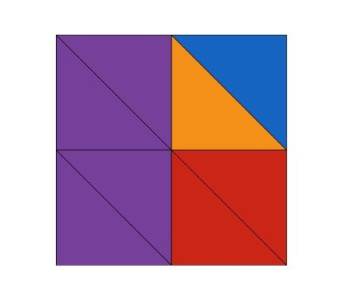
GRADE 3 NUMBER SENSE + COMPUTATIONAL FLUENCY
OPEN QUESTIONS
ELEMENTARY MATH PROJECT
61. Name a fraction that is less than ½ but close to ½. How close can you get? Share your strategy.
62. Describe the fractions that you see in the image.
How will you share your thinking with others?

Slide 34
GRADE 3 NUMBER SENSE + COMPUTATIONAL FLUENCY
OPEN QUESTIONS
ELEMENTARY MATH PROJECT
63. Look for examples of fractions in your home, neighbourhood, or classroom. Do you have some measuring tools that include fractions? Can you “see” fractions in your food – a carton of eggs, a pizza, a cake? Where can you “see” fractions in buildings or trees? What different ideas can you think of? How will you record the different fractions you find?
64. Here is a math story:
I baked a loaf of bread. A loaf of bread can be sliced into 12 slices of bread. My son likes ham and cheese sandwiches made with two pieces of bread. He eats one and a half sandwiches a day. What math question could you ask? Show what strategy you would use to figure out the answer to your question.

Slide 35
GRADE 3 NUMBER SENSE + COMPUTATIONAL FLUENCY
OPEN QUESTIONS
ELEMENTARY MATH PROJECT
65. Jono ate ½ a small pizza. Milton ate ¼ of a large pizza. Who ate more pizza? Could the answer be either of them? Justify your reasoning using pictures, numbers, and words.
66. How you would share four submarine sandwiches equally between you and two of your friends. How much would each person get? Show your thinking.
67. Pick a number larger than 100 but smaller than 1000. Is your number even or odd? How would you explain this to someone new to the concept of even and odd numbers?

Slide 36
GRADE 3 NUMBER SENSE + COMPUTATIONAL FLUENCY
OPEN QUESTIONS
ELEMENTARY MATH PROJECT
68. Investigate. The numbers 6 and 4 are even. If you add them, you get 10, which is also even.
Will two even numbers always add up to an even number? Justify your answer.
How about adding two odd numbers? Adding an even number and an odd number?
69. Count to 100 or 500 in at least three different ways. Record how you counted by printing the numbers or showing the counting on a number chart. What patterns did you notice that made counting easier?

Slide 37
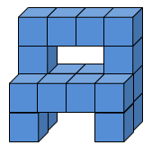
GRADE 3 NUMBER SENSE + COMPUTATIONAL FLUENCY
OPEN QUESTIONS
ELEMENTARY MATH PROJECT
70. How many unit cubes make up the structure in the image below? How do you know? Describe several different ways you can think about this structure. Use number sentences (equations) to represent your thinking.
71. Think of a 3-digit number using the digits 1 to 9.
Explain or show how you would round it to the nearest hundred.
Explain or show how you would round it to the nearest ten.

Slide 38
GRADE 3 NUMBER SENSE + COMPUTATIONAL FLUENCY
OPEN QUESTIONS
ELEMENTARY MATH PROJECT
72. Margo says 550 rounded to the nearest hundred is 600. Obenewa says 500 is acceptable, too. Margo disagrees. Who do you agree with? Justify your answer.
73. Give an example of when you would want to round a number to the nearest ten or hundred in a real-life context. Why would you do this rather than use the number as is?
74. Describe a situation where you would estimate a quantity (a number greater than 100 but less than 1000) rather than know or find the exact amount. Explain why.

Slide 39
GRADE 3 NUMBER SENSE + COMPUTATIONAL FLUENCY
OPEN QUESTIONS
ELEMENTARY MATH PROJECT
72. Margo says 550 rounded to the nearest hundred is 600. Obenewa says 500 is acceptable, too. Margo disagrees. Who do you agree with? Justify your answer.
73. Give an example of when you would want to round a number to the nearest ten or hundred in a real-life context. Why would you do this rather than use the number as is?
74. Describe a situation where you would estimate a quantity (a number greater than 100 but less than 1000) rather than know or find the exact amount. Explain why.

Slide 40
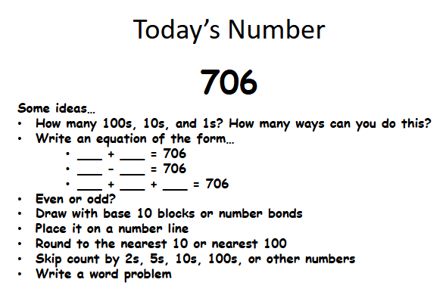
GRADE 3 NUMBER SENSE + COMPUTATIONAL FLUENCY
OPEN QUESTIONS
ELEMENTARY MATH PROJECT

Slide 41
GRADE 3 NUMBER SENSE + COMPUTATIONAL FLUENCY
OPEN QUESTIONS
ELEMENTARY MATH PROJECT
75. Consider the number 357. We read this number as “three hundred fifty seven”. How does the way we say the number relate to the place value of each digit? Find at least two other examples of 3-digit numbers where this is true. Are there any exceptions?
76. You’re walking from your house to a friend’s house.
You get to choose how you skip count to get there (by 2s, 5s, 10s… or mix them!).
Draw or describe your walking path using skip counting.
Explain why you chose your pattern and how you know you reached the same final number.

Slide 42
GRADE 3 NUMBER SENSE + COMPUTATIONAL FLUENCY
OPEN QUESTIONS
ELEMENTARY MATH PROJECT
77. Part A: Look around your classroom or home. Choose one container. Estimate how many of a particular object it could hold. Determine a lower and upper bound for your estimate. That is, what is the largest the number could possibly be? What is the smallest?
Part B: Test your estimate using any strategy you like and explain your strategy.
How close was your estimate? What would you do differently next time?
Part C: If you chose a different object to fill the container, how would that change your estimate? Explain your reasoning.

Slide 43
GRADE 3 NUMBER SENSE + COMPUTATIONAL FLUENCY
OPEN QUESTIONS
ELEMENTARY MATH PROJECT
78. Pretend your number is a recipe, and you can “break it apart” into ingredients. Choose any number between 50 and 200. Decompose it in two or more different ways (e.g., 143 = 100 + 40 + 3 or 143 = 70 + 70 + 3). Explain using pictures, numbers, and words why both “recipes” still make the same number.
79. Think of a place outdoors or on the land — trees on a trail, rocks on a beach, cattails by a pond. Create a skip-counting pattern based on something you notice in nature (e.g., “There were driftwood pieces in groups of 4”). Record your pattern and explain how it connects to the place you chose.

Slide 44
GRADE 3 NUMBER SENSE + COMPUTATIONAL FLUENCY
OPEN QUESTIONS
ELEMENTARY MATH PROJECT
80. You’re sharing a pizza with friends. You get to choose how many friends and how it is cut. Show two different ways the pizza could be shared fairly and explain which one you think is the easiest. Use pictures, materials, or words to show your thinking. How does this activity connect to the concept of fractions?
81. Choose a question: 29+6, 48+26, 459+36, 548+236
How does making 10 help you think about ways to add these two numbers? Show your thinking using a model (e.g., ten frame, number line, or number bonds).

Slide 45
GRADE 3 NUMBER SENSE + COMPUTATIONAL FLUENCY
OPEN QUESTIONS
ELEMENTARY MATH PROJECT
82. Choose three questions:
22 – 16, 51 – 25, 74 – 28, 135 – 67, 385 – 149, 615 – 265
How will you show your thinking? Use pictures, numbers, symbols and/or words.

Slide 46
GRADE 3 NUMBER SENSE + COMPUTATIONAL FLUENCY
OPEN QUESTIONS
ELEMENTARY MATH PROJECT
83. Choose an answer: 12, 55, 99, 260, 485
Can you think of three different subtraction (take away or difference) questions that have this answer. What materials like blocks, or tools like ten-frames, could help you with this task? Record your questions with pictures, numbers or words.
84. Choose a question: 21-15, 42-18, 120 – 85, 350-129
What math story can you tell, draw or create to show that you understand the question. How will you share your story?

Slide 47
GRADE 3 NUMBER SENSE + COMPUTATIONAL FLUENCY
OPEN QUESTIONS
ELEMENTARY MATH PROJECT
85. Choose two questions: 38+7, 49+8, 58+27, 779+18, 688+227
What different strategies can you use to add the numbers together?
How can you show or record how you figured out the answers?
86. Choose a question: 12+12, 36+15, 50+50, 250+275
What math story can you tell, draw or create with materials to show you understand the question and can connect it to something in your life or imagination.
How will you share your story?

Slide 48
GRADE 3 NUMBER SENSE + COMPUTATIONAL FLUENCY
OPEN QUESTIONS
ELEMENTARY MATH PROJECT
87. Choose three of these equations to solve:
9+___=17, 45+___=70, 89+___=100, 265+___=450, 200 - ___=98, 425 - ___=175
Choose equations that are going to make you think. Use items to move around, tallies, drawings or mental math strategies. How will you record and share your thinking?
88. Choose three of these math equations to solve:
9 +___=17, 27+ 8=___, 10 +___=25, 10 + ___ =115, ___ + 80=400, 250 + ____= 775
Use blocks or counters to move around, tallies, drawings or mental math strategies. How will you record and share your thinking?

Slide 49
GRADE 3 NUMBER SENSE + COMPUTATIONAL FLUENCY
OPEN QUESTIONS
ELEMENTARY MATH PROJECT
89. Create a math story in which the quantity (number of something) in the story increases or changes. What is the math sentence or equation that represents what happens in your math story? Act your story out with materials and take a picture or video yourself to share it or draw a picture.

Slide 50
GRADE 3 NUMBER SENSE + COMPUTATIONAL FLUENCY
OPEN QUESTIONS
ELEMENTARY MATH PROJECT
90. Solve at least three questions: 2X5, 5X3, 4X2, 3X6, 6X1, 2X7, 5X4, 3X10
Draw a picture to represent each equation. Print the multiplication equation and the addition equation that is represented in your drawing. For example, 3X5 could also be written as 5+5+5.

Slide 51
GRADE 3 NUMBER SENSE + COMPUTATIONAL FLUENCY
OPEN QUESTIONS
ELEMENTARY MATH PROJECT
91. Division can be thought about as either sharing or grouping. Solve the following division questions using drawings that show sharing or grouping:
8 ÷ 4
12 ÷ 6
15 ÷ 3
20 ÷ 5

Slide 52
GRADE 3 NUMBER SENSE + COMPUTATIONAL FLUENCY
OPEN QUESTIONS
ELEMENTARY MATH PROJECT
92. Division can also be thought of as repeated subtraction.
For example, 12 ÷ 3 can be represented as 12 - 3 – 3 – 3 - 3= 0. So four 3s can be subtracted from 12 so 12 ÷ 3 = 4. Solve these division questions using repeated subtraction:
a) 6 ÷ 2 | b) 10 ÷ 5
c) 16 ÷ 4 | d) 24 ÷ 6

Slide 53
GRADE 3 NUMBER SENSE + COMPUTATIONAL FLUENCY
OPEN QUESTIONS
ELEMENTARY MATH PROJECT
93. Choose one or answer both. Show your understanding of this relationship using pictures, numbers and words using examples.
How are multiplication and division connected?
b) How are addition and subtraction connected?
94. Choose a question: 3 x 4, 12 ÷ 2, 15 ÷ 3, 4 x 12
What math story can you tell, draw or create with materials to show you understand the question. How will you share your story?

Slide 54
GRADE 3 NUMBER SENSE + COMPUTATIONAL FLUENCY
OPEN QUESTIONS
ELEMENTARY MATH PROJECT
95. Choose three questions: 22-14, 51-17, 99 - 36, 140 – 75, 360 -185, 931 - 786 For each question, show two different ways to find the answer. How will you communicate your thinking?
a)
b)
c)

Slide 55
GRADE 3 NUMBER SENSE + COMPUTATIONAL FLUENCY
OPEN QUESTIONS
ELEMENTARY MATH PROJECT
96. Choose three questions:
25 + 36 = ___, 49 + ___ = 70, 52 + ___ = 90,
150 + 75 = ___, 360 + ___ = 500, 587 + 459 = ___
For each question, show two different ways to find the answer. How will you communicate your thinking?
a)
b)
c)

Slide 56
GRADE 3 NUMBER SENSE + COMPUTATIONAL FLUENCY
OPEN QUESTIONS
ELEMENTARY MATH PROJECT
97. The answer is 42. What could the math question be? Think of at least four different questions. Can you think of a question for each operation (addition, subtraction, multiplication and division)?
a)
b)
c)
d)

Slide 57
GRADE 3 NUMBER SENSE + COMPUTATIONAL FLUENCY
OPEN QUESTIONS
ELEMENTARY MATH PROJECT
98. Here is a Cube Conversations image. How many unit cubes are in the image and how did you think about them? Write several different equations that match your thinking. Challenge: Can you think of equations that use more than one operation? (e.g., addition and multiplication)

Slide 58
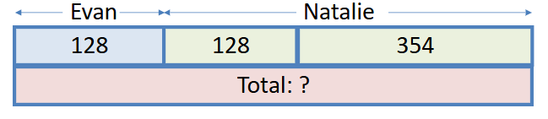
GRADE 3 NUMBER SENSE + COMPUTATIONAL FLUENCY
OPEN QUESTIONS
ELEMENTARY MATH PROJECT
99. Ohenewa is working on a math problem:
“Evan has 128 scratch-n-sniff stickers. Natalie has 354 more stickers than Evan. How many stickers do they have in total?”
She drew the bar model below to help figure it out. Can you explain how this model helps Ohenewa to solve the problem? What equations can you connect to the image? How do they help you find the solution?

Slide 59
GRADE 3 NUMBER SENSE + COMPUTATIONAL FLUENCY
OPEN QUESTIONS
ELEMENTARY MATH PROJECT
100. Create three subtraction facts that equal 6. Would you use the same strategy to help recall each one? Explain why or why not.
a)
b)
c)
101. Make a 3-digit number using the digits 1 to 9 with no digits repeated. Reverse the numbers. Then subtract them. For example, if you picked 123, reversing would be 321, and subtracting gives you 321 − 123 = 198. Do this with at least five different numbers. Do you see a pattern with your answers? How will you share your findings?

Slide 60
GRADE 3 NUMBER SENSE + COMPUTATIONAL FLUENCY
OPEN QUESTIONS
ELEMENTARY MATH PROJECT
102. Pick one: Tell me what you know about 3 × 6 or 18 ÷ 3
Use words, pictures, numbers, symbols, and materials to represent your thinking. How are the two options related?
103. Describe a situation where you might estimate rather than calculating an exact answer.
104. Choose one:
Describe two different meanings of subtraction.
Describe two different meanings of division.
For each meaning, create a story problem related to your life or the community in which you live. How will you share your story problems?

Slide 61
GRADE 3 NUMBER SENSE + COMPUTATIONAL FLUENCY
OPEN QUESTIONS
ELEMENTARY MATH PROJECT
105. Explain how multiplication helps you to divide. Use a specific example to help convey your ideas clearly.
106. Use a hundreds chart. Pick three numbers that you could skip count by. Explain how the patterns in the hundreds chart help you to skip count more easily. How does skip counting connect to multiplication?
107. Use natural materials (rocks, shells, pinecones) to build an array. How does your array show the concept of multiplication?

Slide 62
GRADE 3 NUMBER SENSE + COMPUTATIONAL FLUENCY
OPEN QUESTIONS
ELEMENTARY MATH PROJECT
108. Create a “Which one doesn’t belong?” using equations. Can you think of a reason why each one does not belong?

Slide 63
GRADE 3 NUMBER SENSE + COMPUTATIONAL FLUENCY
OPEN QUESTIONS
ELEMENTARY MATH PROJECT
109. I walked through a garden and saw a row of radishes growing. There were 82 radishes. A rabbit came along and ate some radishes. Then there were 48 radishes still in the garden. What math question could you ask? Show what strategy you would use to figure out the answer to your question.
110. I opened a package of seeds and planted 3 rows of seeds in the garden. Each row had 24 seeds. I planted some more in a pot. I used up all 92 seeds in the package of seeds. How many seeds did I plant in the pot? What strategies will you use to answer the problem? Share your thinking

Slide 64
GRADE 3 NUMBER SENSE + COMPUTATIONAL FLUENCY
OPEN QUESTIONS
ELEMENTARY MATH PROJECT
111. There were 231 ladybugs on a plant and some flew away. There were still 78 ladybugs on the plant. How many flew away? You could draw or use materials to help you think about this. Share how you solved this problem. Create your own math problem about ladybugs.
112. I collected some shells at the beach. I put 18 white shells in my pail and then put some purple shells in my pail. I added 43 more white shells. I lined up all my shells up on a log and counted 84 shells. How many purple shells did I collect? Think of two different ways to solve this problem and share your thinking and your solution/answer.

Slide 65
GRADE 3 NUMBER SENSE + COMPUTATIONAL FLUENCY
OPEN QUESTIONS
ELEMENTARY MATH PROJECT
113. Here are some interesting bee facts: It takes 21-24 days for a bee to grow from egg to adult. As many as 50 000 honeybees can live in one hive. The largest known bee is the Wallace’s giant bee with a length of up to 4cm and a wingspan of 6cm. The queen bee lays 1500-2000 eggs a day. A honeybee can fly about 24 kilometres in an hour. A honeybee has 5 eyes. What math problems could you pose and solve with this information?
114. 915 bees flew out of the hive to find nectar and pollen. Some bees stopped at the first garden and 650 flew to find another one. How many bees stopped at the first garden? You could use a number line or base ten blocks or another way to help you think about this. Share how you solved this problem. Create and solve your own math story about bees.

Slide 66
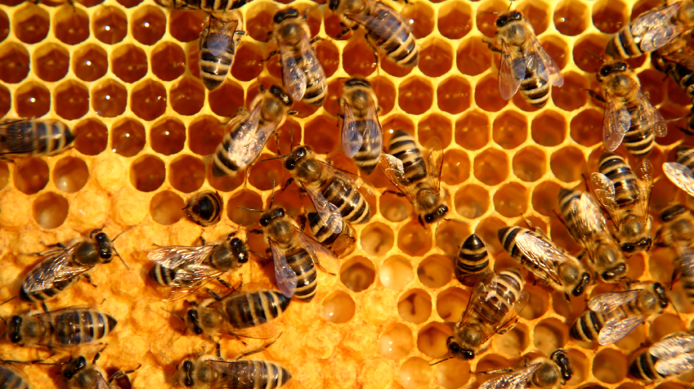
GRADE 3 NUMBER SENSE + COMPUTATIONAL FLUENCY
OPEN QUESTIONS
ELEMENTARY MATH PROJECT
115. Below is a picture that goes with a story problem. What story problem might this picture inspire? Brainstorm different possibilities. Choose your favourite. Share with a friend.

