Slide 1


GRADE 3 PATTERN
CLOSED QUESTIONS
ELEMENTARY MATH PROJECT
1. Consider the following pattern: 7, 17, 27, 37, …
Write the next three numbers in the pattern and state the pattern rule.
2. In an increasing pattern, the first term is 1 and the fourth term is 7. What is the fifth term?
3. Denzel made a complex repeating pattern. The pattern goes like this…​
ABB pattern for colour​
AB pattern for size​
ABA pattern for shape​
Here is the beginning of the pattern. Draw the next three ​

Slide 2
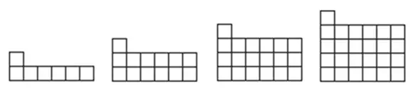
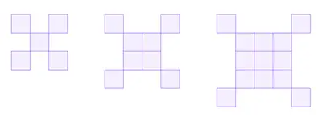

GRADE 3 PATTERN
CLOSED QUESTIONS
ELEMENTARY MATH PROJECT
4. Fill in the blanks for each pattern.
1, 3, 5, 7, ____
____, 22, 26, 30, 34
2, 4, ____, 16, 32
100, 80, 60, 40, ____
1000, 500, ____, 125
1, 2, 4, 7, 11, ____
5. Use grid paper. Draw the next image in the pattern.
a.
b.
c.

Slide 3
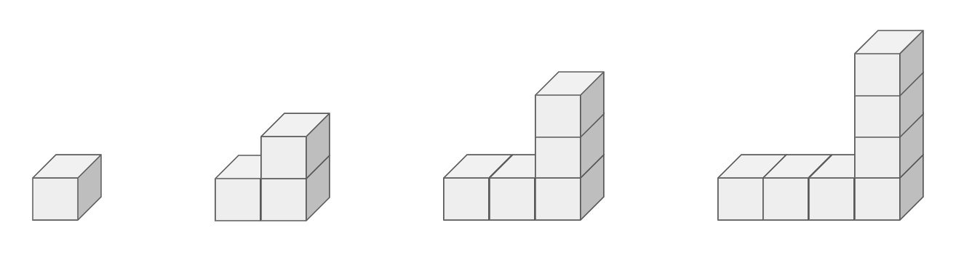
GRADE 3 PATTERN
OPEN QUESTIONS
ELEMENTARY MATH PROJECT
6. Consider the following pattern:
How do you see the pattern changing?​
Draw the next image. How many cubes are in it?
What is the pattern rule for the number of cubes?​
How many cubes are in the 10th image. Show your strategy.
Challenge: How many cubes in the 100th image?

Slide 4
GRADE 3 PATTERN
OPEN QUESTIONS
ELEMENTARY MATH PROJECT
7. The first two terms in a pattern are: 1, 4, …
How might the pattern continue? What is the pattern rule?
How many different patterns can you describe that begin this way (1, 4, …)?
8. Create your own increasing or decreasing pattern using numbers or shapes. Explain how someone could figure out the rule for your pattern.

Slide 5
GRADE 3 PATTERN
OPEN QUESTIONS
ELEMENTARY MATH PROJECT
9. Create an increasing pattern that becomes a decreasing pattern partway through. Explain why someone looking at it might think it’s tricky.
10. Make up a short story that includes a pattern (e.g., steps climbed, animals joining a parade, shells on the beach). Describe the pattern rule in your story.

Slide 6
GRADE 3 ALGEBRA
CLOSED QUESTIONS
ELEMENTARY MATH PROJECT
1. Write the three other equations in the same “fact family” as ☐ + 7 = 20.
2. Solve for the unknown variable.
x + 15 = 24
83 + n = 121
u – 337 = 400
100 – m = 23

Slide 7
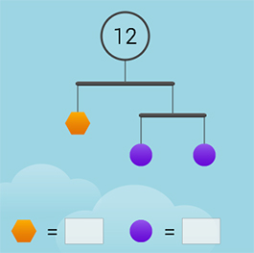
GRADE 3 ALGEBRA
CLOSED QUESTIONS
ELEMENTARY MATH PROJECT
3. Find the value of each shape in the image below:
4. Sam has a large bag of candies. She ate many over several weeks. Now she has 118 candies left. If the bag had 250 candies to start, how many did she eat?

Slide 8
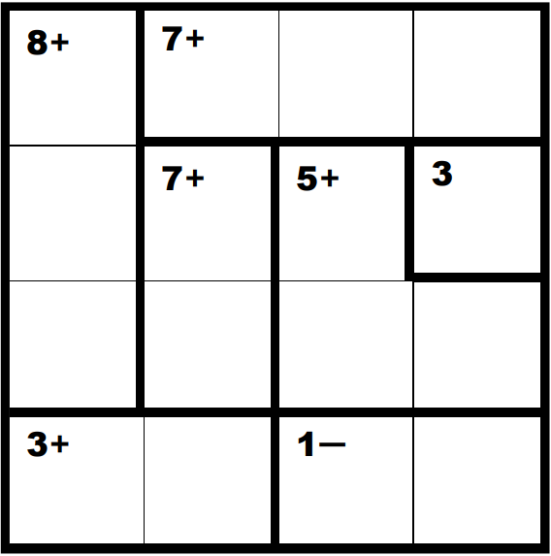
GRADE 3 ALGEBRA
CLOSED QUESTIONS
ELEMENTARY MATH PROJECT
5. Solve the following KenKen Puzzle:

Slide 9
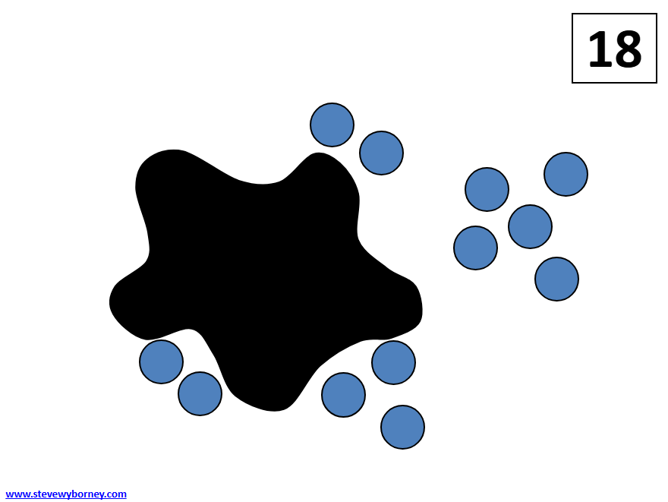
GRADE 3 ALGEBRA
OPEN QUESTIONS
ELEMENTARY MATH PROJECT
6. Write an equation to represent the Splat! image shown below.
Describe or show how solving the Splat! is connected to solving your equation.
7. Create a story problem that matches the equation: ☐ – 4 = 9
Your story should help someone understand what the unknown number is.

Slide 10
GRADE 3 ALGEBRA
OPEN QUESTIONS
ELEMENTARY MATH PROJECT
8. Create a “Which One Doesn’t Belong?” using four equations. Write four equations where one is different from the rest--it doesn’t belong! Then explain why it does not belong. Challenge: Give a reason why EACH equation does not belong.

Slide 11
GRADE 3 ALGEBRA
OPEN QUESTIONS
ELEMENTARY MATH PROJECT
9. Create an addition equation and a subtraction equation that both have the same unknown number. Explain how you know they match.
10. Create 3 equations to trade with a friend and see if they can solve for the correct answer.
a)
b)
c)

