Slide 1

ELEMENTARY MATH PROJECT
GRADE 3 PRACTICE QUESTIONS
NUMBER SENSE + COMPUTATIONAL FLUENCY

Slide 2
GRADE 3 NUMBER SENSE + COMPUTATIONAL FLUENCY:
CLOSED QUESTIONS
ELEMENTARY MATH PROJECT
1. Consider the set of numbers: 602, 125, 999, 500, 941
Decompose each number by place value
(e.g., 256 = 200 + 50 + 6).
Put the set of numbers in order from least to greatest. How did decomposing each number by place value help you to order them?

Slide 3
GRADE 3 NUMBER SENSE + COMPUTATIONAL FLUENCY:
CLOSED QUESTIONS
ELEMENTARY MATH PROJECT
2. Consider the number 531.
What number is 2 more? What number is 2 less?
What number is 5 more? What number is 5 less?
What number is 10 more? What number is 10 less?
What number is 100 more? What number is 100 less?
Record all nine numbers in order from least to greatest.

Slide 4
GRADE 3 NUMBER SENSE + COMPUTATIONAL FLUENCY:
CLOSED QUESTIONS
ELEMENTARY MATH PROJECT
3. A dime is a tenth of a dollar (100 cents) and a quarter is one-fourth of a dollar.
Use coins (or draw them) to count by tenths to 200 and then by quarters to 200.
Write out how you counted using fraction symbols (e.g., 1/10, 2/10, 3/10, …)

Slide 5
GRADE 3 NUMBER SENSE + COMPUTATIONAL FLUENCY:
CLOSED QUESTIONS
ELEMENTARY MATH PROJECT
4. Print the numbers counting backwards by 3s from 60 to 0. Describe any patterns that make it easier to complete this task.

Slide 6
GRADE 3 NUMBER SENSE + COMPUTATIONAL FLUENCY:
CLOSED QUESTIONS
ELEMENTARY MATH PROJECT
5. Raul counted a sack of marbles by 2s and made groups of 10 as he went. When he counted out 10 groups of 10, he grouped them into a pile of 100. He continued this way until he counted 347 marbles. Draw a picture of how he might have organized his marbles. Is this how you would have counted them? Explain.

Slide 7
GRADE 3 NUMBER SENSE + COMPUTATIONAL FLUENCY:
CLOSED QUESTIONS
ELEMENTARY MATH PROJECT
6. Print the first ten numbers for each of the following:
Counting up by 2s starting at 85.
Counting back by 4s starting at 312.
Counting forwards by 3s starting at 25.
Counting backwards by 5s starting at 178.
Counting forward by 10s starting at 723.

Slide 8
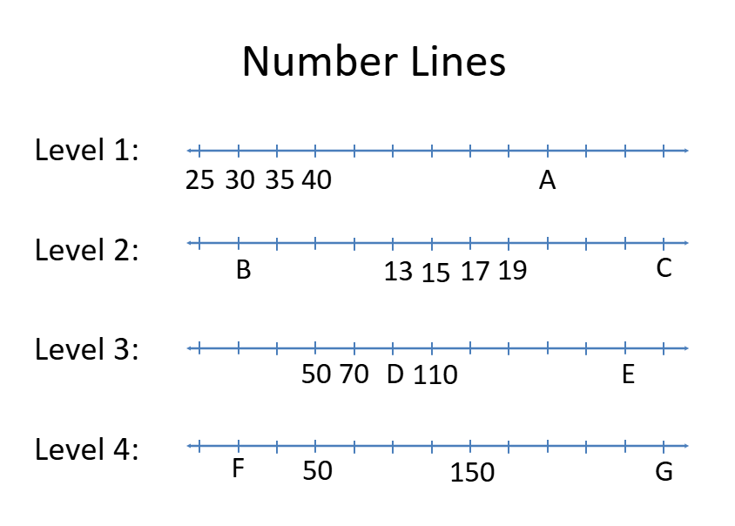
GRADE 3 NUMBER SENSE + COMPUTATIONAL FLUENCY:
CLOSED QUESTIONS
ELEMENTARY MATH PROJECT
7. Determine which numbers would replace the letters A through G

Slide 9
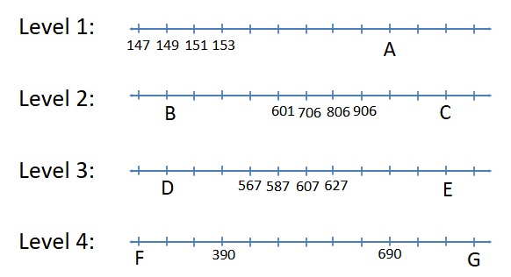
GRADE 3 NUMBER SENSE + COMPUTATIONAL FLUENCY:
CLOSED QUESTIONS
ELEMENTARY MATH PROJECT
8. Determine which numbers would replace the letters A through G.

Slide 10
GRADE 3 NUMBER SENSE + COMPUTATIONAL FLUENCY:
CLOSED QUESTIONS
ELEMENTARY MATH PROJECT
9. Use materials or draw pictures. Represent each fraction below three ways: As part of a region, a set, and on a number line.
a) ½ b) ¾ c) ⅖ d) ⅝

Slide 11
GRADE 3 NUMBER SENSE + COMPUTATIONAL FLUENCY:
CLOSED QUESTIONS
ELEMENTARY MATH PROJECT
10. True or False: A fraction is a number. How do you know?

Slide 12
GRADE 3 NUMBER SENSE + COMPUTATIONAL FLUENCY:
CLOSED QUESTIONS
ELEMENTARY MATH PROJECT
11. If you eat half of a pizza and your friend eats a third of what's left, how much pizza remains uneaten? Show your reasoning by drawing a picture or using fraction materials.

Slide 13
GRADE 3 NUMBER SENSE + COMPUTATIONAL FLUENCY:
CLOSED QUESTIONS
ELEMENTARY MATH PROJECT
11. If you eat half of a pizza and your friend eats a third of what's left, how much pizza remains uneaten? Show your reasoning by drawing a picture or using fraction materials.

Slide 14
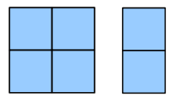
GRADE 3 NUMBER SENSE + COMPUTATIONAL FLUENCY:
CLOSED QUESTIONS
ELEMENTARY MATH PROJECT
12. The image below represents ⅖ of a serving of graham crackers. What does one serving look like? How do you know?

Slide 15
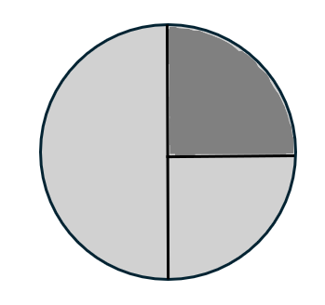
GRADE 3 NUMBER SENSE + COMPUTATIONAL FLUENCY:
CLOSED QUESTIONS
ELEMENTARY MATH PROJECT
13. Brin drew a picture of ⅓ but Danica says it’s not correct. What mistake did Brin make and how can she fix it?

Slide 16
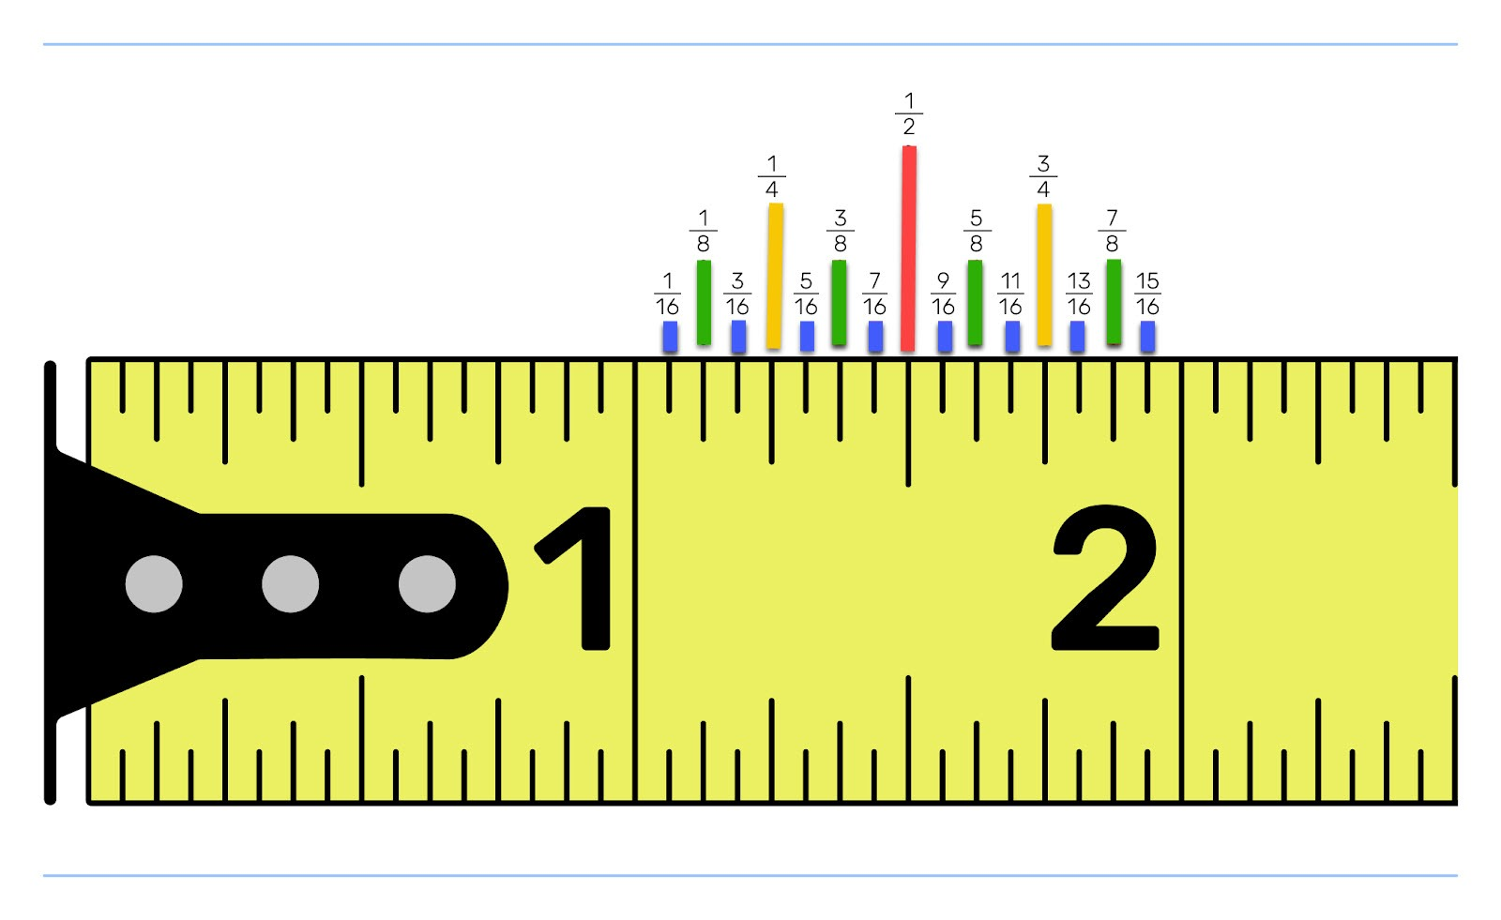
GRADE 3 NUMBER SENSE + COMPUTATIONAL FLUENCY:
CLOSED QUESTIONS
ELEMENTARY MATH PROJECT
14. Look at the image of the measuring tape below. Notice the different sized benchmark lines. These represent multiple number lines laid on top of one another. What fraction are the gaps in each of these number lines going up by? Skip count by fractions for each of these number lines. Label each benchmark with a fraction.

Slide 17
GRADE 3 NUMBER SENSE + COMPUTATIONAL FLUENCY:
CLOSED QUESTIONS
ELEMENTARY MATH PROJECT
15. Look at a metric ruler.
Use fractions to describe how 1 mm is related to 1 cm.

Slide 18
GRADE 3 NUMBER SENSE + COMPUTATIONAL FLUENCY:
CLOSED QUESTIONS
ELEMENTARY MATH PROJECT
16. You are skip counting forward by 25s starting at 125.
a) What are the next three numbers?
b) If you keep going, will you land on 300 exactly?
c) Explain why or why not.

Slide 19
GRADE 3 NUMBER SENSE + COMPUTATIONAL FLUENCY:
CLOSED QUESTIONS
ELEMENTARY MATH PROJECT
17. A number is covered on a hundreds chart. You can see:
The number above it is 362.
The number to the right of it is ???
The number below it is 382.
What is the missing number? What is the number to the right of it? Is the hidden number even or odd?

Slide 20
GRADE 3 NUMBER SENSE + COMPUTATIONAL FLUENCY:
CLOSED QUESTIONS
ELEMENTARY MATH PROJECT
18. You have the number 748.
a) Write 748 in expanded form.
b) How many tens would you have if you traded all the hundreds for tens?
c) What is 748 – 300?

Slide 21
GRADE 3 NUMBER SENSE + COMPUTATIONAL FLUENCY:
CLOSED QUESTIONS
ELEMENTARY MATH PROJECT
19. Put the numbers in order from least to greatest:
307, 370, 703, 730
a) Write the correct order.
b) Reverse each number.
c) Which original number changes the most in value when reversed?

Slide 22
GRADE 3 NUMBER SENSE + COMPUTATIONAL FLUENCY:
CLOSED QUESTIONS
ELEMENTARY MATH PROJECT
20. Use counters or draw pictures. You have 12 berries.
a) What is 1/2 of the berries?
b) What is 1/3 of the berries?
c) If you ate 1/4 of the berries, how many berries would be left?

Slide 23
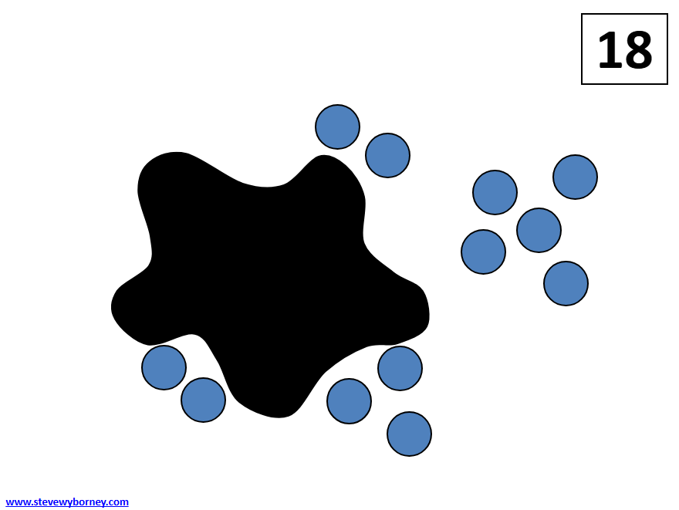
GRADE 3 NUMBER SENSE + COMPUTATIONAL FLUENCY:
CLOSED QUESTIONS
ELEMENTARY MATH PROJECT
21. Here is a Splat! problem to solve. If there are 18 blue dots altogether, how many are hiding under the splat? Show or explain your thinking. Can you write the several related equations that connect to this image? Hint: think “fact family”

Slide 24
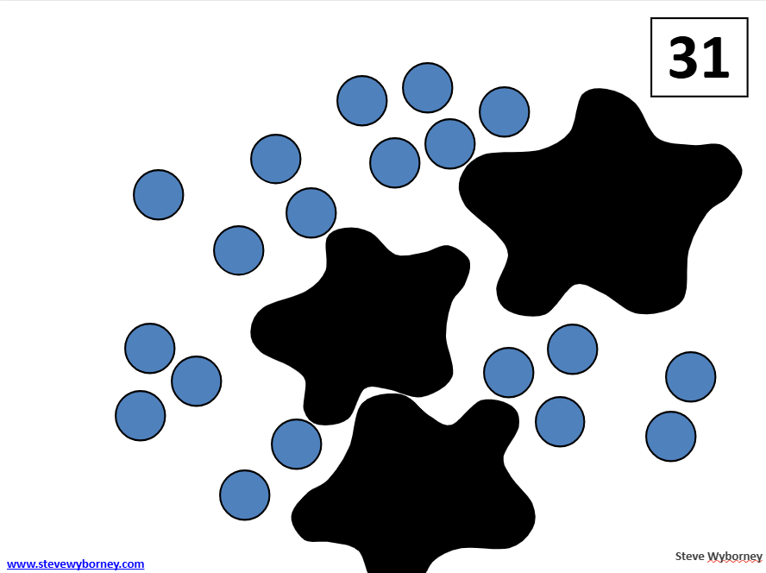
GRADE 3 NUMBER SENSE + COMPUTATIONAL FLUENCY:
CLOSED QUESTIONS
ELEMENTARY MATH PROJECT
22. Here is a Splat! problem to solve. Multiple splats have the same number of blue dots hiding under them. If there are 31 blue dots altogether, how many are hiding under each splat? Show or explain your thinking. Can you write several different equations that connect to this image?

Slide 25
GRADE 3 NUMBER SENSE + COMPUTATIONAL FLUENCY:
CLOSED QUESTIONS
ELEMENTARY MATH PROJECT
23. Solve using a make-10 strategy:
a) 8 + 6 | b) 9 + 7
c) 5 + 8 | d) 6 +9

Slide 26
GRADE 3 NUMBER SENSE + COMPUTATIONAL FLUENCY:
CLOSED QUESTIONS
ELEMENTARY MATH PROJECT
24. Solve using near doubles:
a) 6 + 7 | b) 8 + 9
c) 5 + 6 | d) 9 + 10

Slide 27
GRADE 3 NUMBER SENSE + COMPUTATIONAL FLUENCY:
CLOSED QUESTIONS
ELEMENTARY MATH PROJECT
25. Solve using think addition:
a) 15 – 7 | b) 14 - 9
c) 13 – 6 | d) 17 -8

Slide 28
GRADE 3 NUMBER SENSE + COMPUTATIONAL FLUENCY:
CLOSED QUESTIONS
ELEMENTARY MATH PROJECT
26. Order the sums from least to greatest:
11 + 4, 9 + 8, 7 + 6, 5 + 2

Slide 29
GRADE 3 NUMBER SENSE + COMPUTATIONAL FLUENCY:
CLOSED QUESTIONS
ELEMENTARY MATH PROJECT
27. Add using friendly numbers:
a) 198 + 7 | b) 299 + 16
c) 495 + 146 | d) 398 + 297

Slide 30
GRADE 3 NUMBER SENSE + COMPUTATIONAL FLUENCY:
CLOSED QUESTIONS
ELEMENTARY MATH PROJECT
28. Subtract using compensation:
a) 58 – 29 | b) 356 - 97
c) 402 - 198 | d) 503 - 299

Slide 31
GRADE 3 NUMBER SENSE + COMPUTATIONAL FLUENCY:
CLOSED QUESTIONS
ELEMENTARY MATH PROJECT
29. Use place value strategy to add:
a) 58 + 21 | b) 157 + 32
c) 345 + 221 | d) 507 + 132

Slide 32
GRADE 3 NUMBER SENSE + COMPUTATIONAL FLUENCY:
CLOSED QUESTIONS
ELEMENTARY MATH PROJECT
30. Solve:
a) 465 + 390 | b) 372 + 539
c) 620 – 430 | d) 703 - 256

Slide 33
GRADE 3 NUMBER SENSE + COMPUTATIONAL FLUENCY:
CLOSED QUESTIONS
ELEMENTARY MATH PROJECT
31. Fill in the blank. Show your thinking. How can you check your answer is correct?
327 + ___ = 400
___ − 250 = 175
600 = 480 + ___

Slide 34
GRADE 3 NUMBER SENSE + COMPUTATIONAL FLUENCY:
CLOSED QUESTIONS
ELEMENTARY MATH PROJECT
32. Draw an array model for each. Write the multiplication sentence that matches.
a) 2 rows of 5 b) 4 rows of 3

Slide 35
GRADE 3 NUMBER SENSE + COMPUTATIONAL FLUENCY:
CLOSED QUESTIONS
ELEMENTARY MATH PROJECT
33. Complete the repeated addition sentence:
a) 4 × 3 = ___ + ____ + ____ + ____
b) 5 × 2 = ___ + ____ + ____ + ____ + ____

Slide 36
GRADE 3 NUMBER SENSE + COMPUTATIONAL FLUENCY:
CLOSED QUESTIONS
ELEMENTARY MATH PROJECT
34. Show an equal groups model for each.
a) 2 × 6 b) 5 × 3

Slide 37
GRADE 3 NUMBER SENSE + COMPUTATIONAL FLUENCY:
CLOSED QUESTIONS
ELEMENTARY MATH PROJECT
35. Count by 3s starting at 3. Write the first five numbers. How does this connect to multiplication?

Slide 38
GRADE 3 NUMBER SENSE + COMPUTATIONAL FLUENCY:
CLOSED QUESTIONS
ELEMENTARY MATH PROJECT
36. Use a model to show that 3 × 4 and 4 × 3 give the same answer. Explain how the model shows this.

Slide 39
GRADE 3 NUMBER SENSE + COMPUTATIONAL FLUENCY:
CLOSED QUESTIONS
ELEMENTARY MATH PROJECT
37. Share 24 counters equally among 4 people. How many does each person get?
Next, make groups of 4 using the 24 counters. How many groups can you make?
How are these two tasks similar? How are they different?

Slide 40
GRADE 3 NUMBER SENSE + COMPUTATIONAL FLUENCY:
CLOSED QUESTIONS
ELEMENTARY MATH PROJECT
38. Write the related facts (i.e., “fact family”) for 4 × 6 = 24

Slide 41
GRADE 3 NUMBER SENSE + COMPUTATIONAL FLUENCY:
CLOSED QUESTIONS
ELEMENTARY MATH PROJECT
39. Fill in the missing number and share how you figured it out:
a) 30 ÷ ___ = 5
b) ___ ÷ 4 = 3

Slide 42
GRADE 3 NUMBER SENSE + COMPUTATIONAL FLUENCY:
CLOSED QUESTIONS
ELEMENTARY MATH PROJECT
18 cookies shared among 3 friends | 3 + 18
I have $3. You have $18. What is the total? | 18 − 3
I have 18 cookies. I give you 3 of them. | 3 × 18
3 groups of 18 items | 18 ÷ 3
3 rows of 18 items
I have $18. You have $3. How many more dollars do you have?
I’ve got 18 cookies. I give each friend 3 cookies. How many friends get cookies?
40. Match the description on the left with the correct number sentence on the right. The number sentences can be used more than once.

Slide 43
GRADE 3 NUMBER SENSE + COMPUTATIONAL FLUENCY:
CLOSED QUESTIONS
ELEMENTARY MATH PROJECT
41. Which one doesn’t belong and why?
5 x 4 | 20 ÷ 4
20 ÷ 5 | 15 + 5

Slide 44
GRADE 3 NUMBER SENSE + COMPUTATIONAL FLUENCY:
CLOSED QUESTIONS
ELEMENTARY MATH PROJECT
42. Which two equations are related? How do you know?
3 × 7 = 21 | 7 − 3 = 4
21 − 7 = 14 | 21 ÷ 3 = 7

Slide 45
GRADE 3 NUMBER SENSE + COMPUTATIONAL FLUENCY:
CLOSED QUESTIONS
ELEMENTARY MATH PROJECT
43. Harnoor says 4, 6, and 10 are in the same fact family.
Manu says it’s 4, 6, and 24.
Who is correct? Could they both be right? Explain.

Slide 46
GRADE 3 NUMBER SENSE + COMPUTATIONAL FLUENCY:
CLOSED QUESTIONS
ELEMENTARY MATH PROJECT
44. Which statement is true and why?
4 × 5 means 5 + 5 + 5 + 5
4 × 5 means 4 + 4 + 4 + 4 + 4

Slide 47
GRADE 3 NUMBER SENSE + COMPUTATIONAL FLUENCY:
CLOSED QUESTIONS
ELEMENTARY MATH PROJECT
45. Show how you can find the answer with skip counting.
a) 5 x 7 | b) 9 x 2
c) 6 x 3 | d) 8 x 4

Slide 48
GRADE 3 NUMBER SENSE + COMPUTATIONAL FLUENCY:
CLOSED QUESTIONS
ELEMENTARY MATH PROJECT
46. Solve. Show your strategy.
a) 240 + 360 | b) 560 – 240
c) 7 × 4 | d) 32 ÷ 4

Slide 49
GRADE 3 NUMBER SENSE + COMPUTATIONAL FLUENCY:
CLOSED QUESTIONS
ELEMENTARY MATH PROJECT
47. True or false. If false, explain why and make it true.
a) 9 + 8 = 20 − 3
b) 6 × 4 = 24 ÷ 1
c) 2 + 2 + 2 = 6 + 4 = 10

Slide 50
GRADE 3 NUMBER SENSE + COMPUTATIONAL FLUENCY:
CLOSED QUESTIONS
ELEMENTARY MATH PROJECT
48. Estimate to find the larger amount. Show or explain your reasoning.
a) 297 + 408 or 812 − 289
b) 2 × 12 or 100 ÷ 2

Slide 51
GRADE 3 NUMBER SENSE + COMPUTATIONAL FLUENCY:
CLOSED QUESTIONS
ELEMENTARY MATH PROJECT
49. Which expression gives a result closest to 200?
a) 215 − 18 | b) 182 + 49
c) 310 − 140 | d) 190 + 23

Slide 52
GRADE 3 NUMBER SENSE + COMPUTATIONAL FLUENCY:
CLOSED QUESTIONS
ELEMENTARY MATH PROJECT
50. Show 5 × 6 three ways:
Repeated addition
Equal groups
Array model

Slide 53
GRADE 3 NUMBER SENSE + COMPUTATIONAL FLUENCY:
CLOSED QUESTIONS
ELEMENTARY MATH PROJECT
51. Show 24 ÷ 6 three ways:
Fair share
Equal groups
Repeated subtraction

Slide 54
GRADE 3 NUMBER SENSE + COMPUTATIONAL FLUENCY:
OPEN QUESTIONS
ELEMENTARY MATH PROJECT
52. Choose two numbers: 48, 72, 139, 471, 684
What different ways can you represent them? Consider using drawings, base ten blocks, symbols, ten frames, tally marks, etc.

Slide 55
GRADE 3 NUMBER SENSE + COMPUTATIONAL FLUENCY:
OPEN QUESTIONS
ELEMENTARY MATH PROJECT
53. Choose a number: 25, 99, 250, 860
What different ways can you decompose it? Decompose means break into parts (e.g., 30 can be decomposed into 15 + 15 or 20 + 5 + 5 and many other ways).
How will you show your thinking?

Slide 56
GRADE 3 NUMBER SENSE + COMPUTATIONAL FLUENCY:
OPEN QUESTIONS
ELEMENTARY MATH PROJECT
54. Choose a number: 65, 100, 256
Find that quantity of items (rocks, pieces of Lego, cutlery, seeds, leaves, books, blocks, toys) around your home or outside.
What three different ways can you count the items?
Can you think of more ways? How can you show or record how you counted them?

Slide 57
GRADE 3 NUMBER SENSE + COMPUTATIONAL FLUENCY:
OPEN QUESTIONS
ELEMENTARY MATH PROJECT
55. Here is a list of benchmark numbers in order:
0, 250, 500, 750, 1000
Draw a number line with these numbers on it and then add these numbers to it:
125, 450, 900, 10, 700, 589
How will you share your reasoning for where you placed each of the numbers?

Slide 58

GRADE 3 NUMBER SENSE + COMPUTATIONAL FLUENCY:
OPEN QUESTIONS
ELEMENTARY MATH PROJECT
56. Where would you put 667 on the number line below? Justify your decision

Slide 59
GRADE 3 NUMBER SENSE + COMPUTATIONAL FLUENCY:
OPEN QUESTIONS
ELEMENTARY MATH PROJECT
57. Choose a number: 75, 120, 500, 750
What are three different ways to count to that number? For example, by 5s, 7s, 20s or 50s. Record how you counted – try to challenge yourself to count in a way that you haven’t counted before.

Slide 60
GRADE 3 NUMBER SENSE + COMPUTATIONAL FLUENCY:
OPEN QUESTIONS
ELEMENTARY MATH PROJECT
58. Choose one of the following numbers and represent it in at least five different ways: 75, 98, 125, 475, 825
Consider using pictures, tallies, ten frames/100 grids, blocks, drawings of coins, number lines, or using words, including other languages.

Slide 61
GRADE 3 NUMBER SENSE + COMPUTATIONAL FLUENCY:
OPEN QUESTIONS
ELEMENTARY MATH PROJECT
59. What does the bottom number in a fraction (denominator) tell us?
What does the top number in a fraction (numerator) tell us?
Use pictures, numbers, and words to explain.

Slide 62
GRADE 3 NUMBER SENSE + COMPUTATIONAL FLUENCY:
OPEN QUESTIONS
ELEMENTARY MATH PROJECT
60. A fraction is a number that represents a part of a whole.
One-half is written as the symbol 1⁄2 . The 2 is called the denominator and shows how many equal parts the whole has. The 1 is the numerator and represents how many parts of the whole we are talking about. What different ways can you represent 1⁄2 using materials, pictures and diagrams?
Choose another fraction or two: 1⁄4 or 3⁄4 or 2/10 or ⅔ or one of your own. What ways can you represent these fractions?

Slide 63
GRADE 3 NUMBER SENSE + COMPUTATIONAL FLUENCY:
OPEN QUESTIONS
ELEMENTARY MATH PROJECT
61. Name a fraction that is less than ½ but close to ½. How close can you get? Share your strategy.

Slide 64
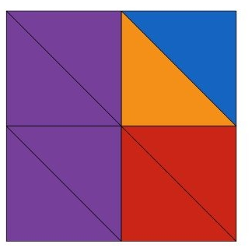
GRADE 3 NUMBER SENSE + COMPUTATIONAL FLUENCY:
OPEN QUESTIONS
ELEMENTARY MATH PROJECT
62. Describe the fractions that you see in the image.
How will you share your thinking with others?

Slide 65
GRADE 3 NUMBER SENSE + COMPUTATIONAL FLUENCY:
OPEN QUESTIONS
ELEMENTARY MATH PROJECT
63. Look for examples of fractions in your home, neighbourhood, or classroom. Do you have some measuring tools that include fractions? Can you “see” fractions in your food – a carton of eggs, a pizza, a cake? Where can you “see” fractions in buildings or trees? What different ideas can you think of? How will you record the different fractions you find?

Slide 66
GRADE 3 NUMBER SENSE + COMPUTATIONAL FLUENCY:
OPEN QUESTIONS
ELEMENTARY MATH PROJECT
64. Here is a math story:
I baked a loaf of bread. A loaf of bread can be sliced into 12 slices of bread. My son likes ham and cheese sandwiches made with two pieces of bread. He eats one and a half sandwiches a day. What math question could you ask? Show what strategy you would use to figure out the answer to your question.

Slide 67
GRADE 3 NUMBER SENSE + COMPUTATIONAL FLUENCY:
OPEN QUESTIONS
ELEMENTARY MATH PROJECT
65. Jono ate ½ a small pizza. Milton ate ¼ of a large pizza. Who ate more pizza? Could the answer be either of them? Justify your reasoning using pictures, numbers, and words.

Slide 68
GRADE 3 NUMBER SENSE + COMPUTATIONAL FLUENCY:
OPEN QUESTIONS
ELEMENTARY MATH PROJECT
66. How you would share four submarine sandwiches equally between you and two of your friends. How much would each person get? Show your thinking.

Slide 69
GRADE 3 NUMBER SENSE + COMPUTATIONAL FLUENCY:
OPEN QUESTIONS
ELEMENTARY MATH PROJECT
67. Pick a number larger than 100 but smaller than 1000. Is your number even or odd? How would you explain this to someone new to the concept of even and odd numbers?

Slide 70
GRADE 3 NUMBER SENSE + COMPUTATIONAL FLUENCY:
OPEN QUESTIONS
ELEMENTARY MATH PROJECT
68. Investigate. The numbers 6 and 4 are even. If you add them, you get 10, which is also even.
Will two even numbers always add up to an even number? Justify your answer.
How about adding two odd numbers? Adding an even number and an odd number?

Slide 71
GRADE 3 NUMBER SENSE + COMPUTATIONAL FLUENCY:
OPEN QUESTIONS
ELEMENTARY MATH PROJECT
69. Count to 100 or 500 in at least three different ways. Record how you counted by printing the numbers or showing the counting on a number chart. What patterns did you notice that made counting easier?

Slide 72
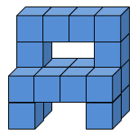
GRADE 3 NUMBER SENSE + COMPUTATIONAL FLUENCY:
OPEN QUESTIONS
ELEMENTARY MATH PROJECT
70. How many unit cubes make up the structure in the image here? How do you know? Describe several different ways you can think about this structure. Use number sentences (equations) to represent your thinking.

Slide 73
GRADE 3 NUMBER SENSE + COMPUTATIONAL FLUENCY:
OPEN QUESTIONS
ELEMENTARY MATH PROJECT
71. Think of a 3-digit number using the digits 1 to 9.
Explain or show how you would round it to the nearest hundred.
Explain or show how you would round it to the nearest ten.

Slide 74
GRADE 3 NUMBER SENSE + COMPUTATIONAL FLUENCY:
OPEN QUESTIONS
ELEMENTARY MATH PROJECT
72. Margo says 550 rounded to the nearest hundred is 600. Obenewa says 500 is acceptable, too. Margo disagrees. Who do you agree with? Justify your answer.

Slide 75
GRADE 3 NUMBER SENSE + COMPUTATIONAL FLUENCY:
OPEN QUESTIONS
ELEMENTARY MATH PROJECT
73. Give an example of when you would want to round a number to the nearest ten or hundred in a real-life context. Why would you do this rather than use the number as is?

Slide 76
GRADE 3 NUMBER SENSE + COMPUTATIONAL FLUENCY:
OPEN QUESTIONS
ELEMENTARY MATH PROJECT
74. Describe a situation where you would estimate a quantity (a number greater than 100 but less than 1000) rather than know or find the exact amount. Explain why.

Slide 77
GRADE 3 NUMBER SENSE + COMPUTATIONAL FLUENCY:
OPEN QUESTIONS
ELEMENTARY MATH PROJECT
75. Consider the number 357. We read this number as “three hundred fifty seven”. How does the way we say the number relate to the place value of each digit? Find at least two other examples of 3-digit numbers where this is true. Are there any exceptions?

Slide 78
GRADE 3 NUMBER SENSE + COMPUTATIONAL FLUENCY:
OPEN QUESTIONS
ELEMENTARY MATH PROJECT
76. You’re walking from your house to a friend’s house.
You get to choose how you skip count to get there (by 2s, 5s, 10s… or mix them!).
Draw or describe your walking path using skip counting.
Explain why you chose your pattern and how you know you reached the same final number.

Slide 79
GRADE 3 NUMBER SENSE + COMPUTATIONAL FLUENCY:
OPEN QUESTIONS
ELEMENTARY MATH PROJECT
77. Part A: Look around your classroom or home. Choose one container. Estimate how many of a particular object it could hold. Determine a lower and upper bound for your estimate. That is, what is the largest the number could possibly be? What is the smallest?
Part B: Test your estimate using any strategy you like and explain your strategy. How close was your estimate? What would you do differently next time?
Part C: If you chose a different object to fill the container, how would that change your estimate? Explain your reasoning.

Slide 80
GRADE 3 NUMBER SENSE + COMPUTATIONAL FLUENCY:
OPEN QUESTIONS
ELEMENTARY MATH PROJECT
78. Pretend your number is a recipe, and you can “break it apart” into ingredients. Choose any number between 50 and 200. Decompose it in two or more different ways (e.g., 143 = 100 + 40 + 3 or 143 = 70 + 70 + 3). Explain using pictures, numbers, and words why both “recipes” still make the same number.

Slide 81
GRADE 3 NUMBER SENSE + COMPUTATIONAL FLUENCY:
OPEN QUESTIONS
ELEMENTARY MATH PROJECT
79. Think of a place outdoors or on the land — trees on a trail, rocks on a beach, cattails by a pond. Create a skip-counting pattern based on something you notice in nature (e.g., “There were driftwood pieces in groups of 4”). Record your pattern and explain how it connects to the place you chose.

Slide 82
GRADE 3 NUMBER SENSE + COMPUTATIONAL FLUENCY:
OPEN QUESTIONS
ELEMENTARY MATH PROJECT
80. You’re sharing a pizza with friends. You get to choose how many friends and how it is cut. Show two different ways the pizza could be shared fairly and explain which one you think is the easiest. Use pictures, materials, or words to show your thinking. How does this activity connect to the concept of fractions?

Slide 83
GRADE 3 NUMBER SENSE + COMPUTATIONAL FLUENCY:
OPEN QUESTIONS
ELEMENTARY MATH PROJECT
81. Choose a question: 29+6, 48+26, 459+36, 548+236
How does making 10 help you think about ways to add these two numbers? Show your thinking using a model (e.g., ten frame, number line, or number bonds).

Slide 84
GRADE 3 NUMBER SENSE + COMPUTATIONAL FLUENCY:
OPEN QUESTIONS
ELEMENTARY MATH PROJECT
82. Choose three questions:
22 – 16, 51 – 25, 74 – 28, 135 – 67, 385 – 149, 615 – 265
How will you show your thinking? Use pictures, numbers, symbols and/or words.

Slide 85
GRADE 3 NUMBER SENSE + COMPUTATIONAL FLUENCY:
OPEN QUESTIONS
ELEMENTARY MATH PROJECT
83. Choose an answer: 12, 55, 99, 260, 485
Can you think of three different subtraction (take away or difference) questions that have this answer. What materials like blocks, or tools like ten-frames, could help you with this task? Record your questions with pictures, numbers or words.

Slide 86
GRADE 3 NUMBER SENSE + COMPUTATIONAL FLUENCY:
OPEN QUESTIONS
ELEMENTARY MATH PROJECT
84. Choose a question: 21-15, 42-18, 120 – 85, 350-129
What math story can you tell, draw or create to show that you understand the question. How will you share your story?

Slide 87
GRADE 3 NUMBER SENSE + COMPUTATIONAL FLUENCY:
OPEN QUESTIONS
ELEMENTARY MATH PROJECT
85. Choose two questions:
38+7, 49+8, 58+27, 779+18, 688+227
What different strategies can you use to add the numbers together?
How can you show or record how you figured out the answers?

Slide 88
GRADE 3 NUMBER SENSE + COMPUTATIONAL FLUENCY:
OPEN QUESTIONS
ELEMENTARY MATH PROJECT
86. Choose a question: 12+12, 36+15, 50+50, 250+275
What math story can you tell, draw or create with materials to show you understand the question and can connect it to something in your life or imagination. How will you share your story?

Slide 89
GRADE 3 NUMBER SENSE + COMPUTATIONAL FLUENCY:
OPEN QUESTIONS
ELEMENTARY MATH PROJECT
87. Choose three of these equations to solve:
9+___=17, 45+___=70, 89+___=100, 265+___=450, 200 - ___=98, 425 - ___=175
Choose equations that are going to make you think. Use items to move around, tallies, drawings or mental math strategies. How will you record and share your thinking?

Slide 90
GRADE 3 NUMBER SENSE + COMPUTATIONAL FLUENCY:
OPEN QUESTIONS
ELEMENTARY MATH PROJECT
88. Choose three of these math equations to solve:
9 +___=17, 27+ 8=___, 10 +___=25, 10 + ___ =115, ___ + 80=400, 250 + ____= 775
Use blocks or counters to move around, tallies, drawings or mental math strategies. How will you record and share your thinking?

Slide 91
GRADE 3 NUMBER SENSE + COMPUTATIONAL FLUENCY:
OPEN QUESTIONS
ELEMENTARY MATH PROJECT
89. Create a math story in which the quantity (number of something) in the story increases or changes. What is the math sentence or equation that represents what happens in your math story? Act your story out with materials and take a picture or video yourself to share it or draw a picture.

Slide 92
GRADE 3 NUMBER SENSE + COMPUTATIONAL FLUENCY:
OPEN QUESTIONS
ELEMENTARY MATH PROJECT
90. Solve at least three questions:
2X5, 5X3, 4X2, 3X6, 6X1, 2X7, 5X4, 3X10
Draw a picture to represent each equation. Print the multiplication equation and the addition equation that is represented in your drawing. For example, 3X5 could also be written as 5+5+5.

Slide 93
GRADE 3 NUMBER SENSE + COMPUTATIONAL FLUENCY:
OPEN QUESTIONS
ELEMENTARY MATH PROJECT
91. Division can be thought about as either sharing or grouping. Solve the following division questions using drawings that show sharing or grouping:
8 ÷ 4
12 ÷ 6
15 ÷ 3
20 ÷ 5

Slide 94
GRADE 3 NUMBER SENSE + COMPUTATIONAL FLUENCY:
OPEN QUESTIONS
ELEMENTARY MATH PROJECT
92. Division can also be thought of as repeated subtraction.
For example, 12 ÷ 3 can be represented as 12 - 3 – 3 – 3 - 3= 0. So four 3s can be subtracted from 12 so 12 ÷ 3 = 4. Solve these division questions using repeated subtraction:
a) 6 ÷ 2 | b) 10 ÷ 5
c) 16 ÷ 4 | d) 24 ÷ 6

Slide 95
GRADE 3 NUMBER SENSE + COMPUTATIONAL FLUENCY:
OPEN QUESTIONS
ELEMENTARY MATH PROJECT
93. Choose one or answer both. Show your understanding of this relationship using pictures, numbers and words using examples.
How are multiplication and division connected?
b) How are addition and subtraction connected?

Slide 96
GRADE 3 NUMBER SENSE + COMPUTATIONAL FLUENCY:
OPEN QUESTIONS
ELEMENTARY MATH PROJECT
94. Choose a question: 3 x 4, 12 ÷ 2, 15 ÷ 3, 4 x 12
What math story can you tell, draw or create with materials to show you understand the question. How will you share your story?

Slide 97
GRADE 3 NUMBER SENSE + COMPUTATIONAL FLUENCY:
OPEN QUESTIONS
ELEMENTARY MATH PROJECT
95. Choose three questions:
22-14, 51-17, 99 - 36, 140 – 75, 360 -185, 931 - 786
For each question, show two different ways to find the answer. How will you communicate your thinking?

Slide 98
GRADE 3 NUMBER SENSE + COMPUTATIONAL FLUENCY:
OPEN QUESTIONS
ELEMENTARY MATH PROJECT
96. Choose three questions:
25 + 36 = ___, 49 + ___ = 70, 52 + ___ = 90,
150 + 75 = ___, 360 + ___ = 500, 587 + 459 = ___
For each question, show two different ways to find the answer. How will you communicate your thinking?

Slide 99
GRADE 3 NUMBER SENSE + COMPUTATIONAL FLUENCY:
OPEN QUESTIONS
ELEMENTARY MATH PROJECT
97. The answer is 42. What could the math question be? Think of at least four different questions. Can you think of a question for each operation (addition, subtraction, multiplication and division)?

Slide 100
GRADE 3 NUMBER SENSE + COMPUTATIONAL FLUENCY:
OPEN QUESTIONS
ELEMENTARY MATH PROJECT
98. Here is a Cube Conversations image. How many unit cubes are in the image and how did you think about them? Write several different equations that match your thinking. Challenge: Can you think of equations that use more than one operation? (e.g., addition and multiplication)

Slide 101
GRADE 3 NUMBER SENSE + COMPUTATIONAL FLUENCY:
OPEN QUESTIONS
ELEMENTARY MATH PROJECT
99. Ohenewa is working on a math problem:
“Evan has 128 scratch-n-sniff stickers. Natalie has 354 more stickers than Evan. How many stickers do they have in total?”

Slide 102
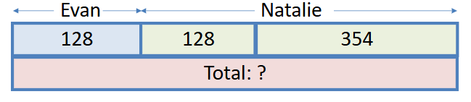
GRADE 3 NUMBER SENSE + COMPUTATIONAL FLUENCY:
OPEN QUESTIONS
ELEMENTARY MATH PROJECT
99. continued…
She drew the bar model below to help figure it out. Can you explain how this model helps Ohenewa to solve the problem? What equations can you connect to the image? How do they help you find the solution?

Slide 103
GRADE 3 NUMBER SENSE + COMPUTATIONAL FLUENCY:
OPEN QUESTIONS
ELEMENTARY MATH PROJECT
100. Create three subtraction facts that equal 6. Would you use the same strategy to help recall each one? Explain why or why not.

Slide 104
GRADE 3 NUMBER SENSE + COMPUTATIONAL FLUENCY:
OPEN QUESTIONS
ELEMENTARY MATH PROJECT
101. Make a 3-digit number using the digits 1 to 9 with no digits repeated. Reverse the numbers. Then subtract them. For example, if you picked 123, reversing would be 321, and subtracting gives you 321 − 123 = 198. Do this with at least five different numbers. Do you see a pattern with your answers? How will you share your findings?

Slide 105
GRADE 3 NUMBER SENSE + COMPUTATIONAL FLUENCY:
OPEN QUESTIONS
ELEMENTARY MATH PROJECT
102. Pick one:
Tell me what you know about 3 × 6 or 18 ÷ 3
Use words, pictures, numbers, symbols, and materials to represent your thinking. How are the two options related?

Slide 106
GRADE 3 NUMBER SENSE + COMPUTATIONAL FLUENCY:
OPEN QUESTIONS
ELEMENTARY MATH PROJECT
103. Describe a situation where you might estimate rather than calculating an exact answer.

Slide 107
GRADE 3 NUMBER SENSE + COMPUTATIONAL FLUENCY:
OPEN QUESTIONS
ELEMENTARY MATH PROJECT
104. Choose one:
Describe two different meanings of subtraction.
Describe two different meanings of division.
For each meaning, create a story problem related to your life or the community in which you live. How will you share your story problems?

Slide 108
GRADE 3 NUMBER SENSE + COMPUTATIONAL FLUENCY:
OPEN QUESTIONS
ELEMENTARY MATH PROJECT
105. Explain how multiplication helps you to divide. Use a specific example to help convey your ideas clearly.

Slide 109
GRADE 3 NUMBER SENSE + COMPUTATIONAL FLUENCY:
OPEN QUESTIONS
ELEMENTARY MATH PROJECT
106. Use a hundreds chart. Pick three numbers that you could skip count by. Explain how the patterns in the hundreds chart help you to skip count more easily. How does skip counting connect to multiplication?

Slide 110
GRADE 3 NUMBER SENSE + COMPUTATIONAL FLUENCY:
OPEN QUESTIONS
ELEMENTARY MATH PROJECT
107. Use natural materials (rocks, shells, pinecones) to build an array. How does your array show the concept of multiplication?

Slide 111
GRADE 3 NUMBER SENSE + COMPUTATIONAL FLUENCY:
OPEN QUESTIONS
ELEMENTARY MATH PROJECT
108. Create a “Which one doesn’t belong?” using equations. Can you think of a reason why each one does not belong?

Slide 112
GRADE 3 NUMBER SENSE + COMPUTATIONAL FLUENCY:
OPEN QUESTIONS
ELEMENTARY MATH PROJECT
109. I walked through a garden and saw a row of radishes growing. There were 82 radishes. A rabbit came along and ate some radishes. Then there were 48 radishes still in the garden. What math question could you ask? Show what strategy you would use to figure out the answer to your question.

Slide 113
GRADE 3 NUMBER SENSE + COMPUTATIONAL FLUENCY:
OPEN QUESTIONS
ELEMENTARY MATH PROJECT
110. I opened a package of seeds and planted 3 rows of seeds in the garden. Each row had 24 seeds. I planted some more in a pot. I used up all 92 seeds in the package of seeds. How many seeds did I plant in the pot? What strategies will you use to answer the problem? Share your thinking

Slide 114
GRADE 3 NUMBER SENSE + COMPUTATIONAL FLUENCY:
OPEN QUESTIONS
ELEMENTARY MATH PROJECT
111. There were 231 ladybugs on a plant and some flew away. There were still 78 ladybugs on the plant. How many flew away? You could draw or use materials to help you think about this. Share how you solved this problem. Create your own math problem about ladybugs.

Slide 115
GRADE 3 NUMBER SENSE + COMPUTATIONAL FLUENCY:
OPEN QUESTIONS
ELEMENTARY MATH PROJECT
112. I collected some shells at the beach. I put 18 white shells in my pail and then put some purple shells in my pail. I added 43 more white shells. I lined up all my shells up on a log and counted 84 shells. How many purple shells did I collect? Think of two different ways to solve this problem and share your thinking and your solution/answer.

Slide 116
GRADE 3 NUMBER SENSE + COMPUTATIONAL FLUENCY:
OPEN QUESTIONS
ELEMENTARY MATH PROJECT
113. Here are some interesting bee facts: It takes 21-24 days for a bee to grow from egg to adult. As many as 50 000 honeybees can live in one hive. The largest known bee is the Wallace’s giant bee with a length of up to 4cm and a wingspan of 6cm. The queen bee lays 1500-2000 eggs a day. A honeybee can fly about 24 kilometres in an hour. A honeybee has 5 eyes. What math problems could you pose and solve with this information?

Slide 117
GRADE 3 NUMBER SENSE + COMPUTATIONAL FLUENCY:
OPEN QUESTIONS
ELEMENTARY MATH PROJECT
114. 915 bees flew out of the hive to find nectar and pollen. Some bees stopped at the first garden and 650 flew to find another one. How many bees stopped at the first garden? You could use a number line or base ten blocks or another way to help you think about this. Share how you solved this problem. Create and solve your own math story about bees.

Slide 118
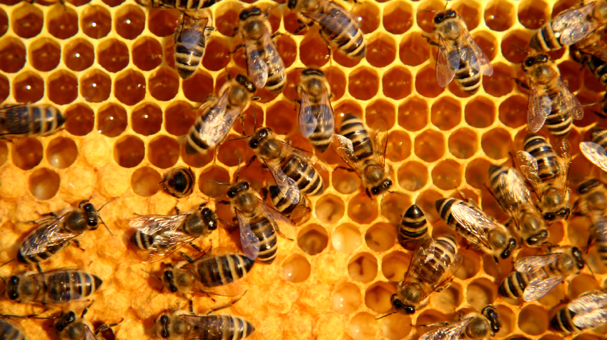
GRADE 3 NUMBER SENSE + COMPUTATIONAL FLUENCY:
OPEN QUESTIONS
ELEMENTARY MATH PROJECT
115. Below is a picture that goes with a story problem. What story problem might this picture inspire? Brainstorm different possibilities. Choose your favourite. Share with a friend.

Slide 119
ELEMENTARY MATH PROJECT
GRADE 3 PRACTICE QUESTIONS
PATTERN

Slide 120
GRADE 3 PATTERN:
CLOSED QUESTIONS
ELEMENTARY MATH PROJECT
1. Consider the following pattern: 7, 17, 27, 37, …
Write the next three numbers in the pattern and state the pattern rule.

Slide 121
GRADE 3 PATTERN:
CLOSED QUESTIONS
ELEMENTARY MATH PROJECT
2. In an increasing pattern, the first term is 1 and the fourth term is 7. What is the fifth term?

Slide 122

GRADE 3 PATTERN:
CLOSED QUESTIONS
ELEMENTARY MATH PROJECT
3. Denzel made a complex repeating pattern. The pattern goes like this…​
ABB pattern for colour​
AB pattern for size​
ABA pattern for shape​
Here is the beginning of the pattern. Draw the next three ​

Slide 123
GRADE 3 PATTERN:
CLOSED QUESTIONS
ELEMENTARY MATH PROJECT
4. Fill in the blanks for each pattern.
1, 3, 5, 7, ____
____, 22, 26, 30, 34
2, 4, ____, 16, 32
100, 80, 60, 40, ____
1000, 500, ____, 125
1, 2, 4, 7, 11, ____

Slide 124
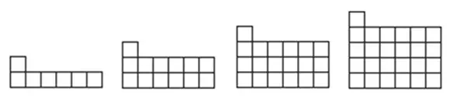
GRADE 3 PATTERN:
CLOSED QUESTIONS
ELEMENTARY MATH PROJECT
5. Use grid paper. Draw the next image in the pattern.
a.

Slide 125
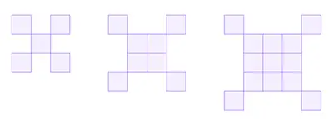
GRADE 3 PATTERN:
CLOSED QUESTIONS
ELEMENTARY MATH PROJECT
5. Use grid paper. Draw the next image in the pattern.
b.

Slide 126
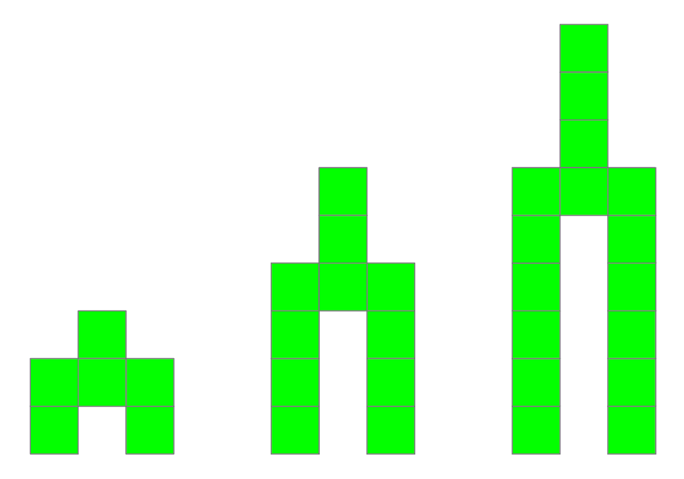
GRADE 3 PATTERN:
CLOSED QUESTIONS
ELEMENTARY MATH PROJECT
5. Use grid paper. Draw the next image in the pattern.
c.

Slide 127
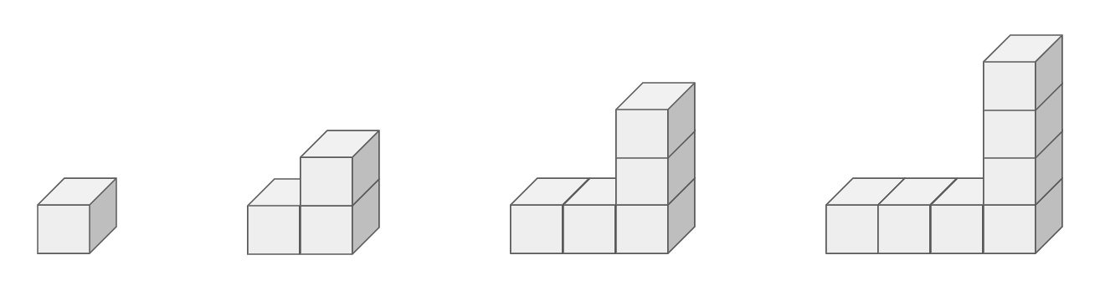
GRADE 3 PATTERN:
OPEN QUESTIONS
ELEMENTARY MATH PROJECT
6. Consider the following pattern:
How do you see the pattern changing?​
Draw the next image. How many cubes are in it?
What is the pattern rule for the number of cubes?​
How many cubes are in the 10th image. Show your strategy.
Challenge: How many cubes in the 100th image?

Slide 128
GRADE 3 PATTERN:
OPEN QUESTIONS
ELEMENTARY MATH PROJECT
7. The first two terms in a pattern are: 1, 4, …
How might the pattern continue? What is the pattern rule?
How many different patterns can you describe that begin this way (1, 4, …)?

Slide 129
GRADE 3 PATTERN:
OPEN QUESTIONS
ELEMENTARY MATH PROJECT
8. Create your own increasing or decreasing pattern using numbers or shapes. Explain how someone could figure out the rule for your pattern.

Slide 130
GRADE 3 PATTERN:
OPEN QUESTIONS
ELEMENTARY MATH PROJECT
9. Create an increasing pattern that becomes a decreasing pattern partway through. Explain why someone looking at it might think it’s tricky.

Slide 131
GRADE 3 PATTERN:
OPEN QUESTIONS
ELEMENTARY MATH PROJECT
10. Make up a short story that includes a pattern (e.g., steps climbed, animals joining a parade, shells on the beach). Describe the pattern rule in your story.

Slide 132
ELEMENTARY MATH PROJECT
GRADE 3 PRACTICE QUESTIONS
ALGEBRA

Slide 133
GRADE 3 ALGEBRA:
CLOSED QUESTIONS
ELEMENTARY MATH PROJECT
Write the three other equations in the same “fact family” as
☐ + 7 = 20.

Slide 134
GRADE 3 ALGEBRA:
CLOSED QUESTIONS
ELEMENTARY MATH PROJECT
2. Solve for the unknown variable.
x + 15 = 24
83 + n = 121
u – 337 = 400
100 – m = 23

Slide 135
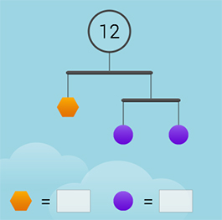
GRADE 3 ALGEBRA:
CLOSED QUESTIONS
ELEMENTARY MATH PROJECT
3. Find the value of each shape in the image:

Slide 136
GRADE 3 ALGEBRA:
CLOSED QUESTIONS
ELEMENTARY MATH PROJECT
4. Sam has a large bag of candies. She ate many over several weeks. Now she has 118 candies left. If the bag had 250 candies to start, how many did she eat?

Slide 137
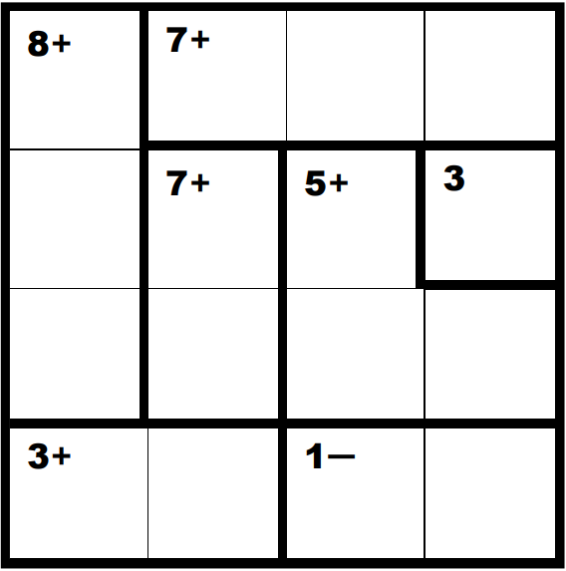
GRADE 3 ALGEBRA:
CLOSED QUESTIONS
ELEMENTARY MATH PROJECT
5. Solve the following KenKen Puzzle:

Slide 138
GRADE 3 ALGEBRA:
OPEN QUESTIONS
ELEMENTARY MATH PROJECT
6. Write an equation to represent the Splat! image shown below.
Describe or show how solving the Splat! is connected to solving your equation

Slide 139
GRADE 3 ALGEBRA:
OPEN QUESTIONS
ELEMENTARY MATH PROJECT
7. Create a story problem that matches the equation: ☐ – 4 = 9
Your story should help someone understand what the unknown number is.

Slide 140
GRADE 3 ALGEBRA:
OPEN QUESTIONS
ELEMENTARY MATH PROJECT
8. Create a “Which One Doesn’t Belong?” using four equations. Write four equations where one is different from the rest--it doesn’t belong! Then explain why it does not belong. Challenge: Give a reason why EACH equation does not belong.

Slide 141
GRADE 3 ALGEBRA:
OPEN QUESTIONS
ELEMENTARY MATH PROJECT
9. Create an addition equation and a subtraction equation that both have the same unknown number. Explain how you know they match.

Slide 142
GRADE 3 ALGEBRA:
OPEN QUESTIONS
ELEMENTARY MATH PROJECT
10. Create 3 equations to trade with a friend and see if they can solve for the correct answer.

Slide 143
ELEMENTARY MATH PROJECT
GRADE 3 PRACTICE QUESTIONS
DATA

Slide 144
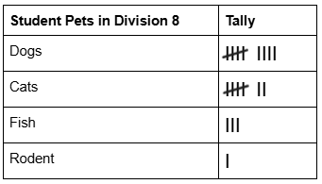
GRADE 3 DATA:
CLOSED QUESTIONS
ELEMENTARY MATH PROJECT
1. Create a Bar Graph or Pictograph based on the data collected below

Slide 145
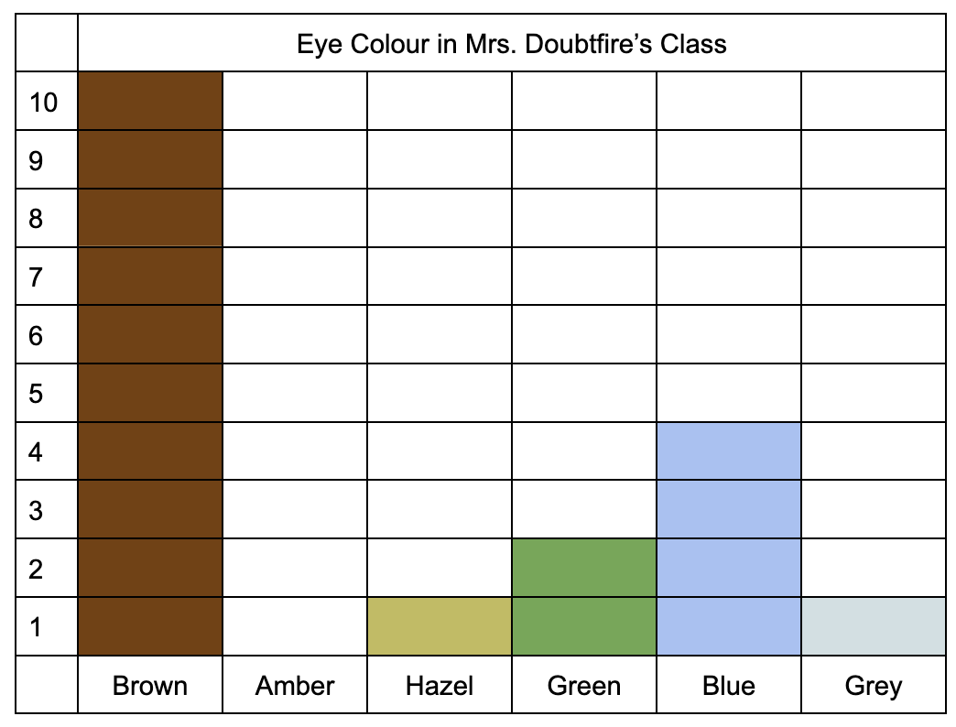
GRADE 3 DATA:
CLOSED QUESTIONS
ELEMENTARY MATH PROJECT
2. What are three comparisons you can make about the data in the graph?

Slide 146
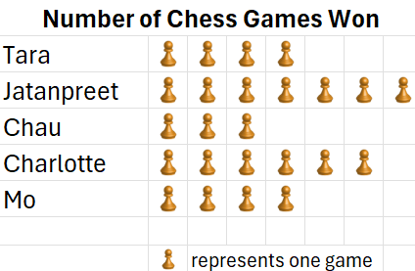
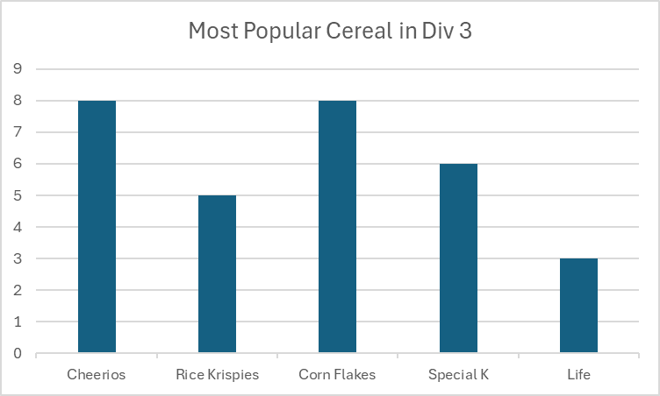
GRADE 3 DATA:
CLOSED QUESTIONS
ELEMENTARY MATH PROJECT
3. Change it up! Represent an existing Bar Graph as a Pictograph OR Change an existing Pictograph into a Bar Graph. Below are two examples if you cannot find your own.

Slide 147
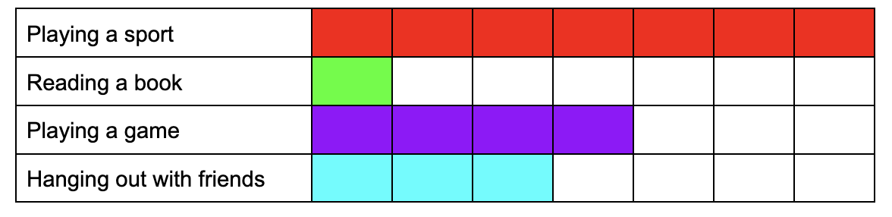
GRADE 3 DATA:
CLOSED QUESTIONS
ELEMENTARY MATH PROJECT
4. A bar graph shows how some students spend their recess time. Each unit is 1 student.

Slide 148
GRADE 3 DATA:
CLOSED QUESTIONS
ELEMENTARY MATH PROJECT
4.
Which activity is the most popular?
Which activity is the least popular?
How many more students played a sport than a game?
How many students were surveyed?

Slide 149
GRADE 3 DATA:
CLOSED QUESTIONS
ELEMENTARY MATH PROJECT
5. Ask friends and family what their favourite day of the week is. Record the data in a Tally Chart. Represent the data using a Bar Graph. Include all labels and a title.
Which day was the most popular?
Which was the least popular?

Slide 150
GRADE 3 DATA:
OPEN QUESTIONS
ELEMENTARY MATH PROJECT
6. Collect real data (e.g., pets, favourite games, eye colour) from your classmates. Use a tally chart to record your data. Represent the data using a bar graph or pictograph. Include all the important labels and a title. Explain what someone could learn from your graph.

Slide 151
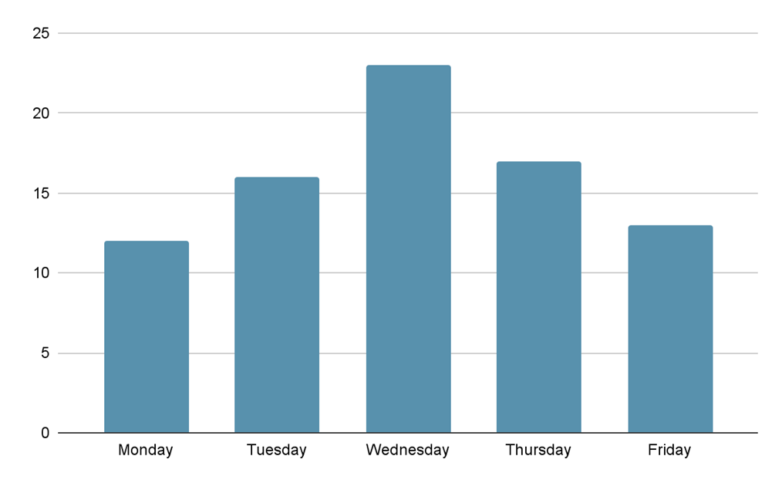
GRADE 3 DATA:
OPEN QUESTIONS
ELEMENTARY MATH PROJECT
7. Describe what you think this graph could be trying to tell us. Give some reasons why.

Slide 152
GRADE 3 DATA:
OPEN QUESTIONS
ELEMENTARY MATH PROJECT
8. Choose a graph that you made or found. Write three questions that someone could answer using the graph.

Slide 153
GRADE 3 DATA:
OPEN QUESTIONS
ELEMENTARY MATH PROJECT
9. Imagine a friend created a bar graph about favourite sports, but they forgot to label something. Describe what could be missing and explain why it’s important.

Slide 154
GRADE 3 DATA:
OPEN QUESTIONS
ELEMENTARY MATH PROJECT
10. a) How are a bar graph and a pictograph similar? How are they different?
b) Which do you like better? Explain why.

Slide 155
ELEMENTARY MATH PROJECT
GRADE 3 PRACTICE QUESTIONS
PROBABILITY

Slide 156
GRADE 3 PROBABILITY:
CLOSED QUESTIONS
ELEMENTARY MATH PROJECT
1. A bag hides five marbles. How many of each colour are there if the following is true:
You are more likely to draw a red marble than a blue marble.
You are less likely to draw a blue marble than a yellow marble.
Two of these colours are equally likely.

Slide 157
GRADE 3 PROBABILITY:
CLOSED QUESTIONS
ELEMENTARY MATH PROJECT
2. What is the probability of rolling each outcome using a regular 6-sided die?
Four
An even number
A 3 or a 5
A number greater than 4
Seven

Slide 158
GRADE 3 PROBABILITY:
CLOSED QUESTIONS
ELEMENTARY MATH PROJECT
3. A spinner has 4 equal sections:
red, red, blue, yellow.
Are you more likely, less likely, or equally likely to spin red compared to blue? Why?

Slide 159
GRADE 3 PROBABILITY:
CLOSED QUESTIONS
ELEMENTARY MATH PROJECT
4. Use the word certain or uncertain to describe the likelihood of each event:
The sun will set today.
I will eat pizza for dinner.
I am in grade 3.
It will rain on my next birthday.
The passing of time.

Slide 160
GRADE 3 PROBABILITY:
CLOSED QUESTIONS
ELEMENTARY MATH PROJECT
5. Always, sometimes, never true…
Games of probability use dice.
Games with dice involve chance.
Games of strategy involve probability.
Games based only on probability are unfair.

Slide 161
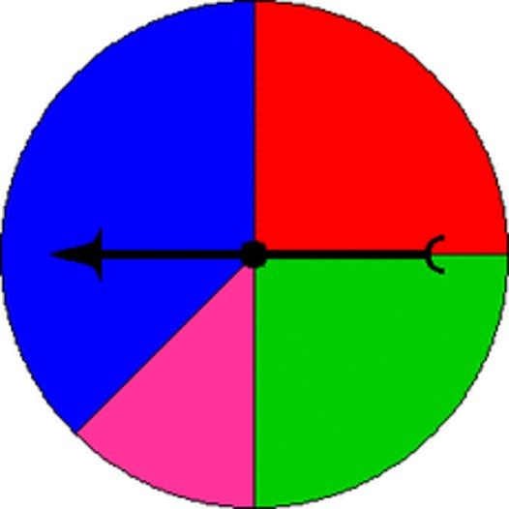
GRADE 3 PROBABILITY:
OPEN QUESTIONS
ELEMENTARY MATH PROJECT
6. Four students are playing a game. They each pick a colour at random. If the spinner lands on their colour, they win. If not, they lose. Is this a fair game? Why or why not?

Slide 162
GRADE 3 PROBABILITY:
OPEN QUESTIONS
ELEMENTARY MATH PROJECT
7. A coin has two sides: heads and tails. If you toss the coin 10 times, what is one possible outcome (i.e., how many heads and how many tails)? Will this always happen? Why or why not?

Slide 163
GRADE 3 PROBABILITY:
OPEN QUESTIONS
ELEMENTARY MATH PROJECT
8. You roll two dice and find the sum. Give an example of a sum that you think is more likely and one that you think is less likely. Explain your reasoning.

Slide 164
GRADE 3 PROBABILITY:
OPEN QUESTIONS
ELEMENTARY MATH PROJECT
9. Design a game where one outcome is very likely and another is very unlikely.
Describe your game and explain why the outcomes have those probabilities.

Slide 165
GRADE 3 PROBABILITY:
OPEN QUESTIONS
ELEMENTARY MATH PROJECT
10. Help Red give an example of an event for each outcome on the probability meter.
Refer to the video: https://www.youtube.com/watch?v=7XuNVVlD98g

Slide 166
ELEMENTARY MATH PROJECT
GRADE 3 PRACTICE QUESTIONS
MEASUREMENT

Slide 167
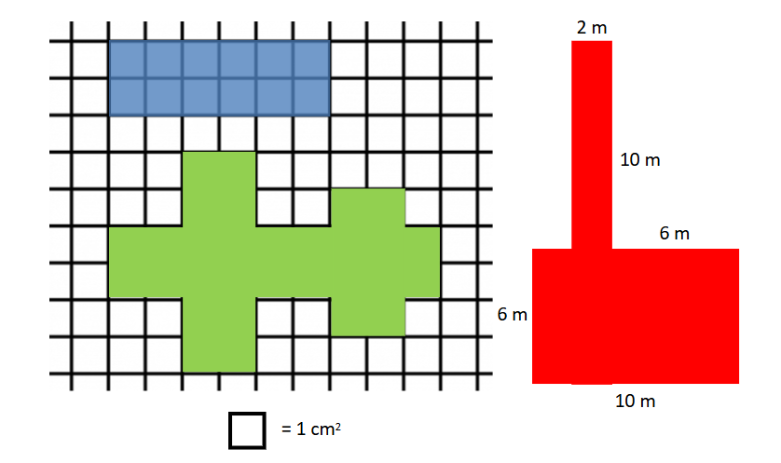
GRADE 3 MEASUREMENT:
CLOSED QUESTIONS
ELEMENTARY MATH PROJECT
1. Pick one of the shapes (blue, green, or red). Find its area and perimeter.

Slide 168
GRADE 3 MEASUREMENT:
CLOSED QUESTIONS
ELEMENTARY MATH PROJECT
2. About how many cans of pop are in a 2 litre bottle of pop? Justify your thinking.

Slide 169
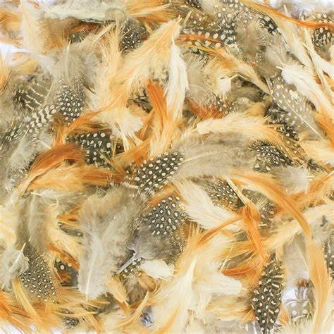
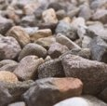
GRADE 3 MEASUREMENT:
CLOSED QUESTIONS
ELEMENTARY MATH PROJECT
3. Which weighs more?
A 1000 gram bag of feathers
A 1 kilogram bag of rocks
Justify your thinking.

Slide 170
GRADE 3 MEASUREMENT:
CLOSED QUESTIONS
ELEMENTARY MATH PROJECT
4. Use a ruler. Draw each of the following shapes.
A 3 cm square
A rectangle that is 8 cm long and 5 cm wide
A triangle with a square corner and side lengths: 3 cm, 4 cm, 5 cm
Challenge: A circle with a circumference as close to 20 cm as you can get!

Slide 171
GRADE 3 MEASUREMENT:
OPEN QUESTIONS
ELEMENTARY MATH PROJECT
6. Exploring Linear Measurement
MILLIMETRE
Symbol | What is a good referent? | I can use it to measure…

Slide 172
GRADE 3 MEASUREMENT:
OPEN QUESTIONS
ELEMENTARY MATH PROJECT
6. Exploring Linear Measurement
CENTIMETRE
Symbol | What is a good referent? | I can use it to measure…

Slide 173
GRADE 3 MEASUREMENT:
OPEN QUESTIONS
ELEMENTARY MATH PROJECT
6. Exploring Linear Measurement
METRE
Symbol | What is a good referent? | I can use it to measure…

Slide 174
GRADE 3 MEASUREMENT:
OPEN QUESTIONS
ELEMENTARY MATH PROJECT
6. Exploring Linear Measurement
KILOMETRE
Symbol | What is a good referent? | I can use it to measure…

Slide 175
GRADE 3 MEASUREMENT:
OPEN QUESTIONS
ELEMENTARY MATH PROJECT
7. a) Describe or show a strategy for measuring the distance around a circle or curved object like a cylinder.

Slide 176
GRADE 3 MEASUREMENT:
OPEN QUESTIONS
ELEMENTARY MATH PROJECT
7. b) Find some objects that are curved to measure (water bottle, tree trunk, your head).
Write them in the chart below. Estimate the distance around them. Then measure them. How close did you get (find the difference between your estimate and measurement)?

Slide 177
GRADE 3 MEASUREMENT:
OPEN QUESTIONS
ELEMENTARY MATH PROJECT
7b)
Curved Object | Estimate | Measurement | Difference

Slide 178
GRADE 3 MEASUREMENT:
OPEN QUESTIONS
ELEMENTARY MATH PROJECT
8. Explain how one person could measure something and get a big number, and a different person could measure the same thing and get a small number. Use a specific example to support your thinking.

Slide 179
GRADE 3 MEASUREMENT:
OPEN QUESTIONS
ELEMENTARY MATH PROJECT
9. Use a balance scale and weights. Find two very different objects that have almost the same mass. How can you tell if they have the same mass? How close in mass were the two objects?

Slide 180
GRADE 3 MEASUREMENT:
OPEN QUESTIONS
ELEMENTARY MATH PROJECT
10. In Canada, we have to be familiar with both the Metric System and the Imperial System. Make a pro/con list for each system. Then decide which one you think is better using your pro/con lists to justify your choice.

Slide 181
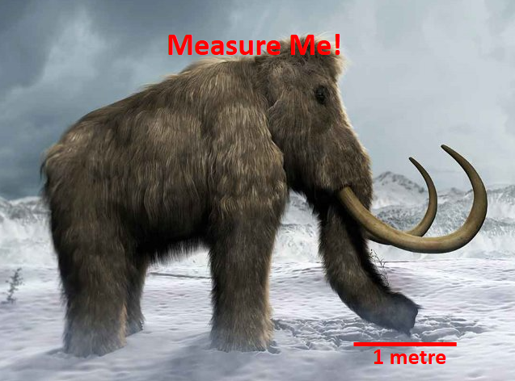
GRADE 3 MEASUREMENT:
OPEN QUESTIONS
ELEMENTARY MATH PROJECT
11. Estimate the length of the wholly mammoth in the picture using the referent for 1 metre. Explain your process and how you know your estimate is reasonable.

Slide 182
GRADE 3 MEASUREMENT:
OPEN QUESTIONS
ELEMENTARY MATH PROJECT
11. Estimation Clipboard. Use the first image (top, left) to estimate the lengths of the strings labelled A through F. Justify your estimates.
Visually list the strings in order from shortest to longest. Do your number estimates agree with the order of your letters? Adjust your estimates if you need to.

Slide 183
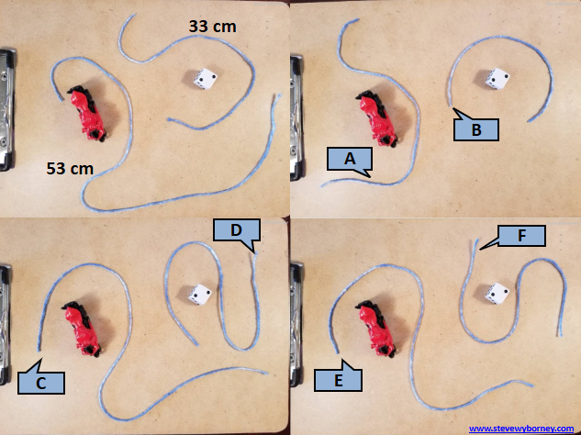
GRADE 3 MEASUREMENT:
OPEN QUESTIONS
ELEMENTARY MATH PROJECT
11. Estimation Clipboard

Slide 184
ELEMENTARY MATH PROJECT
GRADE 3 PRACTICE QUESTIONS
GEOMETRY

Slide 185
GRADE 3 GEOMETRY:
CLOSED QUESTIONS
ELEMENTARY MATH PROJECT
1. Provide a set of 3D solids. How many faces, edges, vertices do each have?
Cube
Rectangular prism
Rectangular pyramid
Tetrahedron
Triangular prism

Slide 186
GRADE 3 GEOMETRY:
CLOSED QUESTIONS
ELEMENTARY MATH PROJECT
2. What 2D shapes are in a hexagonal prism? How about a hexagonal pyramid?

Slide 187
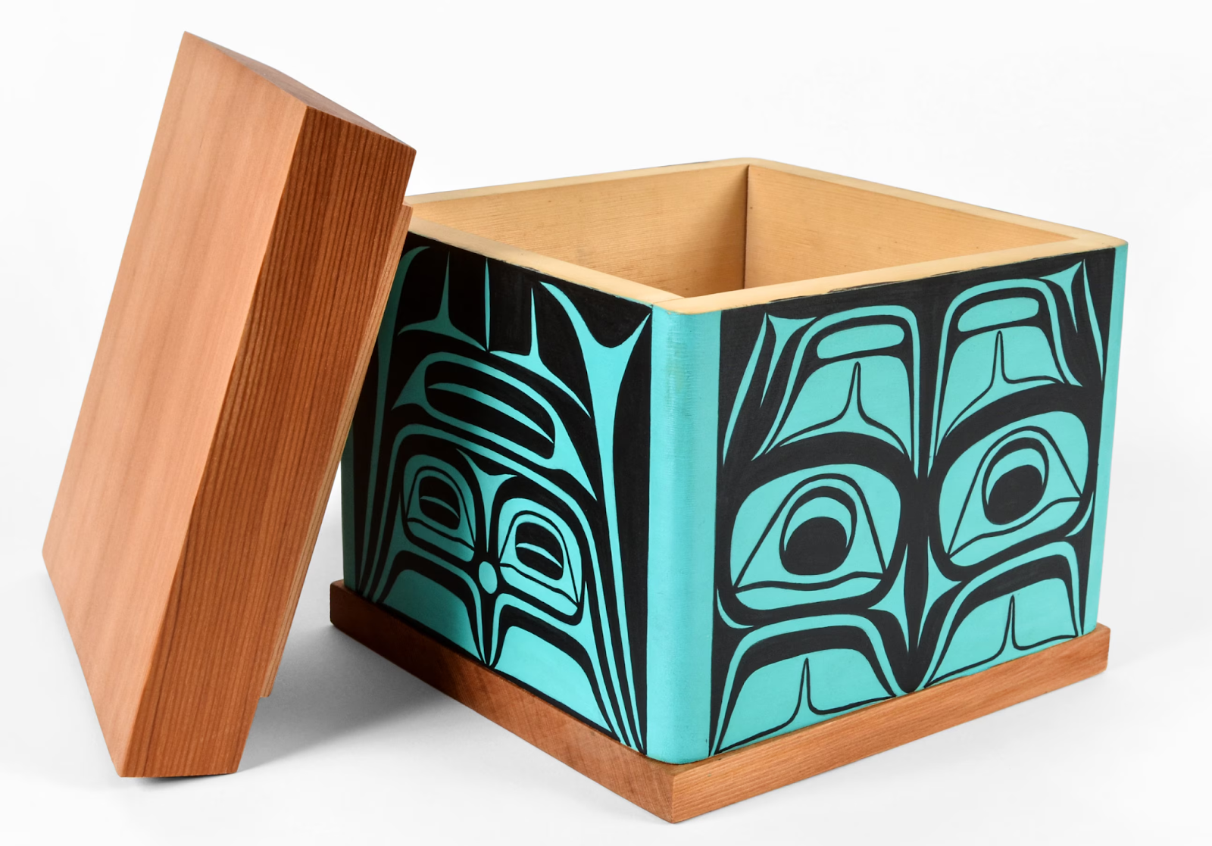
GRADE 3 GEOMETRY:
CLOSED QUESTIONS
ELEMENTARY MATH PROJECT
3. What shapes do you see in a bentwood box?

Slide 188
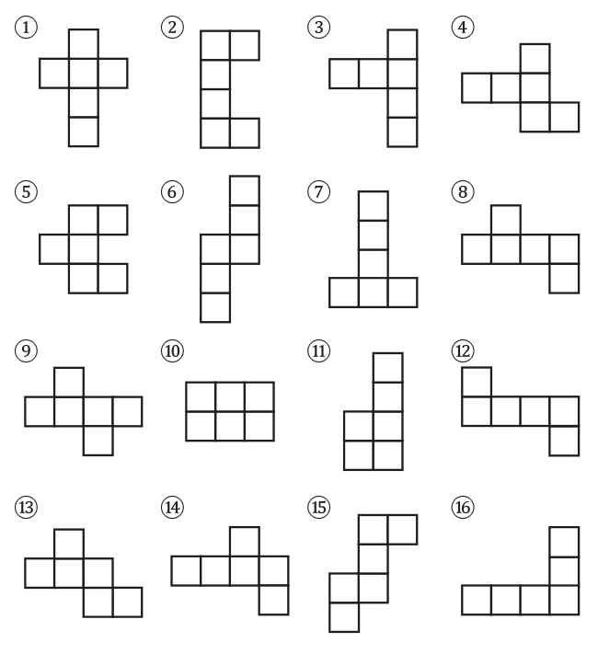
GRADE 3 GEOMETRY:
CLOSED QUESTIONS
ELEMENTARY MATH PROJECT
4. Investigate. Look at the following nets. Which of them can fold into a cube? Which cannot?

Slide 189
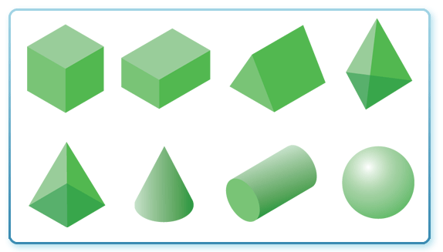
GRADE 3 GEOMETRY:
CLOSED QUESTIONS
ELEMENTARY MATH PROJECT
5. Name the 3D solids in the image.

Slide 190
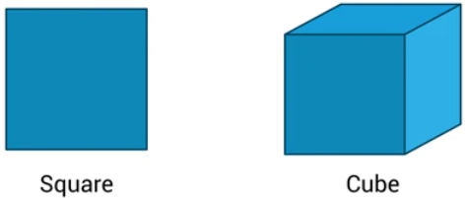
GRADE 3 GEOMETRY:
OPEN QUESTIONS
ELEMENTARY MATH PROJECT
6. Consider a square and a cube. How are they similar? How are they different?

Slide 191
GRADE 3 GEOMETRY:
OPEN QUESTIONS
ELEMENTARY MATH PROJECT
7. How many different ways can you draw a quadrilateral? Name them if you can!

Slide 192
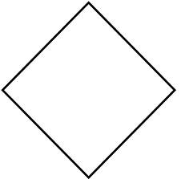
GRADE 3 GEOMETRY:
OPEN QUESTIONS
ELEMENTARY MATH PROJECT
8. Lucy says the shape below is a diamond. Samuel says it’s a square. Who do you agree with? Justify your thinking.

Slide 193
GRADE 3 GEOMETRY:
OPEN QUESTIONS
ELEMENTARY MATH PROJECT
9. a) Identify three different kinds of prisms. Name them. What gives a prism its name?
b) Identify three different kinds of pyramids. Name them. What gives a pyramid its name?
c) How are prisms and pyramids similar? How are they different?

Slide 194
GRADE 3 GEOMETRY:
OPEN QUESTIONS
ELEMENTARY MATH PROJECT
10. Platonic Solids investigation. Using multiple copies of a single shape, how many different 3D shapes can you make? How do you know you have found all the ways?

Slide 195
ELEMENTARY MATH PROJECT
GRADE 3 PRACTICE QUESTIONS
FINANCIAL LITERACY

Slide 196
GRADE 3 FINANCIAL LITERACY:
CLOSED QUESTIONS
ELEMENTARY MATH PROJECT
1. How many of the same kind of coin do you need to make $1?
Quarter
Dime
Nickel

Slide 197
GRADE 3 FINANCIAL LITERACY:
CLOSED QUESTIONS
ELEMENTARY MATH PROJECT
2. Describe three different ways that someone can make a payment for a good or service.

Slide 198
GRADE 3 FINANCIAL LITERACY:
CLOSED QUESTIONS
ELEMENTARY MATH PROJECT
3. A family from one Nation trades 3 items for another 3 items with a different Nation. Is trading an equal number of items always a fair trade? Why or why not?

Slide 199
GRADE 3 FINANCIAL LITERACY:
CLOSED QUESTIONS
ELEMENTARY MATH PROJECT
4. Find all possible ways to make 35¢. How do you know you found all the ways?

Slide 200
GRADE 3 FINANCIAL LITERACY:
CLOSED QUESTIONS
ELEMENTARY MATH PROJECT
5. What is the least number of Canadian coins and bills you would need to make $99.95?

Slide 201
GRADE 3 FINANCIAL LITERACY:
OPEN QUESTIONS
ELEMENTARY MATH PROJECT
6. Imagine two kids want to trade items instead of using money—similar to First Peoples bartering traditions. Describe a trade that would be fair, and explain why it is fair.

Slide 202
GRADE 3 FINANCIAL LITERACY:
OPEN QUESTIONS
ELEMENTARY MATH PROJECT
7. You want to buy some new fish for your fish tank. Describe two or more ways to earn money. Explain which one you think would be the easiest or most fun, and why.

Slide 203
GRADE 3 FINANCIAL LITERACY:
OPEN QUESTIONS
ELEMENTARY MATH PROJECT
8. A toy costs $17.89. What combination of bills and coins could you use to give the exact payment?

Slide 204
GRADE 3 FINANCIAL LITERACY:
OPEN QUESTIONS
ELEMENTARY MATH PROJECT
9. A book set costs $48. List two different ways someone could pay a cashier using bills. (You do not need to give the exact amount--the cashier can give you change!)

Slide 205
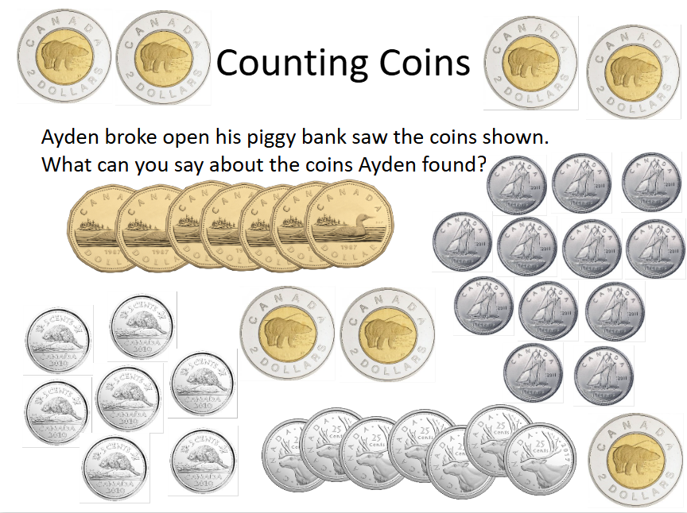
GRADE 3 FINANCIAL LITERACY:
OPEN QUESTIONS
ELEMENTARY MATH PROJECT
10.

Slide 206
ELEMENTARY MATH PROJECT
GRADE 3 PRACTICE QUESTIONS
MIXED PRACTICE

Slide 207
GRADE 3 MIXED PRACTICE:
ELEMENTARY MATH PROJECT
1. I want to buy three board games. They cost: $48, $24 and $13 (including tax). I have a $100 bill. Is that enough to buy all three games?​ Show your thinking.

Slide 208
GRADE 3 MIXED PRACTICE:
ELEMENTARY MATH PROJECT
2. You’re celebrating your birthday with 12 friends. Will baking 20 cookies be enough for you and your guests? Explain.​

Slide 209
GRADE 3 MIXED PRACTICE:
ELEMENTARY MATH PROJECT
3. A student says 1000 – 246 = 864. Does this answer make sense?​ Why or why not?

Slide 210
GRADE 3 MIXED PRACTICE:
ELEMENTARY MATH PROJECT
4. The distance from New Westminster to Kelowna is 372 km. If you drive 100 km every hour, about how many hours will it take to get to Kelowna?​

Slide 211
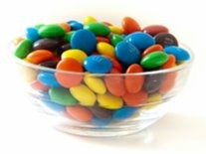
GRADE 3 MIXED PRACTICE:
ELEMENTARY MATH PROJECT
5. About how many candies are in the candy bowl?​ How do you know this is a reasonable estimate?

Slide 212
GRADE 3 MIXED PRACTICE:
ELEMENTARY MATH PROJECT
6. Why is area measured in square units (ex. cm2) while perimeter is measured in linear units (ex. cm)?​ Show your thinking using specific examples.

Slide 213
GRADE 3 MIXED PRACTICE:
ELEMENTARY MATH PROJECT
7. Draw a net for a triangular prism.​ Is this the only way to make the net? Explain or show your reasoning.

Slide 214
GRADE 3 MIXED PRACTICE:
ELEMENTARY MATH PROJECT
8. Estimate the numerical value of letters A, B, and C on the number line below. Justify your answer.

Slide 215
GRADE 3 MIXED PRACTICE:
ELEMENTARY MATH PROJECT
9. Which months have exactly 30 days?​

Slide 216
GRADE 3 MIXED PRACTICE:
ELEMENTARY MATH PROJECT
10. A bike costs $389 in total. If you pay with a $1000 bill, how much change would you get back?

Slide 217
GRADE 3 MIXED PRACTICE:
ELEMENTARY MATH PROJECT
11. 786 = ____ hundreds + ____ tens + ____ ones​
How many ways can you fill in the blanks so that the equation is true?​

Slide 218
GRADE 3 MIXED PRACTICE:
ELEMENTARY MATH PROJECT
12. Calculate: 923 – 289 ​
Show your strategy. How can you check that your answer is reasonable?

Slide 219
GRADE 3 MIXED PRACTICE:
ELEMENTARY MATH PROJECT
13. How are the “equal groups” and “fair share” meanings of division similar? How are they different? Use an example to support your answer.​

Slide 220
GRADE 3 MIXED PRACTICE:
ELEMENTARY MATH PROJECT
14. Round 327 to the nearest 100 and nearest 10. Explain or show your reasoning.
100
10​

Slide 221
GRADE 3 MIXED PRACTICE:
ELEMENTARY MATH PROJECT
15. If you count forward by 10s starting at 324, will you eventually say the number 444? Explain.​

Slide 222
GRADE 3 MIXED PRACTICE:
ELEMENTARY MATH PROJECT
16. Fill in the blank: 678 = ______ tens + 8 ones​

Slide 223
GRADE 3 MIXED PRACTICE:
ELEMENTARY MATH PROJECT
17. Is 356 closer to 250 or 500?​ Justify your thinking.

Slide 224
GRADE 3 MIXED PRACTICE:
ELEMENTARY MATH PROJECT
18. A friend always forgets 6 + 8 = 14. What strategy could you share to help them remember?​

Slide 225
GRADE 3 MIXED PRACTICE:
ELEMENTARY MATH PROJECT
19. Living in Canada, we need to be familiar with both the metric system and Imperial measures.
How many inches are in a foot?​
How many centimetres are in a metre?​
How many millilitres are in a cup?
How many millilitres are in a litre?

Slide 226
GRADE 3 MIXED PRACTICE:
ELEMENTARY MATH PROJECT
20. Which is greater: 432 + 555 OR 1000 – 256
Explain your reasoning.

Slide 227
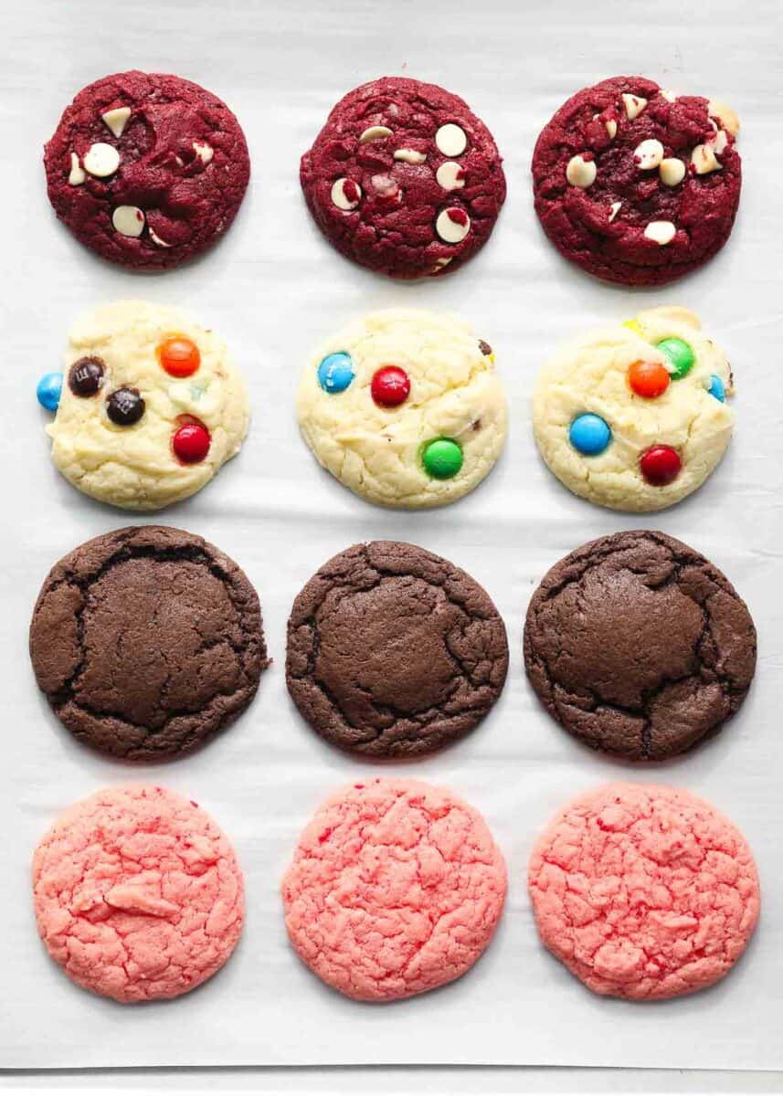
GRADE 3 MIXED PRACTICE:
ELEMENTARY MATH PROJECT
21. What fraction of the cookies are pink?

Slide 228
GRADE 3 MIXED PRACTICE:
ELEMENTARY MATH PROJECT
22. Represent the fraction ¾ using three different models.
How does each model help you to understand ¾ in a different way?

Slide 229
GRADE 3 MIXED PRACTICE:
ELEMENTARY MATH PROJECT
23. What does the top number in a fraction (numerator) mean?
What does the bottom number in a fraction (denominator) mean?
Use pictures, numbers, words to explain your thinking.

Slide 230
GRADE 3 MIXED PRACTICE:
ELEMENTARY MATH PROJECT
24. How would you explain what 3 × 4 means to a student in a younger grade?
Use at least one model in your explanation.

Slide 231
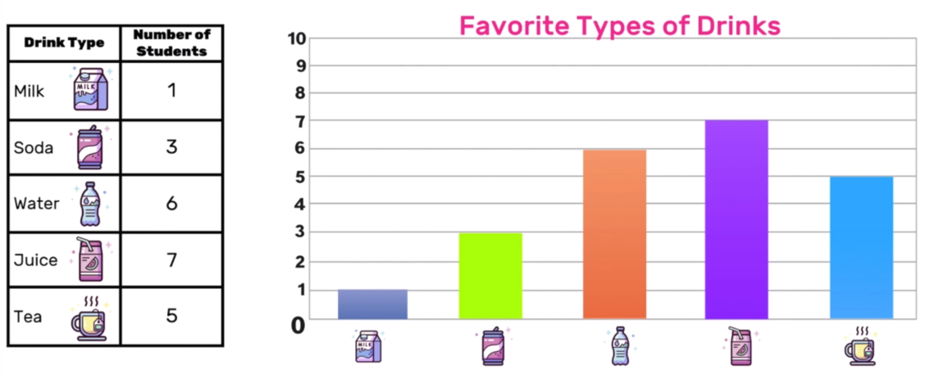
GRADE 3 MIXED PRACTICE:
ELEMENTARY MATH PROJECT
25. What information do the table and graph tell you? How are the two representations similar? How are they different? Which do you prefer and why?

Slide 232
GRADE 3 MIXED PRACTICE:
ELEMENTARY MATH PROJECT
26. Musa and River are A/B partners. They are looking for a random way to decide who will be Partner A and who will be Partner B. How can they do this fairly?

Slide 233
GRADE 3 MIXED PRACTICE:
ELEMENTARY MATH PROJECT
27. Fill in the blanks:
1 minute = _____ seconds
1 hour = _____ minutes
1 day = _____ hours
1 week = _____ days
1 year = _____ months

Slide 234
GRADE 3 MIXED PRACTICE:
ELEMENTARY MATH PROJECT
28. Pick one:
a) How are addition and subtraction related?
b) How are multiplication and division related?
Explain using specific examples.

Slide 235
GRADE 3 MIXED PRACTICE:
ELEMENTARY MATH PROJECT
29. Use grid paper or square tiles. Is it possible to make a shape that has a perimeter of 12 units AND an area of 12 square units? Justify your answer.

Slide 236
GRADE 3 MIXED PRACTICE:
ELEMENTARY MATH PROJECT
30. Write a story problem that can be represented by the equation
☐ + 8 = 12.

