Slide 1

ELEMENTARY MATH PROJECT
GRADE 1 PRACTICE QUESTIONS
DATA

Slide 2
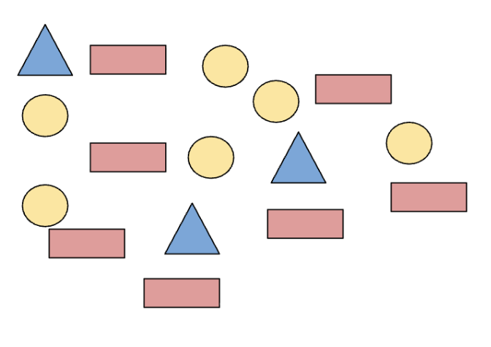
GRADE 1 DATA
CLOSED QUESTIONS
ELEMENTARY MATH PROJECT
1. Count the different shapes using a tally chart. Record your counting.
Shape | Tally
Circles
Triangles
Rectangle

Slide 3
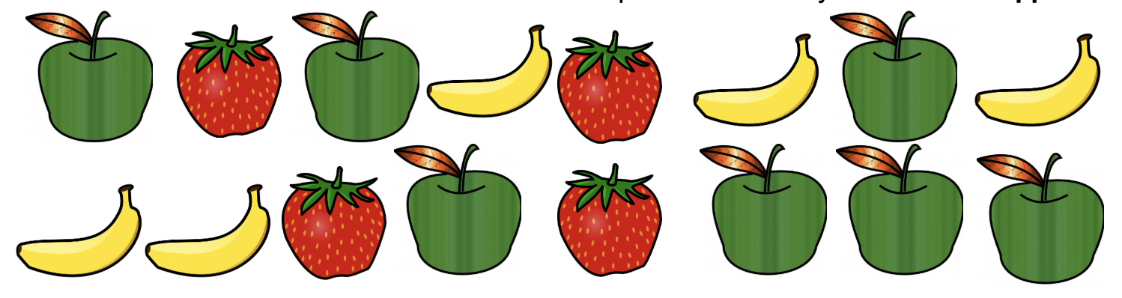
GRADE 1 DATA
CLOSED QUESTIONS
ELEMENTARY MATH PROJECT
2. Use two-colour counters or Unifix cubes to represent how many bananas and apples there are.

Slide 4


GRADE 1 DATA
CLOSED QUESTIONS
ELEMENTARY MATH PROJECT
Shoe Colours in Div.15 | Tally | Count (Number)
Blue |  | 9
Red
White
Black |  | 3
3. Look at the following tally chart. Create a Bar Graph or a Concrete Graph using the data. Include all the important labels and a title.

Slide 5
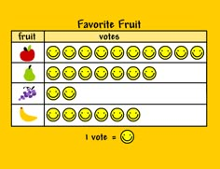
GRADE 1 DATA
CLOSED QUESTIONS
ELEMENTARY MATH PROJECT
4. Look at the following pictograph.
Use it to answer these questions:
How many types of fruit did the student record data for?
What fruit was the favourite?
How many more people liked pears more than grapes?

Slide 6
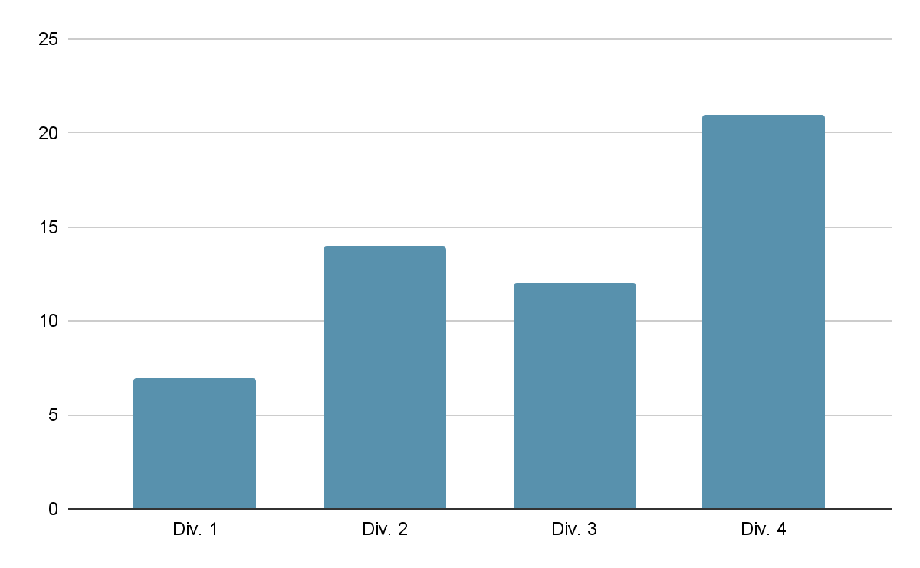
GRADE 1 DATA
OPEN QUESTIONS
ELEMENTARY MATH PROJECT
5. Describe what you think this graph could be trying to tell us and give some reasons why.

Slide 7




GRADE 1 DATA
OPEN QUESTIONS
ELEMENTARY MATH PROJECT
Student Siblings in Div.15 | Tally
1 Brother
1 Sister
No Siblings
More than 2 Siblings
6. Look at the following tally chart. What are 2 questions you could ask using the data?

Slide 8



GRADE 1 DATA
OPEN QUESTIONS
ELEMENTARY MATH PROJECT
8
7
6
5
4
3
2
1
 | Doughnut | Cookie | Ice Cream
7. For the pictograph on this slide, what are some things that you cannot say about the data?

Slide 9
GRADE 1 DATA
OPEN QUESTIONS
ELEMENTARY MATH PROJECT
8. How are a tally chart and a bar graph different?
How are they similar?
When might a bar graph be better than a tally chart?

Slide 10
ELEMENTARY MATH PROJECT
GRADE 1 PRACTICE QUESTIONS
PROBABILITY

Slide 11
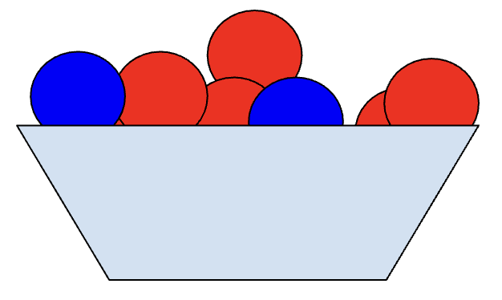
GRADE 1 PROBABILITY
CLOSED QUESTIONS
ELEMENTARY MATH PROJECT
1. If there are 12 red balls and 5 blue balls mixed together in a big bin, if you take a ball without looking, are you more likely to get a red ball or a green ball?

Slide 12
GRADE 1 PROBABILITY
CLOSED QUESTIONS
ELEMENTARY MATH PROJECT
2. Use the scale on the line to put down how certain or uncertain you are of these things happening Friday:
There is cake for breakfast.
The teacher will bring in a puppy.
We will go outside to play.
Someone will wear a blue shirt.
I will use a pencil.

Slide 13
GRADE 1 PROBABILITY
CLOSED QUESTIONS
ELEMENTARY MATH PROJECT
3. When you walk to school, which of these things are you more likely to see? Explain why.
 | More Likely | Less Likely | Why?
Cat or Lizard
Bike or Helicopter
Rock or Rocket

Slide 14
GRADE 1 PROBABILITY
CLOSED QUESTIONS
ELEMENTARY MATH PROJECT
4. Imagine you are walking home from school. What is something you are never going to see?

Slide 15
GRADE 1 PROBABILITY
CLOSED QUESTIONS
ELEMENTARY MATH PROJECT
5. Imagine you are walking down the hall outside your classroom. What is something you are sure to see?

Slide 16
GRADE 1 PROBABILITY
OPEN QUESTIONS
ELEMENTARY MATH PROJECT
6. Explain what it means if two things are “equally likely” to happen. Give an example.

Slide 17
GRADE 1 PROBABILITY
OPEN QUESTIONS
ELEMENTARY MATH PROJECT
7. Look outside. Explain why you think it will be “More Likely,” “Less Likely”, or “Equally Likely” to be sunny tomorrow.

Slide 18
GRADE 1 PROBABILITY
OPEN QUESTIONS
ELEMENTARY MATH PROJECT
8. In this bag there is a piece of fruit. How certain are you that it is an apple? Tell me why you think that?

Slide 19
GRADE 1 PROBABILITY
OPEN QUESTIONS
ELEMENTARY MATH PROJECT
9. You are playing with your friends at recess. Explain what days of the week are you certain it is not? What days of the week are you certain it could it be?

