Slide 1

ELEMENTARY MATH PROJECT
GRADE 1 PRACTICE QUESTIONS
FINANCIAL LITERACY

Slide 2
GRADE 1 FINANCIAL LITERACY
CLOSED QUESTIONS
ELEMENTARY MATH PROJECT
1. How much do you have if you have (remember to use $ and ¢ symbols):
5 loonies
4 toonies
2 dimes

Slide 3
GRADE 1 FINANCIAL LITERACY
CLOSED QUESTIONS
ELEMENTARY MATH PROJECT
2. How do you make 20¢ using only:
pennies | nickels | dimes

Slide 4
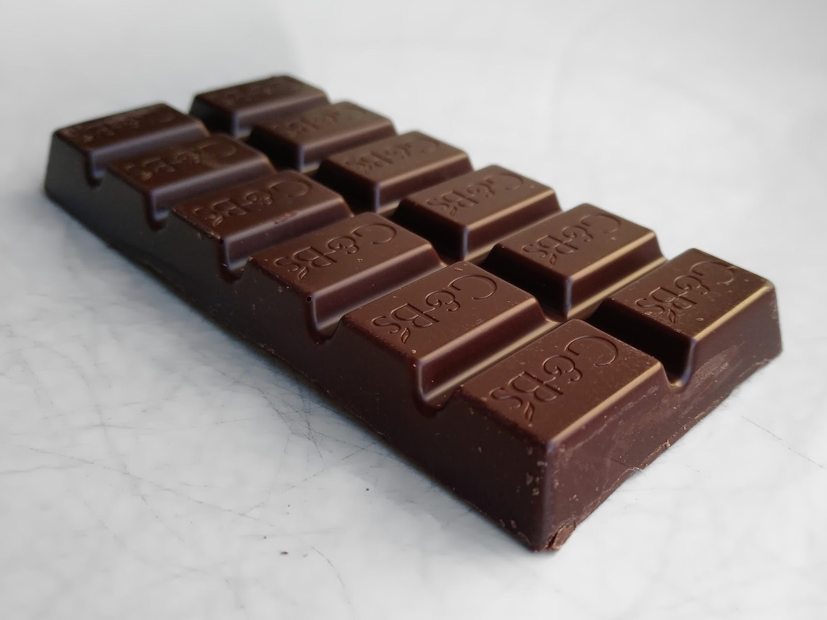
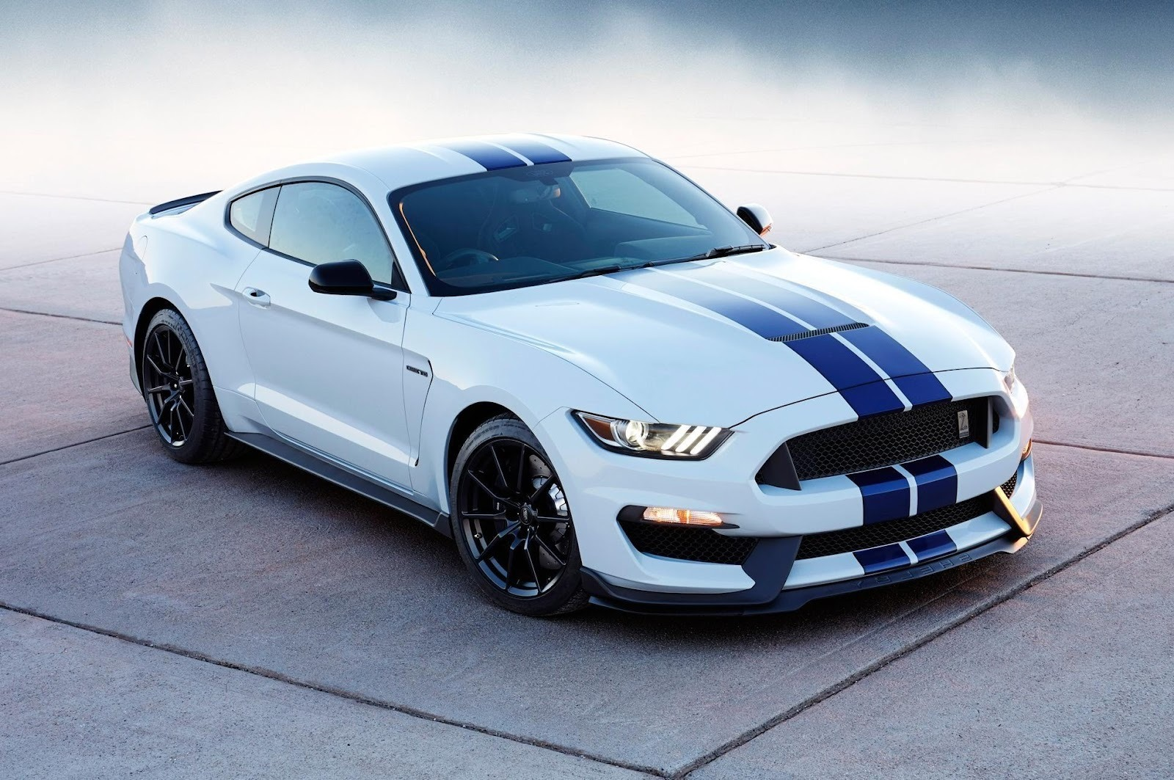
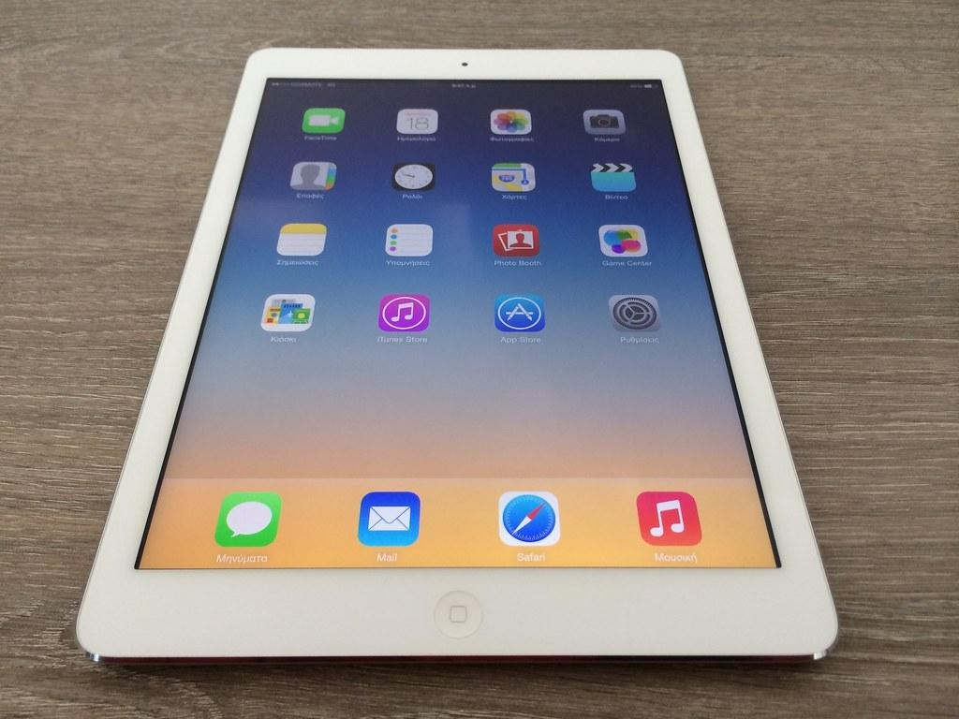
GRADE 1 FINANCIAL LITERACY
CLOSED QUESTIONS
ELEMENTARY MATH PROJECT
3. Which of these things do you think you could buy with $2?

Slide 5
GRADE 1 FINANCIAL LITERACY
CLOSED QUESTIONS
ELEMENTARY MATH PROJECT
4. You have $5. You buy a book for $3. What happens next?
Show with pictures, numbers and words.

Slide 6
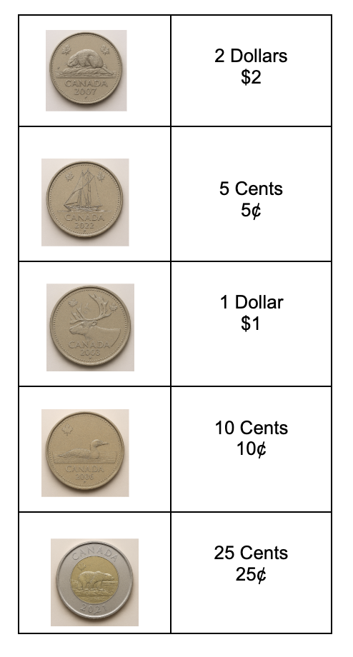
GRADE 1 FINANCIAL LITERACY
CLOSED QUESTIONS
ELEMENTARY MATH PROJECT
5. Match the value of the coin with the correct coin.
Draw a line to match the coin to the value.

Slide 7
GRADE 1 FINANCIAL LITERACY
OPEN QUESTIONS
ELEMENTARY MATH PROJECT
6. There are many ways to make $1.00.
Can you draw or write two different ways using coins?

Slide 8
GRADE 1 FINANCIAL LITERACY
OPEN QUESTIONS
ELEMENTARY MATH PROJECT
7. Is it better to buy a Pencil you need for $1.00 or some Candy you want for $0.75? Explain your thinking using pictures, numbers and words.

Slide 9
GRADE 1 FINANCIAL LITERACY
OPEN QUESTIONS
ELEMENTARY MATH PROJECT
8. Would you rather have 10 nickels or 5 dimes or 2 quarters in your pocket?

Slide 10
GRADE 1 FINANCIAL LITERACY
OPEN QUESTIONS
ELEMENTARY MATH PROJECT
9. You have $6. What could you buy from the list if you want to spend all the money? Use numbers, words, and pictures to show how you spent your money.
Hot Dog | $3
Hamburger | $4
Drink | $1
Chips | $1
Doughnut | $2

Slide 11
GRADE 1 FINANCIAL LITERACY
OPEN QUESTIONS
ELEMENTARY MATH PROJECT
10. You spent $3 and got $2 back.
How much money did you start with?
What could you have bought?

Slide 12
GRADE 1 FINANCIAL LITERACY
OPEN QUESTIONS
ELEMENTARY MATH PROJECT
11. You and 2 friends are buying treats.
A box of cookies with 5 cookies costs $10.
A box of cupcakes with 3 cupcakes costs $9.
Which treat would you choose? Why would you make that choice?

