Slide 1
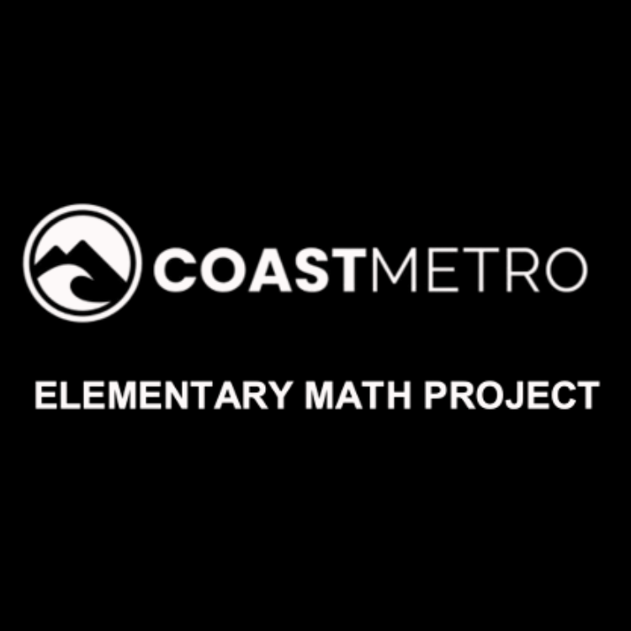
ELEMENTARY MATH PROJECT
GRADE 1 PRACTICE QUESTIONS
GEOMETRY

Slide 2
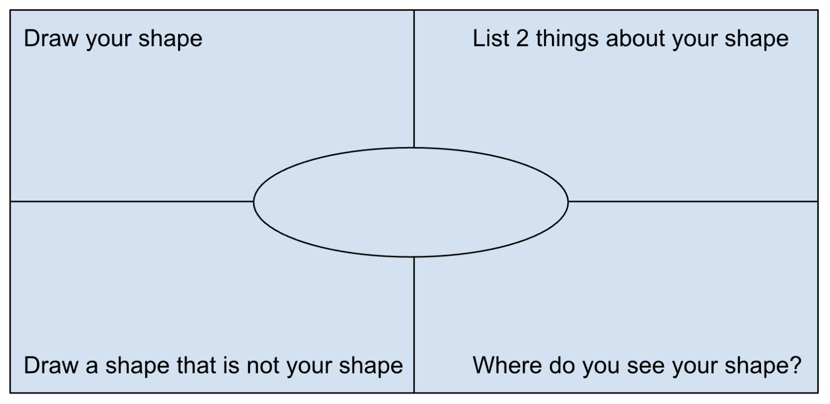
GRADE 1 GEOMETRY
CLOSED QUESTIONS
ELEMENTARY MATH PROJECT
1. Choose one of the shapes below.
Circle
Triangle
Square
Rectangle
Write the name in the middle. Answer the questions in each of the 4 corners for your shape.

Slide 3

GRADE 1 GEOMETRY
CLOSED QUESTIONS
ELEMENTARY MATH PROJECT
2. Look at the following image. Circle 3 shapes you see. How do you know what shapes they are?

Slide 4
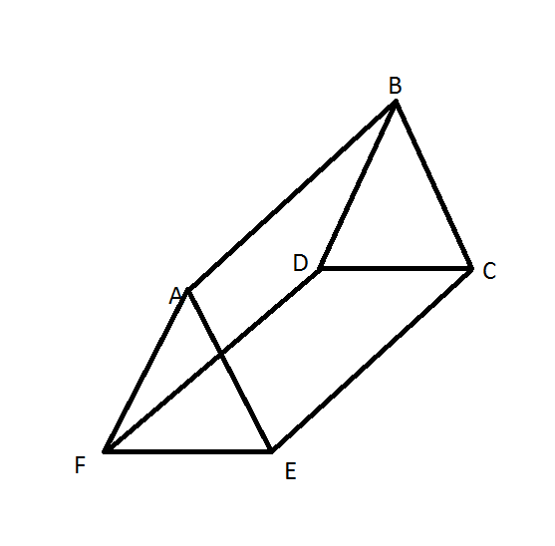
GRADE 1 GEOMETRY
CLOSED QUESTIONS
ELEMENTARY MATH PROJECT
3. Explain what shapes you would need to build a triangular prism? (provide a 3D model as well).

Slide 5

GRADE 1 GEOMETRY
CLOSED QUESTIONS
ELEMENTARY MATH PROJECT
4. Choose 2 or more shapes from your tangram set. Put them together to form a new shape. Draw (or trace) the shape. Can you show the original smaller shapes?

Slide 6
GRADE 1 GEOMETRY
CLOSED QUESTIONS
ELEMENTARY MATH PROJECT
5. If I tell you this is a square, what can you tell me about it?

Slide 7
GRADE 1 GEOMETRY
CLOSED QUESTIONS
ELEMENTARY MATH PROJECT
6. Choose one of the shapes below. Find that shape in the classroom. Draw a picture of it.
Circle Triangle Square Rectangle

Slide 8
GRADE 1 GEOMETRY
OPEN QUESTIONS
ELEMENTARY MATH PROJECT
7. What smaller shapes could you cut from this rectangle? Use the materials provided to help. Write the name of shape on each of the pieces you cut.
a) How many shapes could you cut?

Slide 9
GRADE 1 GEOMETRY
OPEN QUESTIONS
ELEMENTARY MATH PROJECT
8. Look at the two shapes here. How are they the same, and how are they different?

Slide 10
GRADE 1 GEOMETRY
OPEN QUESTIONS
ELEMENTARY MATH PROJECT
9. Can you draw a shape with 4 sides that is not a rectangle or a square?

Slide 11
GRADE 1 GEOMETRY
OPEN QUESTIONS
ELEMENTARY MATH PROJECT
10. Draw a 2-D shape. Cut it in half. Draw and describe the new shape.
Original 2D shape | New Half Shape

Slide 12
ELEMENTARY MATH PROJECT
GRADE 1 PRACTICE QUESTIONS
MEASUREMENT

Slide 13
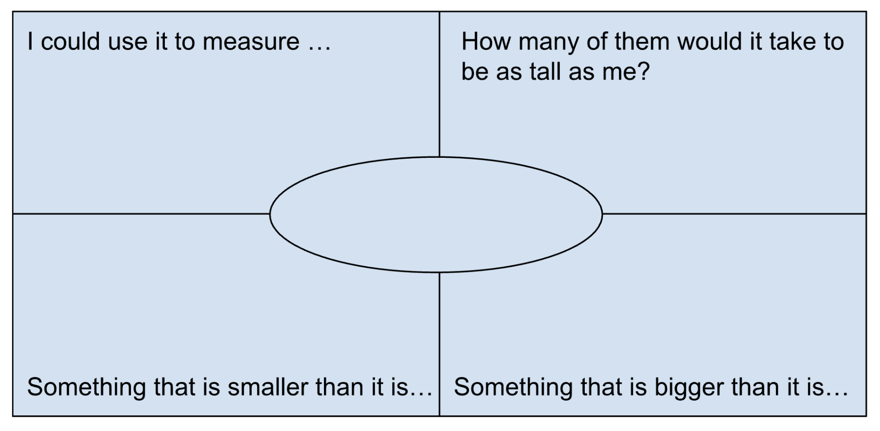
GRADE 1 MEASUREMENT
CLOSED QUESTIONS
ELEMENTARY MATH PROJECT
1. Choose one of the items below.
Pencil
Unit Cube
Toy Car
Tissue Box Write the name in the middle. Answer the questions in each of the 4 corners for your measurement.

Slide 14
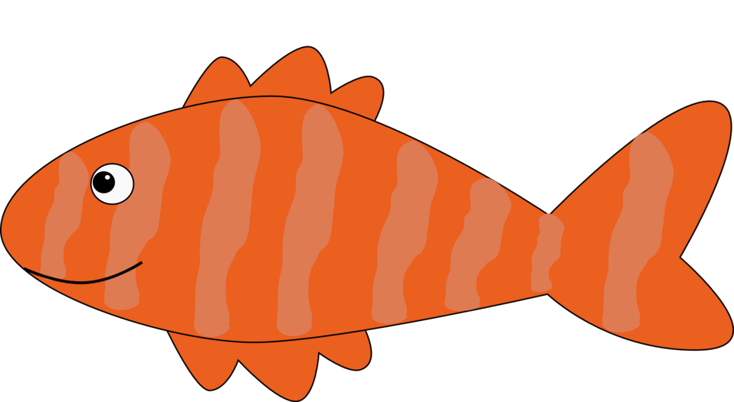
GRADE 1 MEASUREMENT
CLOSED QUESTIONS
ELEMENTARY MATH PROJECT
2. Use linking cubes or Unifix cubes to measure how long (from head to tail) this fish is (number of blocks).

Slide 15
GRADE 1 MEASUREMENT
CLOSED QUESTIONS
ELEMENTARY MATH PROJECT
3. Without measuring, what do you think the length of this pencil is?
Smallest possible length | My estimate for length | Biggest possible length

Slide 16
GRADE 1 MEASUREMENT
CLOSED QUESTIONS
ELEMENTARY MATH PROJECT
4. Use a piece of string or rope to help you figure out about how far it is between the poles of a soccer goalpost.

Slide 17
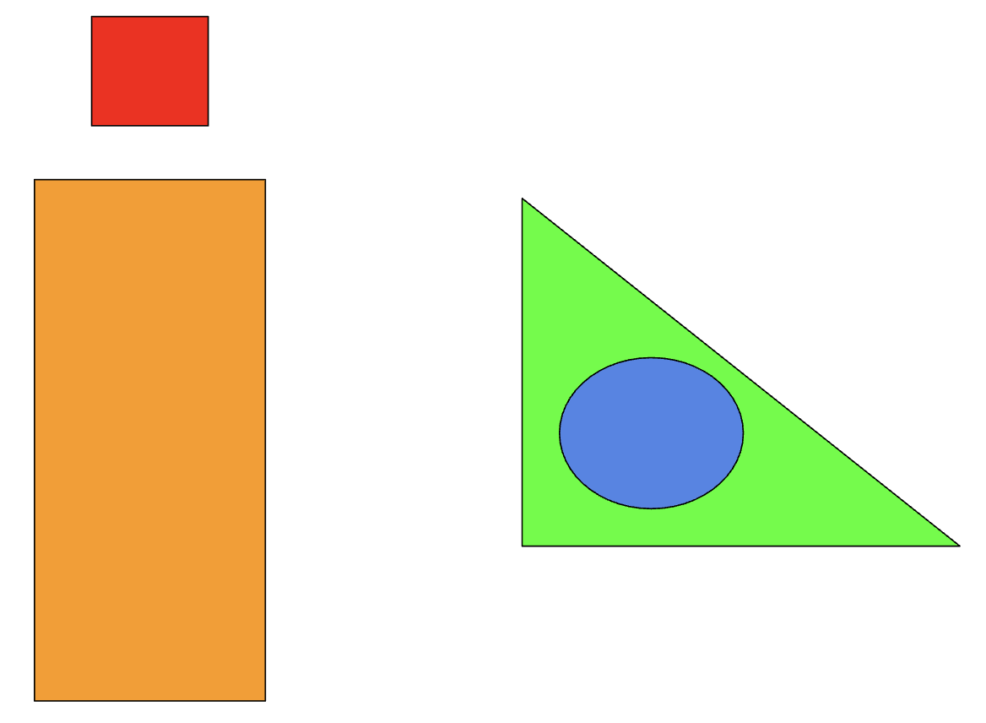
GRADE 1 MEASUREMENT
CLOSED QUESTIONS
ELEMENTARY MATH PROJECT
5. Describe how the shapes are related to each other using the following words:
Left Right
Up Down
Below Above
Inside Outside

Slide 18
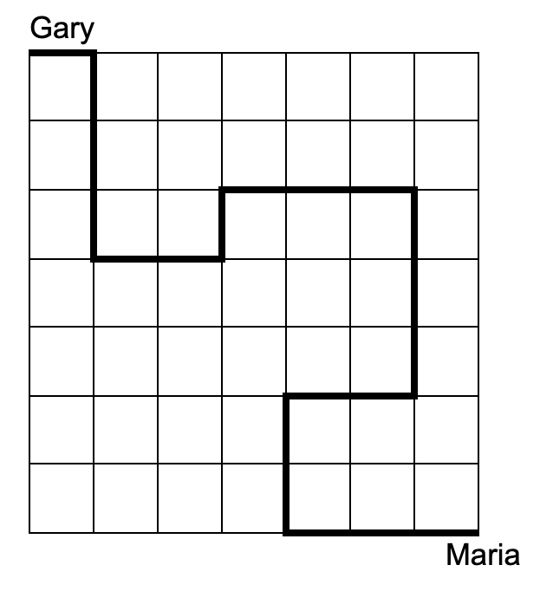
GRADE 1 MEASUREMENT
CLOSED QUESTIONS
ELEMENTARY MATH PROJECT
6. Walking along the lines, can you describe how to walk from Gary to Maria?

Slide 19
GRADE 1 MEASUREMENT
OPEN QUESTIONS
ELEMENTARY MATH PROJECT
7. Using a part of your body (length of a finger, fingertip to elbow, width of a hand).
Use that body part to estimate the width of your desk
Use that body part to estimate the width of a whiteboard or tackboard

Slide 20
GRADE 1 MEASUREMENT
OPEN QUESTIONS
ELEMENTARY MATH PROJECT
8. Pretend you are using a finger to measure the length of a pencil. Explain why you need to use the same finger every time.

Slide 21
GRADE 1 MEASUREMENT
OPEN QUESTIONS
ELEMENTARY MATH PROJECT
9. Explain how one person could measure something and get a really big number, and a different person could measure the same thing and get a small number.

Slide 22
GRADE 1 MEASUREMENT
OPEN QUESTIONS
ELEMENTARY MATH PROJECT
10. Explain how you could measure the distance around a really big tree (one that you could not reach around).

