Slide 1

ELEMENTARY MATH PROJECT
GRADE 1 PRACTICE QUESTIONS
NUMBER CONCEPTS

Slide 2
GRADE 1 NUMBER CONCEPTS
CLOSED QUESTIONS
ELEMENTARY MATH PROJECT
1. What comes next?
1, 2, 3, 4, _____, _____, ______

Slide 3
GRADE 1 NUMBER CONCEPTS
CLOSED QUESTIONS
ELEMENTARY MATH PROJECT
2. Count backward from 10:
10, 9, 8, 7, 6, 5, _____, ______, _____, _____, 0

Slide 4
GRADE 1 NUMBER CONCEPTS
CLOSED QUESTIONS
ELEMENTARY MATH PROJECT
3. What numbers are missing?
1, 2, _____, 4, 5, _____, 7 _____, 9, ______

Slide 5
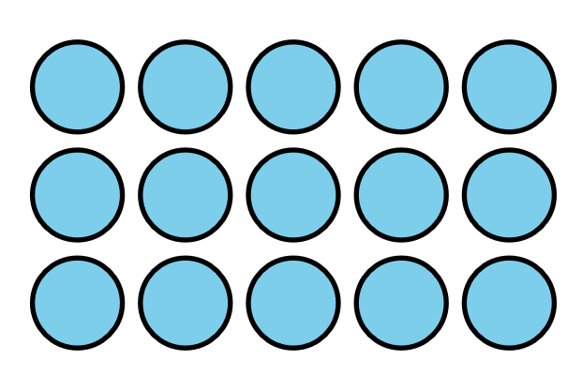
GRADE 1 NUMBER CONCEPTS
CLOSED QUESTIONS
ELEMENTARY MATH PROJECT
4. How many? Can you count them in a different way?

Slide 6
GRADE 1 NUMBER CONCEPTS
CLOSED QUESTIONS
ELEMENTARY MATH PROJECT
5. Let’s count by 5s!
5, _____, _____, _____, ______

Slide 7
GRADE 1 NUMBER CONCEPTS
CLOSED QUESTIONS
ELEMENTARY MATH PROJECT
6. Let’s count by 2s!
2, 4, ____, ____, 10, 12, ____, ____, ___, 20

Slide 8
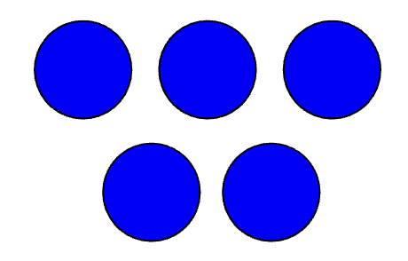
GRADE 1 NUMBER CONCEPTS
CLOSED QUESTIONS
ELEMENTARY MATH PROJECT
7. How many dots do you see? (Try not to count at first). How do you see them?

Slide 9
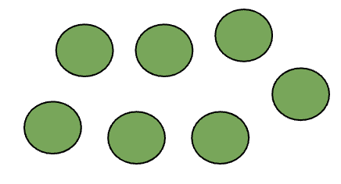
GRADE 1 NUMBER CONCEPTS
CLOSED QUESTIONS
ELEMENTARY MATH PROJECT
8. How many dots do you see? (Try not to count at first). How do you see them?

Slide 10
GRADE 1 NUMBER CONCEPTS
CLOSED QUESTIONS
ELEMENTARY MATH PROJECT
9. Circle the number that is closest to 5:
11, 9, 16, 2

Slide 11
GRADE 1 NUMBER CONCEPTS
CLOSED QUESTIONS
ELEMENTARY MATH PROJECT
10. Circle the number that is closest to 10:
16, 7, 12, 6

Slide 12
GRADE 1 NUMBER CONCEPTS
CLOSED QUESTIONS
ELEMENTARY MATH PROJECT
11. In the number pairs, circle which number is the greatest.
3 7
8 5
12 9
15 19
18 14

Slide 13
GRADE 1 NUMBER CONCEPTS
CLOSED QUESTIONS
ELEMENTARY MATH PROJECT
12. Order these numbers from least to greatest:
17, 4, 12, 7, 10
_____, _____, _____, ______, _____

Slide 14
GRADE 1 NUMBER CONCEPTS
CLOSED QUESTIONS
ELEMENTARY MATH PROJECT
13. Estimate where these numbers go in order on the number line: 10, 14, 5, 19, 8 and record them on the number line.
0
20

Slide 15
GRADE 1 NUMBER CONCEPTS
CLOSED QUESTIONS
ELEMENTARY MATH PROJECT
14. What is a number that is more than 8 but less than 12?

Slide 16
GRADE 1 NUMBER CONCEPTS
CLOSED QUESTIONS
ELEMENTARY MATH PROJECT
15. On a number line, what number comes halfway between 0 and 20?
0
20

Slide 17
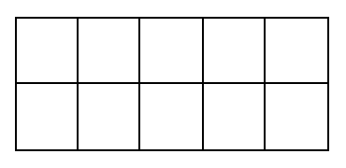
GRADE 1 NUMBER CONCEPTS
CLOSED QUESTIONS
ELEMENTARY MATH PROJECT
16. Show one way to make 6 on a ten frame.

Slide 18
GRADE 1 NUMBER CONCEPTS
CLOSED QUESTIONS
ELEMENTARY MATH PROJECT
17. Make the number 8 using tally marks,

Slide 19
GRADE 1 NUMBER CONCEPTS
CLOSED QUESTIONS
ELEMENTARY MATH PROJECT
18. Draw a picture that shows 10 of something. Print the word for 10.

Slide 20
GRADE 1 NUMBER CONCEPTS
CLOSED QUESTIONS
ELEMENTARY MATH PROJECT
19. Represent the number 13.
DOTS | TALLIES | TEN FRAMES

Slide 21
GRADE 1 NUMBER CONCEPTS
CLOSED QUESTIONS
ELEMENTARY MATH PROJECT
20. Make the number 17 using tally marks.

Slide 22
GRADE 1 NUMBER CONCEPTS
CLOSED QUESTIONS
ELEMENTARY MATH PROJECT
21. Show one way to represent 12 on ten frames.

Slide 23
GRADE 1 NUMBER CONCEPTS
CLOSED QUESTIONS
ELEMENTARY MATH PROJECT
22. How many tens and ones are in 16?
______ tens ______ ones

Slide 24
GRADE 1 NUMBER CONCEPTS
CLOSED QUESTIONS
ELEMENTARY MATH PROJECT
23. Represent the number 18.
DOTS | TALLIES | TEN FRAMES

Slide 25
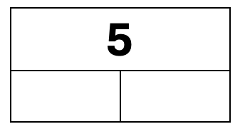
GRADE 1 NUMBER CONCEPTS
CLOSED QUESTIONS
ELEMENTARY MATH PROJECT
24. Show three ways to decompose 5 into two parts.

Slide 26
GRADE 1 NUMBER CONCEPTS
CLOSED QUESTIONS
ELEMENTARY MATH PROJECT
25. Use ten frames to show two ways to decompose 7 into parts.
________ and _________
________ and _________

Slide 27
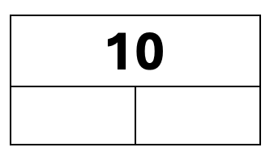
GRADE 1 NUMBER CONCEPTS
CLOSED QUESTIONS
ELEMENTARY MATH PROJECT
26. Show three ways to decompose 10 into two parts

Slide 28
GRADE 1 NUMBER CONCEPTS
CLOSED QUESTIONS
ELEMENTARY MATH PROJECT
27. Decompose the numbers into tens and ones.
12 is ______ ten and ______ ones
15 is ______ ten and ______ ones
19 is ______ ten and ______ ones

Slide 29
GRADE 1 NUMBER CONCEPTS
OPEN QUESTIONS
ELEMENTARY MATH PROJECT
28. Grab a handful of small blocks, cubes, or counters. What different ways could you count them? Record your counts using pictures and numbers.

Slide 30
GRADE 1 NUMBER CONCEPTS
OPEN QUESTIONS
ELEMENTARY MATH PROJECT
29. Count out 20 cubes or counters by ones. What different ways can you organize the cubes or counters to count them?

Slide 31
GRADE 1 NUMBER CONCEPTS
OPEN QUESTIONS
ELEMENTARY MATH PROJECT
30. Start at 2. Count by 2s. What patterns do you notice?

Slide 32
GRADE 1 NUMBER CONCEPTS
OPEN QUESTIONS
ELEMENTARY MATH PROJECT
31. Find a collection of items in your classroom like a basket of books or a jar of pencils. About how many do you think there are? Count to find out how many. Is there a different way you could count them?

Slide 33
GRADE 1 NUMBER CONCEPTS
OPEN QUESTIONS
ELEMENTARY MATH PROJECT
32. Choose three different collections in your classroom to count. What different ways can you count them? Record how you counted using pictures, numbers, and words.

Slide 34
GRADE 1 NUMBER CONCEPTS
OPEN QUESTIONS
ELEMENTARY MATH PROJECT
33. Grab a handful of crayons or pencil crayons. Estimate about how many there are. Compare you handful with a classmate. Who do you think has more? Count and check and compare the numbers you each have.

Slide 35
GRADE 1 NUMBER CONCEPTS
OPEN QUESTIONS
ELEMENTARY MATH PROJECT
34. Is 12 closer to 10 or 15? How do you know?

Slide 36
GRADE 1 NUMBER CONCEPTS
OPEN QUESTIONS
ELEMENTARY MATH PROJECT
35. About how many books do you think you have in your classroom? About how many pencils do you think there are? Are there more books or pencils?

Slide 37
GRADE 1 NUMBER CONCEPTS
OPEN QUESTIONS
ELEMENTARY MATH PROJECT
36. Place 8 and 15 on the number line. Explain your reasoning to a partner.
0
20

Slide 38
GRADE 1 NUMBER CONCEPTS
OPEN QUESTIONS
ELEMENTARY MATH PROJECT
37. When is 10 a lot of something? When is 10 a little of something? Draw a picture and add numbers and words to show your thinking.

Slide 39
GRADE 1 NUMBER CONCEPTS
OPEN QUESTIONS
ELEMENTARY MATH PROJECT
38. What different ways can you represent 5? Think about using words, pictures, numbers, tallies, ten frames, etc.

Slide 40
GRADE 1 NUMBER CONCEPTS
OPEN QUESTIONS
ELEMENTARY MATH PROJECT
39. What different ways can you decompose 7 into parts? Use materials, pictures, numbers, ten frames, etc.

Slide 41
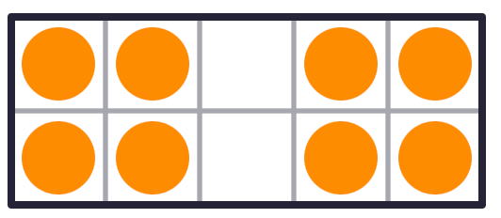
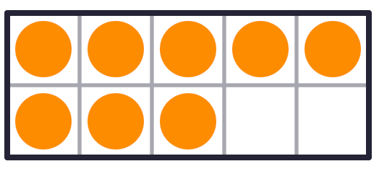
GRADE 1 NUMBER CONCEPTS
OPEN QUESTIONS
ELEMENTARY MATH PROJECT
40. How are these representations of 8 the same? How are they different?

Slide 42
GRADE 1 NUMBER CONCEPTS
OPEN QUESTIONS
ELEMENTARY MATH PROJECT
41. What different ways can you represent 10? Think about using words, pictures, numbers, tallies, ten frames, etc.

Slide 43
GRADE 1 NUMBER CONCEPTS
OPEN QUESTIONS
ELEMENTARY MATH PROJECT
42. Get a collection of 12 or 15 items. What different ways can you decompose the whole amount into parts? How could you record all the different ways you find using pictures, numbers, and words.

Slide 44
GRADE 1 NUMBER CONCEPTS
OPEN QUESTIONS
ELEMENTARY MATH PROJECT
43. What different ways can you represent 16? Think about using words, pictures, numbers, tallies, ten frames, etc.

Slide 45

GRADE 1 COMPUTATIONAL FLUENCY
CLOSED QUESTIONS
ELEMENTARY MATH PROJECT
1. There are 4 orange cubes and 3 blue cubes. When you combine them together, how many cubes are there?
What is the addition equation? ______ + ______ = ______

Slide 46
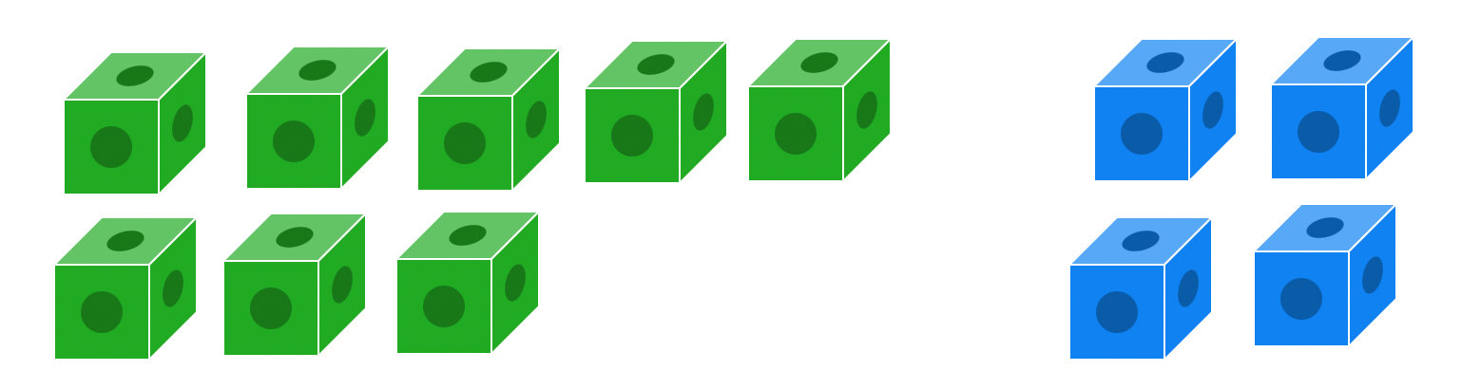
GRADE 1 COMPUTATIONAL FLUENCY
CLOSED QUESTIONS
ELEMENTARY MATH PROJECT
2. There are 8 green cubes and 4 blue cubes. When you combine them together, how many cubes are there?
What is the addition equation? ______ + ______ = ______

Slide 47

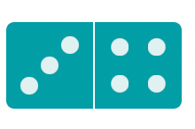
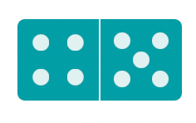

GRADE 1 COMPUTATIONAL FLUENCY
CLOSED QUESTIONS
ELEMENTARY MATH PROJECT
3. Add the dots on the dominoes together. Print the equation that matches the dominoes.
_____ + _____ = ______
_____ + _____ = ______
_____ + _____ = ______
_____ + _____ = ______

Slide 48
GRADE 1 COMPUTATIONAL FLUENCY
CLOSED QUESTIONS
ELEMENTARY MATH PROJECT
4. Draw a picture or use tally marks to solve the following addition equations.
3 + 5 = | 8 + 2 =
9 + 5 = | 7 + 8 =

Slide 49
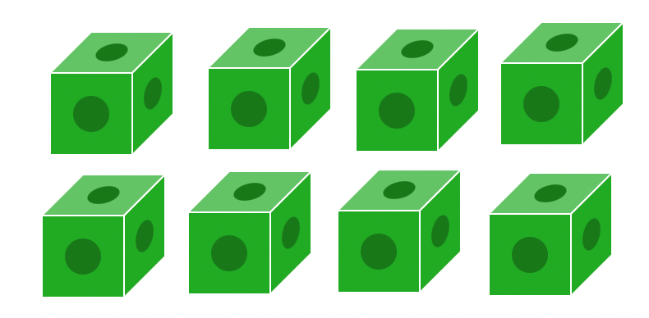
GRADE 1 COMPUTATIONAL FLUENCY
CLOSED QUESTIONS
ELEMENTARY MATH PROJECT
5. There are 8 green cubes. If you remove 2 of them, how many green cubes will be left?
What is the subtraction equation? ______ - ______ = ______

Slide 50
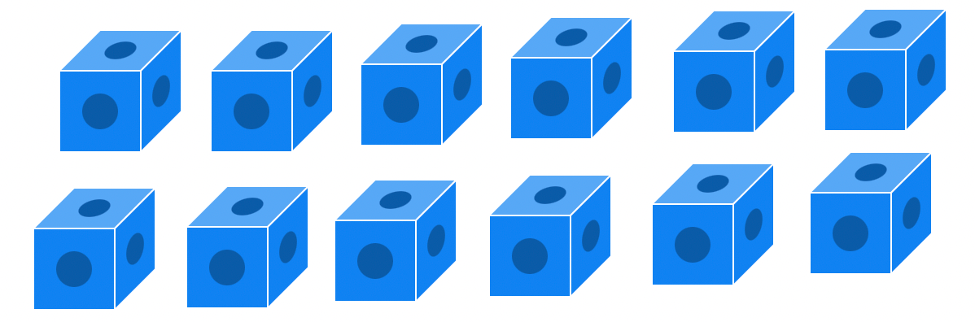
GRADE 1 COMPUTATIONAL FLUENCY
CLOSED QUESTIONS
ELEMENTARY MATH PROJECT
6. There are 12 green cubes. If you remove 3 of them, how many green cubes will be left?
What is the subtraction equation? ______ - ______ = ______

Slide 51
GRADE 1 COMPUTATIONAL FLUENCY
CLOSED QUESTIONS
ELEMENTARY MATH PROJECT
7. Draw pictures to solve the following subtraction equations.
4 - 2 = | 10 - 5 =
8 - 3 = | 15 - 7 =

Slide 52

GRADE 1 COMPUTATIONAL FLUENCY
CLOSED QUESTIONS
ELEMENTARY MATH PROJECT
8. How do ten frames help you think about adding?
Solve: 7 + 6 = ____

Slide 53
GRADE 1 COMPUTATIONAL FLUENCY
CLOSED QUESTIONS
ELEMENTARY MATH PROJECT
9. How do ten frames help you think about adding?
Solve: 12 – 4 = ____

Slide 54
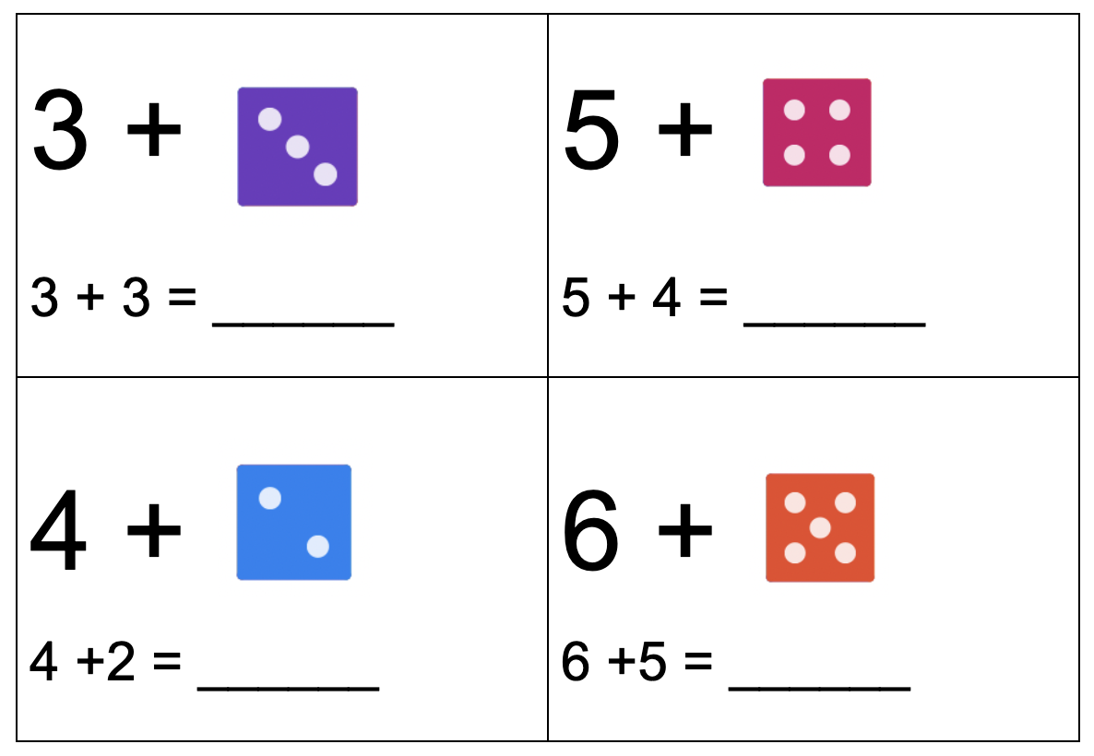
GRADE 1 COMPUTATIONAL FLUENCY
CLOSED QUESTIONS
ELEMENTARY MATH PROJECT
10. Use the dice to help you practice counting on:

Slide 55
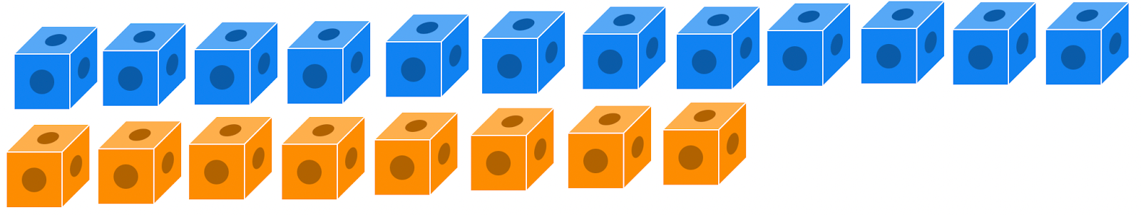
GRADE 1 COMPUTATIONAL FLUENCY
CLOSED QUESTIONS
ELEMENTARY MATH PROJECT
11. Subtract by comparing to find the difference. Show your thinking.
How many more blue cubes than orange cubes are there?
12 - 8 = _______

Slide 56
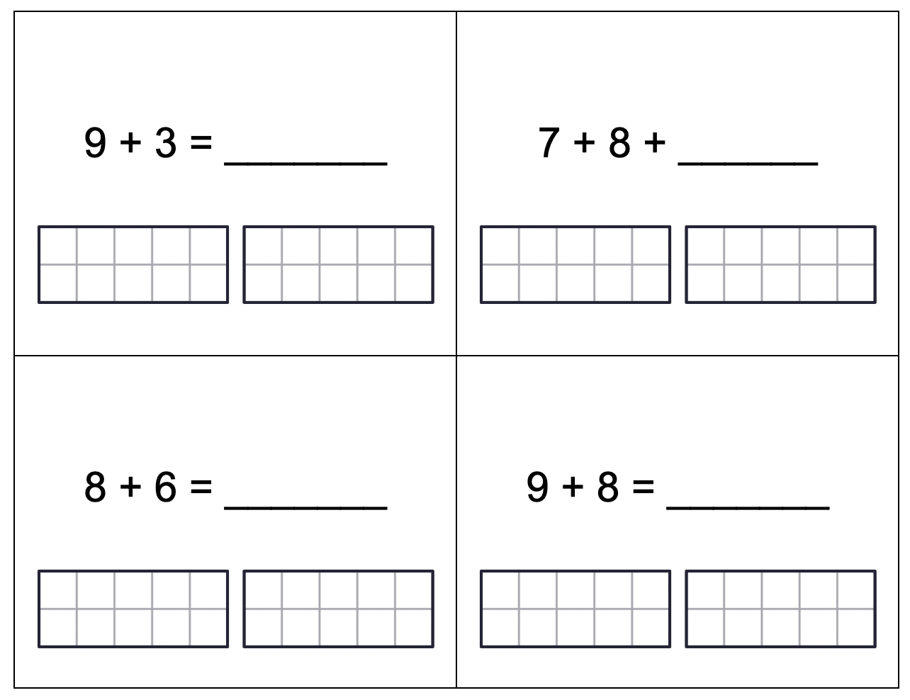
GRADE 1 COMPUTATIONAL FLUENCY
CLOSED QUESTIONS
ELEMENTARY MATH PROJECT
12. Use a ten frame to make 10 to add over 10. Use dots, numbers and symbols to show how you solved the questions.

Slide 57
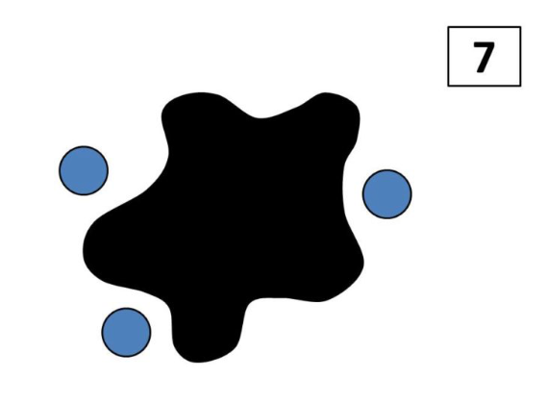
GRADE 1 COMPUTATIONAL FLUENCY
CLOSED QUESTIONS
ELEMENTARY MATH PROJECT
13. There are 7 blue dots. We can see 3. Some are hiding under the splat. How many dots are under the splat?
_______ dots under the splat
What math equation matches this splat?
_______________________________

Slide 58
GRADE 1 COMPUTATIONAL FLUENCY
CLOSED QUESTIONS
ELEMENTARY MATH PROJECT
14. There are 9 birds in a tree and 6 fly away. How many birds are still in the tree?
Use pictures, numbers, and words to show how you solve the problem.
What equation could you write to match the problem?_____________

Slide 59
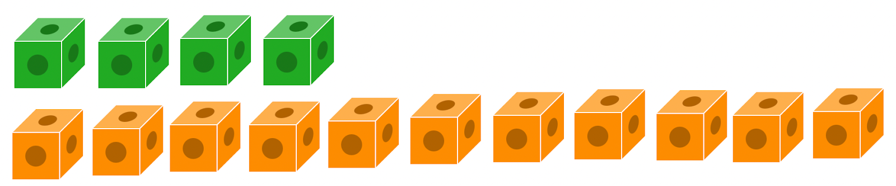
GRADE 1 COMPUTATIONAL FLUENCY
CLOSED QUESTIONS
ELEMENTARY MATH PROJECT
15. Subtract by comparing to find the difference. Show your thinking.
How many more orange cubes than green cubes are there?
11 - 4 = _______

Slide 60
GRADE 1 COMPUTATIONAL FLUENCY
CLOSED QUESTIONS
ELEMENTARY MATH PROJECT
16. Draw pictures or use tally marks to show how you solved the following addition equations.
3 + ____ = 7 | _____ + 3 = 11
9 + _____ = 16 | _____ + 7 = 14

Slide 61
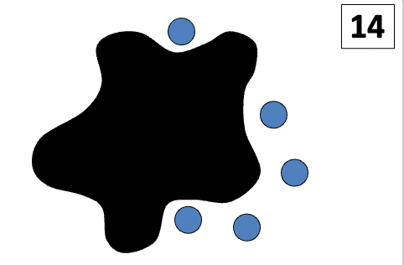
GRADE 1 COMPUTATIONAL FLUENCY
CLOSED QUESTIONS
ELEMENTARY MATH PROJECT
17. There are 14 blue dots. We can see 5. Some are hiding under the splat. How many dots are under the splat?
_______ dots under the splat
What math equation matches this splat?
_______________________________

Slide 62
GRADE 1 COMPUTATIONAL FLUENCY
CLOSED QUESTIONS
ELEMENTARY MATH PROJECT
18. Draw pictures to show how you solved the following subtraction equations.
____ - 5 = 10 | 8 - ____ = 7
19 - ____ = 9 | _____ + 8 = 16

Slide 63
GRADE 1 COMPUTATIONAL FLUENCY
CLOSED QUESTIONS
ELEMENTARY MATH PROJECT
19. There are 6 ladybugs on a leaf and 5 more flew down and joined them. How many ladybugs are on the leaf now?
Use pictures, numbers, and words to show how you solve the problem.
What equation could you write to match the problem? ______________________

Slide 64
GRADE 1 COMPUTATIONAL FLUENCY
OPEN QUESTIONS
ELEMENTARY MATH PROJECT
20. What different ways can you solve 5 + 4?

Slide 65
GRADE 1 COMPUTATIONAL FLUENCY
OPEN QUESTIONS
ELEMENTARY MATH PROJECT
21. The answer is 8. What could the addition or subtraction question be? Record as many questions that you can think of!

Slide 66
GRADE 1 COMPUTATIONAL FLUENCY
OPEN QUESTIONS
ELEMENTARY MATH PROJECT
22. What three numbers could you add together that make a total of 10. Show as many different ways as you can think of.

Slide 67
GRADE 1 COMPUTATIONAL FLUENCY
OPEN QUESTIONS
ELEMENTARY MATH PROJECT
23. Show or explain how you could use a making 10 strategy to add 7 + 4?

Slide 68
GRADE 1 COMPUTATIONAL FLUENCY
OPEN QUESTIONS
ELEMENTARY MATH PROJECT
24. What different ways can you solve 9 - 4?

Slide 69
GRADE 1 COMPUTATIONAL FLUENCY
OPEN QUESTIONS
ELEMENTARY MATH PROJECT
25. What different ways could you use ten frames to help you solve 8 + 6? Show three different ways and use words and equations to explain what you did.

Slide 70
GRADE 1 COMPUTATIONAL FLUENCY
OPEN QUESTIONS
ELEMENTARY MATH PROJECT
26. The answer is 15. What could the addition or subtraction question be? Record as many questions that you can think of!

Slide 71
GRADE 1 COMPUTATIONAL FLUENCY
OPEN QUESTIONS
ELEMENTARY MATH PROJECT
27. What different ways can you solve 9 + 6?

Slide 72
GRADE 1 COMPUTATIONAL FLUENCY
OPEN QUESTIONS
ELEMENTARY MATH PROJECT
28. What three numbers could you add together that make a total of 16. Show as many different ways as you can think of.

Slide 73
GRADE 1 COMPUTATIONAL FLUENCY
OPEN QUESTIONS
ELEMENTARY MATH PROJECT
29. What is a story you can tell to match the equation 8 + 4 =12?
Use pictures, numbers, and words to share your story.

Slide 74
ELEMENTARY MATH PROJECT
GRADE 1 PRACTICE QUESTIONS
PATTERNS

Slide 75

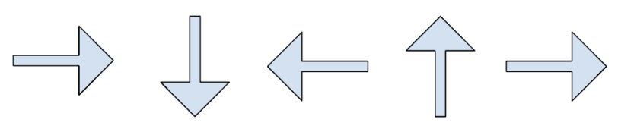
GRADE 1 PATTERNS
CLOSED QUESTIONS
ELEMENTARY MATH PROJECT
1. Continue the patterns below:
Start of the pattern | Continue the pattern
2, 4, 6, 8

Slide 76
GRADE 1 PATTERNS
CLOSED QUESTIONS
ELEMENTARY MATH PROJECT
2. Can you identify the pattern rules from question 1?
2, 4, 6, 8

Slide 77
GRADE 1 PATTERNS
CLOSED QUESTIONS
ELEMENTARY MATH PROJECT
3. What are the next 3 shapes of this pattern?
Can you make this same pattern using circles and triangles that are the same colour?

Slide 78
GRADE 1 PATTERNS
CLOSED QUESTIONS
ELEMENTARY MATH PROJECT
4. Can you identify the pattern rules from below and continue the pattern to include 10 cars?
a) ABA b) AAB c) BAB d) BBA
Original Pattern | Pattern Rule | Continue the Pattern (10 cars)
a) 🚗🚗🚙
b) 🚗🚙🚙🚗🚙🚙
c) 🚙🚗🚙
d) 🚗🚙🚗

Slide 79
GRADE 1 PATTERNS
CLOSED QUESTIONS
ELEMENTARY MATH PROJECT
5. How many tiles will be in the 5th step of this pattern?
Step 1: 🔳
Step 2: 🔳🔳
Step 3: 🔳🔳🔳
Step 4: 🔳🔳🔳🔳

Slide 80
GRADE 1 PATTERNS
OPEN QUESTIONS
ELEMENTARY MATH PROJECT
6. I’m thinking of a pattern that uses 2 shapes.
What could my pattern look like? What do you call this pattern?

Slide 81
GRADE 1 PATTERNS
OPEN QUESTIONS
ELEMENTARY MATH PROJECT
7. I’m thinking of a pattern that uses 3 shapes. Can you show two different pattern rules?
What could my pattern look like?

Slide 82

GRADE 1 PATTERNS
OPEN QUESTIONS
ELEMENTARY MATH PROJECT
8. There is a mistake in this pattern:
What is the mistake and how do you know?
What can you change to correct the pattern?

Slide 83
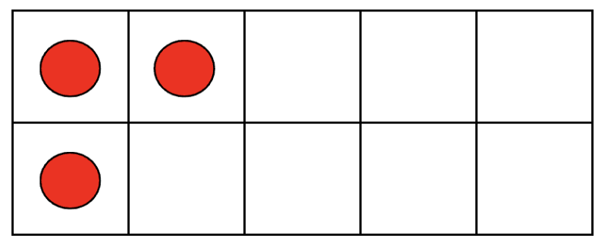
GRADE 1 PATTERNS
OPEN QUESTIONS
ELEMENTARY MATH PROJECT
9. What pattern could you make if this is the first image?
Can you explain the rule?

Slide 84
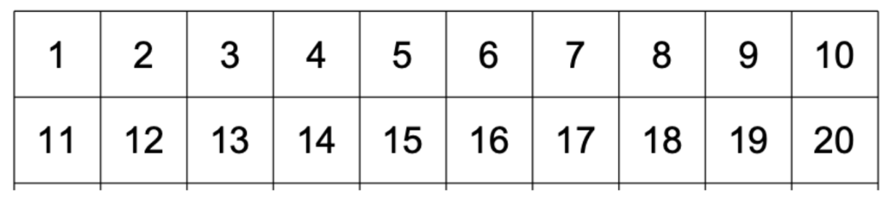
GRADE 1 PATTERNS
OPEN QUESTIONS
ELEMENTARY MATH PROJECT
10. What pattern(s) can you find in this 20 chart?

Slide 85
ELEMENTARY MATH PROJECT
GRADE 1 PRACTICE QUESTIONS
ALGEBRA

Slide 86
GRADE 1 ALGEBRA
CLOSED QUESTIONS
ELEMENTARY MATH PROJECT
1. Look at the images below. How many do you need to make 10?
a)

Slide 87
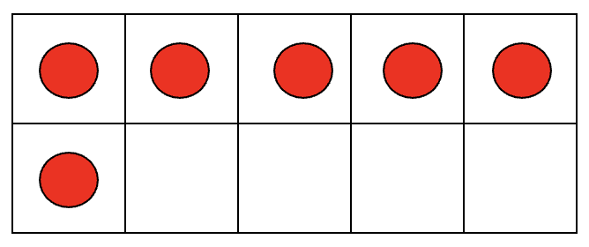
GRADE 1 ALGEBRA
CLOSED QUESTIONS
ELEMENTARY MATH PROJECT
1. Look at the images below. How many do you need to make 10?
b)

Slide 88
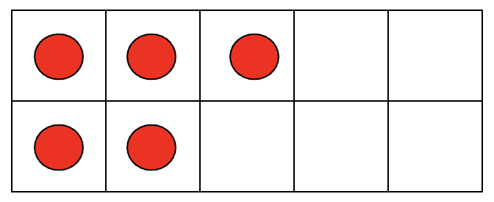
GRADE 1 ALGEBRA
CLOSED QUESTIONS
ELEMENTARY MATH PROJECT
1. Look at the images below. How many do you need to make 10?
c)

Slide 89
GRADE 1 ALGEBRA
CLOSED QUESTIONS
ELEMENTARY MATH PROJECT
2. Answer the following sentences:
a) If you start at 3, how many more do you need to get to 7
b) Use the linking cubes to make 6. Can you show how many more you need to build 13?
c) Count out 15 counters. How many do you need to remove to get to 9?

Slide 90
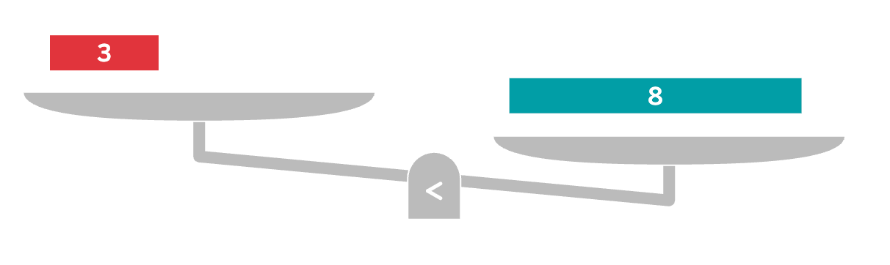
GRADE 1 ALGEBRA
CLOSED QUESTIONS
ELEMENTARY MATH PROJECT
3. What should you add to balance the scales?
a)

Slide 91
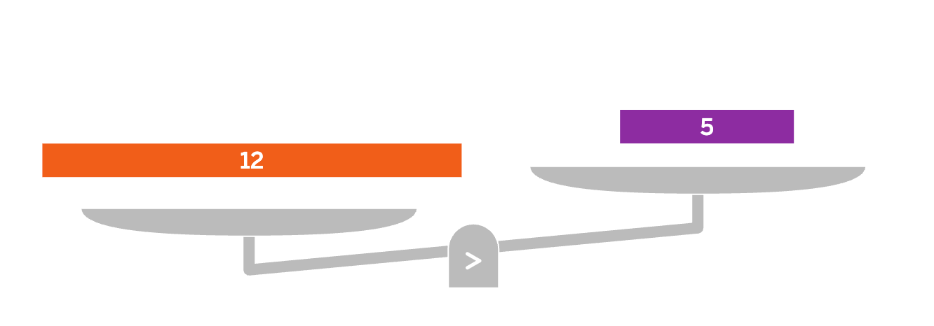
GRADE 1 ALGEBRA
CLOSED QUESTIONS
ELEMENTARY MATH PROJECT
3. What should you add to balance the scales?
b)

Slide 92
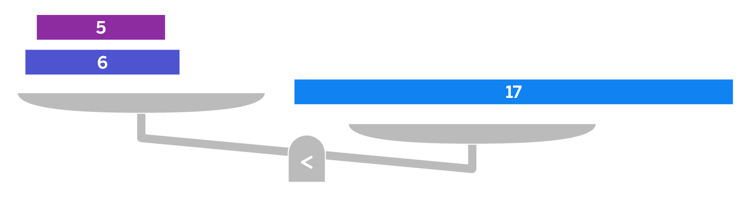
GRADE 1 ALGEBRA
CLOSED QUESTIONS
ELEMENTARY MATH PROJECT
3. What should you add to balance the scales?
c)

Slide 93
GRADE 1 ALGEBRA
CLOSED QUESTIONS
ELEMENTARY MATH PROJECT
4. Which of these number sentences is correct (balanced)?
a) 2 + 2 = 5
b) 4 + 3 = 8
c) 5 + 5 = 10
d) 2 + 6 = 7

Slide 94
GRADE 1 ALGEBRA
CLOSED QUESTIONS
ELEMENTARY MATH PROJECT
5. What number should go in the box?
⬜ – 3 = 2
⬜= _____

Slide 95
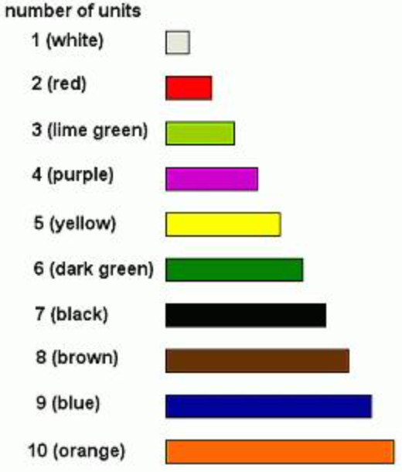
GRADE 1 ALGEBRA
OPEN QUESTIONS
ELEMENTARY MATH PROJECT
6. Use the Cuisenaire rods to build 7 in two different ways.

Slide 96
GRADE 1 ALGEBRA
OPEN QUESTIONS
ELEMENTARY MATH PROJECT
7. Build a number bigger than 10 using the Linking Cubes. Take some of them away and show how many are left. Write a number sentence that says the same thing.

Slide 97
GRADE 1 ALGEBRA
OPEN QUESTIONS
ELEMENTARY MATH PROJECT
8. Look at this equation: 16 - 5 ≠ 9
Can you draw a picture or use manipulatives to show how you know this?
What could you do to make it an “=” sign instead?

Slide 98
GRADE 1 ALGEBRA
OPEN QUESTIONS
ELEMENTARY MATH PROJECT
9. How many ways can you show how 4, 5, and 9 are friendly or related.

Slide 99
GRADE 1 ALGEBRA
OPEN QUESTIONS
ELEMENTARY MATH PROJECT
10. Write 2 equations (number sentences) that both have the same number on one side of the equals sign.

Slide 100
ELEMENTARY MATH PROJECT
GRADE 1 PRACTICE QUESTIONS
DATA

Slide 101
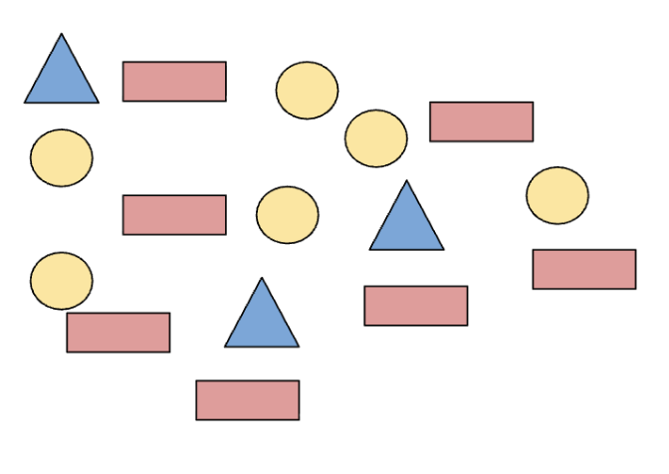
GRADE 1 DATA
CLOSED QUESTIONS
ELEMENTARY MATH PROJECT
1. Count the different shapes using a tally chart. Record your counting.
Shape | Tally
Circles
Triangles
Rectangle

Slide 102
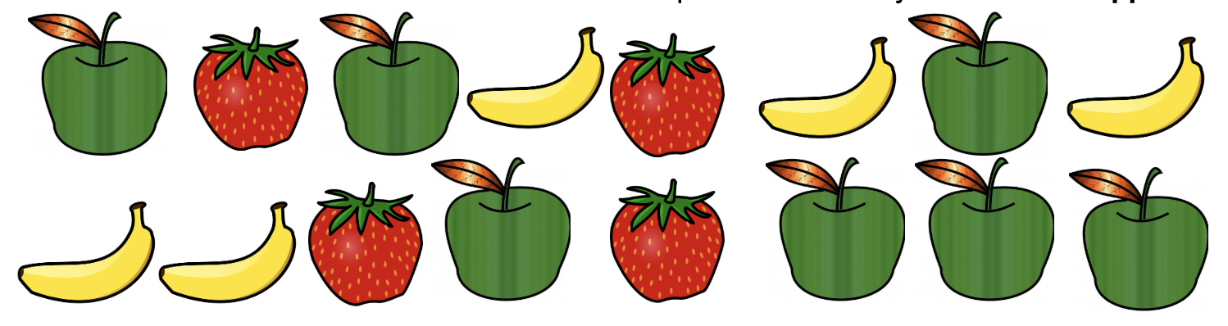
GRADE 1 DATA
CLOSED QUESTIONS
ELEMENTARY MATH PROJECT
2. Use two-colour counters or Unifix cubes to represent how many bananas and apples there are.

Slide 103


GRADE 1 DATA
CLOSED QUESTIONS
ELEMENTARY MATH PROJECT
Shoe Colours in Div.15 | Tally | Count (Number)
Blue |  | 9
Red
White
Black |  | 3
3. Look at the following tally chart. Create a Bar Graph or a Concrete Graph using the data. Include all the important labels and a title.

Slide 104
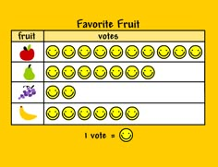
GRADE 1 DATA
CLOSED QUESTIONS
ELEMENTARY MATH PROJECT
4. Look at the following pictograph.
Use it to answer these questions:
How many types of fruit did the student record data for?
What fruit was the favourite?
How many more people liked pears more than grapes?

Slide 105
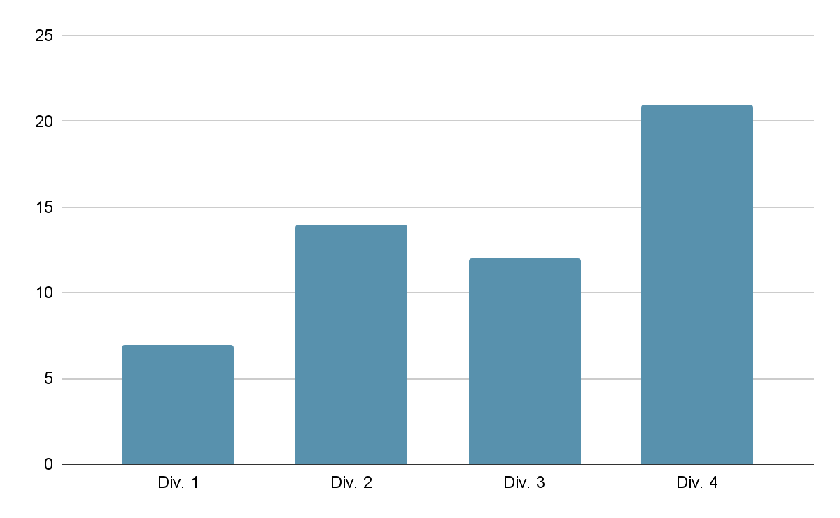
GRADE 1 DATA
OPEN QUESTIONS
ELEMENTARY MATH PROJECT
5. Describe what you think this graph could be trying to tell us and give some reasons why.

Slide 106




GRADE 1 DATA
OPEN QUESTIONS
ELEMENTARY MATH PROJECT
Student Siblings in Div.15 | Tally
1 Brother
1 Sister
No Siblings
More than 2 Siblings
6. Look at the following tally chart. What are 2 questions you could ask using the data?

Slide 107



GRADE 1 DATA
OPEN QUESTIONS
ELEMENTARY MATH PROJECT
8
7
6
5
4
3
2
1
 | Doughnut | Cookie | Ice Cream
7. For the pictograph on this slide, what are some things that you cannot say about the data?

Slide 108
GRADE 1 DATA
OPEN QUESTIONS
ELEMENTARY MATH PROJECT
8. How are a tally chart and a bar graph different?
How are they similar?
When might a bar graph be better than a tally chart?

Slide 109
ELEMENTARY MATH PROJECT
GRADE 1 PRACTICE QUESTIONS
PROBABILITY

Slide 110
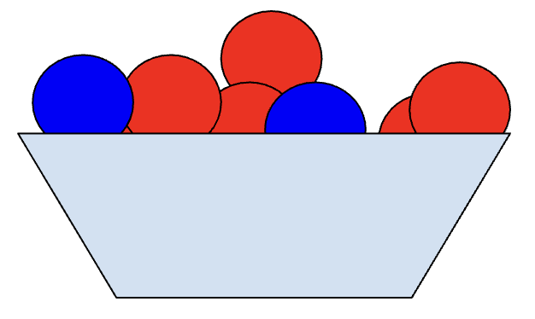
GRADE 1 PROBABILITY
CLOSED QUESTIONS
ELEMENTARY MATH PROJECT
1. If there are 12 red balls and 5 blue balls mixed together in a big bin, if you take a ball without looking, are you more likely to get a red ball or a green ball?

Slide 111
GRADE 1 PROBABILITY
CLOSED QUESTIONS
ELEMENTARY MATH PROJECT
2. Use the scale on the line to put down how certain or uncertain you are of these things happening Friday:
There is cake for breakfast.
The teacher will bring in a puppy.
We will go outside to play.
Someone will wear a blue shirt.
I will use a pencil.

Slide 112
GRADE 1 PROBABILITY
CLOSED QUESTIONS
ELEMENTARY MATH PROJECT
3. When you walk to school, which of these things are you more likely to see? Explain why.
 | More Likely | Less Likely | Why?
Cat or Lizard
Bike or Helicopter
Rock or Rocket

Slide 113
GRADE 1 PROBABILITY
CLOSED QUESTIONS
ELEMENTARY MATH PROJECT
4. Imagine you are walking home from school. What is something you are never going to see?

Slide 114
GRADE 1 PROBABILITY
CLOSED QUESTIONS
ELEMENTARY MATH PROJECT
5. Imagine you are walking down the hall outside your classroom. What is something you are sure to see?

Slide 115
GRADE 1 PROBABILITY
OPEN QUESTIONS
ELEMENTARY MATH PROJECT
6. Explain what it means if two things are “equally likely” to happen. Give an example.

Slide 116
GRADE 1 PROBABILITY
OPEN QUESTIONS
ELEMENTARY MATH PROJECT
7. Look outside. Explain why you think it will be “More Likely,” “Less Likely”, or “Equally Likely” to be sunny tomorrow.

Slide 117
GRADE 1 PROBABILITY
OPEN QUESTIONS
ELEMENTARY MATH PROJECT
8. In this bag there is a piece of fruit. How certain are you that it is an apple? Tell me why you think that?

Slide 118
GRADE 1 PROBABILITY
OPEN QUESTIONS
ELEMENTARY MATH PROJECT
9. You are playing with your friends at recess. Explain what days of the week are you certain it is not? What days of the week are you certain it could it be?

Slide 119
ELEMENTARY MATH PROJECT
GRADE 1 PRACTICE QUESTIONS
GEOMETRY

Slide 120
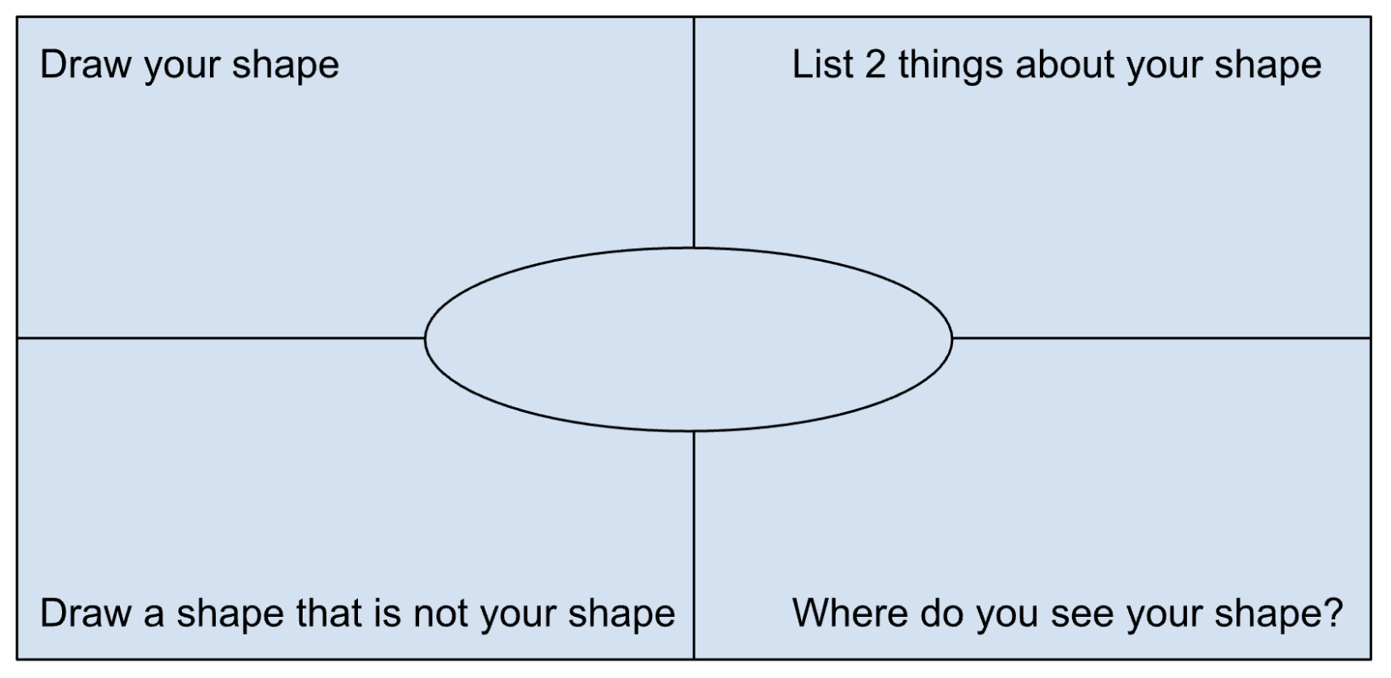
GRADE 1 GEOMETRY
CLOSED QUESTIONS
ELEMENTARY MATH PROJECT
1. Choose one of the shapes below.
Circle
Triangle
Square
Rectangle
Write the name in the middle. Answer the questions in each of the 4 corners for your shape.

Slide 121

GRADE 1 GEOMETRY
CLOSED QUESTIONS
ELEMENTARY MATH PROJECT
2. Look at the following image. Circle 3 shapes you see. How do you know what shapes they are?

Slide 122
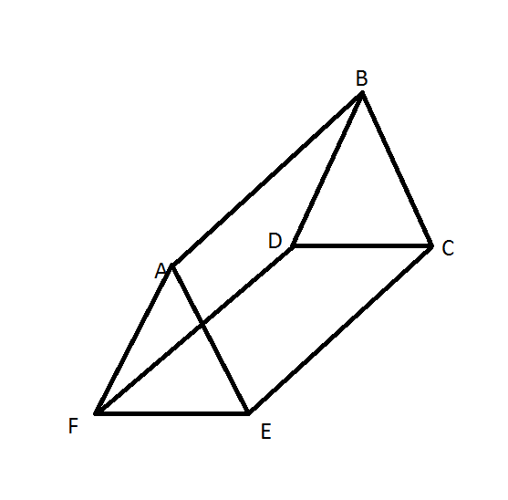
GRADE 1 GEOMETRY
CLOSED QUESTIONS
ELEMENTARY MATH PROJECT
3. Explain what shapes you would need to build a triangular prism? (provide a 3D model as well).

Slide 123

GRADE 1 GEOMETRY
CLOSED QUESTIONS
ELEMENTARY MATH PROJECT
4. Choose 2 or more shapes from your tangram set. Put them together to form a new shape. Draw (or trace) the shape. Can you show the original smaller shapes?

Slide 124
GRADE 1 GEOMETRY
CLOSED QUESTIONS
ELEMENTARY MATH PROJECT
5. If I tell you this is a square, what can you tell me about it?

Slide 125
GRADE 1 GEOMETRY
CLOSED QUESTIONS
ELEMENTARY MATH PROJECT
6. Choose one of the shapes below. Find that shape in the classroom. Draw a picture of it.
Circle Triangle Square Rectangle

Slide 126
GRADE 1 GEOMETRY
OPEN QUESTIONS
ELEMENTARY MATH PROJECT
7. What smaller shapes could you cut from this rectangle? Use the materials provided to help. Write the name of shape on each of the pieces you cut.
a) How many shapes could you cut?

Slide 127
GRADE 1 GEOMETRY
OPEN QUESTIONS
ELEMENTARY MATH PROJECT
8. Look at the two shapes here. How are they the same, and how are they different?

Slide 128
GRADE 1 GEOMETRY
OPEN QUESTIONS
ELEMENTARY MATH PROJECT
9. Can you draw a shape with 4 sides that is not a rectangle or a square?

Slide 129
GRADE 1 GEOMETRY
OPEN QUESTIONS
ELEMENTARY MATH PROJECT
10. Draw a 2-D shape. Cut it in half. Draw and describe the new shape.
Original 2D shape | New Half Shape

Slide 130
ELEMENTARY MATH PROJECT
GRADE 1 PRACTICE QUESTIONS
MEASUREMENT

Slide 131
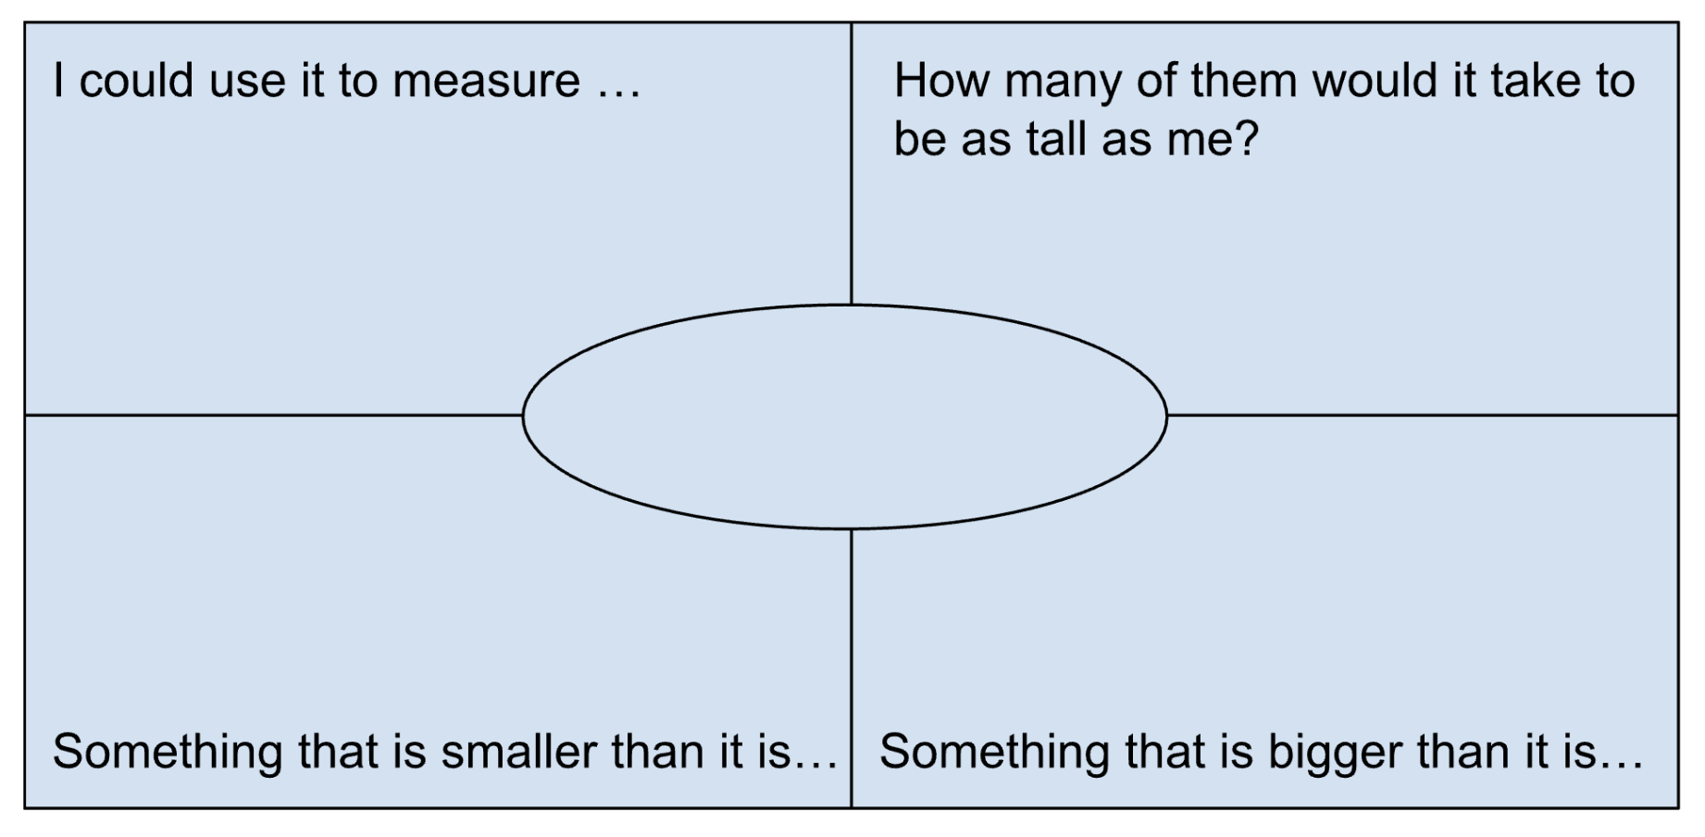
GRADE 1 MEASUREMENT
CLOSED QUESTIONS
ELEMENTARY MATH PROJECT
1. Choose one of the items below.
Pencil
Unit Cube
Toy Car
Tissue Box
Write the name in the middle. Answer the questions in each of the 4 corners for your measurement.

Slide 132

GRADE 1 MEASUREMENT
CLOSED QUESTIONS
ELEMENTARY MATH PROJECT
2. Use linking cubes or Unifix cubes to measure how long (from head to tail) this fish is (number of blocks).

Slide 133
GRADE 1 MEASUREMENT
CLOSED QUESTIONS
ELEMENTARY MATH PROJECT
3. Without measuring, what do you think the length of this pencil is?
Smallest possible length | My estimate for length | Biggest possible length

Slide 134
GRADE 1 MEASUREMENT
CLOSED QUESTIONS
ELEMENTARY MATH PROJECT
4. Use a piece of string or rope to help you figure out about how far it is between the poles of a soccer goalpost.

Slide 135
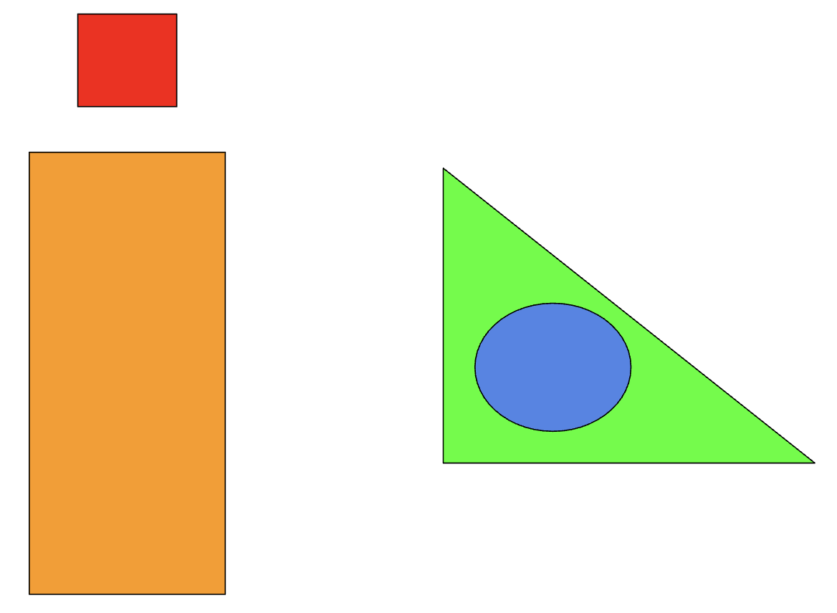
GRADE 1 MEASUREMENT
CLOSED QUESTIONS
ELEMENTARY MATH PROJECT
5. Describe how the shapes are related to each other using the following words:
Left Right
Up Down
Below Above
Inside Outside

Slide 136
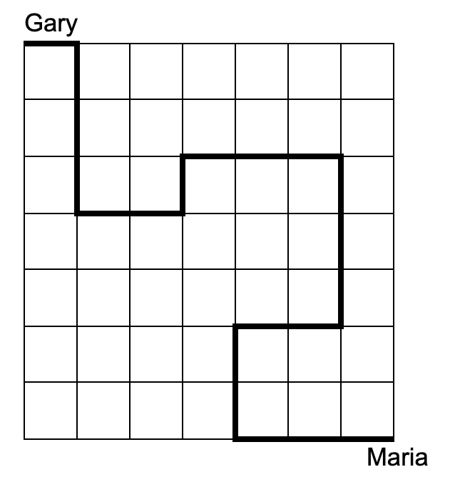
GRADE 1 MEASUREMENT
CLOSED QUESTIONS
ELEMENTARY MATH PROJECT
6. Walking along the lines, can you describe how to walk from Gary to Maria?

Slide 137
GRADE 1 MEASUREMENT
OPEN QUESTIONS
ELEMENTARY MATH PROJECT
7. Using a part of your body (length of a finger, fingertip to elbow, width of a hand).
Use that body part to estimate the width of your desk
Use that body part to estimate the width of a whiteboard or tackboard

Slide 138
GRADE 1 MEASUREMENT
OPEN QUESTIONS
ELEMENTARY MATH PROJECT
8. Pretend you are using a finger to measure the length of a pencil. Explain why you need to use the same finger every time.

Slide 139
GRADE 1 MEASUREMENT
OPEN QUESTIONS
ELEMENTARY MATH PROJECT
9. Explain how one person could measure something and get a really big number, and a different person could measure the same thing and get a small number.

Slide 140
GRADE 1 MEASUREMENT
OPEN QUESTIONS
ELEMENTARY MATH PROJECT
10. Explain how you could measure the distance around a really big tree (one that you could not reach around).

Slide 141
ELEMENTARY MATH PROJECT
GRADE 1 PRACTICE QUESTIONS
FINANCIAL LITERACY

Slide 142
GRADE 1 FINANCIAL LITERACY
CLOSED QUESTIONS
ELEMENTARY MATH PROJECT
1. How much do you have if you have (remember to use $ and ¢ symbols):
5 loonies
4 toonies
2 dimes

Slide 143
GRADE 1 FINANCIAL LITERACY
CLOSED QUESTIONS
ELEMENTARY MATH PROJECT
2. How do you make 20¢ using only:
pennies | nickels | dimes

Slide 144
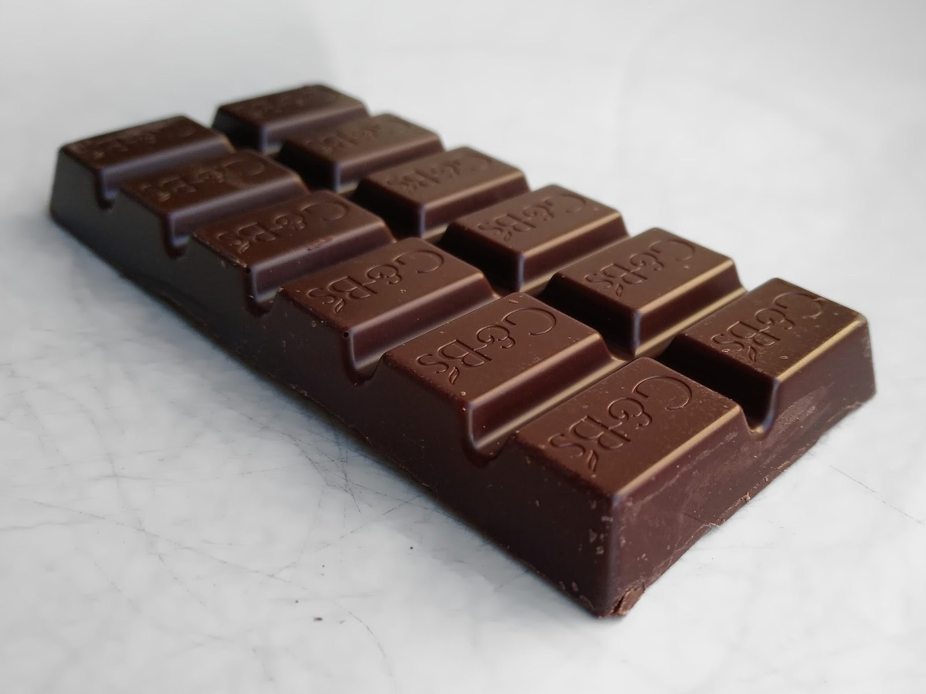
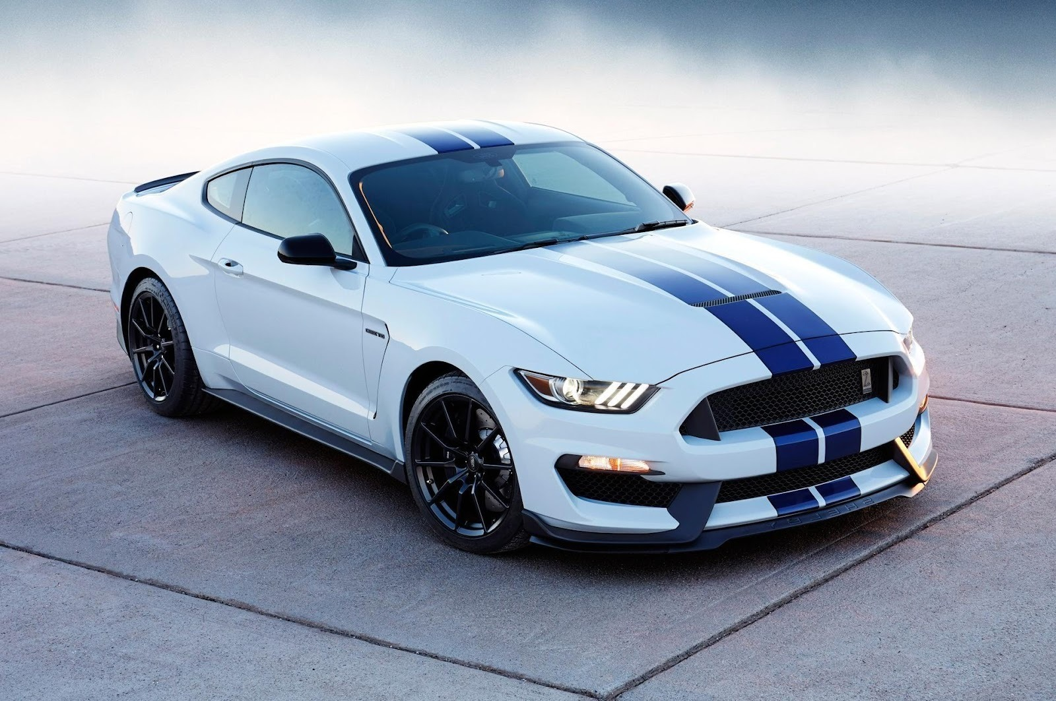

GRADE 1 FINANCIAL LITERACY
CLOSED QUESTIONS
ELEMENTARY MATH PROJECT
3. Which of these things do you think you could buy with $2?

Slide 145
GRADE 1 FINANCIAL LITERACY
CLOSED QUESTIONS
ELEMENTARY MATH PROJECT
4. You have $5. You buy a book for $3. What happens next?
Show with pictures, numbers and words.

Slide 146
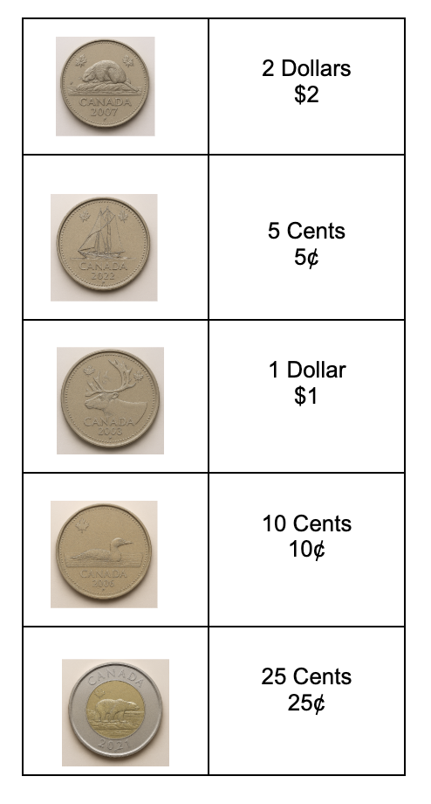
GRADE 1 FINANCIAL LITERACY
CLOSED QUESTIONS
ELEMENTARY MATH PROJECT
5. Match the value of the coin with the correct coin.
Draw a line to match the coin to the value.

Slide 147
GRADE 1 FINANCIAL LITERACY
OPEN QUESTIONS
ELEMENTARY MATH PROJECT
6. There are many ways to make $1.00.
Can you draw or write two different ways using coins?

Slide 148
GRADE 1 FINANCIAL LITERACY
OPEN QUESTIONS
ELEMENTARY MATH PROJECT
7. Is it better to buy a Pencil you need for $1.00 or some Candy you want for $0.75? Explain your thinking using pictures, numbers and words.

Slide 149
GRADE 1 FINANCIAL LITERACY
OPEN QUESTIONS
ELEMENTARY MATH PROJECT
8. Would you rather have 10 nickels or 5 dimes or 2 quarters in your pocket?

Slide 150
GRADE 1 FINANCIAL LITERACY
OPEN QUESTIONS
ELEMENTARY MATH PROJECT
9. You have $6. What could you buy from the list if you want to spend all the money? Use numbers, words, and pictures to show how you spent your money.
Hot Dog | $3
Hamburger | $4
Drink | $1
Chips | $1
Doughnut | $2

Slide 151
GRADE 1 FINANCIAL LITERACY
OPEN QUESTIONS
ELEMENTARY MATH PROJECT
10. You spent $3 and got $2 back.
How much money did you start with?
What could you have bought?

Slide 152
GRADE 1 FINANCIAL LITERACY
OPEN QUESTIONS
ELEMENTARY MATH PROJECT
11. You and 2 friends are buying treats.
A box of cookies with 5 cookies costs $10.
A box of cupcakes with 3 cupcakes costs $9.
Which treat would you choose? Why would you make that choice?

Slide 153
ELEMENTARY MATH PROJECT
GRADE 1 PRACTICE QUESTIONS
MIXED REVIEW

Slide 154

GRADE 1 MIXED REVIEW
ELEMENTARY MATH PROJECT
1. How many orange dots are there?

Slide 155
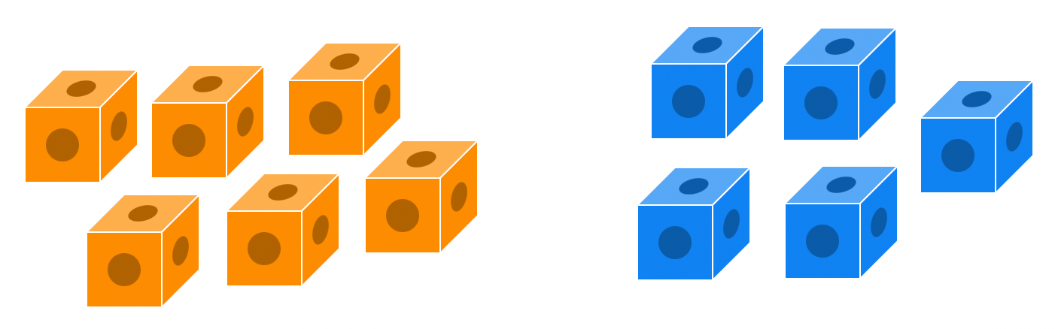
GRADE 1 MIXED REVIEW
ELEMENTARY MATH PROJECT
2. There are 6 orange cubes and 5 blue cubes. When you combine them together, how many cubes are there?
What is the addition equation? ______ + ______ = ______

Slide 156

GRADE 1 MIXED REVIEW
ELEMENTARY MATH PROJECT
3. Draw what comes next in the pattern:
______ ______ ______

Slide 157
GRADE 1 MIXED REVIEW
ELEMENTARY MATH PROJECT
4. Show one way to make 7 on a ten frame.

Slide 158
GRADE 1 MIXED REVIEW
ELEMENTARY MATH PROJECT
5. Draw pictures or use tally marks to solve the following addition equations.
3 + 5 = _____ | 8 + ____ = 10
_____ + 5 = 14 | 7 + 8 =

Slide 159

GRADE 1 MIXED REVIEW
ELEMENTARY MATH PROJECT
6. How are these two shapes the same? How are they different?

Slide 160
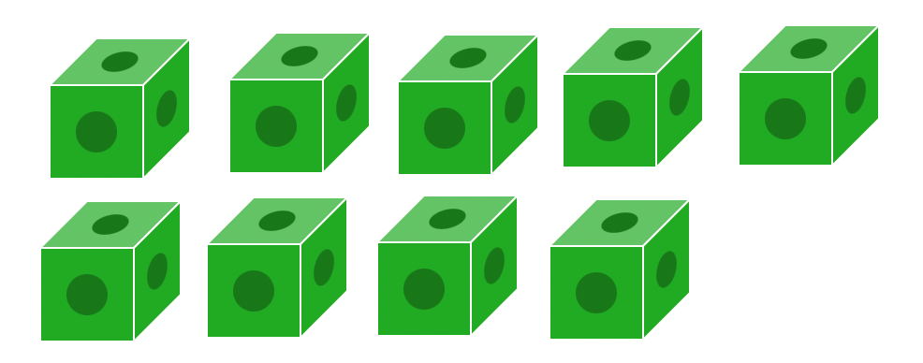
GRADE 1 MIXED REVIEW
ELEMENTARY MATH PROJECT
7. There are 9 green cubes. If you remove 3 cubes, how many will be left?
What is the subtraction equation? ______ - ______ = ______

Slide 161
GRADE 1 MIXED REVIEW
ELEMENTARY MATH PROJECT
8. About how long do you think your pencil is?
What could you measure it with?

Slide 162
GRADE 1 MIXED REVIEW
ELEMENTARY MATH PROJECT
9. Draw pictures to solve the following subtraction equations.
12 - 2 = ____ | _____ - 3 = 6
19 - ____ = 10 | 17 - 6 =

Slide 163
GRADE 1 MIXED REVIEW
ELEMENTARY MATH PROJECT
10. There are 14 ducks in the pond and some fly away. There are 8 ducks still in the pond. How many flew away?
Use pictures, numbers, and words to show how you solved this problem.

