Slide 1
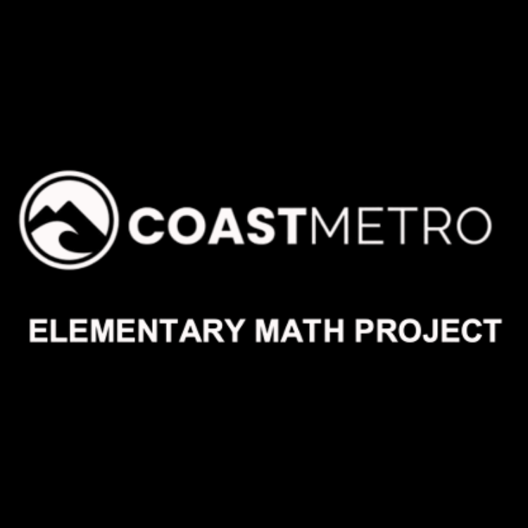
ELEMENTARY MATH PROJECT
GRADE 1 PRACTICE QUESTIONS
MIXED REVIEW

Slide 2

GRADE 1 MIXED REVIEW
ELEMENTARY MATH PROJECT
1. How many orange dots are there?

Slide 3
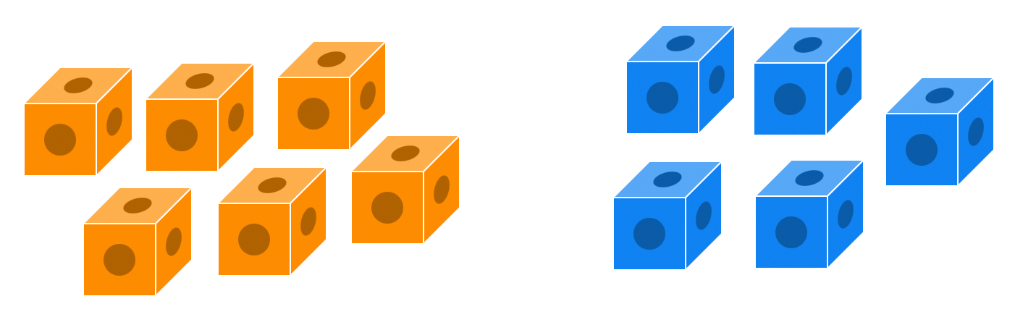
GRADE 1 MIXED REVIEW
ELEMENTARY MATH PROJECT
2. There are 6 orange cubes and 5 blue cubes. When you combine them together, how many cubes are there?
What is the addition equation? ______ + ______ = ______

Slide 4

GRADE 1 MIXED REVIEW
ELEMENTARY MATH PROJECT
3. Draw what comes next in the pattern:
______ ______ ______

Slide 5
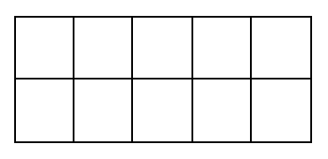
GRADE 1 MIXED REVIEW
ELEMENTARY MATH PROJECT
4. Show one way to make 7 on a ten frame.

Slide 6
GRADE 1 MIXED REVIEW
ELEMENTARY MATH PROJECT
5. Draw pictures or use tally marks to solve the following addition equations.
3 + 5 = _____ | 8 + ____ = 10
_____ + 5 = 14 | 7 + 8 =

Slide 7

GRADE 1 MIXED REVIEW
ELEMENTARY MATH PROJECT
6. How are these two shapes the same? How are they different?

Slide 8
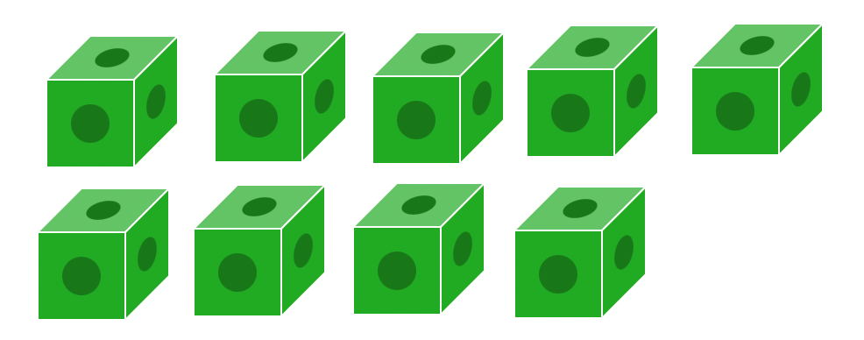
GRADE 1 MIXED REVIEW
ELEMENTARY MATH PROJECT
7. There are 9 green cubes. If you remove 3 cubes, how many will be left?
What is the subtraction equation? ______ - ______ = ______

Slide 9
GRADE 1 MIXED REVIEW
ELEMENTARY MATH PROJECT
8. About how long do you think your pencil is?
What could you measure it with?

Slide 10
GRADE 1 MIXED REVIEW
ELEMENTARY MATH PROJECT
9. Draw pictures to solve the following subtraction equations.
12 - 2 = ____ | _____ - 3 = 6
19 - ____ = 10 | 17 - 6 =

Slide 11
GRADE 1 MIXED REVIEW
ELEMENTARY MATH PROJECT
10. There are 14 ducks in the pond and some fly away. There are 8 ducks still in the pond. How many flew away?
Use pictures, numbers, and words to show how you solved this problem.

