Slide 1

ELEMENTARY MATH PROJECT
GRADE 1 PRACTICE QUESTIONS
NUMBER CONCEPTS

Slide 2
GRADE 1 NUMBER CONCEPTS
CLOSED QUESTIONS
ELEMENTARY MATH PROJECT
1. What comes next?
1, 2, 3, 4, _____, _____, ______

Slide 3
GRADE 1 NUMBER CONCEPTS
CLOSED QUESTIONS
ELEMENTARY MATH PROJECT
2. Count backward from 10:
10, 9, 8, 7, 6, 5, _____, ______, _____, _____, 0

Slide 4
GRADE 1 NUMBER CONCEPTS
CLOSED QUESTIONS
ELEMENTARY MATH PROJECT
3. What numbers are missing?
1, 2, _____, 4, 5, _____, 7 _____, 9, ______

Slide 5
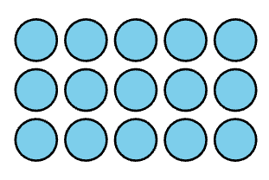
GRADE 1 NUMBER CONCEPTS
CLOSED QUESTIONS
ELEMENTARY MATH PROJECT
4. How many? Can you count them in a different way?

Slide 6
GRADE 1 NUMBER CONCEPTS
CLOSED QUESTIONS
ELEMENTARY MATH PROJECT
5. Let’s count by 5s!
5, _____, _____, _____, ______

Slide 7
GRADE 1 NUMBER CONCEPTS
CLOSED QUESTIONS
ELEMENTARY MATH PROJECT
6. Let’s count by 2s!
2, 4, ____, ____, 10, 12, ____, ____, ___, 20

Slide 8
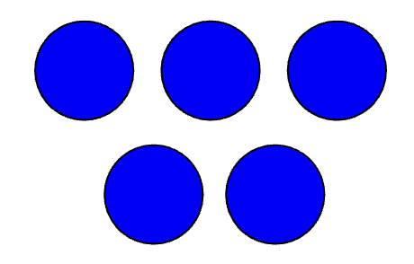
GRADE 1 NUMBER CONCEPTS
CLOSED QUESTIONS
ELEMENTARY MATH PROJECT
7. How many dots do you see? (Try not to count at first). How do you see them?

Slide 9
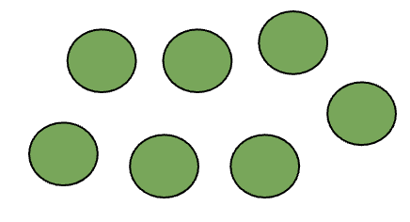
GRADE 1 NUMBER CONCEPTS
CLOSED QUESTIONS
ELEMENTARY MATH PROJECT
8. How many dots do you see? (Try not to count at first). How do you see them?

Slide 10
GRADE 1 NUMBER CONCEPTS
CLOSED QUESTIONS
ELEMENTARY MATH PROJECT
9. Circle the number that is closest to 5:
11, 9, 16, 2

Slide 11
GRADE 1 NUMBER CONCEPTS
CLOSED QUESTIONS
ELEMENTARY MATH PROJECT
10. Circle the number that is closest to 10:
16, 7, 12, 6

Slide 12
GRADE 1 NUMBER CONCEPTS
CLOSED QUESTIONS
ELEMENTARY MATH PROJECT
11. In the number pairs, circle which number is the greatest.
3 7
8 5
12 9
15 19
18 14

Slide 13
GRADE 1 NUMBER CONCEPTS
CLOSED QUESTIONS
ELEMENTARY MATH PROJECT
12. Order these numbers from least to greatest:
17, 4, 12, 7, 10
_____, _____, _____, ______, _____

Slide 14
GRADE 1 NUMBER CONCEPTS
CLOSED QUESTIONS
ELEMENTARY MATH PROJECT
13. Estimate where these numbers go in order on the number line: 10, 14, 5, 19, 8 and record them on the number line.
0
20

Slide 15
GRADE 1 NUMBER CONCEPTS
CLOSED QUESTIONS
ELEMENTARY MATH PROJECT
14. What is a number that is more than 8 but less than 12?

Slide 16
GRADE 1 NUMBER CONCEPTS
CLOSED QUESTIONS
ELEMENTARY MATH PROJECT
15. On a number line, what number comes halfway between 0 and 20?
0
20

Slide 17
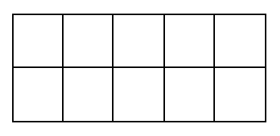
GRADE 1 NUMBER CONCEPTS
CLOSED QUESTIONS
ELEMENTARY MATH PROJECT
16. Show one way to make 6 on a ten frame.

Slide 18
GRADE 1 NUMBER CONCEPTS
CLOSED QUESTIONS
ELEMENTARY MATH PROJECT
17. Make the number 8 using tally marks,

Slide 19
GRADE 1 NUMBER CONCEPTS
CLOSED QUESTIONS
ELEMENTARY MATH PROJECT
18. Draw a picture that shows 10 of something. Print the word for 10.

Slide 20
GRADE 1 NUMBER CONCEPTS
CLOSED QUESTIONS
ELEMENTARY MATH PROJECT
19. Represent the number 13.
DOTS | TALLIES | TEN FRAMES

Slide 21
GRADE 1 NUMBER CONCEPTS
CLOSED QUESTIONS
ELEMENTARY MATH PROJECT
20. Make the number 17 using tally marks.

Slide 22
GRADE 1 NUMBER CONCEPTS
CLOSED QUESTIONS
ELEMENTARY MATH PROJECT
21. Show one way to represent 12 on ten frames.

Slide 23
GRADE 1 NUMBER CONCEPTS
CLOSED QUESTIONS
ELEMENTARY MATH PROJECT
22. How many tens and ones are in 16?
______ tens ______ ones

Slide 24
GRADE 1 NUMBER CONCEPTS
CLOSED QUESTIONS
ELEMENTARY MATH PROJECT
23. Represent the number 18.
DOTS | TALLIES | TEN FRAMES

Slide 25
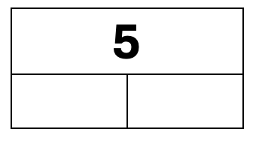
GRADE 1 NUMBER CONCEPTS
CLOSED QUESTIONS
ELEMENTARY MATH PROJECT
24. Show three ways to decompose 5 into two parts.

Slide 26
GRADE 1 NUMBER CONCEPTS
CLOSED QUESTIONS
ELEMENTARY MATH PROJECT
25. Use ten frames to show two ways to decompose 7 into parts.
________ and _________
________ and _________

Slide 27
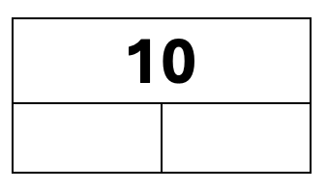
GRADE 1 NUMBER CONCEPTS
CLOSED QUESTIONS
ELEMENTARY MATH PROJECT
26. Show three ways to decompose 10 into two parts

Slide 28
GRADE 1 NUMBER CONCEPTS
CLOSED QUESTIONS
ELEMENTARY MATH PROJECT
27. Decompose the numbers into tens and ones.
12 is ______ ten and ______ ones
15 is ______ ten and ______ ones
19 is ______ ten and ______ ones

Slide 29
GRADE 1 NUMBER CONCEPTS
OPEN QUESTIONS
ELEMENTARY MATH PROJECT
28. Grab a handful of small blocks, cubes, or counters. What different ways could you count them? Record your counts using pictures and numbers.

Slide 30
GRADE 1 NUMBER CONCEPTS
OPEN QUESTIONS
ELEMENTARY MATH PROJECT
29. Count out 20 cubes or counters by ones. What different ways can you organize the cubes or counters to count them?

Slide 31
GRADE 1 NUMBER CONCEPTS
OPEN QUESTIONS
ELEMENTARY MATH PROJECT
30. Start at 2. Count by 2s. What patterns do you notice?

Slide 32
GRADE 1 NUMBER CONCEPTS
OPEN QUESTIONS
ELEMENTARY MATH PROJECT
31. Find a collection of items in your classroom like a basket of books or a jar of pencils. About how many do you think there are? Count to find out how many. Is there a different way you could count them?

Slide 33
GRADE 1 NUMBER CONCEPTS
OPEN QUESTIONS
ELEMENTARY MATH PROJECT
32. Choose three different collections in your classroom to count. What different ways can you count them? Record how you counted using pictures, numbers, and words.

Slide 34
GRADE 1 NUMBER CONCEPTS
OPEN QUESTIONS
ELEMENTARY MATH PROJECT
33. Grab a handful of crayons or pencil crayons. Estimate about how many there are. Compare you handful with a classmate. Who do you think has more? Count and check and compare the numbers you each have.

Slide 35
GRADE 1 NUMBER CONCEPTS
OPEN QUESTIONS
ELEMENTARY MATH PROJECT
34. Is 12 closer to 10 or 15? How do you know?

Slide 36
GRADE 1 NUMBER CONCEPTS
OPEN QUESTIONS
ELEMENTARY MATH PROJECT
35. About how many books do you think you have in your classroom? About how many pencils do you think there are? Are there more books or pencils?

Slide 37
GRADE 1 NUMBER CONCEPTS
OPEN QUESTIONS
ELEMENTARY MATH PROJECT
36. Place 8 and 15 on the number line. Explain your reasoning to a partner.
0
20

Slide 38
GRADE 1 NUMBER CONCEPTS
OPEN QUESTIONS
ELEMENTARY MATH PROJECT
37. When is 10 a lot of something? When is 10 a little of something? Draw a picture and add numbers and words to show your thinking.

Slide 39
GRADE 1 NUMBER CONCEPTS
OPEN QUESTIONS
ELEMENTARY MATH PROJECT
38. What different ways can you represent 5? Think about using words, pictures, numbers, tallies, ten frames, etc.

Slide 40
GRADE 1 NUMBER CONCEPTS
OPEN QUESTIONS
ELEMENTARY MATH PROJECT
39. What different ways can you decompose 7 into parts? Use materials, pictures, numbers, ten frames, etc.

Slide 41
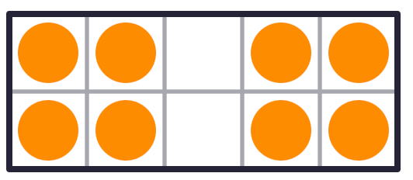
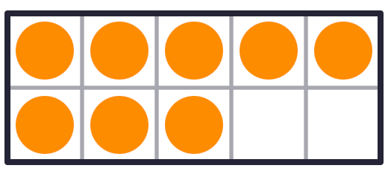
GRADE 1 NUMBER CONCEPTS
OPEN QUESTIONS
ELEMENTARY MATH PROJECT
40. How are these representations of 8 the same? How are they different?

Slide 42
GRADE 1 NUMBER CONCEPTS
OPEN QUESTIONS
ELEMENTARY MATH PROJECT
41. What different ways can you represent 10? Think about using words, pictures, numbers, tallies, ten frames, etc.

Slide 43
GRADE 1 NUMBER CONCEPTS
OPEN QUESTIONS
ELEMENTARY MATH PROJECT
42. Get a collection of 12 or 15 items. What different ways can you decompose the whole amount into parts? How could you record all the different ways you find using pictures, numbers, and words.

Slide 44
GRADE 1 NUMBER CONCEPTS
OPEN QUESTIONS
ELEMENTARY MATH PROJECT
43. What different ways can you represent 16? Think about using words, pictures, numbers, tallies, ten frames, etc.

Slide 45

GRADE 1 COMPUTATIONAL FLUENCY
CLOSED QUESTIONS
ELEMENTARY MATH PROJECT
1. There are 4 orange cubes and 3 blue cubes. When you combine them together, how many cubes are there?
What is the addition equation? ______ + ______ = ______

Slide 46
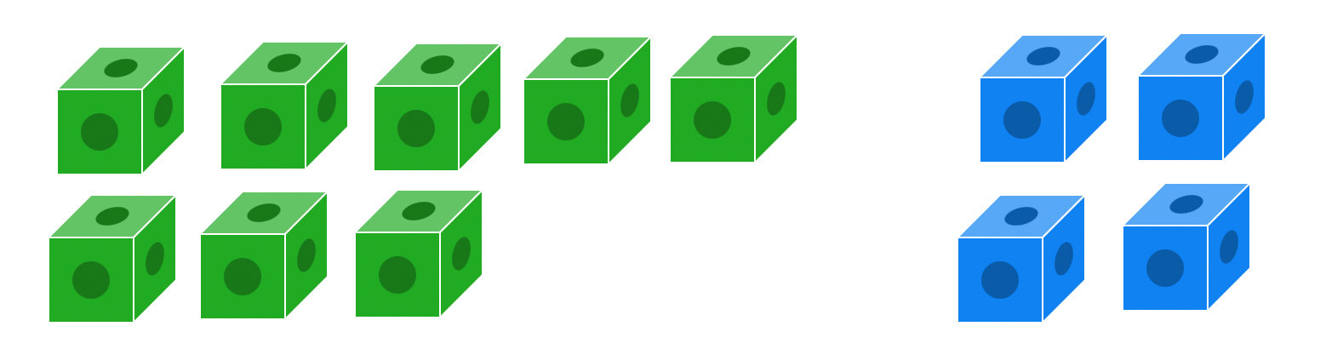
GRADE 1 COMPUTATIONAL FLUENCY
CLOSED QUESTIONS
ELEMENTARY MATH PROJECT
2. There are 8 green cubes and 4 blue cubes. When you combine them together, how many cubes are there?
What is the addition equation? ______ + ______ = ______

Slide 47


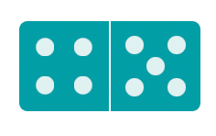

GRADE 1 COMPUTATIONAL FLUENCY
CLOSED QUESTIONS
ELEMENTARY MATH PROJECT
3. Add the dots on the dominoes together. Print the equation that matches the dominoes.
_____ + _____ = ______
_____ + _____ = ______
_____ + _____ = ______
_____ + _____ = ______

Slide 48
GRADE 1 COMPUTATIONAL FLUENCY
CLOSED QUESTIONS
ELEMENTARY MATH PROJECT
4. Draw a picture or use tally marks to solve the following addition equations.
3 + 5 = | 8 + 2 =
9 + 5 = | 7 + 8 =

Slide 49
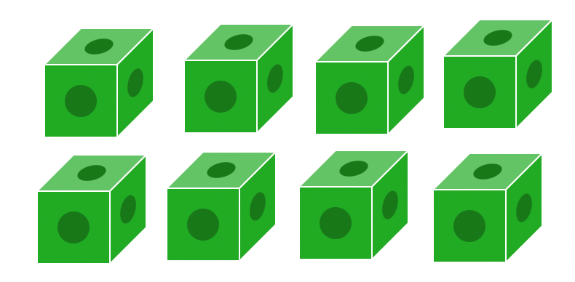
GRADE 1 COMPUTATIONAL FLUENCY
CLOSED QUESTIONS
ELEMENTARY MATH PROJECT
5. There are 8 green cubes. If you remove 2 of them, how many green cubes will be left?
What is the subtraction equation? ______ - ______ = ______

Slide 50
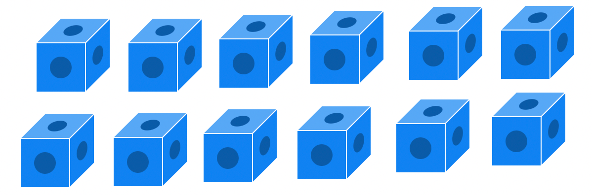
GRADE 1 COMPUTATIONAL FLUENCY
CLOSED QUESTIONS
ELEMENTARY MATH PROJECT
6. There are 12 green cubes. If you remove 3 of them, how many green cubes will be left?
What is the subtraction equation? ______ - ______ = ______

Slide 51
GRADE 1 COMPUTATIONAL FLUENCY
CLOSED QUESTIONS
ELEMENTARY MATH PROJECT
7. Draw pictures to solve the following subtraction equations.
4 - 2 = | 10 - 5 =
8 - 3 = | 15 - 7 =

Slide 52

GRADE 1 COMPUTATIONAL FLUENCY
CLOSED QUESTIONS
ELEMENTARY MATH PROJECT
8. How do ten frames help you think about adding?
Solve: 7 + 6 = ____

Slide 53
GRADE 1 COMPUTATIONAL FLUENCY
CLOSED QUESTIONS
ELEMENTARY MATH PROJECT
9. How do ten frames help you think about adding?
Solve: 12 – 4 = ____

Slide 54
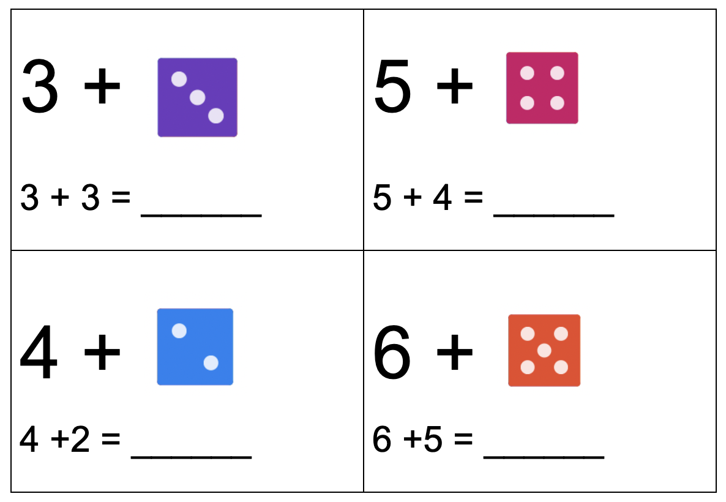
GRADE 1 COMPUTATIONAL FLUENCY
CLOSED QUESTIONS
ELEMENTARY MATH PROJECT
10. Use the dice to help you practice counting on:

Slide 55
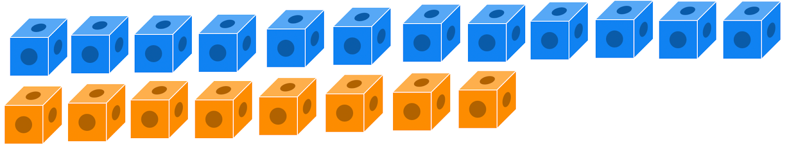
GRADE 1 COMPUTATIONAL FLUENCY
CLOSED QUESTIONS
ELEMENTARY MATH PROJECT
11. Subtract by comparing to find the difference. Show your thinking.
How many more blue cubes than orange cubes are there?
12 - 8 = _______

Slide 56
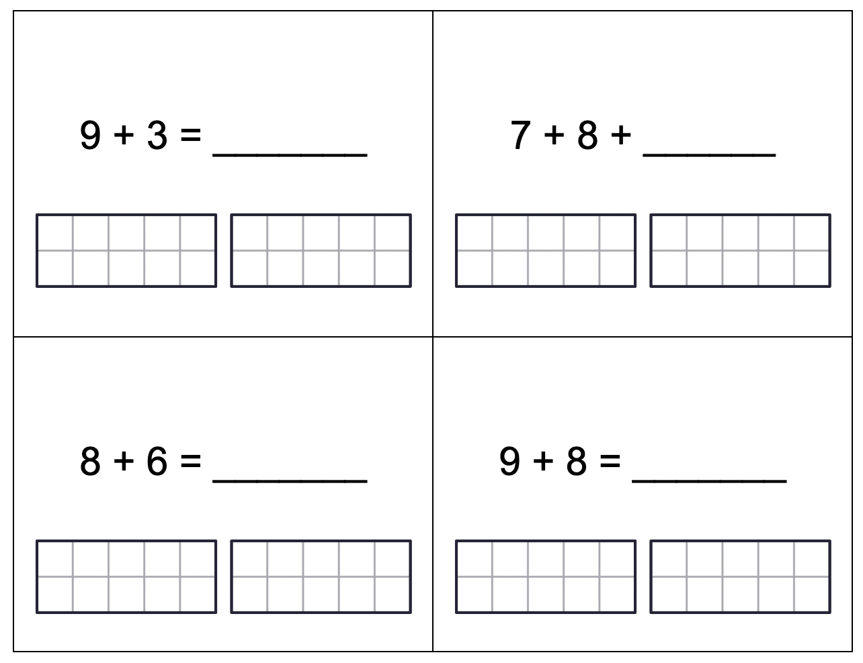
GRADE 1 COMPUTATIONAL FLUENCY
CLOSED QUESTIONS
ELEMENTARY MATH PROJECT
12. Use a ten frame to make 10 to add over 10. Use dots, numbers and symbols to show how you solved the questions.

Slide 57
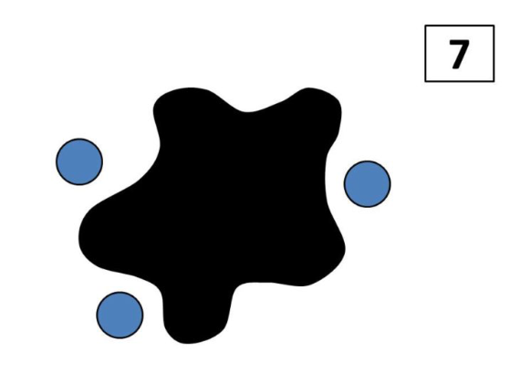
GRADE 1 COMPUTATIONAL FLUENCY
CLOSED QUESTIONS
ELEMENTARY MATH PROJECT
13. There are 7 blue dots. We can see 3. Some are hiding under the splat. How many dots are under the splat?
_______ dots under the splat
What math equation matches this splat?
_______________________________

Slide 58
GRADE 1 COMPUTATIONAL FLUENCY
CLOSED QUESTIONS
ELEMENTARY MATH PROJECT
14. There are 9 birds in a tree and 6 fly away. How many birds are still in the tree?
Use pictures, numbers, and words to show how you solve the problem.
What equation could you write to match the problem?_____________

Slide 59
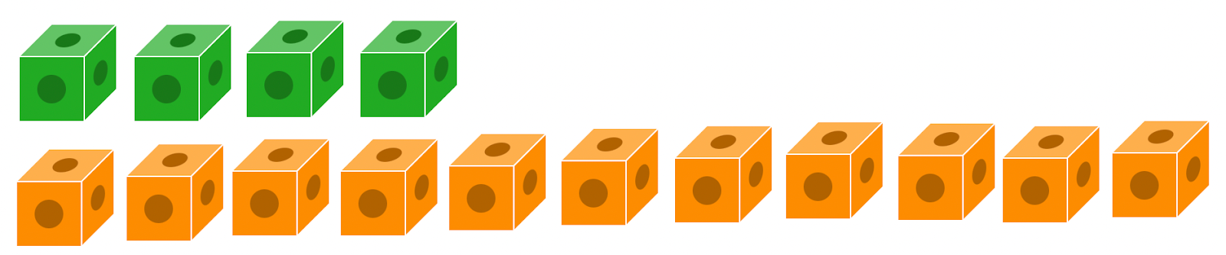
GRADE 1 COMPUTATIONAL FLUENCY
CLOSED QUESTIONS
ELEMENTARY MATH PROJECT
15. Subtract by comparing to find the difference. Show your thinking.
How many more orange cubes than green cubes are there?
11 - 4 = _______

Slide 60
GRADE 1 COMPUTATIONAL FLUENCY
CLOSED QUESTIONS
ELEMENTARY MATH PROJECT
16. Draw pictures or use tally marks to show how you solved the following addition equations.
3 + ____ = 7 | _____ + 3 = 11
9 + _____ = 16 | _____ + 7 = 14

Slide 61
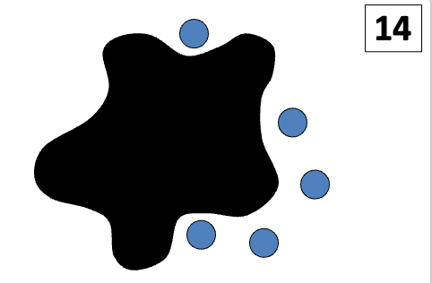
GRADE 1 COMPUTATIONAL FLUENCY
CLOSED QUESTIONS
ELEMENTARY MATH PROJECT
17. There are 14 blue dots. We can see 5. Some are hiding under the splat. How many dots are under the splat?
_______ dots under the splat
What math equation matches this splat?
_______________________________

Slide 62
GRADE 1 COMPUTATIONAL FLUENCY
CLOSED QUESTIONS
ELEMENTARY MATH PROJECT
18. Draw pictures to show how you solved the following subtraction equations.
____ - 5 = 10 | 8 - ____ = 7
19 - ____ = 9 | _____ + 8 = 16

Slide 63
GRADE 1 COMPUTATIONAL FLUENCY
CLOSED QUESTIONS
ELEMENTARY MATH PROJECT
19. There are 6 ladybugs on a leaf and 5 more flew down and joined them. How many ladybugs are on the leaf now?
Use pictures, numbers, and words to show how you solve the problem.
What equation could you write to match the problem? ______________________

Slide 64
GRADE 1 COMPUTATIONAL FLUENCY
OPEN QUESTIONS
ELEMENTARY MATH PROJECT
20. What different ways can you solve 5 + 4?

Slide 65
GRADE 1 COMPUTATIONAL FLUENCY
OPEN QUESTIONS
ELEMENTARY MATH PROJECT
21. The answer is 8. What could the addition or subtraction question be? Record as many questions that you can think of!

Slide 66
GRADE 1 COMPUTATIONAL FLUENCY
OPEN QUESTIONS
ELEMENTARY MATH PROJECT
22. What three numbers could you add together that make a total of 10. Show as many different ways as you can think of.

Slide 67
GRADE 1 COMPUTATIONAL FLUENCY
OPEN QUESTIONS
ELEMENTARY MATH PROJECT
23. Show or explain how you could use a making 10 strategy to add 7 + 4?

Slide 68
GRADE 1 COMPUTATIONAL FLUENCY
OPEN QUESTIONS
ELEMENTARY MATH PROJECT
24. What different ways can you solve 9 - 4?

Slide 69
GRADE 1 COMPUTATIONAL FLUENCY
OPEN QUESTIONS
ELEMENTARY MATH PROJECT
25. What different ways could you use ten frames to help you solve 8 + 6? Show three different ways and use words and equations to explain what you did.

Slide 70
GRADE 1 COMPUTATIONAL FLUENCY
OPEN QUESTIONS
ELEMENTARY MATH PROJECT
26. The answer is 15. What could the addition or subtraction question be? Record as many questions that you can think of!

Slide 71
GRADE 1 COMPUTATIONAL FLUENCY
OPEN QUESTIONS
ELEMENTARY MATH PROJECT
27. What different ways can you solve 9 + 6?

Slide 72
GRADE 1 COMPUTATIONAL FLUENCY
OPEN QUESTIONS
ELEMENTARY MATH PROJECT
28. What three numbers could you add together that make a total of 16. Show as many different ways as you can think of.

Slide 73
GRADE 1 COMPUTATIONAL FLUENCY
OPEN QUESTIONS
ELEMENTARY MATH PROJECT
29. What is a story you can tell to match the equation 8 + 4 =12?
Use pictures, numbers, and words to share your story.

