Slide 1

ELEMENTARY MATH PROJECT
GRADE 1 PRACTICE QUESTIONS
PATTERNS

Slide 2
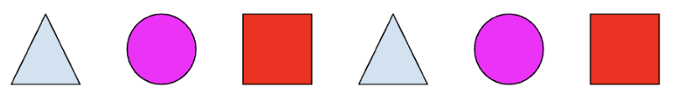
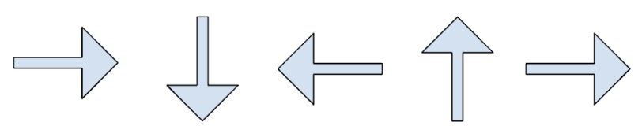
GRADE 1 PATTERNS
CLOSED QUESTIONS
ELEMENTARY MATH PROJECT
1. Continue the patterns below:
Start of the pattern | Continue the pattern
2, 4, 6, 8

Slide 3
GRADE 1 PATTERNS
CLOSED QUESTIONS
ELEMENTARY MATH PROJECT
2. Can you identify the pattern rules from question 1?
2, 4, 6, 8

Slide 4
GRADE 1 PATTERNS
CLOSED QUESTIONS
ELEMENTARY MATH PROJECT
3. What are the next 3 shapes of this pattern?
Can you make this same pattern using circles and triangles that are the same colour?

Slide 5
GRADE 1 PATTERNS
CLOSED QUESTIONS
ELEMENTARY MATH PROJECT
4. Can you identify the pattern rules from below and continue the pattern to include 10 cars? a) ABA b) AAB c) BAB d) BBA
Original Pattern | Pattern Rule | Continue the Pattern (10 cars)
a) 🚗🚗🚙
b) 🚗🚙🚙🚗🚙🚙
c) 🚙🚗🚙
d) 🚗🚙🚗

Slide 6
GRADE 1 PATTERNS
CLOSED QUESTIONS
ELEMENTARY MATH PROJECT
5. How many tiles will be in the 5th step of this pattern?
Step 1: 🔳
Step 2: 🔳🔳
Step 3: 🔳🔳🔳
Step 4: 🔳🔳🔳🔳

Slide 7
GRADE 1 PATTERNS
OPEN QUESTIONS
ELEMENTARY MATH PROJECT
6. I’m thinking of a pattern that uses 2 shapes.
What could my pattern look like? What do you call this pattern?

Slide 8
GRADE 1 PATTERNS
OPEN QUESTIONS
ELEMENTARY MATH PROJECT
7. I’m thinking of a pattern that uses 3 shapes. Can you show two different pattern rules?
What could my pattern look like?

Slide 9

GRADE 1 PATTERNS
OPEN QUESTIONS
ELEMENTARY MATH PROJECT
8. There is a mistake in this pattern:
What is the mistake and how do you know?
What can you change to correct the pattern?

Slide 10
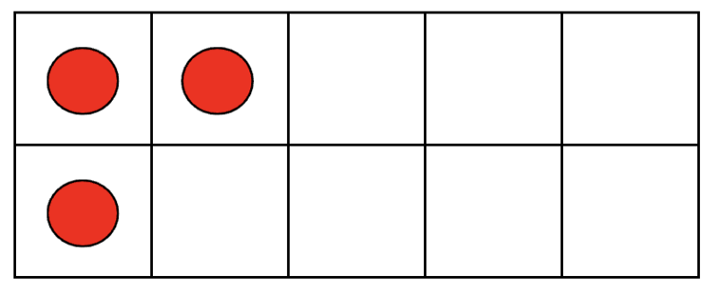
GRADE 1 PATTERNS
OPEN QUESTIONS
ELEMENTARY MATH PROJECT
9. What pattern could you make if this is the first image?
Can you explain the rule?

Slide 11
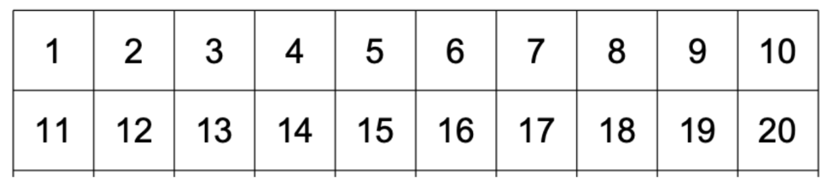
GRADE 1 PATTERNS
OPEN QUESTIONS
ELEMENTARY MATH PROJECT
10. What pattern(s) can you find in this 20 chart?

Slide 12
ELEMENTARY MATH PROJECT
GRADE 1 PRACTICE QUESTIONS
ALGEBRA

Slide 13
GRADE 1 ALGEBRA
CLOSED QUESTIONS
ELEMENTARY MATH PROJECT
1. Look at the images below. How many do you need to make 10?
a)

Slide 14
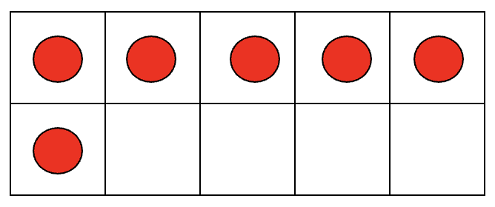
GRADE 1 ALGEBRA
CLOSED QUESTIONS
ELEMENTARY MATH PROJECT
1. Look at the images below. How many do you need to make 10?
b)

Slide 15
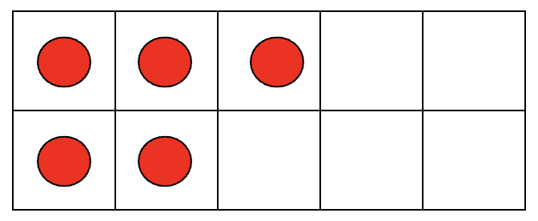
GRADE 1 ALGEBRA
CLOSED QUESTIONS
ELEMENTARY MATH PROJECT
1. Look at the images below. How many do you need to make 10?
c)

Slide 16
GRADE 1 ALGEBRA
CLOSED QUESTIONS
ELEMENTARY MATH PROJECT
2. Answer the following sentences:
a) If you start at 3, how many more do you need to get to 7
b) Use the linking cubes to make 6. Can you show how many more you need to build 13?
c) Count out 15 counters. How many do you need to remove to get to 9?

Slide 17
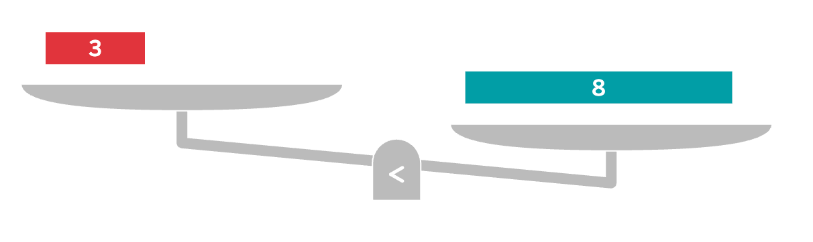
GRADE 1 ALGEBRA
CLOSED QUESTIONS
ELEMENTARY MATH PROJECT
3. What should you add to balance the scales?
a)

Slide 18
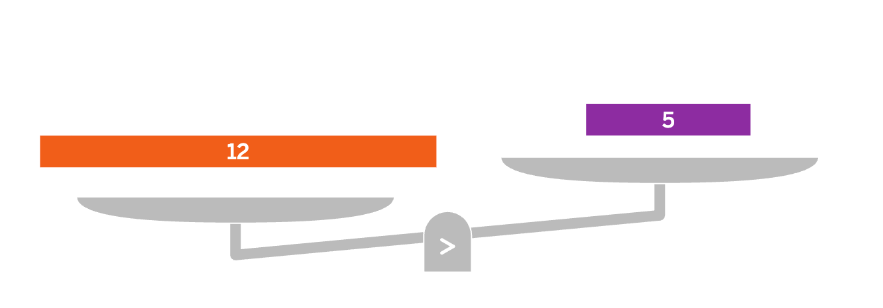
GRADE 1 ALGEBRA
CLOSED QUESTIONS
ELEMENTARY MATH PROJECT
3. What should you add to balance the scales?
b)

Slide 19
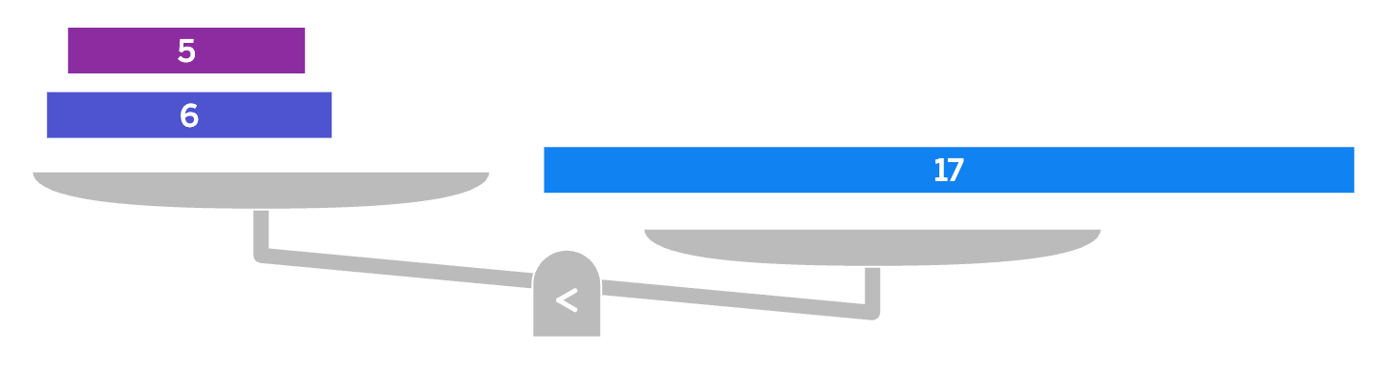
GRADE 1 ALGEBRA
CLOSED QUESTIONS
ELEMENTARY MATH PROJECT
3. What should you add to balance the scales?
c)

Slide 20
GRADE 1 ALGEBRA
CLOSED QUESTIONS
ELEMENTARY MATH PROJECT
4. Which of these number sentences is correct (balanced)? a) 2 + 2 = 5
b) 4 + 3 = 8
c) 5 + 5 = 10
d) 2 + 6 = 7

Slide 21
GRADE 1 ALGEBRA
CLOSED QUESTIONS
ELEMENTARY MATH PROJECT
5. What number should go in the box?
⬜ – 3 = 2
⬜= _____

Slide 22
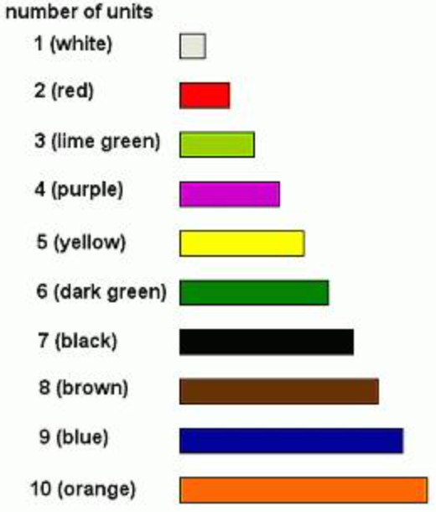
GRADE 1 ALGEBRA
OPEN QUESTIONS
ELEMENTARY MATH PROJECT
6. Use the Cuisenaire rods to build 7 in two different ways.

Slide 23
GRADE 1 ALGEBRA
OPEN QUESTIONS
ELEMENTARY MATH PROJECT
7. Build a number bigger than 10 using the Linking Cubes. Take some of them away and show how many are left. Write a number sentence that says the same thing.

Slide 24
GRADE 1 ALGEBRA
OPEN QUESTIONS
ELEMENTARY MATH PROJECT
8. Look at this equation: 16 - 5 ≠ 9
Can you draw a picture or use manipulatives to show how you know this?
What could you do to make it an “=” sign instead?

Slide 25
GRADE 1 ALGEBRA
OPEN QUESTIONS
ELEMENTARY MATH PROJECT
9. How many ways can you show how 4, 5, and 9 are friendly or related.

Slide 26
GRADE 1 ALGEBRA
OPEN QUESTIONS
ELEMENTARY MATH PROJECT
10. Write 2 equations (number sentences) that both have the same number on one side of the equals sign.

