Slide 1
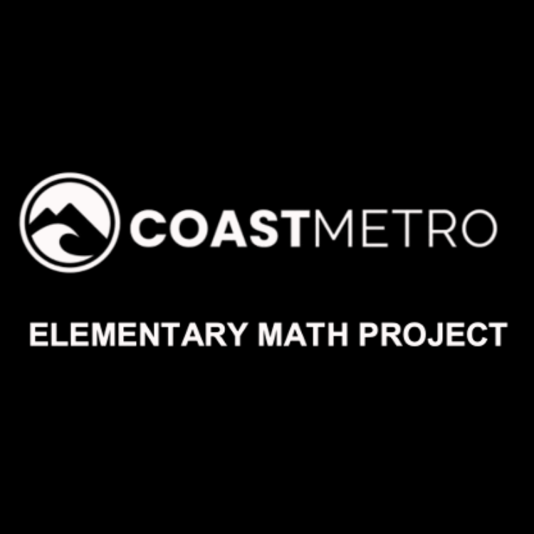
ELEMENTARY MATH PROJECT
GRADE 7 PRACTICE QUESTIONS
CARTESIAN COORDINATES

Slide 2
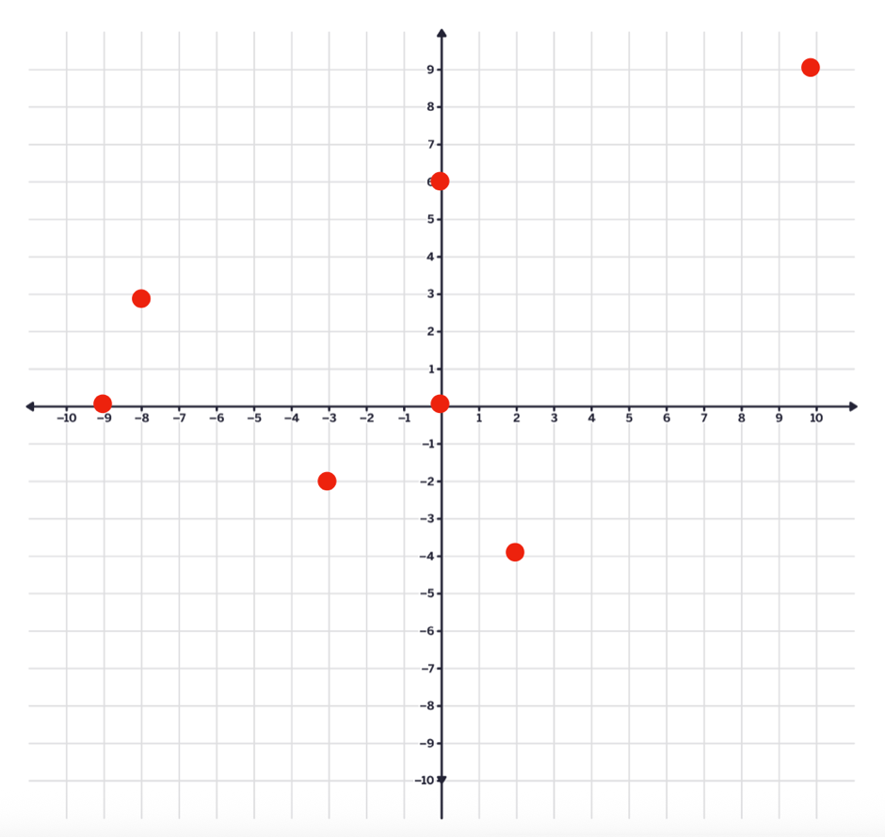
GRADE 7 CARTESIAN COORDINATES:
CLOSED QUESTIONS
ELEMENTARY MATH PROJECT
1. What are the coordinates for each point on the Cartesian Plane shown? Label each ordered pair on the graph.

Slide 3
GRADE 7 CARTESIAN COORDINATES:
CLOSED QUESTIONS
ELEMENTARY MATH PROJECT
2. Plot the following points (ordered pairs) on the Cartesian Plane.
(-3,4)
(0,0)
(-6, -5)
(7, 8)
(1,- 2)

Slide 4
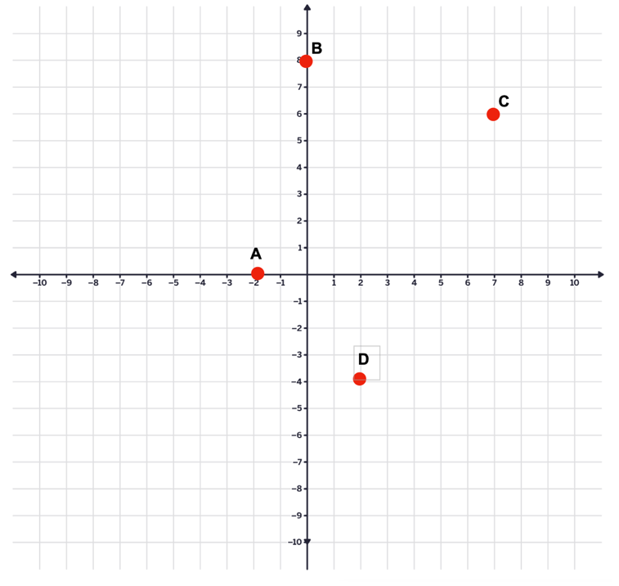
GRADE 7 CARTESIAN COORDINATES:
CLOSED QUESTIONS
ELEMENTARY MATH PROJECT
3. Which letter on the graph matches each ordered pair.
(-4 , -2)
(7, 6)
(0 , 8)
(-2 , 0)

Slide 5
GRADE 7 CARTESIAN COORDINATES:
CLOSED QUESTIONS
ELEMENTARY MATH PROJECT
4. Predict in which quadrant each of the following points will lie. Then plot them on the Cartesian plane. Were your predictions correct?
(4, 3) Quadrant ______
(-5, 2) Quadrant ______
(-3, -4) Quadrant ______
(6, -1) Quadrant ______
(0, 5) Quadrant ______
(-7, 0) Quadrant ______

Slide 6
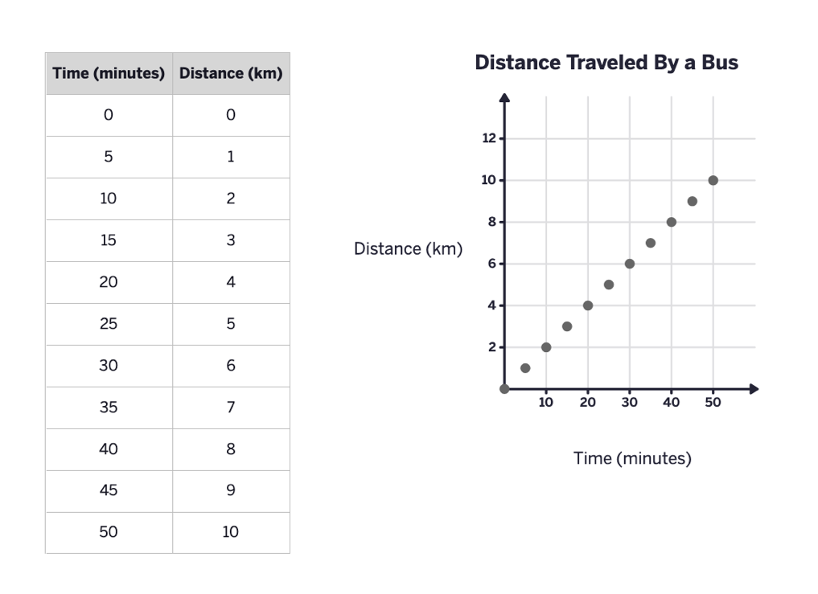
GRADE 7 CARTESIAN COORDINATES:
CLOSED QUESTIONS
ELEMENTARY MATH PROJECT
5.

Slide 7
GRADE 7 CARTESIAN COORDINATES:
CLOSED QUESTIONS
ELEMENTARY MATH PROJECT
5.
According to this graph, how long does it take the local bus to drive 3km?
How long did it take for the bus to complete its entire route?
What was the total distance travelled during the bus’s trip?
In which quadrant of the Cartesian Plan is the graph? Why?

Slide 8
GRADE 7 CARTESIAN COORDINATES:
CLOSED QUESTIONS
ELEMENTARY MATH PROJECT
6. A taxi company charges $3.50 to start the ride and 1.25 for every kilometer travelled.
Complete the table of values showing the total cost for these distances:
DISTANCE (km) | COST ($)
0
2
4
6

Slide 9
GRADE 7 CARTESIAN COORDINATES:
CLOSED QUESTIONS
ELEMENTARY MATH PROJECT
6.
Use your table to create a graph of Cost ($) on the y-axis and distance (km) on the x-axis.
Draw a straight line through the points.
What is cost for 5km?
At what distance does the cost reach $10?

Slide 10
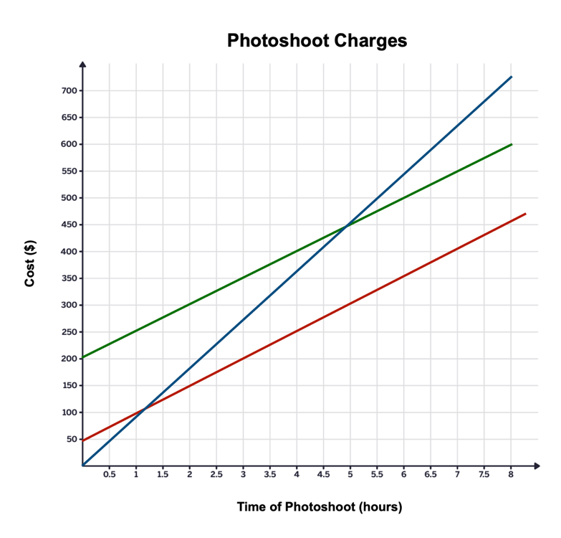
GRADE 7 CARTESIAN COORDINATES:
CLOSED QUESTIONS
ELEMENTARY MATH PROJECT
7. Which line in the graph best describes the relationship of a photographer charging $50 per hour for a photo session plus an additional $200 for editing and printing costs?

Slide 11
GRADE 7 CARTESIAN COORDINATES:
OPEN QUESTIONS
ELEMENTARY MATH PROJECT
8. Create a polygon with vertices on the Cartesian Plane. Label the vertices with capital letters and identify their ordered pairs.

Slide 12
GRADE 7 CARTESIAN COORDINATES:
OPEN QUESTIONS
ELEMENTARY MATH PROJECT
9. Dosaj has a bank account with $250 in it. He has a paper route job and deposits $50 of his earnings into his account at the end of every month.
Create a table of values that represents how much money is in Dosaj’s account each month for a year.
Draw a graph that represents this data.
Use the graph to tell how long it will take Dosaj to have $400 in his account.
Predict how long it will take Dosaj to have $1000 in his account, if he doesn’t spend any money.

Slide 13
ELEMENTARY MATH PROJECT
GRADE 7 PRACTICE QUESTIONS
CIRCLE GRAPHS

Slide 14
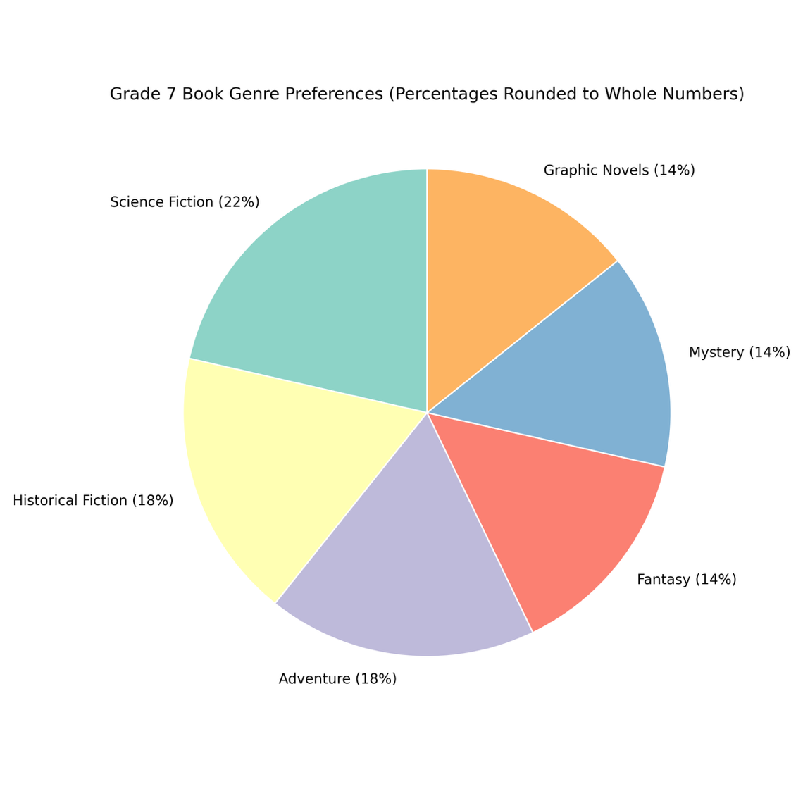
GRADE 7 CIRCLES:
CIRCLE GRAPHS
ELEMENTARY MATH PROJECT
1.

Slide 15
GRADE 7 CIRCLES:
CIRCLE GRAPHS
ELEMENTARY MATH PROJECT
1. The circle graph shows the types of books (genres) students in a grade 7 class prefer to read.
What genre of books does most students enjoy reading? Show your thinking.
What genre of books does students enjoy the least? How do you know?
If there are 28 students in the class, how many students prefer to read adventure books? Show your thinking.
How many more students prefer to read science fiction books than fantasy books? Show your thinking.

Slide 16
GRADE 7 CIRCLES:
CIRCLE GRAPHS
ELEMENTARY MATH PROJECT
2. The data in the chart represents the number of hours a student spends doing specific activities each week.
Calculate the percentage of total time this student spends doing each activity every week. Record the percentages in the chart below.
Activity | Hours in a Week | Percent of Total
weight training | 1.5
swimming | 2
robotics club | 15
television and movies | 8
student council | 2
reading | 1
playing piano | 1.5
video games | 9

Slide 17
GRADE 7 CIRCLES:
CIRCLE GRAPHS
ELEMENTARY MATH PROJECT
2b) On the circle graph, write the percent value for each activity inside or next to its sector. Create a legend on the side that shows the colour used for each activity. Make sure every slice is labeled so it shows what the activity is and the portion of the circle it represents, as a percent value. Also, create a title for this circle graph that describes what the graph shows!

Slide 18
GRADE 7 CIRCLES:
CIRCLE GRAPHS
ELEMENTARY MATH PROJECT
Favourite Ice Cream Flavour | Number of Students | Percent of Total | Decimal Value Equivalent | Central Angle (decimal value equivalent x 360°)
vanilla | 40
chocolate | 20
strawberry | 12
other | 8
TOTALS | 80 | 100 | 1.0 | 360
3. All the grade 7s were surveyed to determine their favourite flavour of ice cream.

Slide 19
GRADE 7 CIRCLES:
CIRCLE GRAPHS
ELEMENTARY MATH PROJECT
3. Complete the chart.
Create a circle graph to represent the data. Use either a protractor, a percent wheel, or technology. Be sure to label the circle with percent values and create a legend on the side of the graph to show what the colours of the graph represent. Also, include a title for your graph!
How many more students prefer vanilla than chocolate?
If we added 10 more students to this grade, and the same proportions stayed the same, how many would prefer chocolate?
If an ice cream truck could only stock two flavours, which should they choose? Explain your choice using data.
What could the data suggest about students’ taste preferences overall? Support your answer using the data.

Slide 20
ELEMENTARY MATH PROJECT
GRADE 7 PRACTICE QUESTIONS
EXPERIMENTAL PROBABILITY

Slide 21
GRADE 7 EXPERIMENTAL PROBABILITY:
CLOSED QUESTIONS
ELEMENTARY MATH PROJECT
1. Sofia flipped two coins and recorded whether she got heads or tails. She did this 20 times and her results were:
(HH), (HT), (TH), (TT), (HT), (HH), (TH), (HT), (TT), (HH), (HT), (TH), (HT), (HH), (TT), (HT), (HH), (TH), (HT), (TT).
What was the experimental probability that Sofia got two heads?

Slide 22
GRADE 7 EXPERIMENTAL PROBABILITY:
CLOSED QUESTIONS
ELEMENTARY MATH PROJECT
2. Ethan drew two cards from a shuffled deck (with replacement) 20 times and recorded the suits in a table.
His results were:
♥♣, ♦♠, ♥♥, ♠♠, ♦♥, ♥♦, ♣♣, ♥♠, ♦♦, ♥♥, ♠♥, ♦♣, ♥♣, ♠♠, ♦♥, ♥♦, ♣♠, ♥♥, ♦♠, ♥♣.
What was the experimental probability that Ethan drew two hearts?

Slide 23
GRADE 7 EXPERIMENTAL PROBABILITY:
CLOSED QUESTIONS
ELEMENTARY MATH PROJECT
3. Leo spun two spinners (each divided into 4 equal sections (orange, green, pink, blue) 15 times and recorded the results in a table:
(Orange–Green), (Pink–Blue), (Blue–Blue), (Green–Orange), (Orange–Orange), (Pink–Pink), (Green–Green), (Blue–Orange), (Orange–Pink), (Green–Blue), (Pink–Orange), (Blue–Green), (Orange–Orange), (Green–Pink), (Pink–Blue)
What was the experimental probability that both spinners landed on the same colour?

Slide 24
GRADE 7 EXPERIMENTAL PROBABILITY:
CLOSED QUESTIONS
ELEMENTARY MATH PROJECT
4. Rafa drew two marbles from a bag (with replacement) 20 times. The bag had 3 red, 2 blue, and 1 green marble.
Her recorded results were: (R-B), (G-R), (R-R), (B-B), (R-G), (B-R), (R-R), (G-G), (R-B), (B-G), (R-R), (G-R), (B-B), (R-G), (R-R), (B-R), (G-G), (R-B), (B-G), (R-R).
What was the experimental probability that she drew two red marbles?

Slide 25
GRADE 7 EXPERIMENTAL PROBABILITY:
CLOSED QUESTIONS
ELEMENTARY MATH PROJECT
5. Arjun flipped a coin and rolled a die 9 times and recorded the results in a table:
(H-3), (T-6), (H-2), (H-5,) (T-4), (H-1), (T-2), (H-6), (T-3).
What was the experimental probability that he got heads and an even number?

Slide 26
GRADE 7 EXPERIMENTAL PROBABILITY:
OPEN QUESTIONS
ELEMENTARY MATH PROJECT
6. Flip a coin and roll a die 20 times. Record each outcome in a table.
Count how many times you got HEADS and an EVEN NUMBER. Calculate the experimental probability.

Slide 27
GRADE 7 EXPERIMENTAL PROBABILITY:
OPEN QUESTIONS
ELEMENTARY MATH PROJECT
7. Flip a coin and role a die 100 times. Record each outcome in a table.
Count how many times you got HEADS and an EVEN NUMBER. Calculate the experimental probability.

Slide 28
GRADE 7 EXPERIMENTAL PROBABILITY:
OPEN QUESTIONS
ELEMENTARY MATH PROJECT
8. Choose any two tools (dice, coins, spinners, cards, marbles) and design your own experiment with 30 trials. Record your results and calculate the experimental probability for a specific event.

Slide 29
GRADE 7 EXPERIMENTAL PROBABILITY:
OPEN QUESTIONS
ELEMENTARY MATH PROJECT
9. Roll two ten-sided dice 100 times and record the results.
Calculate the experimental probability of rolling a sum of 11.
Calculate the theoretical probability.
How do your results compare to the theoretical probability? Why do you think this is?

