Slide 1

ELEMENTARY MATH PROJECT
GRADE 7 PRACTICE QUESTIONS
FINANCIAL LITERACY

Slide 2
GRADE 7 FINANCIAL LITERACY:
CLOSED QUESTIONS
ELEMENTARY MATH PROJECT
1. Show how to find each amount using mental math.
50% of 66
25% of 32
10% of 15
1% of 170

Slide 3
GRADE 7 FINANCIAL LITERACY:
CLOSED QUESTIONS
ELEMENTARY MATH PROJECT
2. Use mental math to determine the amount. Show your thinking using pictures and numbers.
a) 60% of 50 b) 35% of 240

Slide 4
GRADE 7 FINANCIAL LITERACY:
CLOSED QUESTIONS
ELEMENTARY MATH PROJECT
3. Calculate the total cost (final price).
A concert ticket costs $250 plus GST.
Noah buys a bike for $350 with a 15% discount and pays GST and PST.
Mia buys two hoodies for $98 each and pays GST.

Slide 5
GRADE 7 FINANCIAL LITERACY:
CLOSED QUESTIONS
ELEMENTARY MATH PROJECT
4. Calculate.
a) 37% of 485 b) 68% of 942

Slide 6
GRADE 7 FINANCIAL LITERACY:
CLOSED QUESTIONS
ELEMENTARY MATH PROJECT
5. Determine the original price.
A backpack is on sale for $45 after a 10% discount.
Final price of a fridge was $1200 after a 30% discount.

Slide 7
GRADE 7 FINANCIAL LITERACY:
CLOSED QUESTIONS
ELEMENTARY MATH PROJECT
6. What is the total amount paid for a restaurant bill of $175, if a tip of 20% was provided.

Slide 8
GRADE 7 FINANCIAL LITERACY:
OPEN QUESTIONS
ELEMENTARY MATH PROJECT
7. If GST increased to 7%, how would that affect the total price of a $100 item?

Slide 9
GRADE 7 FINANCIAL LITERACY:
OPEN QUESTIONS
ELEMENTARY MATH PROJECT
8. Which is better, 20% off or $20 off on a $150 item. Explain and justify your thinking.

Slide 10
GRADE 7 FINANCIAL LITERACY:
OPEN QUESTIONS
ELEMENTARY MATH PROJECT
9. Show two ways to estimate the total cost of an item with tax and discount.

Slide 11
GRADE 7 FINANCIAL LITERACY:
OPEN QUESTIONS
ELEMENTARY MATH PROJECT
10. Name an item that you have on your wish list. Find the current price of it and calculate what the final cost after taxes would be if it were on sale for 20% off.

Slide 12
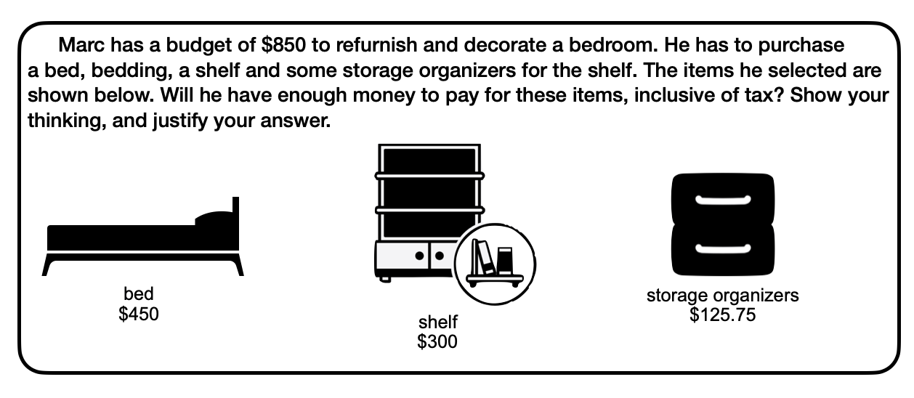
GRADE 7 FINANCIAL LITERACY:
PROBLEMS
ELEMENTARY MATH PROJECT
1.

Slide 13
GRADE 7 FINANCIAL LITERACY:
PROBLEMS
ELEMENTARY MATH PROJECT
2. What is the total cost of four tires that sell for $275 each, plus 5% GST and a fixed fee of $6.50 per tire for an Eco Fee? You do not have to pay for PST because you are planning on mounting these tires on your car, yourself.

Slide 14
GRADE 7 FINANCIAL LITERACY:
PROBLEMS
ELEMENTARY MATH PROJECT
3. The selling price of a gaming console is about 35% more than it costs, at a store. It is currently sold at a discount of 15% off the selling price. How much does the store still gain?

Slide 15
GRADE 7 FINANCIAL LITERACY:
PROBLEMS
ELEMENTARY MATH PROJECT
4. In 2021, Richmond BC’s population was 209, 937 and Kelowna BC’s population was 144, 576. Over the next two years:
Richmond’s population grew by 6% in the first year, then 4% in the second year.
Kelowna’s population grew by a total of 10% across the same two years.
Did the population of each city increase by the same amount? Explain using math.
What is the new population of each city after two years (round to the nearest whole number)?

Slide 16
GRADE 7 FINANCIAL LITERACY:
PROBLEMS
ELEMENTARY MATH PROJECT
5. Paco saved $1250 over the year from a part time job.
He decided to take $850 of it to the bank to put in a savings account where it will earn 2% interest every month.
How much will be in his account after three months if he doesn’t withdraw any money?

Slide 17
GRADE 7 FINANCIAL LITERACY:
PROBLEMS
ELEMENTARY MATH PROJECT
6. You bought shoes at 40% off and a jacket at 20% off and paid the same amount for each. How would you figure out the original prices?

