Slide 1
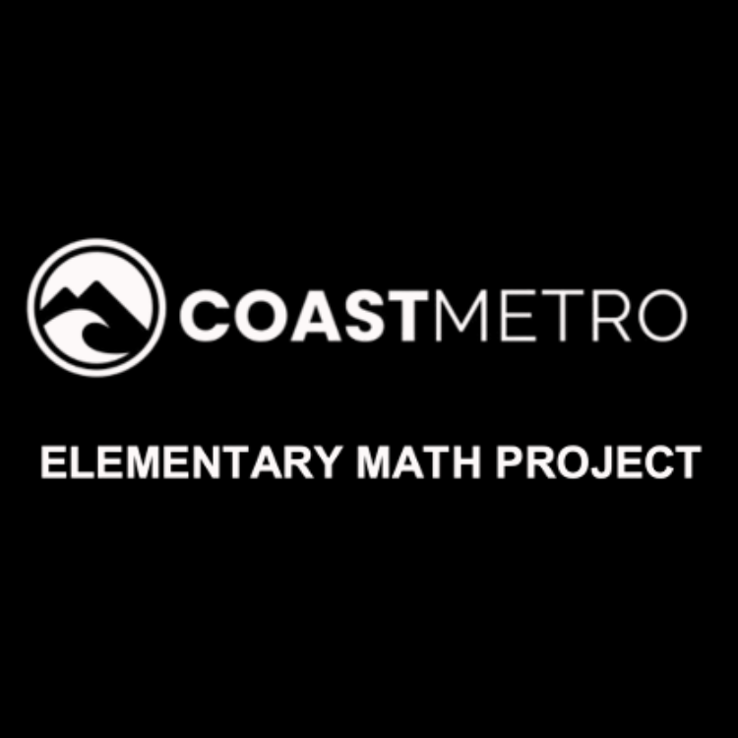
ELEMENTARY MATH PROJECT
GRADE 7 PRACTICE QUESTIONS
TWO-STEP EQUATIONS

Slide 2
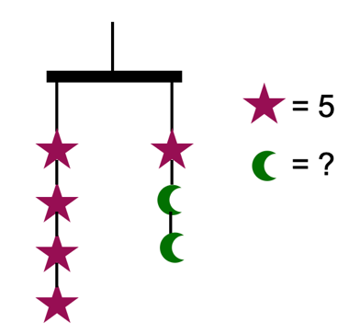
GRADE 7 TWO-STEP EQUATIONS:
CLOSED QUESTIONS
ELEMENTARY MATH PROJECT
1. Use an algebraic equation to determine the value of the crescent moon. Show your thinking.

Slide 3
GRADE 7 TWO-STEP EQUATIONS:
CLOSED QUESTIONS
ELEMENTARY MATH PROJECT
2. Draw a picture to model the equation -3x + 7 = 19, using algebra tiles.

Slide 4
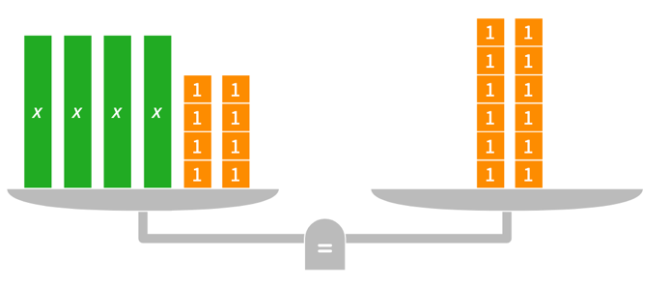
GRADE 7 TWO-STEP EQUATIONS:
CLOSED QUESTIONS
ELEMENTARY MATH PROJECT
3a. Solve the equation modelled by each balance scale. Show your thinking using pictures and numbers.

Slide 5
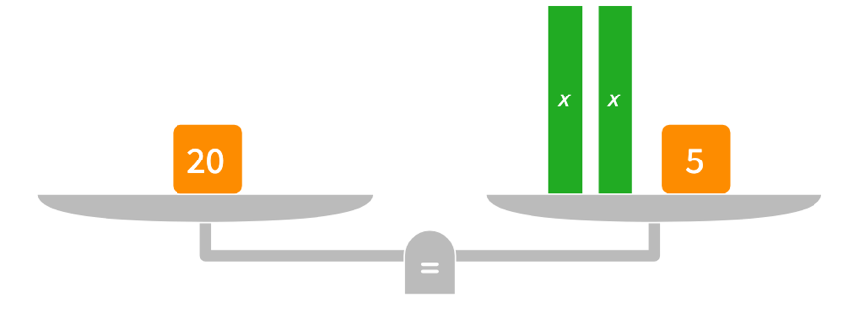
GRADE 7 TWO-STEP EQUATIONS:
CLOSED QUESTIONS
ELEMENTARY MATH PROJECT
3b. Solve the equation modelled by each balance scale. Show your thinking using pictures and numbers.

Slide 6
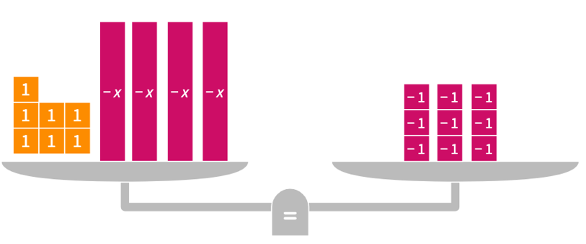
GRADE 7 TWO-STEP EQUATIONS:
CLOSED QUESTIONS
ELEMENTARY MATH PROJECT
3c. Solve the equation modelled by each balance scale. Show your thinking using pictures and numbers.

Slide 7
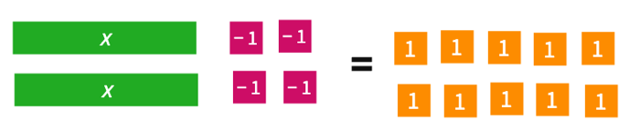
GRADE 7 TWO-STEP EQUATIONS:
CLOSED QUESTIONS
ELEMENTARY MATH PROJECT
4a. Use algebra tiles to solve the equations. Check each solution using symbols.

Slide 8
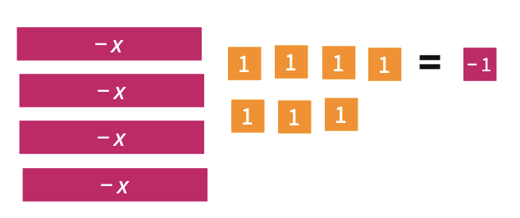
GRADE 7 TWO-STEP EQUATIONS:
CLOSED QUESTIONS
ELEMENTARY MATH PROJECT
4b. Use algebra tiles to solve the equations. Check each solution using symbols.

Slide 9
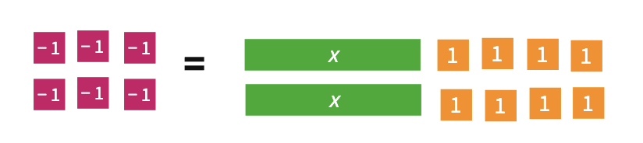
GRADE 7 TWO-STEP EQUATIONS:
CLOSED QUESTIONS
ELEMENTARY MATH PROJECT
4c. Use algebra tiles to solve the equations. Check each solution using symbols.

Slide 10
GRADE 7 TWO-STEP EQUATIONS:
CLOSED QUESTIONS
ELEMENTARY MATH PROJECT
5. Show whether x = -5 is the solution to each equation.
-6x + 4 = 34
3 – 8x = 43
27 = -9x – 18
40 = 5x + 65

Slide 11
GRADE 7 TWO-STEP EQUATIONS:
CLOSED QUESTIONS
ELEMENTARY MATH PROJECT
6. What is the first operation you should perform to solve each equation. Share your thinking.
2x – 2 = 16
9 – 9y = -27
71 = -9x -1

Slide 12
GRADE 7 TWO-STEP EQUATIONS:
CLOSED QUESTIONS
ELEMENTARY MATH PROJECT
7. Use inverse operations to solve the equations. Show your steps and check your solutions.
6x-4 = -32
22= -5x – 3
-30 = 7x – 9

Slide 13
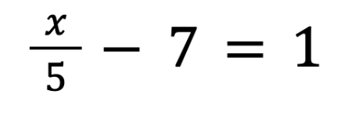
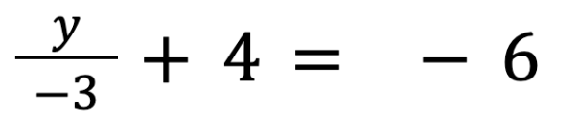
GRADE 7 TWO-STEP EQUATIONS:
CLOSED QUESTIONS
ELEMENTARY MATH PROJECT
8. Use inverse operations to solve the equations. Show your steps and check your solutions.

Slide 14
GRADE 7 TWO-STEP EQUATIONS:
CLOSED QUESTIONS
ELEMENTARY MATH PROJECT
9. Create word sentences.
Word Sentence | Equation
Three times a number plus two is ten. | 3x + 2 = 10
 | 3x = 9
 | 2x + 4 = 10
 | 9 = 5x - 27
 | 7 + 4x = 12

Slide 15
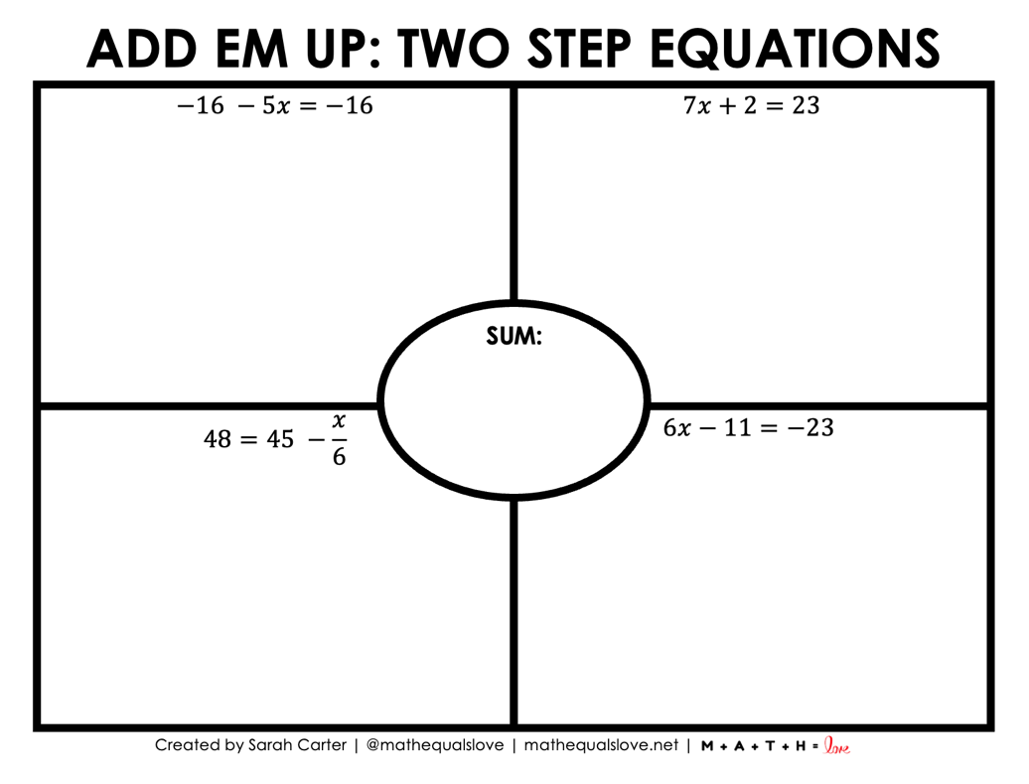
GRADE 7 TWO-STEP EQUATIONS:
CLOSED QUESTIONS
ELEMENTARY MATH PROJECT
10.

Slide 16
GRADE 7 TWO-STEP EQUATIONS:
OPEN QUESTIONS
ELEMENTARY MATH PROJECT
11. You write the equation 4x – 5 = 15 to solve a word problem. What might the word problem be?

Slide 17
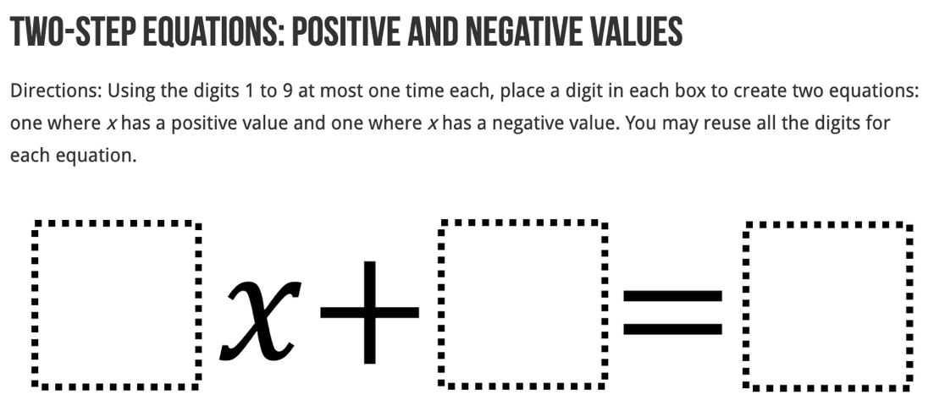
GRADE 7 TWO-STEP EQUATIONS:
OPEN QUESTIONS
ELEMENTARY MATH PROJECT
12.

Slide 18
GRADE 7 TWO-STEP EQUATIONS:
PROBLEMS
ELEMENTARY MATH PROJECT
1. How many laps did the players run if the coach told them to run nine less than six times the number of laps they ran yesterday, and that total was 15?

Slide 19
GRADE 7 TWO-STEP EQUATIONS:
PROBLEMS
ELEMENTARY MATH PROJECT
2. Lilly has two more than three times as many candies as Max. If she has 17 candies, how many does Max have?

Slide 20
GRADE 7 TWO-STEP EQUATIONS:
PROBLEMS
ELEMENTARY MATH PROJECT
3. How many pencils are there if, five times the number of pencils plus nine equals thirty-four.

Slide 21
GRADE 7 TWO-STEP EQUATIONS:
PROBLEMS
ELEMENTARY MATH PROJECT
4. If Marcus triples the amount of money he has now, and then spends $75, he will have just enough left to buy a new laptop that costs $450. Write and solve an equation to determine how much money Marcus has now.

Slide 22
GRADE 7 TWO-STEP EQUATIONS:
PROBLEMS
ELEMENTARY MATH PROJECT
5. If a number is doubled and five is subtracted from the product, the result is nine. What is the number?

Slide 23
ELEMENTARY MATH PROJECT
GRADE 7 PRACTICE QUESTIONS
CIRCLE GEOMETRY

Slide 24
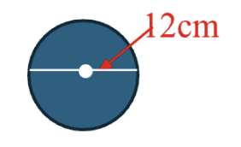
GRADE 7 CIRCLES:
AREA AND CIRCUMFERENCE: CLOSED QUESTIONS
ELEMENTARY MATH PROJECT
1. Estimate the circumference of a circle that has a diameter of 12cm. Show your thinking.

Slide 25
GRADE 7 CIRCLES:
AREA AND CIRCUMFERENCE: CLOSED QUESTIONS
ELEMENTARY MATH PROJECT
2. The diameter of a regulation basketball hoop (rim) is 45.72cm.
What is the radius?
Calculate the circumference

Slide 26
GRADE 7 CIRCLES:
AREA AND CIRCUMFERENCE: CLOSED QUESTIONS
ELEMENTARY MATH PROJECT
3. The Wave Swinger (the classic ride at Playland) has a radius of about 4.18m. Find the circumference (the distance traveled by a swing seat in one full rotation around the ride’s centre).

Slide 27
GRADE 7 CIRCLES:
AREA AND CIRCUMFERENCE: CLOSED QUESTIONS
ELEMENTARY MATH PROJECT
4. A circle has a circumference of 23.55cm. About how far is a point on the circle from the centre?

Slide 28
GRADE 7 CIRCLES:
AREA AND CIRCUMFERENCE: CLOSED QUESTIONS
ELEMENTARY MATH PROJECT
5. A bicycle wheel has a radius of 35cm.
What is the diameter of the wheel?
If the wheel turns 40 revolutions, how far would the bike travel?

Slide 29
GRADE 7 CIRCLES:
AREA AND CIRCUMFERENCE: CLOSED QUESTIONS
ELEMENTARY MATH PROJECT
6. While Luca was on vacation, he stayed at a hotel with a circular swimming pool with a diameter of 15 m. A fence around the pool costs $90 per meter to build. How much did the fence cost?

Slide 30
GRADE 7 CIRCLES:
AREA AND CIRCUMFERENCE: CLOSED QUESTIONS
ELEMENTARY MATH PROJECT
7. Find the area of a circle with the given dimension:
a radius of 2.5m
a diameter of 11km

Slide 31
GRADE 7 CIRCLES:
AREA AND CIRCUMFERENCE: CLOSED QUESTIONS
ELEMENTARY MATH PROJECT
8. A circular outdoor rink has an area of 510m². What is the diameter of the rink, to the nearest tenth of a meter?

Slide 32
GRADE 7 CIRCLES:
AREA AND CIRCUMFERENCE: CLOSED QUESTIONS
ELEMENTARY MATH PROJECT
9. The Canadian toonie has two parts:
an outer ring (made of nickel plating)
an inner circle with a diameter of 16mm (made of brass)
What is the area of the outer ring, rounded to the nearest hundredth of a square millimeter?

Slide 33
GRADE 7 CIRCLES:
AREA AND CIRCUMFERENCE: CLOSED QUESTIONS
ELEMENTARY MATH PROJECT
10. Construct a circle with these measurements:
a radius of 6cm
a diameter of 9cm
a circumference of 25cm

Slide 34
GRADE 7 CIRCLES:
AREA AND CIRCUMFERENCE: OPEN QUESTIONS
ELEMENTARY MATH PROJECT
11. What patterns do you notice when you compare the circumference and diameter of different circles. Explain and justify your thinking using pictures, symbols and words.

Slide 35
GRADE 7 CIRCLES:
AREA AND CIRCUMFERENCE: OPEN QUESTIONS
ELEMENTARY MATH PROJECT
12. How can you estimate the circumference of a circle without using the formula? What strategies might work?

Slide 36
GRADE 7 CIRCLES:
AREA AND CIRCUMFERENCE: OPEN QUESTIONS
ELEMENTARY MATH PROJECT
13. If you double the diameter of a circle, what happens to the circumference? How can you show this in more than one way?

Slide 37
GRADE 7 CIRCLES:
AREA AND CIRCUMFERENCE: OPEN QUESTIONS
ELEMENTARY MATH PROJECT
14. If two circles have the same circumference, do they have the same area? Why? Show your thinking using math.

Slide 38
GRADE 7 CIRCLES:
AREA AND CIRCUMFERENCE: OPEN QUESTIONS
ELEMENTARY MATH PROJECT
15. Describe a situation in which you might want to estimate either the circumference or the area of a circle but would not want to calculate it exactly.

Slide 39
GRADE 7 CIRCLES:
AREA AND CIRCUMFERENCE: OPEN QUESTIONS
ELEMENTARY MATH PROJECT
16. A circle has a radius of 10cm. Is it possible to create a rectangle with the same perimeter and a ratio of width to perimeter of about 1 to 10? If so, what are those measurements? Show your thinking.

Slide 40
GRADE 7 CIRCLES:
AREA AND CIRCUMFERENCE: OPEN QUESTIONS
ELEMENTARY MATH PROJECT
17. You want to compare the circumferences of these two circles. What unit and what tool would you use? Why?

Slide 41
ELEMENTARY MATH PROJECT
GRADE 7 PRACTICE QUESTIONS
PRISMS & CYLINDERS

Slide 42
GRADE 7 PRISMS & CYLINDERS:
CLOSED QUESTIONS
ELEMENTARY MATH PROJECT
1. a. Construct a rectangular prim using cubes. Count and record the number of cubes that make up its volume, as well as the number of cubes in its base and its height. Enter your findings in the table.
Height of Prism | Area of Base | Volume of Rectangular Prism

Slide 43
GRADE 7 PRISMS & CYLINDERS:
CLOSED QUESTIONS
ELEMENTARY MATH PROJECT
1. b) What is the relationship between the area of the base, the height of the prism, and the volume of a rectangular prism?

Slide 44
GRADE 7 PRISMS & CYLINDERS:
CLOSED QUESTIONS
ELEMENTARY MATH PROJECT
2. If the volume of a rectangular prism is 128 cubes and the height is 4 cubes, what is the area of the base?

Slide 45
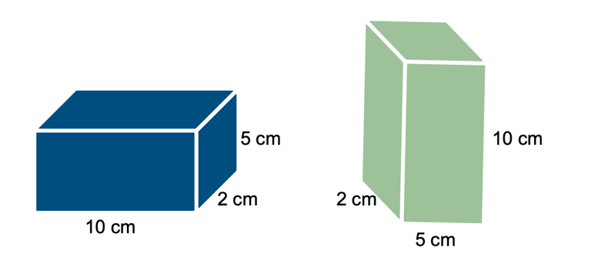
GRADE 7 PRISMS & CYLINDERS:
CLOSED QUESTIONS
ELEMENTARY MATH PROJECT
3. Which box has a greater volume? Explain your reasoning.

Slide 46
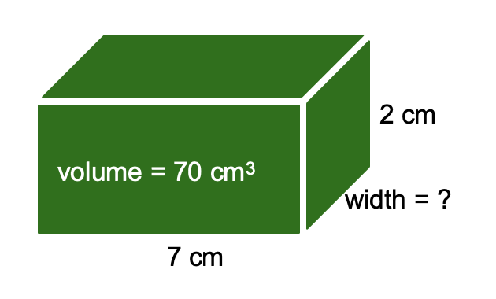
GRADE 7 PRISMS & CYLINDERS:
CLOSED QUESTIONS
ELEMENTARY MATH PROJECT
4.

Slide 47
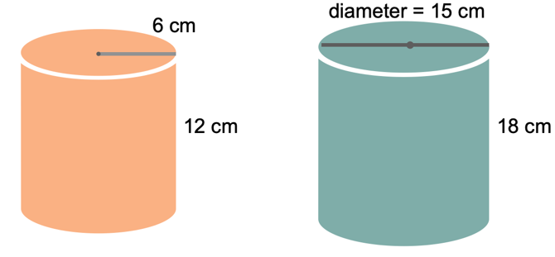
GRADE 7 PRISMS & CYLINDERS:
CLOSED QUESTIONS
ELEMENTARY MATH PROJECT
5. What is the volume of each cylinder?

Slide 48
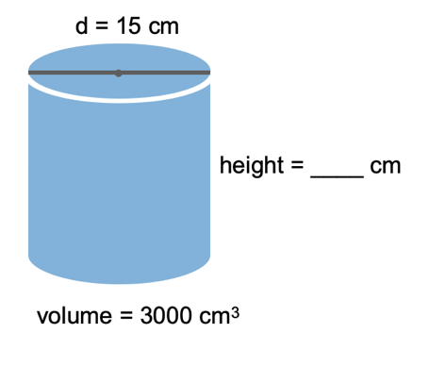
GRADE 7 PRISMS & CYLINDERS:
CLOSED QUESTIONS
ELEMENTARY MATH PROJECT
6.

Slide 49
GRADE 7 PRISMS & CYLINDERS:
CLOSED QUESTIONS
ELEMENTARY MATH PROJECT
7. Aisha and Ben each have two cans with the same base radius of 4 cm. Aisha’s can is shorter, with a height of 6 cm. Ben’s can is taller, with a height of 9 cm. Ben says his can holds more liquid than Aisha’s can. Is he correct? Explain your reasoning.

Slide 50
GRADE 7 PRISMS & CYLINDERS:
CLOSED QUESTIONS
ELEMENTARY MATH PROJECT
8. Lina is pouring juice into a tall glass. The area of the base of the glass is 12 cm², and the glass is 15 cm high. When Lina finishes pouring, the juice reaches a height of only 13 cm. What is the volume of juice in the glass?

Slide 51
GRADE 7 PRISMS & CYLINDERS:
CLOSED QUESTIONS
ELEMENTARY MATH PROJECT
9. If a cylinder has a base with an area of 28cm2 and a volume of 196cm3, what is its height?

Slide 52
GRADE 7 PRISMS & CYLINDERS:
CLOSED QUESTIONS
ELEMENTARY MATH PROJECT
10. Determine the volume of a cylinder that has a circumference of 46cm and a height of 20cm.

Slide 53
GRADE 7 PRISMS & CYLINDERS:
OPEN QUESTIONS
ELEMENTARY MATH PROJECT
11. In what ways is calculating the volume of a cylinder similar to calculating the volume of a rectangular prism? Use pictures, numbers and words to share your thinking.

Slide 54
GRADE 7 PRISMS & CYLINDERS:
OPEN QUESTIONS
ELEMENTARY MATH PROJECT
12. How does changing the height of a rectangular prism affect its volume if the base stays the same?

Slide 55
GRADE 7 PRISMS & CYLINDERS:
OPEN QUESTIONS
ELEMENTARY MATH PROJECT
13. What patterns do you notice when you double one dimension of a prism? How does that compare to doubling two dimensions?

Slide 56
GRADE 7 PRISMS & CYLINDERS:
OPEN QUESTIONS
ELEMENTARY MATH PROJECT
14. How many ways can you build a rectangular prism using 16 cubes. Show your thinking using pictures and numbers.

Slide 57
GRADE 7 PRISMS & CYLINDERS:
OPEN QUESTIONS
ELEMENTARY MATH PROJECT
15. Two cylinders have the same height but different volumes. What makes them the same and what makes them different?

Slide 58
ELEMENTARY MATH PROJECT
GRADE 7 PRACTICE QUESTIONS
CARTESIAN COORDINATES

Slide 59
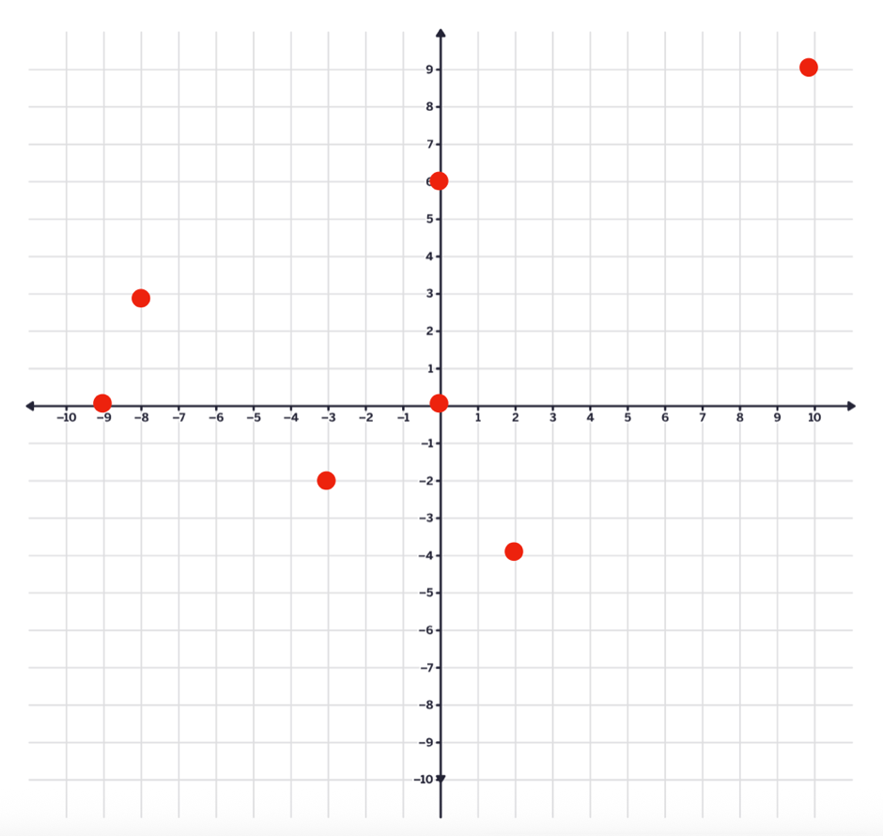
GRADE 7 CARTESIAN COORDINATES:
CLOSED QUESTIONS
ELEMENTARY MATH PROJECT
1. What are the coordinates for each point on the Cartesian Plane shown? Label each ordered pair on the graph.

Slide 60
GRADE 7 CARTESIAN COORDINATES:
CLOSED QUESTIONS
ELEMENTARY MATH PROJECT
2. Plot the following points (ordered pairs) on the Cartesian Plane.
(-3,4)
(0,0)
(-6, -5)
(7, 8)
(1,- 2)

Slide 61
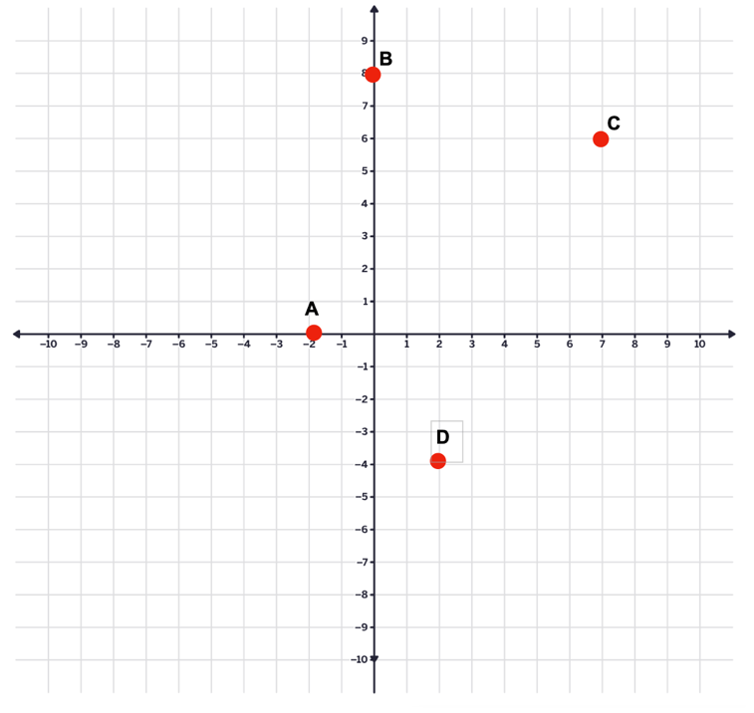
GRADE 7 CARTESIAN COORDINATES:
CLOSED QUESTIONS
ELEMENTARY MATH PROJECT
3. Which letter on the graph matches each ordered pair.
(-4 , -2)
(7, 6)
(0 , 8)
(-2 , 0)

Slide 62
GRADE 7 CARTESIAN COORDINATES:
CLOSED QUESTIONS
ELEMENTARY MATH PROJECT
4. Predict in which quadrant each of the following points will lie. Then plot them on the Cartesian plane. Were your predictions correct?
(4, 3) Quadrant ______
(-5, 2) Quadrant ______
(-3, -4) Quadrant ______
(6, -1) Quadrant ______
(0, 5) Quadrant ______
(-7, 0) Quadrant ______

Slide 63
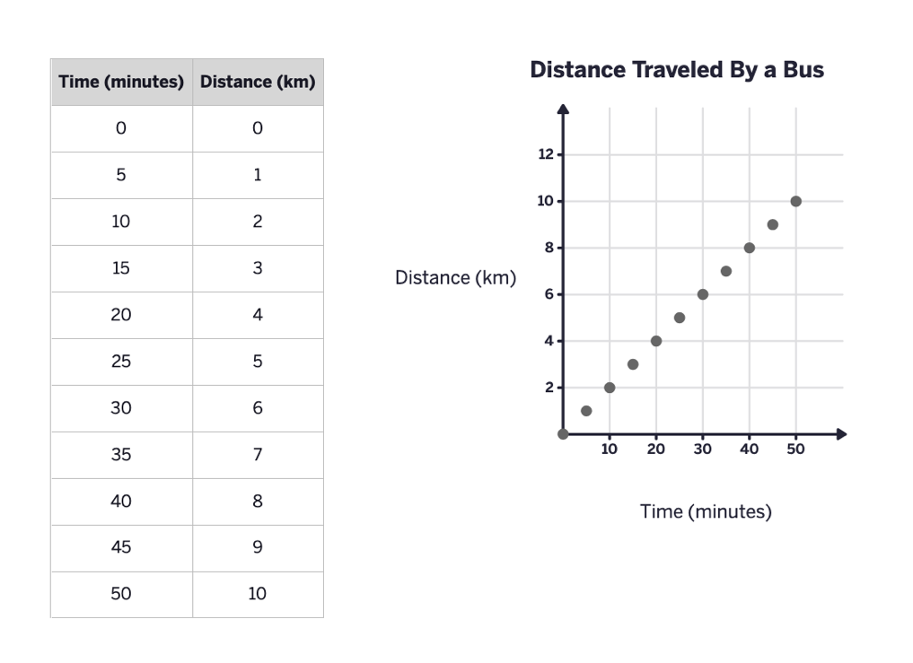
GRADE 7 CARTESIAN COORDINATES:
CLOSED QUESTIONS
ELEMENTARY MATH PROJECT
5.

Slide 64
GRADE 7 CARTESIAN COORDINATES:
CLOSED QUESTIONS
ELEMENTARY MATH PROJECT
5.
According to this graph, how long does it take the local bus to drive 3km?
How long did it take for the bus to complete its entire route?
What was the total distance travelled during the bus’s trip?
In which quadrant of the Cartesian Plan is the graph? Why?

Slide 65
GRADE 7 CARTESIAN COORDINATES:
CLOSED QUESTIONS
ELEMENTARY MATH PROJECT
6. A taxi company charges $3.50 to start the ride and 1.25 for every kilometer travelled.
Complete the table of values showing the total cost for these distances:
DISTANCE (km) | COST ($)
0
2
4
6

Slide 66
GRADE 7 CARTESIAN COORDINATES:
CLOSED QUESTIONS
ELEMENTARY MATH PROJECT
6.
Use your table to create a graph of Cost ($) on the y-axis and distance (km) on the x-axis.
Draw a straight line through the points.
What is cost for 5km?
At what distance does the cost reach $10?

Slide 67
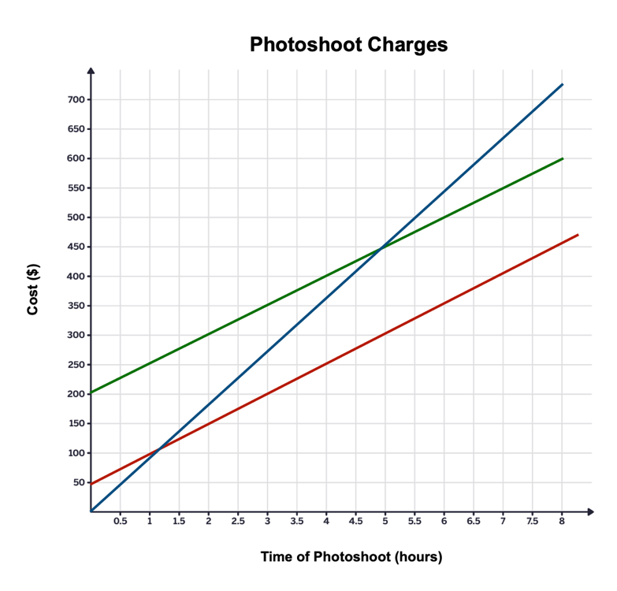
GRADE 7 CARTESIAN COORDINATES:
CLOSED QUESTIONS
ELEMENTARY MATH PROJECT
7. Which line in the graph best describes the relationship of a photographer charging $50 per hour for a photo session plus an additional $200 for editing and printing costs?

Slide 68
GRADE 7 CARTESIAN COORDINATES:
OPEN QUESTIONS
ELEMENTARY MATH PROJECT
8. Create a polygon with vertices on the Cartesian Plane. Label the vertices with capital letters and identify their ordered pairs.

Slide 69
GRADE 7 CARTESIAN COORDINATES:
OPEN QUESTIONS
ELEMENTARY MATH PROJECT
9. Dosaj has a bank account with $250 in it. He has a paper route job and deposits $50 of his earnings into his account at the end of every month.
Create a table of values that represents how much money is in Dosaj’s account each month for a year.
Draw a graph that represents this data.
Use the graph to tell how long it will take Dosaj to have $400 in his account.
Predict how long it will take Dosaj to have $1000 in his account, if he doesn’t spend any money.

Slide 70
ELEMENTARY MATH PROJECT
GRADE 7 PRACTICE QUESTIONS
CIRCLE GRAPHS

Slide 71
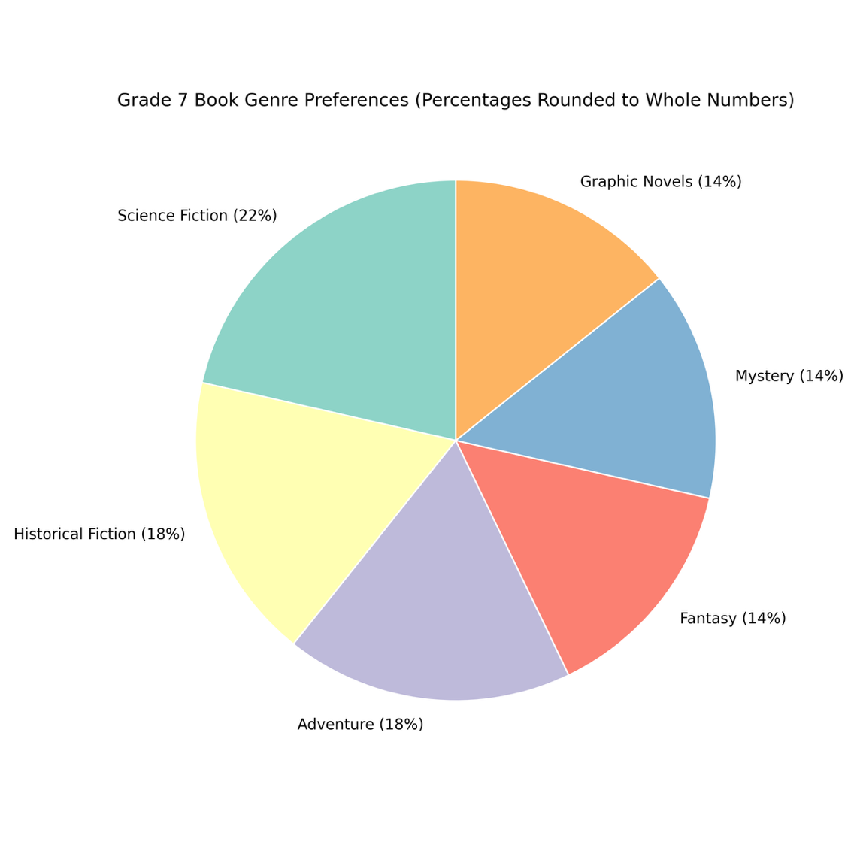
GRADE 7 CIRCLES:
CIRCLE GRAPHS
ELEMENTARY MATH PROJECT
1.

Slide 72
GRADE 7 CIRCLES:
CIRCLE GRAPHS
ELEMENTARY MATH PROJECT
1. The circle graph shows the types of books (genres) students in a grade 7 class prefer to read.
What genre of books does most students enjoy reading? Show your thinking.
What genre of books does students enjoy the least? How do you know?
If there are 28 students in the class, how many students prefer to read adventure books? Show your thinking.
How many more students prefer to read science fiction books than fantasy books? Show your thinking.

Slide 73
GRADE 7 CIRCLES:
CIRCLE GRAPHS
ELEMENTARY MATH PROJECT
2. The data in the chart represents the number of hours a student spends doing specific activities each week.
Calculate the percentage of total time this student spends doing each activity every week. Record the percentages in the chart below.
Activity | Hours in a Week | Percent of Total
weight training | 1.5
swimming | 2
robotics club | 15
television and movies | 8
student council | 2
reading | 1
playing piano | 1.5
video games | 9

Slide 74
GRADE 7 CIRCLES:
CIRCLE GRAPHS
ELEMENTARY MATH PROJECT
2b) On the circle graph, write the percent value for each activity inside or next to its sector. Create a legend on the side that shows the colour used for each activity. Make sure every slice is labeled so it shows what the activity is and the portion of the circle it represents, as a percent value. Also, create a title for this circle graph that describes what the graph shows!

Slide 75
GRADE 7 CIRCLES:
CIRCLE GRAPHS
ELEMENTARY MATH PROJECT
Favourite Ice Cream Flavour | Number of Students | Percent of Total | Decimal Value Equivalent | Central Angle (decimal value equivalent x 360°)
vanilla | 40
chocolate | 20
strawberry | 12
other | 8
TOTALS | 80 | 100 | 1.0 | 360
3. All the grade 7s were surveyed to determine their favourite flavour of ice cream.

Slide 76
GRADE 7 CIRCLES:
CIRCLE GRAPHS
ELEMENTARY MATH PROJECT
3. Complete the chart.
Create a circle graph to represent the data. Use either a protractor, a percent wheel, or technology. Be sure to label the circle with percent values and create a legend on the side of the graph to show what the colours of the graph represent. Also, include a title for your graph!
How many more students prefer vanilla than chocolate?
If we added 10 more students to this grade, and the same proportions stayed the same, how many would prefer chocolate?
If an ice cream truck could only stock two flavours, which should they choose? Explain your choice using data.
What could the data suggest about students’ taste preferences overall? Support your answer using the data.

Slide 77
ELEMENTARY MATH PROJECT
GRADE 7 PRACTICE QUESTIONS
EXPERIMENTAL PROBABILITY

Slide 78
GRADE 7 EXPERIMENTAL PROBABILITY:
CLOSED QUESTIONS
ELEMENTARY MATH PROJECT
1. Sofia flipped two coins and recorded whether she got heads or tails. She did this 20 times and her results were:
(HH), (HT), (TH), (TT), (HT), (HH), (TH), (HT), (TT), (HH), (HT), (TH), (HT), (HH), (TT), (HT), (HH), (TH), (HT), (TT).
What was the experimental probability that Sofia got two heads?

Slide 79
GRADE 7 EXPERIMENTAL PROBABILITY:
CLOSED QUESTIONS
ELEMENTARY MATH PROJECT
2. Ethan drew two cards from a shuffled deck (with replacement) 20 times and recorded the suits in a table.
His results were:
♥♣, ♦♠, ♥♥, ♠♠, ♦♥, ♥♦, ♣♣, ♥♠, ♦♦, ♥♥, ♠♥, ♦♣, ♥♣, ♠♠, ♦♥, ♥♦, ♣♠, ♥♥, ♦♠, ♥♣.
What was the experimental probability that Ethan drew two hearts?

Slide 80
GRADE 7 EXPERIMENTAL PROBABILITY:
CLOSED QUESTIONS
ELEMENTARY MATH PROJECT
3. Leo spun two spinners (each divided into 4 equal sections (orange, green, pink, blue) 15 times and recorded the results in a table:
(Orange–Green), (Pink–Blue), (Blue–Blue), (Green–Orange), (Orange–Orange), (Pink–Pink), (Green–Green), (Blue–Orange), (Orange–Pink), (Green–Blue), (Pink–Orange), (Blue–Green), (Orange–Orange), (Green–Pink), (Pink–Blue)
What was the experimental probability that both spinners landed on the same colour?

Slide 81
GRADE 7 EXPERIMENTAL PROBABILITY:
CLOSED QUESTIONS
ELEMENTARY MATH PROJECT
4. Rafa drew two marbles from a bag (with replacement) 20 times. The bag had 3 red, 2 blue, and 1 green marble.
Her recorded results were: (R-B), (G-R), (R-R), (B-B), (R-G), (B-R), (R-R), (G-G), (R-B), (B-G), (R-R), (G-R), (B-B), (R-G), (R-R), (B-R), (G-G), (R-B), (B-G), (R-R).
What was the experimental probability that she drew two red marbles?

Slide 82
GRADE 7 EXPERIMENTAL PROBABILITY:
CLOSED QUESTIONS
ELEMENTARY MATH PROJECT
5. Arjun flipped a coin and rolled a die 9 times and recorded the results in a table:
(H-3), (T-6), (H-2), (H-5,) (T-4), (H-1), (T-2), (H-6), (T-3).
What was the experimental probability that he got heads and an even number?

Slide 83
GRADE 7 EXPERIMENTAL PROBABILITY:
OPEN QUESTIONS
ELEMENTARY MATH PROJECT
6. Flip a coin and roll a die 20 times. Record each outcome in a table.
Count how many times you got HEADS and an EVEN NUMBER. Calculate the experimental probability.

Slide 84
GRADE 7 EXPERIMENTAL PROBABILITY:
OPEN QUESTIONS
ELEMENTARY MATH PROJECT
7. Flip a coin and role a die 100 times. Record each outcome in a table.
Count how many times you got HEADS and an EVEN NUMBER. Calculate the experimental probability.

Slide 85
GRADE 7 EXPERIMENTAL PROBABILITY:
OPEN QUESTIONS
ELEMENTARY MATH PROJECT
8. Choose any two tools (dice, coins, spinners, cards, marbles) and design your own experiment with 30 trials. Record your results and calculate the experimental probability for a specific event.

Slide 86
GRADE 7 EXPERIMENTAL PROBABILITY:
OPEN QUESTIONS
ELEMENTARY MATH PROJECT
9. Roll two ten-sided dice 100 times and record the results.
Calculate the experimental probability of rolling a sum of 11.
Calculate the theoretical probability.
How do your results compare to the theoretical probability? Why do you think this is?

Slide 87
ELEMENTARY MATH PROJECT
GRADE 7 PRACTICE QUESTIONS
RATIOS

Slide 88
GRADE 7 RATIOS:
CLOSED QUESTIONS
ELEMENTARY MATH PROJECT
1. Simply the following ratios.
12 : 18 | 24 : 36 | 15 : 45
21 : 28 | 32 : 48 | 27 : 63

Slide 89
GRADE 7 RATIOS:
CLOSED QUESTIONS
ELEMENTARY MATH PROJECT
2. Find the missing values.
5 : 8 = 15 : ___
___ : 9 = 4 : 6

Slide 90
GRADE 7 RATIOS:
CLOSED QUESTIONS
ELEMENTARY MATH PROJECT
3. A car travels 240 km in 4 hours. What is the unit rate in kilometres per hour?

Slide 91
GRADE 7 RATIOS:
CLOSED QUESTIONS
ELEMENTARY MATH PROJECT
4. The ratio of red beads to blue beads is 3 : 7. If there are 40 beads in total, how many are red?

Slide 92
GRADE 7 RATIOS:
CLOSED QUESTIONS
ELEMENTARY MATH PROJECT
5. A recipe uses flour and sugar in the ratio 4 : 5. If 20 cups of flour are used, how many cups of sugar are needed?

Slide 93
GRADE 7 RATIOS:
CLOSED QUESTIONS
ELEMENTARY MATH PROJECT
6. The ratio of grade 6’s to grade 7’s in a class is 2 : 3. There are 30 students in total. How many are grade 6’s? How many are grade 7’s?

Slide 94
GRADE 7 RATIOS:
OPEN QUESTIONS
ELEMENTARY MATH PROJECT
7. Explain why the ratios 6 : 9 and 2 : 3 are equivalent. Use more than one method to justify your answer.

Slide 95
GRADE 7 RATIOS:
OPEN QUESTIONS
ELEMENTARY MATH PROJECT
8. A student says: “If you double both numbers in a ratio, the ratio changes.” Do you agree? Explain.

Slide 96
GRADE 7 RATIOS:
OPEN QUESTIONS
ELEMENTARY MATH PROJECT
9. Without calculating exact values, determine which is greater: 4 : 5 or 7 : 9. Explain your reasoning.

Slide 97
GRADE 7 RATIOS:
OPEN QUESTIONS
ELEMENTARY MATH PROJECT
10. Create a real life situation that could be represented by the ratio 3 : 8. Explain what each part represents.

Slide 98
GRADE 7 RATIOS:
OPEN QUESTIONS
ELEMENTARY MATH PROJECT
11. The ratio of cats to dogs is 5 : 7. If 3 more cats are added, does the ratio remain proportional? Explain why or why not.

Slide 99
GRADE 7 RATIOS:
OPEN QUESTIONS
ELEMENTARY MATH PROJECT
12. Explain how a ratio can be written as a fraction. Use an example to support your explanation.

Slide 100
GRADE 7 RATIOS:
OPEN QUESTIONS
ELEMENTARY MATH PROJECT
13. Two recipes use flour and sugar in ratios 2 : 3 and 4 : 5. Are these proportional recipes? Explain how you know.

Slide 101
GRADE 7 RATIOS:
OPEN QUESTIONS
ELEMENTARY MATH PROJECT
14. Store A sells 6 granola bars for 9 dollars. Store B sells 10 granola bars for 14 dollars.
Without calculating both totals in detail, explain how you would determine which store offers the better deal. Justify your reasoning.

Slide 102
GRADE 7 RATIOS:
OPEN QUESTIONS
ELEMENTARY MATH PROJECT
15. A runner completes 15 km in 2 hours.
Two students found the unit rate in different ways. One divided 15 ÷ 2. The other doubled both numbers to get 30 km in 4 hours and then divided.
Are both strategies valid? Explain why or why not.

Slide 103
GRADE 7 RATIOS:
OPEN QUESTIONS
ELEMENTARY MATH PROJECT
16. The ratio of red marbles to blue marbles is 4 : 9. Explain how you could determine the total number of marbles if you were told there are more than 100 marbles but fewer than 150.

Slide 104
ELEMENTARY MATH PROJECT
GRADE 7 PRACTICE QUESTIONS
DECIMALS

Slide 105
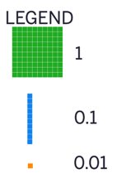
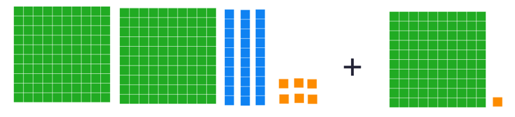
GRADE 7 DECIMALS:
CLOSED QUESTIONS
ELEMENTARY MATH PROJECT
1. Write an addition statement that represents the following model with base-ten blocks. Determine the sum of these decimal values.

Slide 106
GRADE 7 DECIMALS:
CLOSED QUESTIONS
ELEMENTARY MATH PROJECT
2. Use front-end estimation to determine the sum of 62.57 and 28.41.

Slide 107
GRADE 7 DECIMALS:
CLOSED QUESTIONS
ELEMENTARY MATH PROJECT
3. Find the value of 0.383 + 0.699 using base-ten blocks.
Represent your thinking using pictures and numbers.

Slide 108
GRADE 7 DECIMALS:
CLOSED QUESTIONS
ELEMENTARY MATH PROJECT
4. Express the subtraction statement, 0.04 – 0.003, in words.

Slide 109
GRADE 7 DECIMALS:
CLOSED QUESTIONS
ELEMENTARY MATH PROJECT
5. Place the decimal point in the correct position in the answer to make a true statement. Explain your strategy.
$55.73 + $18.75 + $72.39 = $14687
4189.675 – 1501.941 = 2687734

Slide 110
GRADE 7 DECIMALS:
CLOSED QUESTIONS
ELEMENTARY MATH PROJECT
6. Find the value of each expression. Show your reasoning.
3250.52 – 465.6 = | 22.563 + 45.22 + 4.088 = | 2550.06 – 465.14 =

Slide 111
GRADE 7 DECIMALS:
CLOSED QUESTIONS
ELEMENTARY MATH PROJECT
7. Replace the ▭ with a number to make each of the following statements true.
12.03 b. 870.49
+ ▭ - ▭
15.13 630.20

Slide 112
GRADE 7 DECIMALS:
CLOSED QUESTIONS
ELEMENTARY MATH PROJECT
8. Estimate, then calculate. Describe the strategy you used.
a) 78.2 x 5 b) 259.8 x 6

Slide 113
GRADE 7 DECIMALS:
CLOSED QUESTIONS
ELEMENTARY MATH PROJECT
9. Use base-ten blocks to find the product of 55.4 x 3.

Slide 114
GRADE 7 DECIMALS:
CLOSED QUESTIONS
ELEMENTARY MATH PROJECT
10. Find each product below using the equation 32 x 48 = 1536 and what you know about place value.
3.2 x 4.8 =
32 x (0.048) =
0.032 x (3.2) =

Slide 115
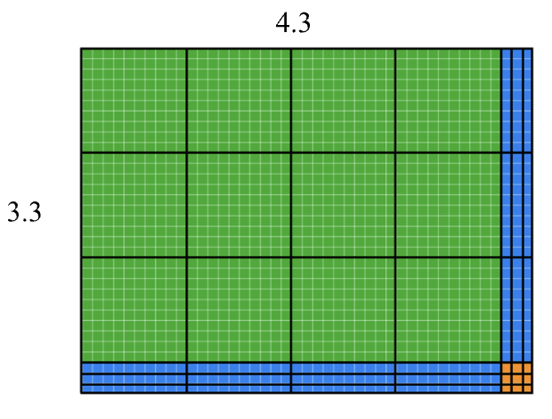
GRADE 7 DECIMALS:
CLOSED QUESTIONS
ELEMENTARY MATH PROJECT
11. Use the area model to determine the product of 4.3 x 3.3, then represent your thinking using numbers.

Slide 116
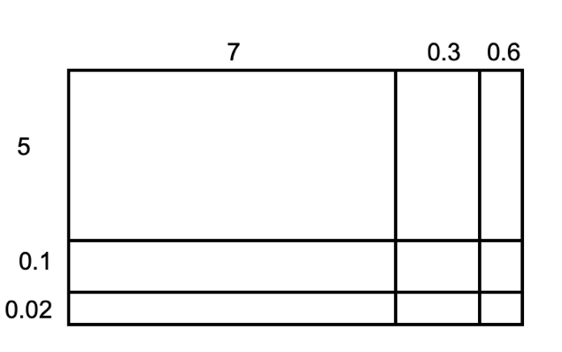
GRADE 7 DECIMALS:
CLOSED QUESTIONS
ELEMENTARY MATH PROJECT
12a. Use the area models (rectangle models) to find the products.

Slide 117
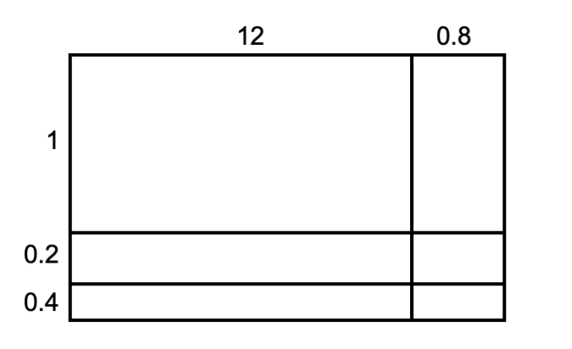
GRADE 7 DECIMALS:
CLOSED QUESTIONS
ELEMENTARY MATH PROJECT
12b. Use the area models (rectangle models) to find the products.

Slide 118
GRADE 7 DECIMALS:
CLOSED QUESTIONS
ELEMENTARY MATH PROJECT
13. Calculate each without using a calculator. Show your thinking.
2.87 x 73.48
0.45 x 151.6

Slide 119
GRADE 7 DECIMALS:
CLOSED QUESTIONS
ELEMENTARY MATH PROJECT
14. Estimate the quotient of 150.70 ÷ 2.6.

Slide 120
GRADE 7 DECIMALS:
CLOSED QUESTIONS
ELEMENTARY MATH PROJECT
15. Use an area model to find the quotient of 150.70 ÷ 2.6.

Slide 121
GRADE 7 DECIMALS:
CLOSED QUESTIONS
ELEMENTARY MATH PROJECT
16. Which of the following quotients has the same value as 5.04 ÷ 7? Explain how you know.
5.04 ÷ 70
50.4 ÷ 70
504, 000 ÷ 700
504,000 ÷ 700, 000

Slide 122
GRADE 7 DECIMALS:
CLOSED QUESTIONS
ELEMENTARY MATH PROJECT
17. Use base-ten blocks to model the calculation of 8 ÷ 1.5.

Slide 123
GRADE 7 DECIMALS:
CLOSED QUESTIONS
ELEMENTARY MATH PROJECT
18. Find the missing value of 36.8 ÷ 2.3 using the area model.
Show your thinking.

Slide 124
GRADE 7 DECIMALS:
CLOSED QUESTIONS
ELEMENTARY MATH PROJECT
19. Calculate each without using a calculator. Show your thinking.
24.2 ÷ 1.1
13.25 ÷ 0.4
170.28 ÷ 0.08

Slide 125
GRADE 7 DECIMALS:
CLOSED QUESTIONS
ELEMENTARY MATH PROJECT
20. What is the value of each expression?
(4.5 + 2.3) x 1.8 =
12. 5 – (3.2 + 2.8) =
8.4 ÷ 2 + 1.6 =
(12.5 + 3.75) ÷ (4.5 – 2.25) + 6.4 =
32.8 ÷ [(6.4 + 1.6) x 0.5] =

Slide 126
GRADE 7 DECIMALS:
OPEN QUESTIONS
ELEMENTARY MATH PROJECT
21. Which expression doesn’t belong? Explain and justify your thinking using math.
2 x 0.3
2 x 3 x 0.1
6 x 0.1
0.1 x 6

Slide 127
GRADE 7 DECIMALS:
OPEN QUESTIONS
ELEMENTARY MATH PROJECT
22. I am thinking of two numbers. Neither number is a whole number. Their product is 12.78. What might the numbers be?

Slide 128
GRADE 7 DECIMALS:
OPEN QUESTIONS
ELEMENTARY MATH PROJECT
23. Two numbers multiply to give a product between 18 and 19. What might these numbers be?

Slide 129
GRADE 7 DECIMALS:
OPEN QUESTIONS
ELEMENTARY MATH PROJECT
24. I multiplied 27 by a decimal and got an answer less than 27. What might be the decimal that I multiplied 27 by?
Give at least 5 possibilities.

Slide 130
GRADE 7 DECIMALS:
OPEN QUESTIONS
ELEMENTARY MATH PROJECT
25. The area of a rectangle is 3.9 units squared. What might the perimeter be?

Slide 131
GRADE 7 DECIMALS:
OPEN QUESTIONS
ELEMENTARY MATH PROJECT
26. Explain why 51.2 ÷ 6.4 has the same value as 5.12 ÷ 0.64.

Slide 132
GRADE 7 DECIMALS:
OPEN QUESTIONS
ELEMENTARY MATH PROJECT
27. Write two division statements that have the same value as
61.12 ÷ 3.2.

Slide 133
GRADE 7 DECIMALS:
PROBLEMS
ELEMENTARY MATH PROJECT
1. There is 0.162 liter of water in a 1-liter bottle. How much more water should be put in the bottle so it contains exactly 1 liter? Show your reasoning.

Slide 134
GRADE 7 DECIMALS:
PROBLEMS
ELEMENTARY MATH PROJECT
2. Diego is 59.5 inches tall. His brother is 40.125 inches tall. How much taller than his brother is Diego? Show your reasoning.

Slide 135
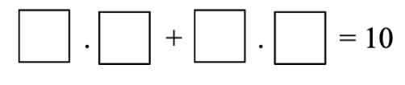
GRADE 7 DECIMALS:
PROBLEMS
ELEMENTARY MATH PROJECT
3. A person rolls a ten-sided die multiple times. After each roll, they write the number in one of the available boxes. The goal is to create a question where the sum is as close to 10 as possible. Once a number has been written, it cannot be erased or rewritten.

Slide 136
GRADE 7 DECIMALS:
PROBLEMS
ELEMENTARY MATH PROJECT
4. Jodi went to a concession stand that sells pretzels for $4.25, drinks for $2.85, and bags of popcorn for $1.99 each. He bought at least one of each item and spent no more than $15.
Could Jodi have purchased 2 pretzels, 2 drinks, and 2 bags of popcorn? Explain your reasoning.
Could he have bought 1 pretzel, 1 drink, and 5 bags of popcorn? Explain your reasoning.

Slide 137
GRADE 7 DECIMALS:
PROBLEMS
ELEMENTARY MATH PROJECT
5. A bag of nickels weighs 5.1 kilogram. Each nickel weighs 2.5 grams. About how many nickels are in the bag?

Slide 138
GRADE 7 DECIMALS:
PROBLEMS
ELEMENTARY MATH PROJECT
6. A roll of ribbon was 12 meters long. Diego cut 9 pieces of ribbon that were 0.4 meter each to tie some presents. He then used the remaining ribbon to make some wreaths. Each wreath required 0.6 meter. For each question, explain your reasoning.
How many meters of ribbon were available for making wreaths?
How many wreaths could Diego make with the available ribbon?

Slide 139
GRADE 7 DECIMALS:
PROBLEMS
ELEMENTARY MATH PROJECT
7. A swimming pool is being filled with water at a rate of 2.4 liters per minute. After 35 minutes, the pool already has 18.5 liters in it?

Slide 140
GRADE 7 DECIMALS:
PROBLEMS
ELEMENTARY MATH PROJECT
8. A car travels 248.6 km on the first day and 312.4km on the second day. On the third day it travels half the distanced of the second day. What is the total distance travelled?

Slide 141
ELEMENTARY MATH PROJECT
GRADE 7 PRACTICE QUESTIONS
PERCENTS

Slide 142
GRADE 7 PERCENTS:
CLOSED QUESTIONS
ELEMENTARY MATH PROJECT
1. Convert the following decimals into percents.
0.6 | 0.125
1.35 | 0.048

Slide 143
GRADE 7 PERCENTS:
CLOSED QUESTIONS
ELEMENTARY MATH PROJECT
2. Convert the following percents into decimals
48% | 7.5%
120% | 0.4%

Slide 144
GRADE 7 PERCENTS:
CLOSED QUESTIONS
ELEMENTARY MATH PROJECT
3. Find 25% of 84.

Slide 145
GRADE 7 PERCENTS:
CLOSED QUESTIONS
ELEMENTARY MATH PROJECT
4. Find 18% of 250.

Slide 146
GRADE 7 PERCENTS:
CLOSED QUESTIONS
ELEMENTARY MATH PROJECT
5. What is 150% of 60?

Slide 147
GRADE 7 PERCENTS:
CLOSED QUESTIONS
ELEMENTARY MATH PROJECT
6. What is 0.5% of 400?

Slide 148
GRADE 7 PERCENTS:
CLOSED QUESTIONS
ELEMENTARY MATH PROJECT
7. 12 is 20% of what number?

Slide 149
GRADE 7 PERCENTS:
CLOSED QUESTIONS
ELEMENTARY MATH PROJECT
8. 45 is 75% of what number?

Slide 150
GRADE 7 PERCENTS:
CLOSED QUESTIONS
ELEMENTARY MATH PROJECT
9. A jacket costs 120 dollars. It is discounted by 15%. What is the sale price?

Slide 151
GRADE 7 PERCENTS:
CLOSED QUESTIONS
ELEMENTARY MATH PROJECT
10. A price increases from 80 dollars to 92 dollars. What is the percent increase?

Slide 152
GRADE 7 PERCENTS:
CLOSED QUESTIONS
ELEMENTARY MATH PROJECT
11. A population decreases from 500 to 425. What is the percent decrease?

Slide 153
GRADE 7 PERCENTS:
CLOSED QUESTIONS
ELEMENTARY MATH PROJECT
12. Which is greater: 35% of 200 or 60% of 120?

Slide 154
GRADE 7 PERCENTS:
OPEN QUESTIONS
ELEMENTARY MATH PROJECT
13. Explain why 25%, 0.25, and 1/4 represent the same quantity. Use a model or example to support your explanation.

Slide 155
GRADE 7 PERCENTS:
OPEN QUESTIONS
ELEMENTARY MATH PROJECT
14. Without calculating exactly, determine which is greater: 40% of 90 or 30% of 120. Explain your reasoning.

Slide 156
GRADE 7 PERCENTS:
OPEN QUESTIONS
ELEMENTARY MATH PROJECT
15. A student says: “Increasing a number by 20% and then decreasing it by 20% returns the number to its original value.” Do you agree? Explain why or why not.

Slide 157
GRADE 7 PERCENTS:
OPEN QUESTIONS
ELEMENTARY MATH PROJECT
16. Explain why 150% of a number is greater than the original number. Use an example to support your explanation.

Slide 158
GRADE 7 PERCENTS:
OPEN QUESTIONS
ELEMENTARY MATH PROJECT
17. Create a real-life situation where 5% would represent a very large amount. Explain your reasoning.

Slide 159
GRADE 7 PERCENTS:
OPEN QUESTIONS
ELEMENTARY MATH PROJECT
18. A store advertises 30% off. Explain two different ways you could determine the sale price of an item.

Slide 160
GRADE 7 PERCENTS:
OPEN QUESTIONS
ELEMENTARY MATH PROJECT
19. Without converting to decimals, determine whether 3/8 is greater or less than 40%. Explain how you know.

Slide 161
GRADE 7 PERCENTS:
OPEN QUESTIONS
ELEMENTARY MATH PROJECT
20. Describe what 0.5% represents. Use a visual or numerical example to support your explanation.

Slide 162
ELEMENTARY MATH PROJECT
GRADE 7 PRACTICE QUESTIONS
INTEGERS

Slide 163


GRADE 7 INTEGERS:
CLOSED QUESTIONS
ELEMENTARY MATH PROJECT
1. Write the integers modelled by the counters below, if red counters are negative and yellow counters are positive.
a) b)

Slide 164
GRADE 7 INTEGERS:
CLOSED QUESTIONS
ELEMENTARY MATH PROJECT
2. Mark these integers on the number line below:
+2
-8
+9
-1

Slide 165
GRADE 7 INTEGERS:
CLOSED QUESTIONS
ELEMENTARY MATH PROJECT
3. Use an integer to represent each situation.
15 m below sea level
Lola deposited $35 in her bank account
Miku the dog dug a hole 2 m deep
A parking spot 3 levels above ground level
A drop in price of $1
7 steps backward

Slide 166
GRADE 7 INTEGERS:
CLOSED QUESTIONS
ELEMENTARY MATH PROJECT
4. Order the integers in the following sets from least to greatest.
-7, -11, +11, 0, -3
+46, -38, -40, -11, +25

Slide 167
GRADE 7 INTEGERS:
CLOSED QUESTIONS
ELEMENTARY MATH PROJECT
5. Name the opposite of each integer.
-20
125
-7

Slide 168
GRADE 7 INTEGERS:
CLOSED QUESTIONS
ELEMENTARY MATH PROJECT
6. What integer comes next in each of the following number patterns:
3, 2, 1, 0, -1, -2,
-6, -4, -2,
10, 7, 4 ,1,

Slide 169
GRADE 7 INTEGERS:
CLOSED QUESTIONS
ELEMENTARY MATH PROJECT
7. Fill in the less than (<) or the greater than (>) symbol to show the relationship between each pair or numbers.
2 ____ 6
-4 _____ 5
3 _____ -7
-1 _____ 2

Slide 170
GRADE 7 INTEGERS:
CLOSED QUESTIONS
ELEMENTARY MATH PROJECT
8. What is the sum of -2 and +2?
Explain your thinking using either a number line or double-sided counters.
Use your response to predict the sum of any opposite integers. Explain your thinking.

Slide 171
GRADE 7 INTEGERS:
CLOSED QUESTIONS
ELEMENTARY MATH PROJECT
9. Use double sided counters to find the sum of (+4) and (-2). Use the graphic organizer to show your thinking.
Draw a picture of the counters that represent +4 and -2. | Combine the counters by organizing them into as many zero pairs as possible.
Draw the counters that are left over. Write the integer that represents these counters. | Complete the addition statement (+4) + (-2) = ____

Slide 172
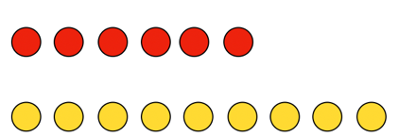
GRADE 7 INTEGERS:
CLOSED QUESTIONS
ELEMENTARY MATH PROJECT
10. What addition statement does the diagram represent?

Slide 173
GRADE 7 INTEGERS:
CLOSED QUESTIONS
ELEMENTARY MATH PROJECT
11. Use a number line to find the sum of (+9) and (-5). Use the graphic organizer below to show your thinking.
Represent your thinking on the number line. | Complete the addition statement (+9) + (-5) = ____

Slide 174
GRADE 7 INTEGERS:
CLOSED QUESTIONS
ELEMENTARY MATH PROJECT
12. Find the sum.
(-3) + (4 )=
(+11) + (– 7 )=
(-5) + (-6)=
(-2) + (+1) + (-9)=

Slide 175
GRADE 7 INTEGERS:
CLOSED QUESTIONS
ELEMENTARY MATH PROJECT
12. Find the sum.
(-3) + (4 )=
(+11) + (– 7 )=
(-5) + (-6)=
(-2) + (+1) + (-9)=

Slide 176
GRADE 7 INTEGERS:
CLOSED QUESTIONS
ELEMENTARY MATH PROJECT
13. A magic square is a grid where the sum of each row, column and diagonal is the same. Fill in the missing numbers in the magic square below. Show your thinking and check your work.
4 |  | -3
 | 0
-2 |  | 5

Slide 177
GRADE 7 INTEGERS:
CLOSED QUESTIONS
ELEMENTARY MATH PROJECT
14. Is the puzzle below a magic square? Explain and justify your thinking.
-8 | -1 | 6
3 | 4 | 7
-2 | 9 | 5

Slide 178
GRADE 7 INTEGERS:
CLOSED QUESTIONS
ELEMENTARY MATH PROJECT
15. Use double sided counters to find the difference, (+3) – (-6). Use the graphic organizer below to show your thinking.
Draw a picture of the counters that represent (+3). | Draw the zero pairs needed to be able to remove (-6).
Remove (-6), and draw the counters that are left over. | Complete the subtraction statement (+3) - (-6) = ____

Slide 179
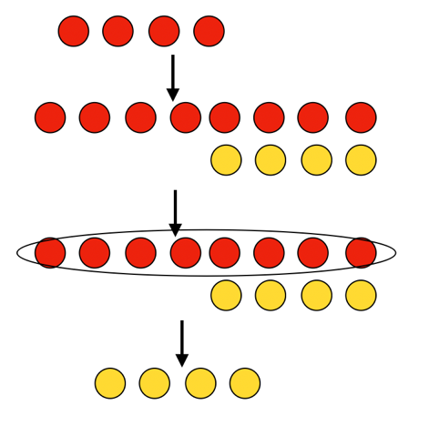
GRADE 7 INTEGERS:
CLOSED QUESTIONS
ELEMENTARY MATH PROJECT
16. Write the subtraction statement that the diagram represents.

Slide 180
GRADE 7 INTEGERS:
CLOSED QUESTIONS
ELEMENTARY MATH PROJECT
17. Determine the difference using double-sided counters. Show your thinking using picture and numbers.
(-5) – (-3) =
(+7) – (-5)=
(+2) – (+9) =

Slide 181
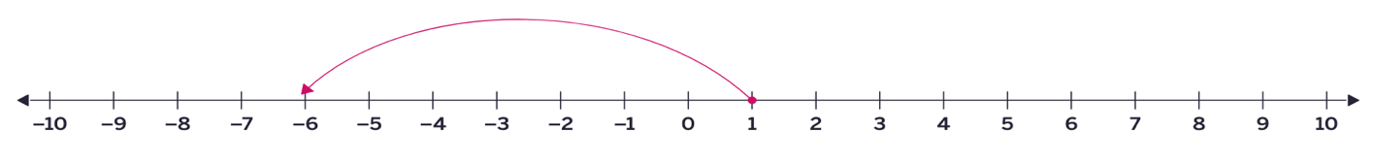
GRADE 7 INTEGERS:
CLOSED QUESTIONS
ELEMENTARY MATH PROJECT
18. Write the subtraction statement that the diagram represents.
a)

Slide 182
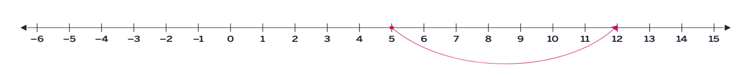
GRADE 7 INTEGERS:
CLOSED QUESTIONS
ELEMENTARY MATH PROJECT
18. Write the subtraction statement that the diagram represents.
b)

Slide 183
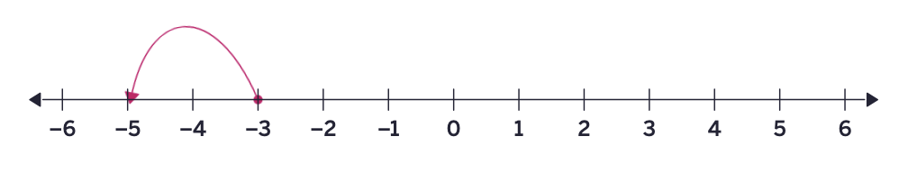
GRADE 7 INTEGERS:
CLOSED QUESTIONS
ELEMENTARY MATH PROJECT
18. Write the subtraction statement that the diagram represents.
c)

Slide 184
GRADE 7 INTEGERS:
CLOSED QUESTIONS
ELEMENTARY MATH PROJECT
19. Find the difference using an open number line. Show your thinking.
(-23) – (+17) =
(+122) – (- 46) =
(-415) – (-55) =

Slide 185

GRADE 7 INTEGERS:
CLOSED QUESTIONS
ELEMENTARY MATH PROJECT
20. Determine the multiplication statement that the diagram represents.
a)

Slide 186
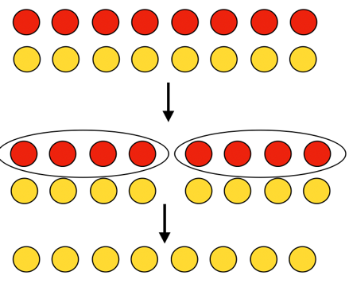
GRADE 7 INTEGERS:
CLOSED QUESTIONS
ELEMENTARY MATH PROJECT
20. Determine the multiplication statement that the diagram represents.
b)

Slide 187
GRADE 7 INTEGERS:
CLOSED QUESTIONS
ELEMENTARY MATH PROJECT
21. Determine the product using double-sided counters. Use pictures to show your thinking.
(+6) x (-7) =
(-6) x (-1) =
(+5) x ( -3) =

Slide 188
GRADE 7 INTEGERS:
CLOSED QUESTIONS
ELEMENTARY MATH PROJECT
22. Write the expression as a multiplication statement.
(-2) + (-2) + (-2) +(-2)

Slide 189
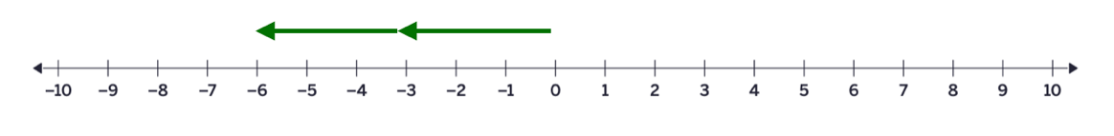
GRADE 7 INTEGERS:
CLOSED QUESTIONS
ELEMENTARY MATH PROJECT
23. Determine the multiplication statement that the diagram represents.

Slide 190
GRADE 7 INTEGERS:
CLOSED QUESTIONS
ELEMENTARY MATH PROJECT
24. Copy and complete the multiplication statement.
(-4) x 🟦 = + 12

Slide 191
GRADE 7 INTEGERS:
CLOSED QUESTIONS
ELEMENTARY MATH PROJECT
25. Determine (-15) ÷ (-3) using a number line.

Slide 192
GRADE 7 INTEGERS:
CLOSED QUESTIONS
ELEMENTARY MATH PROJECT
26. Determine each quotient.
(-75) ÷ (+25) =
( -48) ÷ (-8) =
(-324) ÷ (12) =
456 ÷ (-24) =
(-672) ÷ (-28) =

Slide 193
GRADE 7 INTEGERS:
CLOSED QUESTIONS
ELEMENTARY MATH PROJECT
27. Which expression equals (-4) x (+6)?
(-12) x (-2)
(-24) ÷ (-1)
(+3) x (+8)
(+72) ÷ (-3)

Slide 194
GRADE 7 INTEGERS:
CLOSED QUESTIONS
ELEMENTARY MATH PROJECT
28, Calculate using order of operations.
8 + 3 x 4 – 6
(-12 – 5) x (-3) + (-8)
20 ÷ (-4 + 1) + 7
(-18 ÷ 3) + (7 x -2)
[-6 + (4 x -3)] ÷ 2

Slide 195
GRADE 7 INTEGERS:
CLOSED QUESTIONS
ELEMENTARY MATH PROJECT
29. Complete the statement by including operation symbols to make the statement true.
5 🟦 (-9) 🟦 🟦4 (-1)= 41

Slide 196
GRADE 7 INTEGERS:
CLOSED QUESTIONS
ELEMENTARY MATH PROJECT
30. Sofia evaluated the expression (-3) x (6-2) +4 to equal -14. What mistake did she make? What is the correct value of the expression?

Slide 197
GRADE 7 INTEGERS:
OPEN QUESTIONS
ELEMENTARY MATH PROJECT
31. You add two numbers and the answer is negative.
What two numbers might you have added?

Slide 198
GRADE 7 INTEGERS:
OPEN QUESTIONS
ELEMENTARY MATH PROJECT
32. Would you calculate (-16) – (-4) in the same way you would calculate 16 – (-5)? Explain your thinking.

Slide 199
GRADE 7 INTEGERS:
OPEN QUESTIONS
ELEMENTARY MATH PROJECT
33. Predict the sum of any pair of opposite integers. Explain your reasoning using pictures, words, numbers and symbols.

Slide 200
GRADE 7 INTEGERS:
OPEN QUESTIONS
ELEMENTARY MATH PROJECT
34. Would you rather solve expression, a or b? Explain your reasoning before calculating.
(-12 - 4) x (-3) + 8
12 – (4 x (-3) + 8)

Slide 201
GRADE 7 INTEGERS:
OPEN QUESTIONS
ELEMENTARY MATH PROJECT
35. How are the following expressions the same? How are they different? Which operation changes the outcome the most?
a) (-5 + 8) x 4 b) -5 + (8 x 4)

Slide 202
GRADE 7 INTEGERS:
OPEN QUESTIONS
ELEMENTARY MATH PROJECT
36. Which one doesn’t belong? Share all possible reasons.
(6+3) x (-2)
6 + (3 x (-2))
(-6 +3) x 2
6 – (3 x 2)

Slide 203
GRADE 7 INTEGERS:
OPEN QUESTIONS
ELEMENTARY MATH PROJECT
37. Convince Me! Convince me that (10 – 4) x (-3) + 2 will give you a negative answer, without calculating every step. What clues can you use? How does the order of operations help you predict the sign?

Slide 204
GRADE 7 INTEGERS:
OPEN QUESTIONS
ELEMENTARY MATH PROJECT
38. When you multiply two negative integers and then add a positive integer, the result is always negative. Is this always, sometimes, or never true? Give examples to justify your answer.

Slide 205
GRADE 7 INTEGERS:
PROBLEMS
ELEMENTARY MATH PROJECT
1. A soccer tournament had 8 teams. Each team played 3 matches. Each win gives 3 points, a draw gives 1 point, and a loss gives 0 points. If one team won 2 matches and drew 1 math, how many points did they earn?

Slide 206
GRADE 7 INTEGERS:
PROBLEMS
ELEMENTARY MATH PROJECT
2. A bookstore sold 15 books on Monday and 12 books on Tuesday. Each book costs $8. The store gave a discount of $20 on the total bill. What was the total amount collected after the discount?

Slide 207
GRADE 7 INTEGERS:
PROBLEMS
ELEMENTARY MATH PROJECT
3. A school rented 4 buses for a field trip. Each bus can carry 36 students. There are 128 students going. After filling the buses, how many students will not have a seat?

Slide 208
GRADE 7 INTEGERS:
PROBLEMS
ELEMENTARY MATH PROJECT
4. A fruit seller has 120 apples. He packs them into boxes of 8 apples each. Each box sells for $5. If he sells all the boxes, how much money does he make?

Slide 209
GRADE 7 INTEGERS:
PROBLEMS
ELEMENTARY MATH PROJECT
5. A charity organization collected $450 at an event. They spent $125 on food and $75 on decorations. The remaining amount was divided equally among 5 families. How much did each family receive?

Slide 210
GRADE 7 INTEGERS:
PROBLEMS
ELEMENTARY MATH PROJECT
6. How much colder is -5°C than +3°C?

Slide 211
GRADE 7 INTEGERS:
PROBLEMS
ELEMENTARY MATH PROJECT
7. A new freezer is at a room temperature of 20°C. When the freezer is turned on, the temperature inside drops by 6°C per hour. How long does it take the freezer to reach -12°C.

Slide 212
GRADE 7 INTEGERS:
PROBLEMS
ELEMENTARY MATH PROJECT
8. Because the charging cable is faulty, Maya’s phone battery is charging 15% slower than normal every hour. At 6:00pm, she starts charging her phone, and it shows 50% battery. Normally, her phone would reach 100% in 4 hours. What will her phone’s battery percentage be at 10:00pm?

Slide 213
GRADE 7 INTEGERS:
PROBLEMS
ELEMENTARY MATH PROJECT
9. Why does it make sense that (-3) – (-9) has to have the same result as (-2) – (-8) or 0 – (-6)?

Slide 214
GRADE 7 INTEGERS:
PROBLEMS
ELEMENTARY MATH PROJECT
10. You add the product of two integers to the product of a different two integers and end up with 1. What could you have multiplied and added?

Slide 215
ELEMENTARY MATH PROJECT
GRADE 7 PRACTICE QUESTIONS
FINANCIAL LITERACY

Slide 216
GRADE 7 FINANCIAL LITERACY:
CLOSED QUESTIONS
ELEMENTARY MATH PROJECT
1. Show how to find each amount using mental math.
50% of 66
25% of 32
10% of 15
1% of 170

Slide 217
GRADE 7 FINANCIAL LITERACY:
CLOSED QUESTIONS
ELEMENTARY MATH PROJECT
2. Use mental math to determine the amount. Show your thinking using pictures and numbers.
a) 60% of 50 b) 35% of 240

Slide 218
GRADE 7 FINANCIAL LITERACY:
CLOSED QUESTIONS
ELEMENTARY MATH PROJECT
3. Calculate the total cost (final price).
A concert ticket costs $250 plus GST.
Noah buys a bike for $350 with a 15% discount and pays GST and PST.
Mia buys two hoodies for $98 each and pays GST.

Slide 219
GRADE 7 FINANCIAL LITERACY:
CLOSED QUESTIONS
ELEMENTARY MATH PROJECT
4. Calculate.
a) 37% of 485 b) 68% of 942

Slide 220
GRADE 7 FINANCIAL LITERACY:
CLOSED QUESTIONS
ELEMENTARY MATH PROJECT
5. Determine the original price.
A backpack is on sale for $45 after a 10% discount.
Final price of a fridge was $1200 after a 30% discount.

Slide 221
GRADE 7 FINANCIAL LITERACY:
CLOSED QUESTIONS
ELEMENTARY MATH PROJECT
6. What is the total amount paid for a restaurant bill of $175, if a tip of 20% was provided.

Slide 222
GRADE 7 FINANCIAL LITERACY:
OPEN QUESTIONS
ELEMENTARY MATH PROJECT
7. If GST increased to 7%, how would that affect the total price of a $100 item?

Slide 223
GRADE 7 FINANCIAL LITERACY:
OPEN QUESTIONS
ELEMENTARY MATH PROJECT
8. Which is better, 20% off or $20 off on a $150 item. Explain and justify your thinking.

Slide 224
GRADE 7 FINANCIAL LITERACY:
OPEN QUESTIONS
ELEMENTARY MATH PROJECT
9. Show two ways to estimate the total cost of an item with tax and discount.

Slide 225
GRADE 7 FINANCIAL LITERACY:
OPEN QUESTIONS
ELEMENTARY MATH PROJECT
10. Name an item that you have on your wish list. Find the current price of it and calculate what the final cost after taxes would be if it were on sale for 20% off.

Slide 226
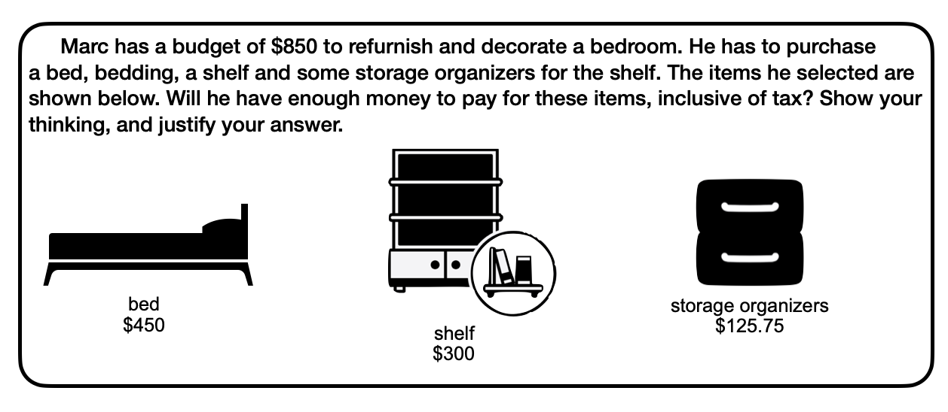
GRADE 7 FINANCIAL LITERACY:
PROBLEMS
ELEMENTARY MATH PROJECT
1.

Slide 227
GRADE 7 FINANCIAL LITERACY:
PROBLEMS
ELEMENTARY MATH PROJECT
2. What is the total cost of four tires that sell for $275 each, plus 5% GST and a fixed fee of $6.50 per tire for an Eco Fee? You do not have to pay for PST because you are planning on mounting these tires on your car, yourself.

Slide 228
GRADE 7 FINANCIAL LITERACY:
PROBLEMS
ELEMENTARY MATH PROJECT
3. The selling price of a gaming console is about 35% more than it costs, at a store. It is currently sold at a discount of 15% off the selling price. How much does the store still gain?

Slide 229
GRADE 7 FINANCIAL LITERACY:
PROBLEMS
ELEMENTARY MATH PROJECT
4. In 2021, Richmond BC’s population was 209, 937 and Kelowna BC’s population was 144, 576. Over the next two years:
Richmond’s population grew by 6% in the first year, then 4% in the second year.
Kelowna’s population grew by a total of 10% across the same two years.
Did the population of each city increase by the same amount? Explain using math.
What is the new population of each city after two years (round to the nearest whole number)?

Slide 230
GRADE 7 FINANCIAL LITERACY:
PROBLEMS
ELEMENTARY MATH PROJECT
5. Paco saved $1250 over the year from a part time job.
He decided to take $850 of it to the bank to put in a savings account where it will earn 2% interest every month.
How much will be in his account after three months if he doesn’t withdraw any money?

Slide 231
GRADE 7 FINANCIAL LITERACY:
PROBLEMS
ELEMENTARY MATH PROJECT
6. You bought shoes at 40% off and a jacket at 20% off and paid the same amount for each. How would you figure out the original prices?

Slide 232
ELEMENTARY MATH PROJECT
GRADE 7 PRACTICE QUESTIONS
MIXED REVIEW

Slide 233
GRADE 7 MIXED REVIEW:
ELEMENTARY MATH PROJECT
1. Solve $$\text{4}\text{x}\text{ − 9 = 19}$$

Slide 234
GRADE 7 MIXED REVIEW:
ELEMENTARY MATH PROJECT
2. Solve
−6 + 3.5 − 2

Slide 235
GRADE 7 MIXED REVIEW:
ELEMENTARY MATH PROJECT
3. Find 35% of 240.

Slide 236
GRADE 7 MIXED REVIEW:
ELEMENTARY MATH PROJECT
4. A price increases from $80 to $92 What is the percent increase?

Slide 237
GRADE 7 MIXED REVIEW:
ELEMENTARY MATH PROJECT
5. The ratio of boys to girls is 3 : 5. If there are 40 students total, how many are boys?

Slide 238
GRADE 7 MIXED REVIEW:
ELEMENTARY MATH PROJECT
6. A car travels 360 km in 4 hours. What is the unit rate in km per hour?

Slide 239
GRADE 7 MIXED REVIEW:
ELEMENTARY MATH PROJECT
7. A rectangular prism has dimensions 6 cm, 4 cm, and 5 cm. What is its volume?

Slide 240
GRADE 7 MIXED REVIEW:
ELEMENTARY MATH PROJECT
8. The diameter of a circle is 14 cm. What is the radius?

Slide 241
GRADE 7 MIXED REVIEW:
ELEMENTARY MATH PROJECT
9. A bag contains 8 red and 12 blue marbles. What is the probability of selecting a blue marble as a decimal?

Slide 242
GRADE 7 MIXED REVIEW:
ELEMENTARY MATH PROJECT
10. A $150 jacket is discounted by 20%. What is the sale price?

Slide 243
GRADE 7 MIXED REVIEW:
ELEMENTARY MATH PROJECT
11. Explain why increasing a number by 25% and then decreasing it by 25% does not return the original number.

Slide 244
GRADE 7 MIXED REVIEW:
ELEMENTARY MATH PROJECT
12. A spinner has 8 equal sections. 3 are blue. What is the experimental probability of landing on blue as a fraction and a percent?

Slide 245
GRADE 7 MIXED REVIEW:
ELEMENTARY MATH PROJECT
13. A $150 jacket increases in price by 12%. What is the new price?

Slide 246
GRADE 7 MIXED REVIEW:
ELEMENTARY MATH PROJECT
14. Explain why multiplying both terms of a ratio by the same number creates an equivalent ratio.

Slide 247
GRADE 7 MIXED REVIEW:
ELEMENTARY MATH PROJECT
15. A student solves 3x + 6 = 21 by subtracting 6 and dividing by 3. Explain why this method works.

Slide 248
GRADE 7 MIXED REVIEW:
ELEMENTARY MATH PROJECT
16. A circle graph shows 30% of students prefer soccer. If 200 students were surveyed, explain how you would determine how many prefer soccer.

Slide 249
GRADE 7 MIXED REVIEW:
ELEMENTARY MATH PROJECT
17. Describe two different ways to determine the unit rate of 90 km in 1.5 hours.

Slide 250
GRADE 7 MIXED REVIEW:
ELEMENTARY MATH PROJECT
18. Explain why subtracting a negative number results in a larger value.

Slide 251
GRADE 7 MIXED REVIEW:
ELEMENTARY MATH PROJECT
19. Without calculating fully, determine which is greater: 40% of 150 or 60% of 90. Explain your reasoning.

Slide 252
GRADE 7 MIXED REVIEW:
ELEMENTARY MATH PROJECT
20. A $200 fundraiser collects 15% more than expected. The total money is then divided in a 2 : 3 ratio between two clubs. Explain how you would determine how much each club receives.

Slide 253
GRADE 7 MIXED REVIEW:
ELEMENTARY MATH PROJECT
21. A school fundraiser raised $1200.
• 35% of the money is used to buy sports equipment. • The remaining money is divided in the ratio 2 : 3 between two clubs.
How much money does each club receive?
Explain your reasoning and show all steps clearly.

