Slide 1
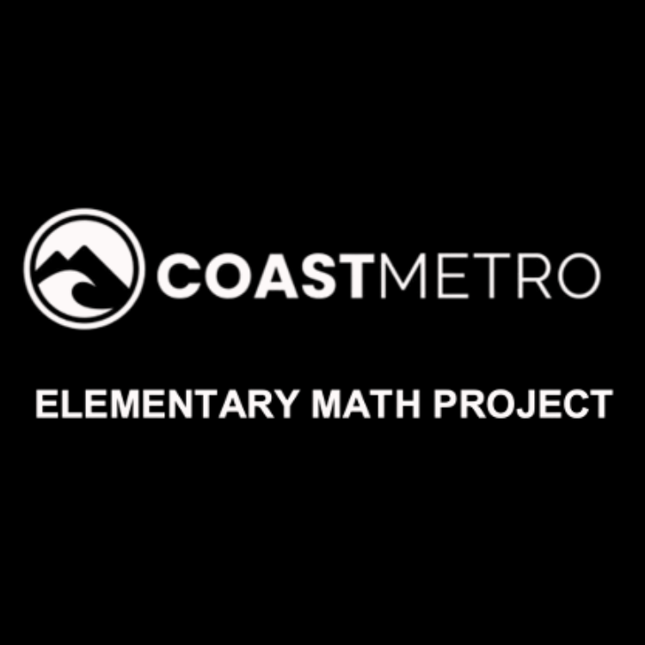
ELEMENTARY MATH PROJECT
GRADE 7 PRACTICE QUESTIONS
CIRCLE GEOMETRY

Slide 2
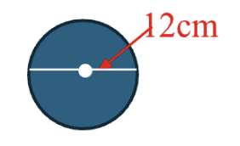
GRADE 7 CIRCLES:
AREA AND CIRCUMFERENCE: CLOSED QUESTIONS
ELEMENTARY MATH PROJECT
1. Estimate the circumference of a circle that has a diameter of 12cm. Show your thinking.

Slide 3
GRADE 7 CIRCLES:
AREA AND CIRCUMFERENCE: CLOSED QUESTIONS
ELEMENTARY MATH PROJECT
2. The diameter of a regulation basketball hoop (rim) is 45.72cm.
What is the radius?
Calculate the circumference

Slide 4
GRADE 7 CIRCLES:
AREA AND CIRCUMFERENCE: CLOSED QUESTIONS
ELEMENTARY MATH PROJECT
3. The Wave Swinger (the classic ride at Playland) has a radius of about 4.18m. Find the circumference (the distance traveled by a swing seat in one full rotation around the ride’s centre).

Slide 5
GRADE 7 CIRCLES:
AREA AND CIRCUMFERENCE: CLOSED QUESTIONS
ELEMENTARY MATH PROJECT
4. A circle has a circumference of 23.55cm. About how far is a point on the circle from the centre?

Slide 6
GRADE 7 CIRCLES:
AREA AND CIRCUMFERENCE: CLOSED QUESTIONS
ELEMENTARY MATH PROJECT
5. A bicycle wheel has a radius of 35cm.
What is the diameter of the wheel?
If the wheel turns 40 revolutions, how far would the bike travel?

Slide 7
GRADE 7 CIRCLES:
AREA AND CIRCUMFERENCE: CLOSED QUESTIONS
ELEMENTARY MATH PROJECT
6. While Luca was on vacation, he stayed at a hotel with a circular swimming pool with a diameter of 15 m. A fence around the pool costs $90 per meter to build. How much did the fence cost?

Slide 8
GRADE 7 CIRCLES:
AREA AND CIRCUMFERENCE: CLOSED QUESTIONS
ELEMENTARY MATH PROJECT
7. Find the area of a circle with the given dimension:
a radius of 2.5m
a diameter of 11km

Slide 9
GRADE 7 CIRCLES:
AREA AND CIRCUMFERENCE: CLOSED QUESTIONS
ELEMENTARY MATH PROJECT
8. A circular outdoor rink has an area of 510m². What is the diameter of the rink, to the nearest tenth of a meter?

Slide 10
GRADE 7 CIRCLES:
AREA AND CIRCUMFERENCE: CLOSED QUESTIONS
ELEMENTARY MATH PROJECT
9. The Canadian toonie has two parts:
an outer ring (made of nickel plating)
an inner circle with a diameter of 16mm (made of brass)
What is the area of the outer ring, rounded to the nearest hundredth of a square millimeter?

Slide 11
GRADE 7 CIRCLES:
AREA AND CIRCUMFERENCE: CLOSED QUESTIONS
ELEMENTARY MATH PROJECT
10. Construct a circle with these measurements:
a radius of 6cm
a diameter of 9cm
a circumference of 25cm

Slide 12
GRADE 7 CIRCLES:
AREA AND CIRCUMFERENCE: OPEN QUESTIONS
ELEMENTARY MATH PROJECT
11. What patterns do you notice when you compare the circumference and diameter of different circles. Explain and justify your thinking using pictures, symbols and words.

Slide 13
GRADE 7 CIRCLES:
AREA AND CIRCUMFERENCE: OPEN QUESTIONS
ELEMENTARY MATH PROJECT
12. How can you estimate the circumference of a circle without using the formula? What strategies might work?

Slide 14
GRADE 7 CIRCLES:
AREA AND CIRCUMFERENCE: OPEN QUESTIONS
ELEMENTARY MATH PROJECT
13. If you double the diameter of a circle, what happens to the circumference? How can you show this in more than one way?

Slide 15
GRADE 7 CIRCLES:
AREA AND CIRCUMFERENCE: OPEN QUESTIONS
ELEMENTARY MATH PROJECT
14. If two circles have the same circumference, do they have the same area? Why? Show your thinking using math.

Slide 16
GRADE 7 CIRCLES:
AREA AND CIRCUMFERENCE: OPEN QUESTIONS
ELEMENTARY MATH PROJECT
15. Describe a situation in which you might want to estimate either the circumference or the area of a circle but would not want to calculate it exactly.

Slide 17
GRADE 7 CIRCLES:
AREA AND CIRCUMFERENCE: OPEN QUESTIONS
ELEMENTARY MATH PROJECT
16. A circle has a radius of 10cm. Is it possible to create a rectangle with the same perimeter and a ratio of width to perimeter of about 1 to 10? If so, what are those measurements? Show your thinking.

Slide 18
GRADE 7 CIRCLES:
AREA AND CIRCUMFERENCE: OPEN QUESTIONS
ELEMENTARY MATH PROJECT
17. You want to compare the circumferences of these two circles. What unit and what tool would you use? Why?

Slide 19
ELEMENTARY MATH PROJECT
GRADE 7 PRACTICE QUESTIONS
PRISMS & CYLINDERS

Slide 20
GRADE 7 PRISMS & CYLINDERS:
CLOSED QUESTIONS
ELEMENTARY MATH PROJECT
1. a. Construct a rectangular prim using cubes. Count and record the number of cubes that make up its volume, as well as the number of cubes in its base and its height. Enter your findings in the table.
Height of Prism | Area of Base | Volume of Rectangular Prism

Slide 21
GRADE 7 PRISMS & CYLINDERS:
CLOSED QUESTIONS
ELEMENTARY MATH PROJECT
1. b) What is the relationship between the area of the base, the height of the prism, and the volume of a rectangular prism?

Slide 22
GRADE 7 PRISMS & CYLINDERS:
CLOSED QUESTIONS
ELEMENTARY MATH PROJECT
2. If the volume of a rectangular prism is 128 cubes and the height is 4 cubes, what is the area of the base?

Slide 23
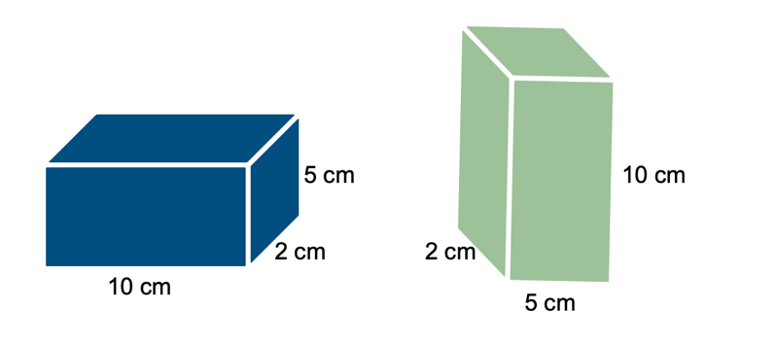
GRADE 7 PRISMS & CYLINDERS:
CLOSED QUESTIONS
ELEMENTARY MATH PROJECT
3. Which box has a greater volume? Explain your reasoning.

Slide 24
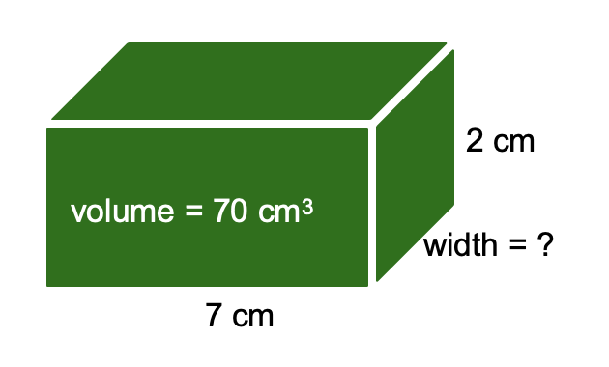
GRADE 7 PRISMS & CYLINDERS:
CLOSED QUESTIONS
ELEMENTARY MATH PROJECT
4.

Slide 25
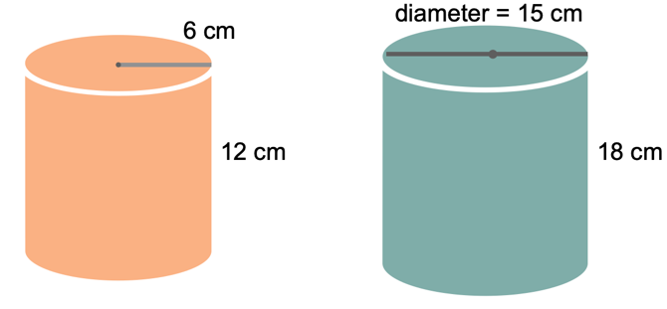
GRADE 7 PRISMS & CYLINDERS:
CLOSED QUESTIONS
ELEMENTARY MATH PROJECT
5. What is the volume of each cylinder?

Slide 26
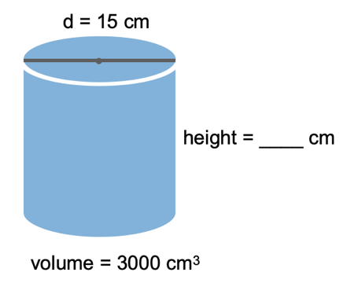
GRADE 7 PRISMS & CYLINDERS:
CLOSED QUESTIONS
ELEMENTARY MATH PROJECT
6.

Slide 27
GRADE 7 PRISMS & CYLINDERS:
CLOSED QUESTIONS
ELEMENTARY MATH PROJECT
7. Aisha and Ben each have two cans with the same base radius of 4 cm. Aisha’s can is shorter, with a height of 6 cm. Ben’s can is taller, with a height of 9 cm. Ben says his can holds more liquid than Aisha’s can. Is he correct? Explain your reasoning.

Slide 28
GRADE 7 PRISMS & CYLINDERS:
CLOSED QUESTIONS
ELEMENTARY MATH PROJECT
8. Lina is pouring juice into a tall glass. The area of the base of the glass is 12 cm², and the glass is 15 cm high. When Lina finishes pouring, the juice reaches a height of only 13 cm. What is the volume of juice in the glass?

Slide 29
GRADE 7 PRISMS & CYLINDERS:
CLOSED QUESTIONS
ELEMENTARY MATH PROJECT
9. If a cylinder has a base with an area of 28cm2 and a volume of 196cm3, what is its height?

Slide 30
GRADE 7 PRISMS & CYLINDERS:
CLOSED QUESTIONS
ELEMENTARY MATH PROJECT
10. Determine the volume of a cylinder that has a circumference of 46cm and a height of 20cm.

Slide 31
GRADE 7 PRISMS & CYLINDERS:
OPEN QUESTIONS
ELEMENTARY MATH PROJECT
11. In what ways is calculating the volume of a cylinder similar to calculating the volume of a rectangular prism? Use pictures, numbers and words to share your thinking.

Slide 32
GRADE 7 PRISMS & CYLINDERS:
OPEN QUESTIONS
ELEMENTARY MATH PROJECT
12. How does changing the height of a rectangular prism affect its volume if the base stays the same?

Slide 33
GRADE 7 PRISMS & CYLINDERS:
OPEN QUESTIONS
ELEMENTARY MATH PROJECT
13. What patterns do you notice when you double one dimension of a prism? How does that compare to doubling two dimensions?

Slide 34
GRADE 7 PRISMS & CYLINDERS:
OPEN QUESTIONS
ELEMENTARY MATH PROJECT
14. How many ways can you build a rectangular prism using 16 cubes. Show your thinking using pictures and numbers.

Slide 35
GRADE 7 PRISMS & CYLINDERS:
OPEN QUESTIONS
ELEMENTARY MATH PROJECT
15. Two cylinders have the same height but different volumes. What makes them the same and what makes them different?

