Slide 1

ELEMENTARY MATH PROJECT
GRADE 7 PRACTICE QUESTIONS
RATIOS

Slide 2
GRADE 7 RATIOS:
CLOSED QUESTIONS
ELEMENTARY MATH PROJECT
1. Simply the following ratios.
12 : 18 | 24 : 36 | 15 : 45
21 : 28 | 32 : 48 | 27 : 63

Slide 3
GRADE 7 RATIOS:
CLOSED QUESTIONS
ELEMENTARY MATH PROJECT
2. Find the missing values.
5 : 8 = 15 : ___
___ : 9 = 4 : 6

Slide 4
GRADE 7 RATIOS:
CLOSED QUESTIONS
ELEMENTARY MATH PROJECT
3. A car travels 240 km in 4 hours. What is the unit rate in kilometres per hour?

Slide 5
GRADE 7 RATIOS:
CLOSED QUESTIONS
ELEMENTARY MATH PROJECT
4. The ratio of red beads to blue beads is 3 : 7. If there are 40 beads in total, how many are red?

Slide 6
GRADE 7 RATIOS:
CLOSED QUESTIONS
ELEMENTARY MATH PROJECT
5. A recipe uses flour and sugar in the ratio 4 : 5. If 20 cups of flour are used, how many cups of sugar are needed?

Slide 7
GRADE 7 RATIOS:
CLOSED QUESTIONS
ELEMENTARY MATH PROJECT
6. The ratio of grade 6’s to grade 7’s in a class is 2 : 3. There are 30 students in total. How many are grade 6’s? How many are grade 7’s?

Slide 8
GRADE 7 RATIOS:
OPEN QUESTIONS
ELEMENTARY MATH PROJECT
7. Explain why the ratios 6 : 9 and 2 : 3 are equivalent. Use more than one method to justify your answer.

Slide 9
GRADE 7 RATIOS:
OPEN QUESTIONS
ELEMENTARY MATH PROJECT
8. A student says: “If you double both numbers in a ratio, the ratio changes.” Do you agree? Explain.

Slide 10
GRADE 7 RATIOS:
OPEN QUESTIONS
ELEMENTARY MATH PROJECT
9. Without calculating exact values, determine which is greater: 4 : 5 or 7 : 9. Explain your reasoning.

Slide 11
GRADE 7 RATIOS:
OPEN QUESTIONS
ELEMENTARY MATH PROJECT
10. Create a real life situation that could be represented by the ratio 3 : 8. Explain what each part represents.

Slide 12
GRADE 7 RATIOS:
OPEN QUESTIONS
ELEMENTARY MATH PROJECT
11. The ratio of cats to dogs is 5 : 7. If 3 more cats are added, does the ratio remain proportional? Explain why or why not.

Slide 13
GRADE 7 RATIOS:
OPEN QUESTIONS
ELEMENTARY MATH PROJECT
12. Explain how a ratio can be written as a fraction. Use an example to support your explanation.

Slide 14
GRADE 7 RATIOS:
OPEN QUESTIONS
ELEMENTARY MATH PROJECT
13. Two recipes use flour and sugar in ratios 2 : 3 and 4 : 5. Are these proportional recipes? Explain how you know.

Slide 15
GRADE 7 RATIOS:
OPEN QUESTIONS
ELEMENTARY MATH PROJECT
14. Store A sells 6 granola bars for 9 dollars. Store B sells 10 granola bars for 14 dollars.
Without calculating both totals in detail, explain how you would determine which store offers the better deal. Justify your reasoning.

Slide 16
GRADE 7 RATIOS:
OPEN QUESTIONS
ELEMENTARY MATH PROJECT
15. A runner completes 15 km in 2 hours.
Two students found the unit rate in different ways. One divided 15 ÷ 2. The other doubled both numbers to get 30 km in 4 hours and then divided.
Are both strategies valid? Explain why or why not.

Slide 17
GRADE 7 RATIOS:
OPEN QUESTIONS
ELEMENTARY MATH PROJECT
16. The ratio of red marbles to blue marbles is 4 : 9. Explain how you could determine the total number of marbles if you were told there are more than 100 marbles but fewer than 150.

Slide 18
ELEMENTARY MATH PROJECT
GRADE 7 PRACTICE QUESTIONS
DECIMALS

Slide 19
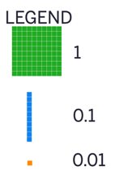
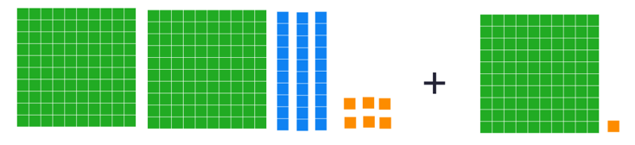
GRADE 7 DECIMALS:
CLOSED QUESTIONS
ELEMENTARY MATH PROJECT
1. Write an addition statement that represents the following model with base-ten blocks. Determine the sum of these decimal values.

Slide 20
GRADE 7 DECIMALS:
CLOSED QUESTIONS
ELEMENTARY MATH PROJECT
2. Use front-end estimation to determine the sum of 62.57 and 28.41.

Slide 21
GRADE 7 DECIMALS:
CLOSED QUESTIONS
ELEMENTARY MATH PROJECT
3. Find the value of 0.383 + 0.699 using base-ten blocks.
Represent your thinking using pictures and numbers.

Slide 22
GRADE 7 DECIMALS:
CLOSED QUESTIONS
ELEMENTARY MATH PROJECT
4. Express the subtraction statement, 0.04 – 0.003, in words.

Slide 23
GRADE 7 DECIMALS:
CLOSED QUESTIONS
ELEMENTARY MATH PROJECT
5. Place the decimal point in the correct position in the answer to make a true statement. Explain your strategy.
$55.73 + $18.75 + $72.39 = $14687
4189.675 – 1501.941 = 2687734

Slide 24
GRADE 7 DECIMALS:
CLOSED QUESTIONS
ELEMENTARY MATH PROJECT
6. Find the value of each expression. Show your reasoning.
3250.52 – 465.6 = | 22.563 + 45.22 + 4.088 = | 2550.06 – 465.14 =

Slide 25
GRADE 7 DECIMALS:
CLOSED QUESTIONS
ELEMENTARY MATH PROJECT
7. Replace the ▭ with a number to make each of the following statements true.
12.03 b. 870.49
+ ▭ - ▭
15.13 630.20

Slide 26
GRADE 7 DECIMALS:
CLOSED QUESTIONS
ELEMENTARY MATH PROJECT
8. Estimate, then calculate. Describe the strategy you used.
a) 78.2 x 5 b) 259.8 x 6

Slide 27
GRADE 7 DECIMALS:
CLOSED QUESTIONS
ELEMENTARY MATH PROJECT
9. Use base-ten blocks to find the product of 55.4 x 3.

Slide 28
GRADE 7 DECIMALS:
CLOSED QUESTIONS
ELEMENTARY MATH PROJECT
10. Find each product below using the equation 32 x 48 = 1536 and what you know about place value.
3.2 x 4.8 =
32 x (0.048) =
0.032 x (3.2) =

Slide 29
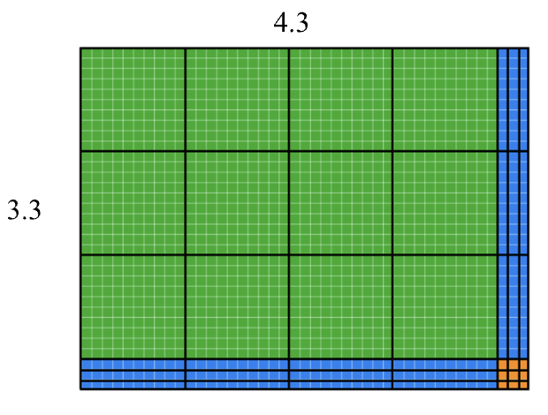
GRADE 7 DECIMALS:
CLOSED QUESTIONS
ELEMENTARY MATH PROJECT
11. Use the area model to determine the product of 4.3 x 3.3, then represent your thinking using numbers.

Slide 30
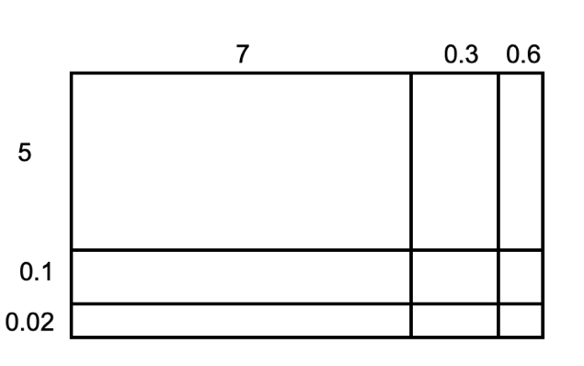
GRADE 7 DECIMALS:
CLOSED QUESTIONS
ELEMENTARY MATH PROJECT
12a. Use the area models (rectangle models) to find the products.

Slide 31
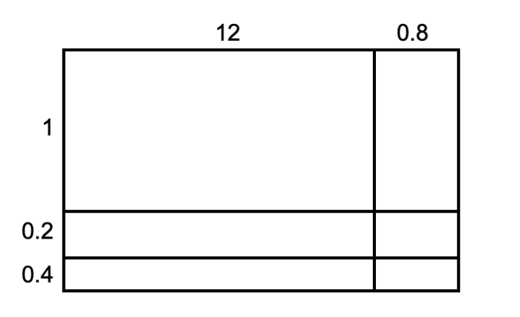
GRADE 7 DECIMALS:
CLOSED QUESTIONS
ELEMENTARY MATH PROJECT
12b. Use the area models (rectangle models) to find the products.

Slide 32
GRADE 7 DECIMALS:
CLOSED QUESTIONS
ELEMENTARY MATH PROJECT
13. Calculate each without using a calculator. Show your thinking.
2.87 x 73.48
0.45 x 151.6

Slide 33
GRADE 7 DECIMALS:
CLOSED QUESTIONS
ELEMENTARY MATH PROJECT
14. Estimate the quotient of 150.70 ÷ 2.6.

Slide 34
GRADE 7 DECIMALS:
CLOSED QUESTIONS
ELEMENTARY MATH PROJECT
15. Use an area model to find the quotient of 150.70 ÷ 2.6.

Slide 35
GRADE 7 DECIMALS:
CLOSED QUESTIONS
ELEMENTARY MATH PROJECT
16. Which of the following quotients has the same value as 5.04 ÷ 7? Explain how you know.
5.04 ÷ 70
50.4 ÷ 70
504, 000 ÷ 700
504,000 ÷ 700, 000

Slide 36
GRADE 7 DECIMALS:
CLOSED QUESTIONS
ELEMENTARY MATH PROJECT
17. Use base-ten blocks to model the calculation of 8 ÷ 1.5.

Slide 37
GRADE 7 DECIMALS:
CLOSED QUESTIONS
ELEMENTARY MATH PROJECT
18. Find the missing value of 36.8 ÷ 2.3 using the area model.
Show your thinking.

Slide 38
GRADE 7 DECIMALS:
CLOSED QUESTIONS
ELEMENTARY MATH PROJECT
19. Calculate each without using a calculator. Show your thinking.
24.2 ÷ 1.1
13.25 ÷ 0.4
170.28 ÷ 0.08

Slide 39
GRADE 7 DECIMALS:
CLOSED QUESTIONS
ELEMENTARY MATH PROJECT
20. What is the value of each expression?
(4.5 + 2.3) x 1.8 =
12. 5 – (3.2 + 2.8) =
8.4 ÷ 2 + 1.6 =
(12.5 + 3.75) ÷ (4.5 – 2.25) + 6.4 =
32.8 ÷ [(6.4 + 1.6) x 0.5] =

Slide 40
GRADE 7 DECIMALS:
OPEN QUESTIONS
ELEMENTARY MATH PROJECT
21. Which expression doesn’t belong? Explain and justify your thinking using math.
2 x 0.3
2 x 3 x 0.1
6 x 0.1
0.1 x 6

Slide 41
GRADE 7 DECIMALS:
OPEN QUESTIONS
ELEMENTARY MATH PROJECT
22. I am thinking of two numbers. Neither number is a whole number. Their product is 12.78. What might the numbers be?

Slide 42
GRADE 7 DECIMALS:
OPEN QUESTIONS
ELEMENTARY MATH PROJECT
23. Two numbers multiply to give a product between 18 and 19. What might these numbers be?

Slide 43
GRADE 7 DECIMALS:
OPEN QUESTIONS
ELEMENTARY MATH PROJECT
24. I multiplied 27 by a decimal and got an answer less than 27. What might be the decimal that I multiplied 27 by?
Give at least 5 possibilities.

Slide 44
GRADE 7 DECIMALS:
OPEN QUESTIONS
ELEMENTARY MATH PROJECT
25. The area of a rectangle is 3.9 units squared. What might the perimeter be?

Slide 45
GRADE 7 DECIMALS:
OPEN QUESTIONS
ELEMENTARY MATH PROJECT
26. Explain why 51.2 ÷ 6.4 has the same value as 5.12 ÷ 0.64.

Slide 46
GRADE 7 DECIMALS:
OPEN QUESTIONS
ELEMENTARY MATH PROJECT
27. Write two division statements that have the same value as
61.12 ÷ 3.2.

Slide 47
GRADE 7 DECIMALS:
PROBLEMS
ELEMENTARY MATH PROJECT
1. There is 0.162 liter of water in a 1-liter bottle. How much more water should be put in the bottle so it contains exactly 1 liter? Show your reasoning.

Slide 48
GRADE 7 DECIMALS:
PROBLEMS
ELEMENTARY MATH PROJECT
2. Diego is 59.5 inches tall. His brother is 40.125 inches tall. How much taller than his brother is Diego? Show your reasoning.

Slide 49
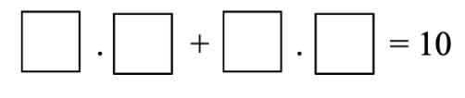
GRADE 7 DECIMALS:
PROBLEMS
ELEMENTARY MATH PROJECT
3. A person rolls a ten-sided die multiple times. After each roll, they write the number in one of the available boxes. The goal is to create a question where the sum is as close to 10 as possible. Once a number has been written, it cannot be erased or rewritten.

Slide 50
GRADE 7 DECIMALS:
PROBLEMS
ELEMENTARY MATH PROJECT
4. Jodi went to a concession stand that sells pretzels for $4.25, drinks for $2.85, and bags of popcorn for $1.99 each. He bought at least one of each item and spent no more than $15.
Could Jodi have purchased 2 pretzels, 2 drinks, and 2 bags of popcorn? Explain your reasoning.
Could he have bought 1 pretzel, 1 drink, and 5 bags of popcorn? Explain your reasoning.

Slide 51
GRADE 7 DECIMALS:
PROBLEMS
ELEMENTARY MATH PROJECT
5. A bag of nickels weighs 5.1 kilogram. Each nickel weighs 2.5 grams. About how many nickels are in the bag?

Slide 52
GRADE 7 DECIMALS:
PROBLEMS
ELEMENTARY MATH PROJECT
6. A roll of ribbon was 12 meters long. Diego cut 9 pieces of ribbon that were 0.4 meter each to tie some presents. He then used the remaining ribbon to make some wreaths. Each wreath required 0.6 meter. For each question, explain your reasoning.
How many meters of ribbon were available for making wreaths?
How many wreaths could Diego make with the available ribbon?

Slide 53
GRADE 7 DECIMALS:
PROBLEMS
ELEMENTARY MATH PROJECT
7. A swimming pool is being filled with water at a rate of 2.4 liters per minute. After 35 minutes, the pool already has 18.5 liters in it?

Slide 54
GRADE 7 DECIMALS:
PROBLEMS
ELEMENTARY MATH PROJECT
8. A car travels 248.6 km on the first day and 312.4km on the second day. On the third day it travels half the distanced of the second day. What is the total distance travelled?

Slide 55
ELEMENTARY MATH PROJECT
GRADE 7 PRACTICE QUESTIONS
PERCENTS

Slide 56
GRADE 7 PERCENTS:
CLOSED QUESTIONS
ELEMENTARY MATH PROJECT
1. Convert the following decimals into percents.
0.6 | 0.125
1.35 | 0.048

Slide 57
GRADE 7 PERCENTS:
CLOSED QUESTIONS
ELEMENTARY MATH PROJECT
2. Convert the following percents into decimals
48% | 7.5%
120% | 0.4%

Slide 58
GRADE 7 PERCENTS:
CLOSED QUESTIONS
ELEMENTARY MATH PROJECT
3. Find 25% of 84.

Slide 59
GRADE 7 PERCENTS:
CLOSED QUESTIONS
ELEMENTARY MATH PROJECT
4. Find 18% of 250.

Slide 60
GRADE 7 PERCENTS:
CLOSED QUESTIONS
ELEMENTARY MATH PROJECT
5. What is 150% of 60?

Slide 61
GRADE 7 PERCENTS:
CLOSED QUESTIONS
ELEMENTARY MATH PROJECT
6. What is 0.5% of 400?

Slide 62
GRADE 7 PERCENTS:
CLOSED QUESTIONS
ELEMENTARY MATH PROJECT
7. 12 is 20% of what number?

Slide 63
GRADE 7 PERCENTS:
CLOSED QUESTIONS
ELEMENTARY MATH PROJECT
8. 45 is 75% of what number?

Slide 64
GRADE 7 PERCENTS:
CLOSED QUESTIONS
ELEMENTARY MATH PROJECT
9. A jacket costs 120 dollars. It is discounted by 15%. What is the sale price?

Slide 65
GRADE 7 PERCENTS:
CLOSED QUESTIONS
ELEMENTARY MATH PROJECT
10. A price increases from 80 dollars to 92 dollars. What is the percent increase?

Slide 66
GRADE 7 PERCENTS:
CLOSED QUESTIONS
ELEMENTARY MATH PROJECT
11. A population decreases from 500 to 425. What is the percent decrease?

Slide 67
GRADE 7 PERCENTS:
CLOSED QUESTIONS
ELEMENTARY MATH PROJECT
12. Which is greater: 35% of 200 or 60% of 120?

Slide 68
GRADE 7 PERCENTS:
OPEN QUESTIONS
ELEMENTARY MATH PROJECT
13. Explain why 25%, 0.25, and 1/4 represent the same quantity. Use a model or example to support your explanation.

Slide 69
GRADE 7 PERCENTS:
OPEN QUESTIONS
ELEMENTARY MATH PROJECT
14. Without calculating exactly, determine which is greater: 40% of 90 or 30% of 120. Explain your reasoning.

Slide 70
GRADE 7 PERCENTS:
OPEN QUESTIONS
ELEMENTARY MATH PROJECT
15. A student says: “Increasing a number by 20% and then decreasing it by 20% returns the number to its original value.” Do you agree? Explain why or why not.

Slide 71
GRADE 7 PERCENTS:
OPEN QUESTIONS
ELEMENTARY MATH PROJECT
16. Explain why 150% of a number is greater than the original number. Use an example to support your explanation.

Slide 72
GRADE 7 PERCENTS:
OPEN QUESTIONS
ELEMENTARY MATH PROJECT
17. Create a real-life situation where 5% would represent a very large amount. Explain your reasoning.

Slide 73
GRADE 7 PERCENTS:
OPEN QUESTIONS
ELEMENTARY MATH PROJECT
18. A store advertises 30% off. Explain two different ways you could determine the sale price of an item.

Slide 74
GRADE 7 PERCENTS:
OPEN QUESTIONS
ELEMENTARY MATH PROJECT
19. Without converting to decimals, determine whether 3/8 is greater or less than 40%. Explain how you know.

Slide 75
GRADE 7 PERCENTS:
OPEN QUESTIONS
ELEMENTARY MATH PROJECT
20. Describe what 0.5% represents. Use a visual or numerical example to support your explanation.

Slide 76
ELEMENTARY MATH PROJECT
GRADE 7 PRACTICE QUESTIONS
INTEGERS

Slide 77


GRADE 7 INTEGERS:
CLOSED QUESTIONS
ELEMENTARY MATH PROJECT
1. Write the integers modelled by the counters below, if red counters are negative and yellow counters are positive.
a) b)

Slide 78
GRADE 7 INTEGERS:
CLOSED QUESTIONS
ELEMENTARY MATH PROJECT
2. Mark these integers on the number line below:
+2
-8
+9
-1

Slide 79
GRADE 7 INTEGERS:
CLOSED QUESTIONS
ELEMENTARY MATH PROJECT
3. Use an integer to represent each situation.
15 m below sea level
Lola deposited $35 in her bank account
Miku the dog dug a hole 2 m deep
A parking spot 3 levels above ground level
A drop in price of $1
7 steps backward

Slide 80
GRADE 7 INTEGERS:
CLOSED QUESTIONS
ELEMENTARY MATH PROJECT
4. Order the integers in the following sets from least to greatest.
-7, -11, +11, 0, -3
+46, -38, -40, -11, +25

Slide 81
GRADE 7 INTEGERS:
CLOSED QUESTIONS
ELEMENTARY MATH PROJECT
5. Name the opposite of each integer.
-20
125
-7

Slide 82
GRADE 7 INTEGERS:
CLOSED QUESTIONS
ELEMENTARY MATH PROJECT
6. What integer comes next in each of the following number patterns:
3, 2, 1, 0, -1, -2,
-6, -4, -2,
10, 7, 4 ,1,

Slide 83
GRADE 7 INTEGERS:
CLOSED QUESTIONS
ELEMENTARY MATH PROJECT
7. Fill in the less than (<) or the greater than (>) symbol to show the relationship between each pair or numbers.
2 ____ 6
-4 _____ 5
3 _____ -7
-1 _____ 2

Slide 84
GRADE 7 INTEGERS:
CLOSED QUESTIONS
ELEMENTARY MATH PROJECT
8. What is the sum of -2 and +2?
Explain your thinking using either a number line or double-sided counters.
Use your response to predict the sum of any opposite integers. Explain your thinking.

Slide 85
GRADE 7 INTEGERS:
CLOSED QUESTIONS
ELEMENTARY MATH PROJECT
9. Use double sided counters to find the sum of (+4) and (-2). Use the graphic organizer to show your thinking.
Draw a picture of the counters that represent +4 and -2. | Combine the counters by organizing them into as many zero pairs as possible.
Draw the counters that are left over. Write the integer that represents these counters. | Complete the addition statement (+4) + (-2) = ____

Slide 86

GRADE 7 INTEGERS:
CLOSED QUESTIONS
ELEMENTARY MATH PROJECT
10. What addition statement does the diagram represent?

Slide 87
GRADE 7 INTEGERS:
CLOSED QUESTIONS
ELEMENTARY MATH PROJECT
11. Use a number line to find the sum of (+9) and (-5). Use the graphic organizer below to show your thinking.
Represent your thinking on the number line. | Complete the addition statement (+9) + (-5) = ____

Slide 88
GRADE 7 INTEGERS:
CLOSED QUESTIONS
ELEMENTARY MATH PROJECT
12. Find the sum.
(-3) + (4 )=
(+11) + (– 7 )=
(-5) + (-6)=
(-2) + (+1) + (-9)=

Slide 89
GRADE 7 INTEGERS:
CLOSED QUESTIONS
ELEMENTARY MATH PROJECT
12. Find the sum.
(-3) + (4 )=
(+11) + (– 7 )=
(-5) + (-6)=
(-2) + (+1) + (-9)=

Slide 90
GRADE 7 INTEGERS:
CLOSED QUESTIONS
ELEMENTARY MATH PROJECT
13. A magic square is a grid where the sum of each row, column and diagonal is the same. Fill in the missing numbers in the magic square below. Show your thinking and check your work.
4 |  | -3
 | 0
-2 |  | 5

Slide 91
GRADE 7 INTEGERS:
CLOSED QUESTIONS
ELEMENTARY MATH PROJECT
14. Is the puzzle below a magic square? Explain and justify your thinking.
-8 | -1 | 6
3 | 4 | 7
-2 | 9 | 5

Slide 92
GRADE 7 INTEGERS:
CLOSED QUESTIONS
ELEMENTARY MATH PROJECT
15. Use double sided counters to find the difference, (+3) – (-6). Use the graphic organizer below to show your thinking.
Draw a picture of the counters that represent (+3). | Draw the zero pairs needed to be able to remove (-6).
Remove (-6), and draw the counters that are left over. | Complete the subtraction statement (+3) - (-6) = ____

Slide 93
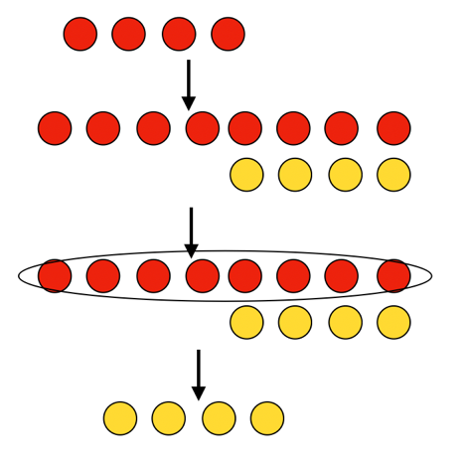
GRADE 7 INTEGERS:
CLOSED QUESTIONS
ELEMENTARY MATH PROJECT
16. Write the subtraction statement that the diagram represents.

Slide 94
GRADE 7 INTEGERS:
CLOSED QUESTIONS
ELEMENTARY MATH PROJECT
17. Determine the difference using double-sided counters. Show your thinking using picture and numbers.
(-5) – (-3) =
(+7) – (-5)=
(+2) – (+9) =

Slide 95
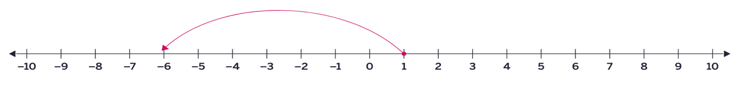
GRADE 7 INTEGERS:
CLOSED QUESTIONS
ELEMENTARY MATH PROJECT
18. Write the subtraction statement that the diagram represents.
a)

Slide 96
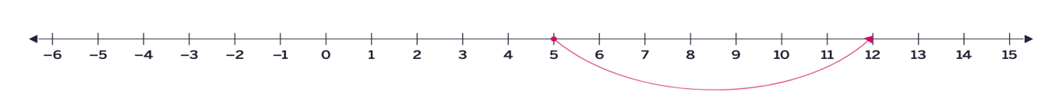
GRADE 7 INTEGERS:
CLOSED QUESTIONS
ELEMENTARY MATH PROJECT
18. Write the subtraction statement that the diagram represents.
b)

Slide 97
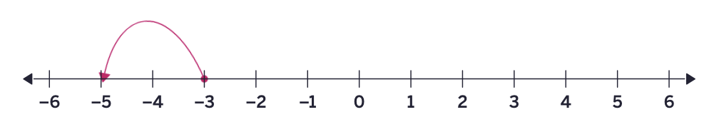
GRADE 7 INTEGERS:
CLOSED QUESTIONS
ELEMENTARY MATH PROJECT
18. Write the subtraction statement that the diagram represents.
c)

Slide 98
GRADE 7 INTEGERS:
CLOSED QUESTIONS
ELEMENTARY MATH PROJECT
19. Find the difference using an open number line. Show your thinking.
(-23) – (+17) =
(+122) – (- 46) =
(-415) – (-55) =

Slide 99

GRADE 7 INTEGERS:
CLOSED QUESTIONS
ELEMENTARY MATH PROJECT
20. Determine the multiplication statement that the diagram represents.
a)

Slide 100
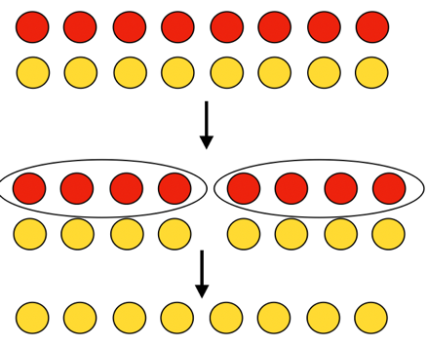
GRADE 7 INTEGERS:
CLOSED QUESTIONS
ELEMENTARY MATH PROJECT
20. Determine the multiplication statement that the diagram represents.
b)

Slide 101
GRADE 7 INTEGERS:
CLOSED QUESTIONS
ELEMENTARY MATH PROJECT
21. Determine the product using double-sided counters. Use pictures to show your thinking.
(+6) x (-7) =
(-6) x (-1) =
(+5) x ( -3) =

Slide 102
GRADE 7 INTEGERS:
CLOSED QUESTIONS
ELEMENTARY MATH PROJECT
22. Write the expression as a multiplication statement.
(-2) + (-2) + (-2) +(-2)

Slide 103
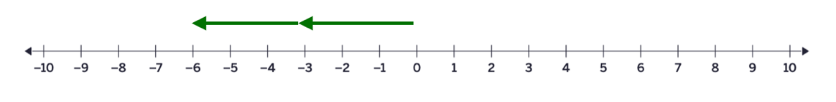
GRADE 7 INTEGERS:
CLOSED QUESTIONS
ELEMENTARY MATH PROJECT
23. Determine the multiplication statement that the diagram represents.

Slide 104
GRADE 7 INTEGERS:
CLOSED QUESTIONS
ELEMENTARY MATH PROJECT
24. Copy and complete the multiplication statement.
(-4) x 🟦 = + 12

Slide 105
GRADE 7 INTEGERS:
CLOSED QUESTIONS
ELEMENTARY MATH PROJECT
25. Determine (-15) ÷ (-3) using a number line.

Slide 106
GRADE 7 INTEGERS:
CLOSED QUESTIONS
ELEMENTARY MATH PROJECT
26. Determine each quotient.
(-75) ÷ (+25) =
( -48) ÷ (-8) =
(-324) ÷ (12) =
456 ÷ (-24) =
(-672) ÷ (-28) =

Slide 107
GRADE 7 INTEGERS:
CLOSED QUESTIONS
ELEMENTARY MATH PROJECT
27. Which expression equals (-4) x (+6)?
(-12) x (-2)
(-24) ÷ (-1)
(+3) x (+8)
(+72) ÷ (-3)

Slide 108
GRADE 7 INTEGERS:
CLOSED QUESTIONS
ELEMENTARY MATH PROJECT
28, Calculate using order of operations.
8 + 3 x 4 – 6
(-12 – 5) x (-3) + (-8)
20 ÷ (-4 + 1) + 7
(-18 ÷ 3) + (7 x -2)
[-6 + (4 x -3)] ÷ 2

Slide 109
GRADE 7 INTEGERS:
CLOSED QUESTIONS
ELEMENTARY MATH PROJECT
29. Complete the statement by including operation symbols to make the statement true.
5 🟦 (-9) 🟦 🟦4 (-1)= 41

Slide 110
GRADE 7 INTEGERS:
CLOSED QUESTIONS
ELEMENTARY MATH PROJECT
30. Sofia evaluated the expression (-3) x (6-2) +4 to equal -14. What mistake did she make? What is the correct value of the expression?

Slide 111
GRADE 7 INTEGERS:
OPEN QUESTIONS
ELEMENTARY MATH PROJECT
31. You add two numbers and the answer is negative.
What two numbers might you have added?

Slide 112
GRADE 7 INTEGERS:
OPEN QUESTIONS
ELEMENTARY MATH PROJECT
32. Would you calculate (-16) – (-4) in the same way you would calculate 16 – (-5)? Explain your thinking.

Slide 113
GRADE 7 INTEGERS:
OPEN QUESTIONS
ELEMENTARY MATH PROJECT
33. Predict the sum of any pair of opposite integers. Explain your reasoning using pictures, words, numbers and symbols.

Slide 114
GRADE 7 INTEGERS:
OPEN QUESTIONS
ELEMENTARY MATH PROJECT
34. Would you rather solve expression, a or b? Explain your reasoning before calculating.
(-12 - 4) x (-3) + 8
12 – (4 x (-3) + 8)

Slide 115
GRADE 7 INTEGERS:
OPEN QUESTIONS
ELEMENTARY MATH PROJECT
35. How are the following expressions the same? How are they different? Which operation changes the outcome the most?
a) (-5 + 8) x 4 b) -5 + (8 x 4)

Slide 116
GRADE 7 INTEGERS:
OPEN QUESTIONS
ELEMENTARY MATH PROJECT
36. Which one doesn’t belong? Share all possible reasons.
(6+3) x (-2)
6 + (3 x (-2))
(-6 +3) x 2
6 – (3 x 2)

Slide 117
GRADE 7 INTEGERS:
OPEN QUESTIONS
ELEMENTARY MATH PROJECT
37. Convince Me! Convince me that (10 – 4) x (-3) + 2 will give you a negative answer, without calculating every step. What clues can you use? How does the order of operations help you predict the sign?

Slide 118
GRADE 7 INTEGERS:
OPEN QUESTIONS
ELEMENTARY MATH PROJECT
38. When you multiply two negative integers and then add a positive integer, the result is always negative. Is this always, sometimes, or never true? Give examples to justify your answer.

Slide 119
GRADE 7 INTEGERS:
PROBLEMS
ELEMENTARY MATH PROJECT
1. A soccer tournament had 8 teams. Each team played 3 matches. Each win gives 3 points, a draw gives 1 point, and a loss gives 0 points. If one team won 2 matches and drew 1 math, how many points did they earn?

Slide 120
GRADE 7 INTEGERS:
PROBLEMS
ELEMENTARY MATH PROJECT
2. A bookstore sold 15 books on Monday and 12 books on Tuesday. Each book costs $8. The store gave a discount of $20 on the total bill. What was the total amount collected after the discount?

Slide 121
GRADE 7 INTEGERS:
PROBLEMS
ELEMENTARY MATH PROJECT
3. A school rented 4 buses for a field trip. Each bus can carry 36 students. There are 128 students going. After filling the buses, how many students will not have a seat?

Slide 122
GRADE 7 INTEGERS:
PROBLEMS
ELEMENTARY MATH PROJECT
4. A fruit seller has 120 apples. He packs them into boxes of 8 apples each. Each box sells for $5. If he sells all the boxes, how much money does he make?

Slide 123
GRADE 7 INTEGERS:
PROBLEMS
ELEMENTARY MATH PROJECT
5. A charity organization collected $450 at an event. They spent $125 on food and $75 on decorations. The remaining amount was divided equally among 5 families. How much did each family receive?

Slide 124
GRADE 7 INTEGERS:
PROBLEMS
ELEMENTARY MATH PROJECT
6. How much colder is -5°C than +3°C?

Slide 125
GRADE 7 INTEGERS:
PROBLEMS
ELEMENTARY MATH PROJECT
7. A new freezer is at a room temperature of 20°C. When the freezer is turned on, the temperature inside drops by 6°C per hour. How long does it take the freezer to reach -12°C.

Slide 126
GRADE 7 INTEGERS:
PROBLEMS
ELEMENTARY MATH PROJECT
8. Because the charging cable is faulty, Maya’s phone battery is charging 15% slower than normal every hour. At 6:00pm, she starts charging her phone, and it shows 50% battery. Normally, her phone would reach 100% in 4 hours. What will her phone’s battery percentage be at 10:00pm?

Slide 127
GRADE 7 INTEGERS:
PROBLEMS
ELEMENTARY MATH PROJECT
9. Why does it make sense that (-3) – (-9) has to have the same result as (-2) – (-8) or 0 – (-6)?

Slide 128
GRADE 7 INTEGERS:
PROBLEMS
ELEMENTARY MATH PROJECT
10. You add the product of two integers to the product of a different two integers and end up with 1. What could you have multiplied and added?

