Slide 1

ELEMENTARY MATH PROJECT
GRADE 7 PRACTICE QUESTIONS
TWO-STEP EQUATIONS

Slide 2
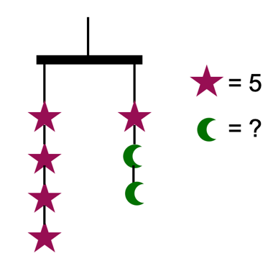
GRADE 7 TWO-STEP EQUATIONS:
CLOSED QUESTIONS
ELEMENTARY MATH PROJECT
1. Use an algebraic equation to determine the value of the crescent moon. Show your thinking.

Slide 3
GRADE 7 TWO-STEP EQUATIONS:
CLOSED QUESTIONS
ELEMENTARY MATH PROJECT
2. Draw a picture to model the equation -3x + 7 = 19, using algebra tiles.

Slide 4

GRADE 7 TWO-STEP EQUATIONS:
CLOSED QUESTIONS
ELEMENTARY MATH PROJECT
3a. Solve the equation modelled by each balance scale. Show your thinking using pictures and numbers.

Slide 5

GRADE 7 TWO-STEP EQUATIONS:
CLOSED QUESTIONS
ELEMENTARY MATH PROJECT
3b. Solve the equation modelled by each balance scale. Show your thinking using pictures and numbers.

Slide 6
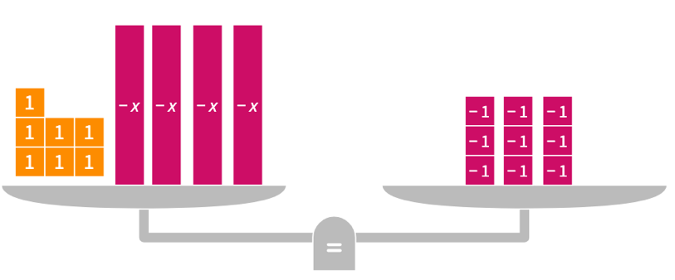
GRADE 7 TWO-STEP EQUATIONS:
CLOSED QUESTIONS
ELEMENTARY MATH PROJECT
3c. Solve the equation modelled by each balance scale. Show your thinking using pictures and numbers.

Slide 7

GRADE 7 TWO-STEP EQUATIONS:
CLOSED QUESTIONS
ELEMENTARY MATH PROJECT
4a. Use algebra tiles to solve the equations. Check each solution using symbols.

Slide 8
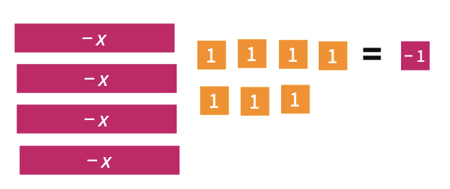
GRADE 7 TWO-STEP EQUATIONS:
CLOSED QUESTIONS
ELEMENTARY MATH PROJECT
4b. Use algebra tiles to solve the equations. Check each solution using symbols.

Slide 9
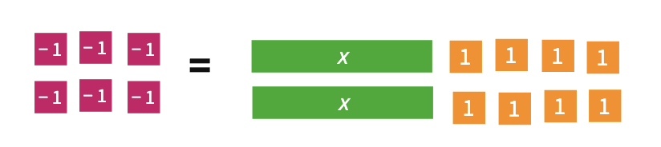
GRADE 7 TWO-STEP EQUATIONS:
CLOSED QUESTIONS
ELEMENTARY MATH PROJECT
4c. Use algebra tiles to solve the equations. Check each solution using symbols.

Slide 10
GRADE 7 TWO-STEP EQUATIONS:
CLOSED QUESTIONS
ELEMENTARY MATH PROJECT
5. Show whether x = -5 is the solution to each equation.
-6x + 4 = 34
3 – 8x = 43
27 = -9x – 18
40 = 5x + 65

Slide 11
GRADE 7 TWO-STEP EQUATIONS:
CLOSED QUESTIONS
ELEMENTARY MATH PROJECT
6. What is the first operation you should perform to solve each equation. Share your thinking.
2x – 2 = 16
9 – 9y = -27
71 = -9x -1

Slide 12
GRADE 7 TWO-STEP EQUATIONS:
CLOSED QUESTIONS
ELEMENTARY MATH PROJECT
7. Use inverse operations to solve the equations. Show your steps and check your solutions.
6x-4 = -32
22= -5x – 3
-30 = 7x – 9

Slide 13
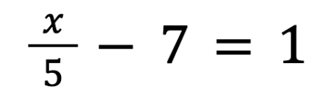
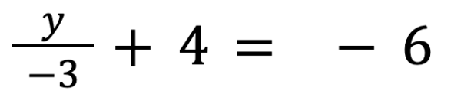
GRADE 7 TWO-STEP EQUATIONS:
CLOSED QUESTIONS
ELEMENTARY MATH PROJECT
8. Use inverse operations to solve the equations. Show your steps and check your solutions.

Slide 14
GRADE 7 TWO-STEP EQUATIONS:
CLOSED QUESTIONS
ELEMENTARY MATH PROJECT
9. Create word sentences.
Word Sentence | Equation
Three times a number plus two is ten. | 3x + 2 = 10
 | 3x = 9
 | 2x + 4 = 10
 | 9 = 5x - 27
 | 7 + 4x = 12

Slide 15
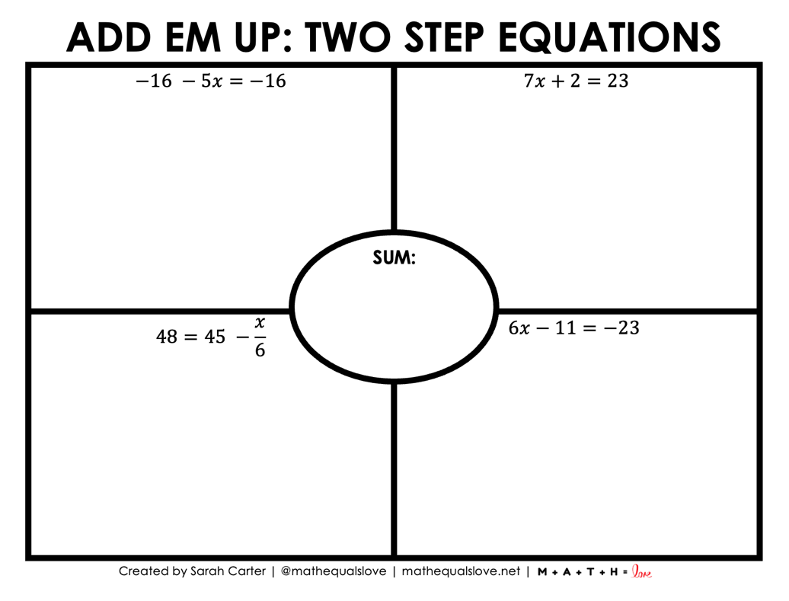
GRADE 7 TWO-STEP EQUATIONS:
CLOSED QUESTIONS
ELEMENTARY MATH PROJECT
10.

Slide 16
GRADE 7 TWO-STEP EQUATIONS:
OPEN QUESTIONS
ELEMENTARY MATH PROJECT
11. You write the equation 4x – 5 = 15 to solve a word problem. What might the word problem be?

Slide 17
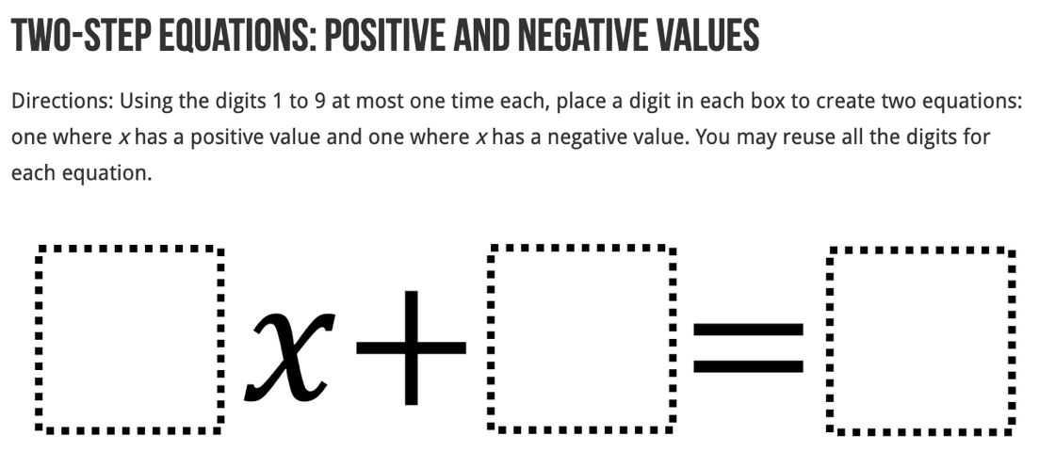
GRADE 7 TWO-STEP EQUATIONS:
OPEN QUESTIONS
ELEMENTARY MATH PROJECT
12.

Slide 18
GRADE 7 TWO-STEP EQUATIONS:
PROBLEMS
ELEMENTARY MATH PROJECT
1. How many laps did the players run if the coach told them to run nine less than six times the number of laps they ran yesterday, and that total was 15?

Slide 19
GRADE 7 TWO-STEP EQUATIONS:
PROBLEMS
ELEMENTARY MATH PROJECT
2. Lilly has two more than three times as many candies as Max. If she has 17 candies, how many does Max have?

Slide 20
GRADE 7 TWO-STEP EQUATIONS:
PROBLEMS
ELEMENTARY MATH PROJECT
3. How many pencils are there if, five times the number of pencils plus nine equals thirty-four.

Slide 21
GRADE 7 TWO-STEP EQUATIONS:
PROBLEMS
ELEMENTARY MATH PROJECT
4. If Marcus triples the amount of money he has now, and then spends $75, he will have just enough left to buy a new laptop that costs $450. Write and solve an equation to determine how much money Marcus has now.

Slide 22
GRADE 7 TWO-STEP EQUATIONS:
PROBLEMS
ELEMENTARY MATH PROJECT
5. If a number is doubled and five is subtracted from the product, the result is nine. What is the number?

