Slide 1

ELEMENTARY MATH PROJECT
GRADE 4 PRACTICE QUESTIONS
DATA & PROBABILITY

Slide 2
GRADE 4 DATA & PROBABILITY
CLOSED QUESTIONS
ELEMENTARY MATH PROJECT
1. You are rolling a regular 6-sided die. Use the words certain, impossible or possible to answer the questions.
You will get an even number.
You will get a number between 1 and 6.
You will get a 10.

Slide 3

GRADE 4 DATA & PROBABILITY
CLOSED QUESTIONS
ELEMENTARY MATH PROJECT
2. You are using this colour spinner.
Use the words unlikely, less likely, more likely or equally likely to answer the questions.
You will land on yellow five times in a row.
You will land on a warm colour (red, yellow pink) instead of a cool colour (green, turquoise, blue).
You will land on a primary colour (red, yellow, blue) instead of a secondary colour (green).

Slide 4
GRADE 4 DATA & PROBABILITY
OPEN QUESTIONS
ELEMENTARY MATH PROJECT
3. Explain how pictographs and bar graphs are similar and how they are different.

Slide 5
GRADE 4 DATA & PROBABILITY
OPEN QUESTIONS
ELEMENTARY MATH PROJECT
4. Create a pictograph using the data in the table below. Make each symbol worth more than one animal. What number is a good choice for the scale?
Animal | Number in the Group
chickens | 15
dogs | 3
horses | 6
cows | 12
cats | 1

Slide 6
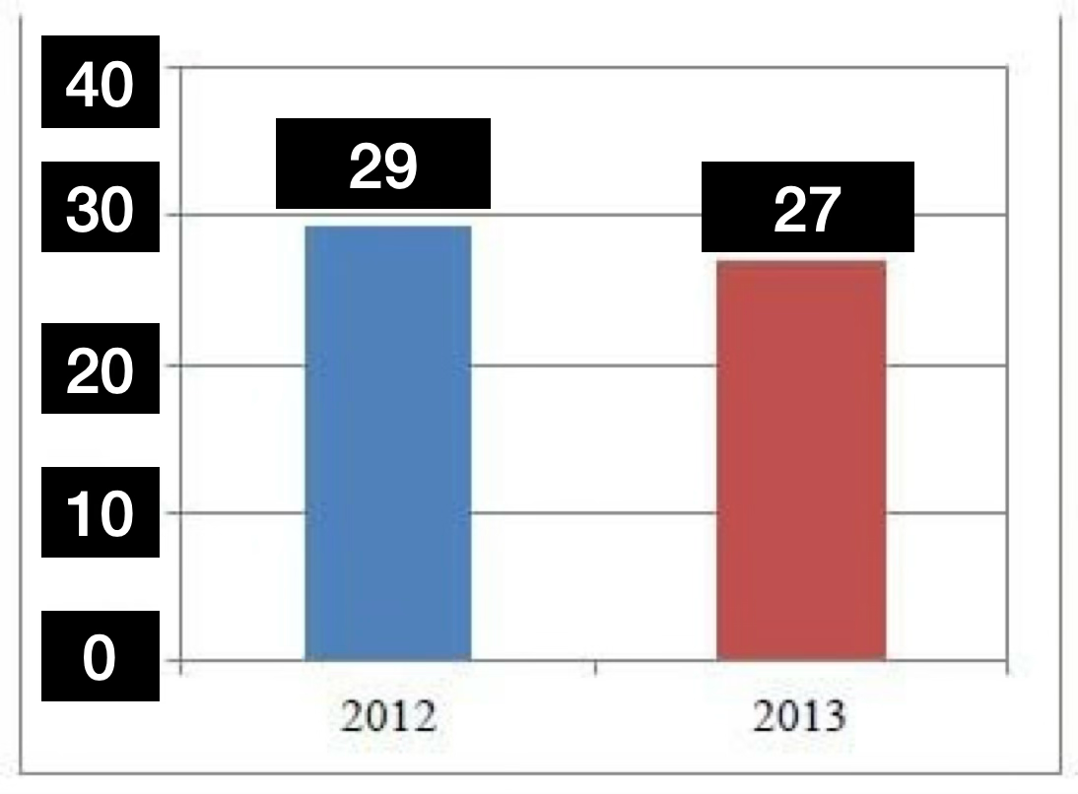
GRADE 4 DATA & PROBABILITY
OPEN QUESTIONS
ELEMENTARY MATH PROJECT
5. Analyze the graph below. What might be happening that would create the data? What title would you give the graph?

Slide 7
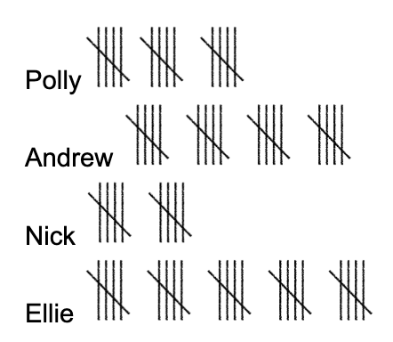
GRADE 4 DATA & PROBABILITY
OPEN QUESTIONS
ELEMENTARY MATH PROJECT
6. Four friends are practicing hitting baseballs. They record their hits using tally marks. Create a bar graph using the tally data below.

Slide 8
GRADE 4 DATA & PROBABILITY
OPEN QUESTIONS
ELEMENTARY MATH PROJECT
7. What are 3 statements that you can make about the data in the graph you created in question 6?

Slide 9
GRADE 4 DATA & PROBABILITY
OPEN QUESTIONS
ELEMENTARY MATH PROJECT
8. Write 3 different questions that you could ask to collect tallies in order to make a bar graph.

Slide 10
GRADE 4 DATA & PROBABILITY
OPEN QUESTIONS
ELEMENTARY MATH PROJECT
9. Make a chart for the numbers 0 to 12. Predict which numbers will happen the most often if you roll 2 dice and add the numbers together. Explain your predictions.

Slide 11
GRADE 4 DATA & PROBABILITY
OPEN QUESTIONS
ELEMENTARY MATH PROJECT
10. Bobby is doing a probability experiment. She has 6 coloured pieces in a bag. Without looking, she pulls out a piece, records the colour, and places it back into the bag. Then she repeats the experiment.
In her first 20 tries, she pulls out 11 yellow pieces, 6 blue pieces and 3 red pieces. Based on what she has pulled out so far, what do you predict is in the bag? Explain your reasoning.

