Slide 1

ELEMENTARY MATH PROJECT
GRADE 4 PRACTICE QUESTIONS
MEASUREMENT & GEOMETRY

Slide 2

GRADE 4 MEASUREMENT & GEOMETRY
CLOSED QUESTIONS
ELEMENTARY MATH PROJECT
1. Identify which shapes have lines of symmetry. Draw the lines on the shapes that have them.

Slide 3
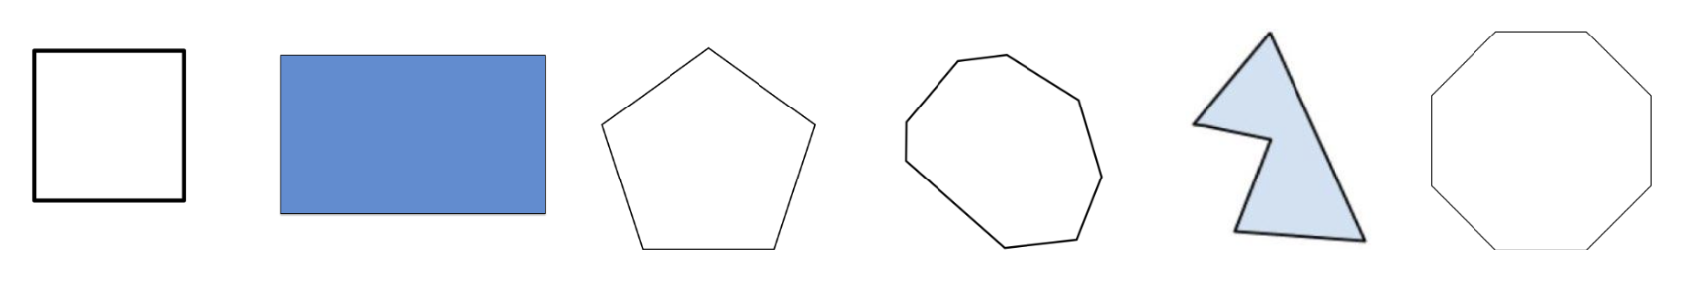
GRADE 4 MEASUREMENT & GEOMETRY
CLOSED QUESTIONS
ELEMENTARY MATH PROJECT
2. Sort the shapes below into regular and irregular shapes.

Slide 4
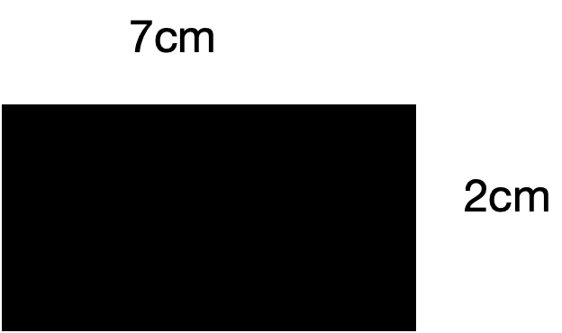
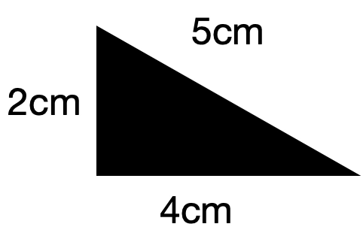
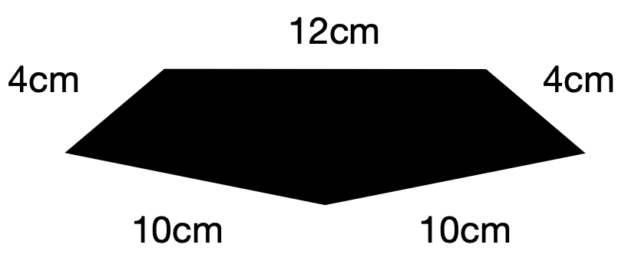
GRADE 4 MEASUREMENT & GEOMETRY
CLOSED QUESTIONS
ELEMENTARY MATH PROJECT
3. Find the perimeter of each shape below.

Slide 5

GRADE 4 MEASUREMENT & GEOMETRY
CLOSED QUESTIONS
ELEMENTARY MATH PROJECT
4. Complete the pictures below so that one is symmetrical and one is not.

Slide 6
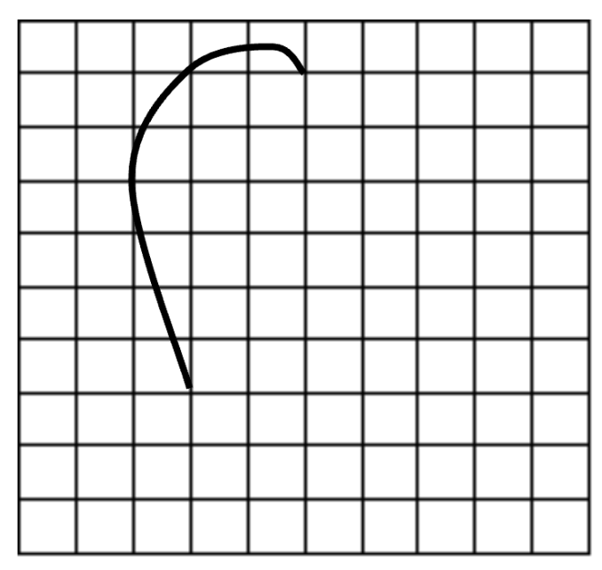
GRADE 4 MEASUREMENT & GEOMETRY
CLOSED QUESTIONS
ELEMENTARY MATH PROJECT
5. Complete the drawing so that it has at least one line of symmetry.

Slide 7
GRADE 4 MEASUREMENT & GEOMETRY
CLOSED QUESTIONS
ELEMENTARY MATH PROJECT
6. How does knowing the number of sides help us name shapes?
Give some examples.

Slide 8
GRADE 4 MEASUREMENT & GEOMETRY
CLOSED QUESTIONS
ELEMENTARY MATH PROJECT
7. Draw 4 different polygons.
Make 2 regular and 2 irregular.
Name each polygon and explain why it is regular or irregular.

Slide 9
GRADE 4 MEASUREMENT & GEOMETRY
CLOSED QUESTIONS
ELEMENTARY MATH PROJECT
8. Use pattern blocks.
a) Sort your pattern blocks into regular and irregular shapes.
b) Can you make a regular shape using only irregular pattern blocks? Draw the shapes you create.

Slide 10
GRADE 4 MEASUREMENT & GEOMETRY
CLOSED QUESTIONS
ELEMENTARY MATH PROJECT
9. Explain why you only need to know the length of one side to find the perimeter of a regular polygon.
Is the same true for irregular polygons?

Slide 11
GRADE 4 MEASUREMENT & GEOMETRY
CLOSED QUESTIONS
ELEMENTARY MATH PROJECT
10. Draw 4 shapes that have a perimeter of 48.

