Slide 1

ELEMENTARY MATH PROJECT
GRADE 4 PRACTICE QUESTIONS
MIXED REVIEW

Slide 2
GRADE 4 MIXED REVIEW
CLOSED QUESTIONS
ELEMENTARY MATH PROJECT
1. Solve the following equations.
a) 54 = 35 - ⬜️
b) ⬜️ + 41 = 104
c) 24 = 12 x ⬜️
d) ⬜️ ÷ 4 = 4

Slide 3
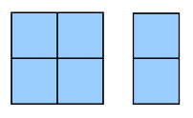
GRADE 4 MIXED REVIEW
CLOSED QUESTIONS
ELEMENTARY MATH PROJECT
2. The diagram represents ⅖ of the graham crackers in a serving.
What would one whole serving look like?

Slide 4
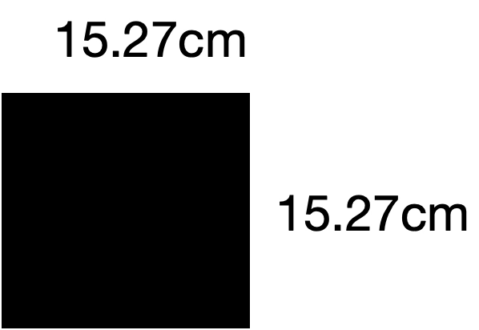
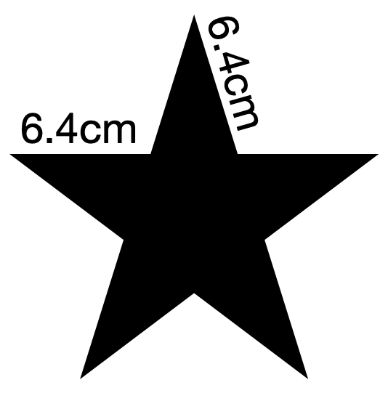
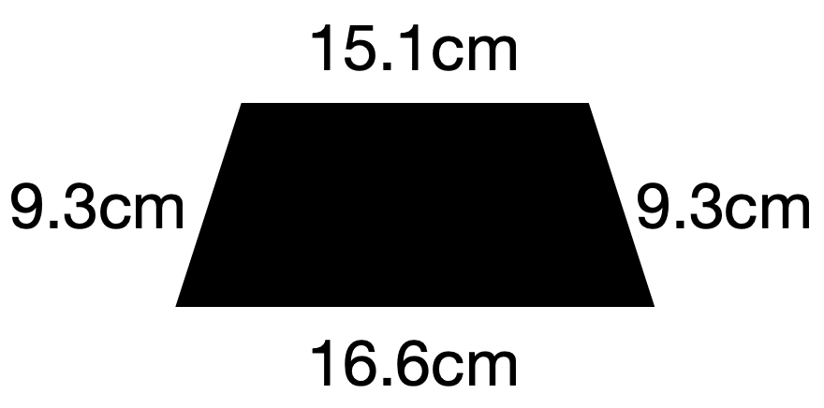
GRADE 4 MIXED REVIEW
CLOSED QUESTIONS
ELEMENTARY MATH PROJECT
3. Calculate the perimeter of the shapes.

Slide 5
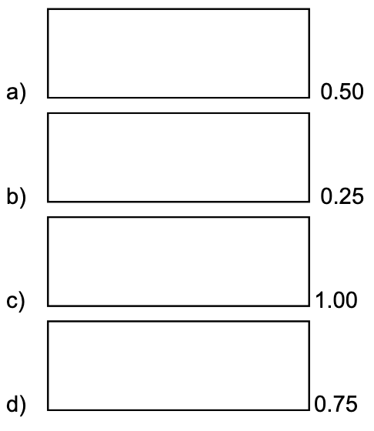
GRADE 4 MIXED REVIEW
CLOSED QUESTIONS
ELEMENTARY MATH PROJECT
4. Colour in the amount of the rectangle represented by the decimal. Write a fraction in lowest terms that is equivalent to the decimal.

Slide 6
GRADE 4 MIXED REVIEW
CLOSED QUESTIONS
ELEMENTARY MATH PROJECT
5. Order these numbers on a number line: 0, 1, 2, 0.5, 0.25, 0.56, ½, ¾

Slide 7
GRADE 4 MIXED REVIEW
CLOSED QUESTIONS
ELEMENTARY MATH PROJECT
6. Fill in the blanks:
8 + 7 = _____ + 5 = _____.
Share your answer with other students in your class. Did you all get the same answer? Which answer is correct and how do you know?

Slide 8
GRADE 4 MIXED REVIEW
OPEN QUESTIONS
ELEMENTARY MATH PROJECT
7. Create 3 fact families that use the number 36.
Use multiplication and division.

Slide 9
GRADE 4 MIXED REVIEW
OPEN QUESTIONS
ELEMENTARY MATH PROJECT
8. Name a fraction that is close to ½ but less than ½.
How close can you get?

Slide 10
GRADE 4 MIXED REVIEW
OPEN QUESTIONS
ELEMENTARY MATH PROJECT
9. Draw 3 different polygons. Make one regular and two irregular.
Name the shapes and identify if they are symmetrical or not.
Measure the length of the sides and calculate the perimeter of each shape.

Slide 11
GRADE 4 MIXED REVIEW
OPEN QUESTIONS
ELEMENTARY MATH PROJECT
10. You make the same amount of allowance each week. You want to buy a sweatshirt that costs $35.99. Decide on an amount of allowance and calculate how many weeks it will take you to buy the sweatshirt.

Slide 12
GRADE 4 MIXED REVIEW
OPEN QUESTIONS
ELEMENTARY MATH PROJECT
11. Look up when sunrise or sunset is for today or use the current time.
Record the time using the 12-hour clock system and the 24-hour clock system.
Draw a picture of an analogue clock to show this time.

Slide 13
GRADE 4 MIXED REVIEW
OPEN QUESTIONS
ELEMENTARY MATH PROJECT
12. You are trying to decide what to buy for your dog at the pet store. The options are: a squeak toy for $10.99, a chew toy for $7.50 or a bag of treats for $15.75.
Can you buy it all for $30. If so, how much change will you get?
If not, which items will you buy?

Slide 14
GRADE 4 MIXED REVIEW
OPEN QUESTIONS
ELEMENTARY MATH PROJECT
13. You have a tray of 12 brownies to share with your friends at a sleepover. How many friends could you have over and how would you share the brownies? Give at least 3 possibilities.

Slide 15
GRADE 4 MIXED REVIEW
OPEN QUESTIONS
ELEMENTARY MATH PROJECT
14. What strategies do you use to help recall that 8 ✕ 7 = 56?
Show at least two ways.

Slide 16

GRADE 4 MIXED REVIEW
OPEN QUESTIONS
ELEMENTARY MATH PROJECT
15. Use the digits 1 through 9 only once to fill in the boxes below so that the difference is as close to 0 as possible. What if it were as close to 1 as possible?

Slide 17
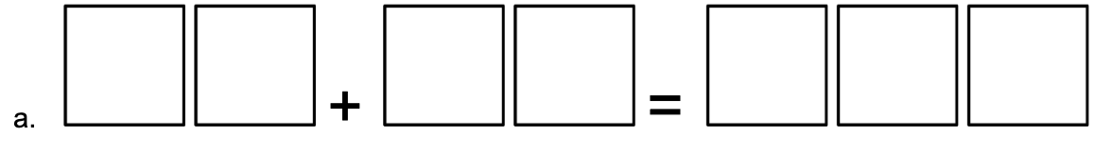
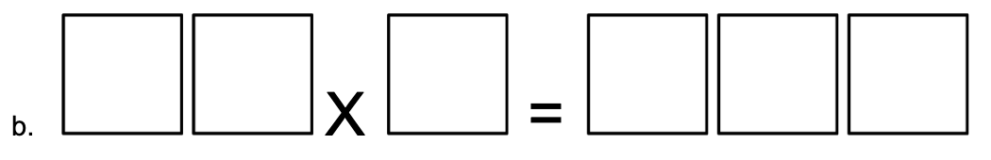
GRADE 4 MIXED REVIEW
OPEN QUESTIONS
ELEMENTARY MATH PROJECT
16. Insert digits in each box to make the equations true.

