Slide 1
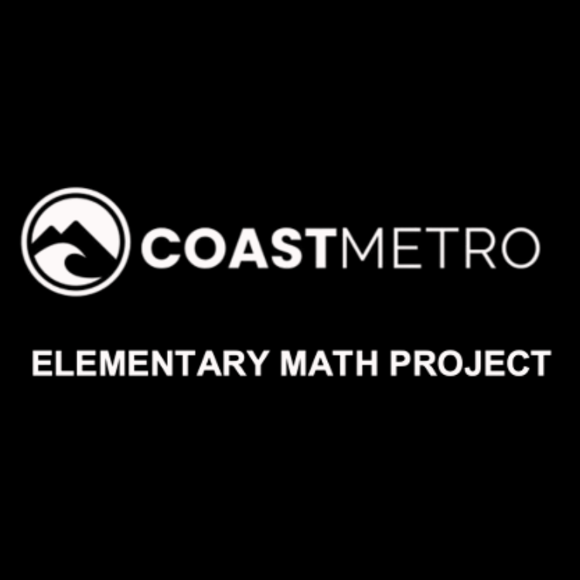
ELEMENTARY MATH PROJECT
GRADE 4 PRACTICE QUESTIONS
PATTERNS & ALGEBRA

Slide 2
GRADE 4 PATTERNS & ALGEBRA
CLOSED QUESTIONS
ELEMENTARY MATH PROJECT
1. Fill in the missing numbers in the patterns below.
1 | 5
2
3 | 15
4
5
6 | 30
1 | 21
2 | 18
3
4 | 12
5
6

Slide 3
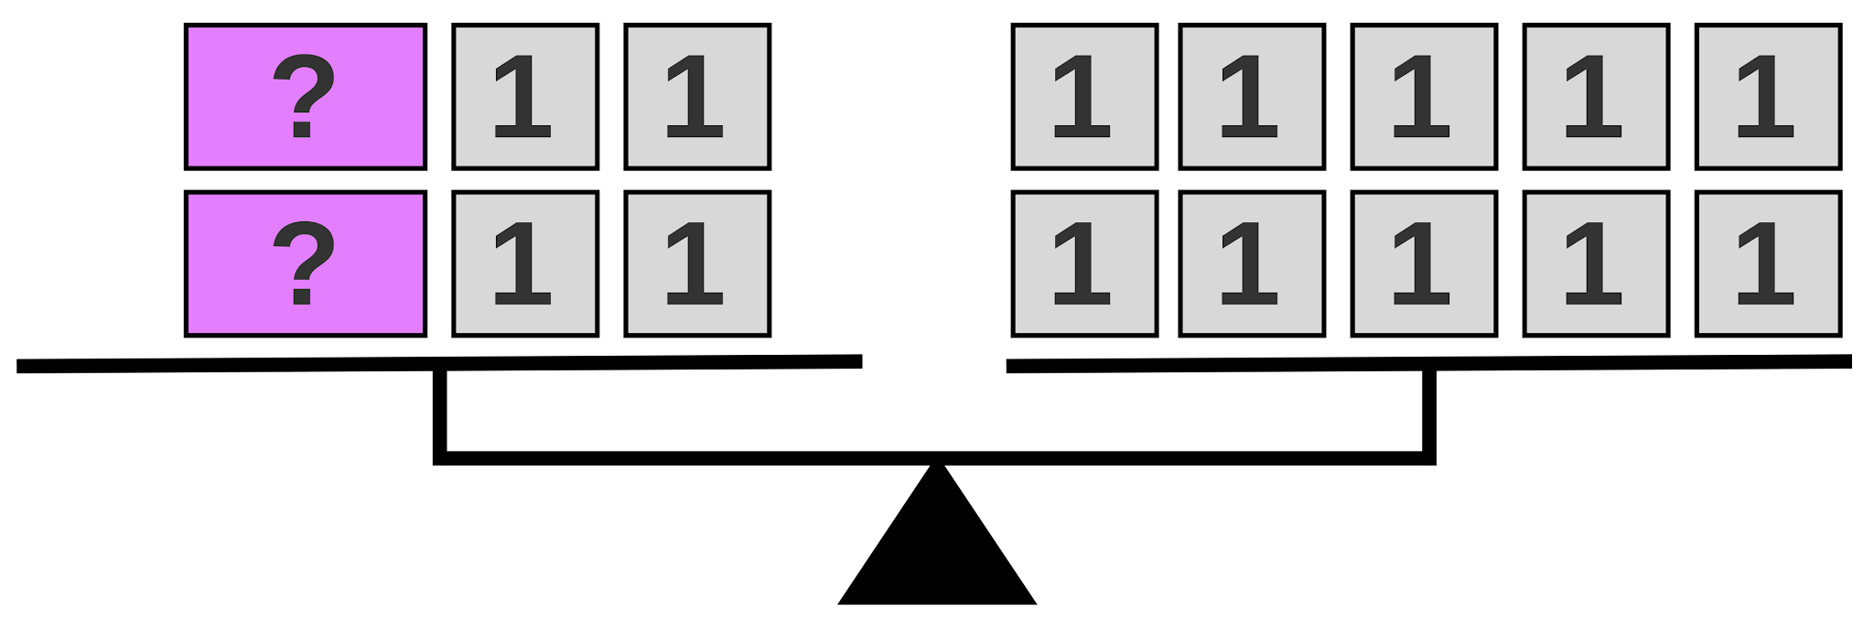
GRADE 4 PATTERNS & ALGEBRA
CLOSED QUESTIONS
ELEMENTARY MATH PROJECT
2. What number could be used to replace the question marks on the balance scale? Write an equation to represent the picture.

Slide 4
GRADE 4 PATTERNS & ALGEBRA
CLOSED QUESTIONS
ELEMENTARY MATH PROJECT
3. Fill in the missing numbers in the equations.
14 - ⬜️ = 7
⬜️ x 5 = 25
c) 36 = 9 + ⬜️

Slide 5
GRADE 4 PATTERNS & ALGEBRA
CLOSED QUESTIONS
ELEMENTARY MATH PROJECT
4. Eli is collecting eggs from his chickens. He collects 12 eggs to fill an egg carton. The first chicken has 4 eggs, the second chicken has 3 eggs and the third chicken has 1 egg. How many eggs must the fourth chicken have to fill the carton? Write an equation to represent the problem.

Slide 6
GRADE 4 PATTERNS & ALGEBRA
CLOSED QUESTIONS
ELEMENTARY MATH PROJECT
5. Darian wants to sort her beads into groups of 10. If she has 120 beads, how many boxes will she need to hold all the groups? Write an equation to represent the problem.

Slide 7
GRADE 4 PATTERNS & ALGEBRA
OPEN QUESTIONS
ELEMENTARY MATH PROJECT
6. a) Create an increasing pattern. Describe the pattern rule.
b) Create a decreasing pattern. Describe the pattern rule.

Slide 8
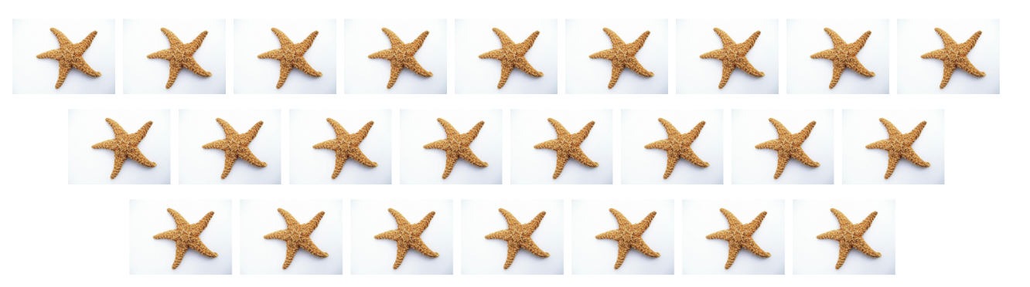
GRADE 4 PATTERNS & ALGEBRA
OPEN QUESTIONS
ELEMENTARY MATH PROJECT
7. Describe the patterns below. Draw step 4.
a)

Slide 9
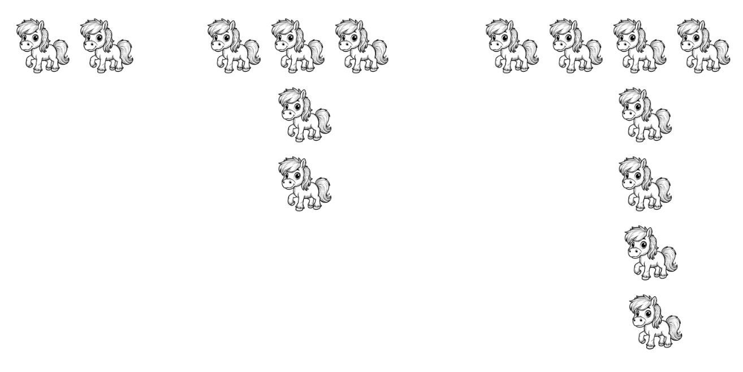
GRADE 4 PATTERNS & ALGEBRA
OPEN QUESTIONS
ELEMENTARY MATH PROJECT
7. Describe the patterns below. Draw step 4.
b)

Slide 10
GRADE 4 PATTERNS & ALGEBRA
OPEN QUESTIONS
ELEMENTARY MATH PROJECT
8. Create a pattern where the 3rd term has 9 objects.
Create a different pattern where the 3rd term is still 9.
Describe your patterns.

Slide 11
GRADE 4 PATTERNS & ALGEBRA
OPEN QUESTIONS
ELEMENTARY MATH PROJECT
9. Use a T-chart to predict the 10th term in the patterns above.

Slide 12
GRADE 4 PATTERNS & ALGEBRA
OPEN QUESTIONS
ELEMENTARY MATH PROJECT
10. Create a fact family that includes the number 12.

