Slide 1

ELEMENTARY MATH PROJECT
GRADE 4 PRACTICE QUESTIONS
NUMBER SENSE

Slide 2
GRADE 4 NUMBER SENSE
CLOSED QUESTIONS
ELEMENTARY MATH PROJECT
1. Find the value of the digit 5 in each number:
a) 5 482
b) 3 615
c) 25 904

Slide 3
GRADE 4 NUMBER SENSE
CLOSED QUESTIONS
ELEMENTARY MATH PROJECT
2. What place is the digit 7 in each number?
7 245
b) 3 478
c) 17 032

Slide 4
GRADE 4 NUMBER SENSE
CLOSED QUESTIONS
ELEMENTARY MATH PROJECT
3. In which number does the digit 5 have the greatest value?
5 234
b) 2 567
c) 15 432

Slide 5
GRADE 4 NUMBER SENSE
CLOSED QUESTIONS
ELEMENTARY MATH PROJECT
4. Order each set from least to greatest:
4 205, 4 025, 4 250
b) 18 901, 18 091, 19 001

Slide 6
GRADE 4 NUMBER SENSE
CLOSED QUESTIONS
ELEMENTARY MATH PROJECT
5. Which number is greater in each pair? Explain how you know.
4 999 or 5 001
b) 23 678 or 23 687

Slide 7
GRADE 4 NUMBER SENSE
CLOSED QUESTIONS
ELEMENTARY MATH PROJECT
6. Fill in the blanks:
3 000 = _____ hundreds
b) 2 400 = _____ hundreds
c) 8 000 = _____ thousands

Slide 8
GRADE 4 NUMBER SENSE
CLOSED QUESTIONS
ELEMENTARY MATH PROJECT
7. Fill in the blanks:
45 hundreds = _____
b) 6 thousands = _____
c) 120 tens = _____

Slide 9
GRADE 4 NUMBER SENSE
CLOSED QUESTIONS
ELEMENTARY MATH PROJECT
8. Write the number in standard form:
3 000 + 400 + 50 + 2
b) 6 000 + 20 + 9

Slide 10
GRADE 4 NUMBER SENSE
CLOSED QUESTIONS
ELEMENTARY MATH PROJECT
9. Write each number in expanded form:
4 582
b) 9 104

Slide 11
GRADE 4 NUMBER SENSE
CLOSED QUESTIONS
ELEMENTARY MATH PROJECT
10. Complete the statement in two different ways:
4 500 = ______ + ______ OR 4 500 = ______ + ______

Slide 12
GRADE 4 NUMBER SENSE
CLOSED QUESTIONS
ELEMENTARY MATH PROJECT
11. Complete:
6 342 = 6 000 + _______ + 40 + _______

Slide 13
GRADE 4 NUMBER SENSE
CLOSED QUESTIONS
ELEMENTARY MATH PROJECT
12. What number is:
5 thousands + 3 hundreds + 7 tens + 2 ones?

Slide 14
GRADE 4 NUMBER SENSE
CLOSED QUESTIONS
ELEMENTARY MATH PROJECT
13. What digit makes this true?
4 __ 82 is greater than 4 582

Slide 15
GRADE 4 NUMBER SENSE
CLOSED QUESTIONS
ELEMENTARY MATH PROJECT
14. Which number is closest to 5 000?
a) 4 890
b) 5 120
c) 4 995

Slide 16
GRADE 4 NUMBER SENSE
CLOSED QUESTIONS
ELEMENTARY MATH PROJECT
15. Round each number to the nearest 1 000:
a) 3 682
b) 7 149

Slide 17
GRADE 4 NUMBER SENSE
CLOSED QUESTIONS
ELEMENTARY MATH PROJECT
16. Which number rounds to 6 000?
a) 5 499
b) 5 501
c) 6 499

Slide 18
GRADE 4 NUMBER SENSE
CLOSED QUESTIONS
ELEMENTARY MATH PROJECT
17. Add 1000 or subtract 100 from each number:
Number | +1000 | -100
2 345
5 870
9 120

Slide 19
GRADE 4 NUMBER SENSE
CLOSED QUESTIONS
ELEMENTARY MATH PROJECT
18. Write a number between 3 400 and 3 500.

Slide 20
GRADE 4 NUMBER SENSE
CLOSED QUESTIONS
ELEMENTARY MATH PROJECT
19. Write three numbers between 8 200 and 8 300.

Slide 21
GRADE 4 NUMBER SENSE
CLOSED QUESTIONS
ELEMENTARY MATH PROJECT
20. Estimate:
4 282 + 3 121
Which is closer?
a) 7 000
b) 8 000

Slide 22
GRADE 4 NUMBER SENSE
CLOSED QUESTIONS
ELEMENTARY MATH PROJECT
21. Which is greater?
398 + 205 or 400 + 200

Slide 23
GRADE 4 NUMBER SENSE
CLOSED QUESTIONS
ELEMENTARY MATH PROJECT
22. 4 500 = 45 hundreds
Is this true or false? Explain.

Slide 24
GRADE 4 NUMBER SENSE
CLOSED QUESTIONS
ELEMENTARY MATH PROJECT
23. Create a number that:
is greater than 4 000
is less than 5 000
has a 6 in the tens place

Slide 25
GRADE 4 NUMBER SENSE
CLOSED QUESTIONS
ELEMENTARY MATH PROJECT
24. A number has:
3 in the thousands place
0 in the hundreds place
8 in the tens place
5 in the ones place
What is the number?

Slide 26
GRADE 4 NUMBER SENSE
CLOSED QUESTIONS
ELEMENTARY MATH PROJECT
25. Write a number that is close to 10 000 but less than 10 000.
Explain how you know it is close.

Slide 27
GRADE 4 NUMBER SENSE
OPEN QUESTIONS
ELEMENTARY MATH PROJECT
26. Create a number that:
is between 4 000 and 5 000
has a 6 in the tens place
Explain how you know your number meets both conditions.

Slide 28
GRADE 4 NUMBER SENSE
OPEN QUESTIONS
ELEMENTARY MATH PROJECT
27. Find two different ways to make 5 000 using addition.
Show your thinking.

Slide 29
GRADE 4 NUMBER SENSE
OPEN QUESTIONS
ELEMENTARY MATH PROJECT
28. Create two addition expressions that both have a sum close to 3 000.
Explain how you know which sum is greater.

Slide 30
GRADE 4 NUMBER SENSE
OPEN QUESTIONS
ELEMENTARY MATH PROJECT
29. Estimate the sum of 4 282 + 3 121.
Explain the strategy you used and why your estimate is reasonable.

Slide 31
GRADE 4 NUMBER SENSE
OPEN QUESTIONS
ELEMENTARY MATH PROJECT
30. Show two different ways to break apart 4 500.
Explain how both ways still represent the same number.

Slide 32
GRADE 4 NUMBER SENSE
OPEN QUESTIONS
ELEMENTARY MATH PROJECT
31. A student says:
“4 500 is the same as 45 tens.”
Do you agree or disagree?
Explain your thinking.

Slide 33
GRADE 4 NUMBER SENSE
OPEN QUESTIONS
ELEMENTARY MATH PROJECT
32. Which number is greater: 4 398 or 4 305?
Explain how you know using place value.

Slide 34
GRADE 4 NUMBER SENSE
OPEN QUESTIONS
ELEMENTARY MATH PROJECT
33. What number makes this true?
3 245 + _____ = 4 000
Explain how you figured it out.

Slide 35
GRADE 4 NUMBER SENSE
OPEN QUESTIONS
ELEMENTARY MATH PROJECT
34. Write three different numbers between 6 400 and 6 500.
Explain how you know each number fits.

Slide 36
GRADE 4 NUMBER SENSE
OPEN QUESTIONS
ELEMENTARY MATH PROJECT
35. Which one doesn’t belong?
a) 4 500 b) 4 050 c) 4 005 d) 4 555
Explain your reasoning.

Slide 37
GRADE 4 NUMBER SENSE
OPEN QUESTIONS
ELEMENTARY MATH PROJECT
36. A number is very close to 10 000, but it is less than 10 000.
What might the number be?
Explain how you know it is close.

Slide 38
GRADE 4 NUMBER SENSE
OPEN QUESTIONS
ELEMENTARY MATH PROJECT
37. Write a number that can be represented as:
3 thousands + 14 hundreds
What is the number?
Explain how you know.

Slide 39
GRADE 4 NUMBER SENSE
OPEN QUESTIONS
ELEMENTARY MATH PROJECT
38. Two students solved 398 + 205 in different ways:
Student A:
398 + 200 = 598
598 + 5 = 603
Student B:
400 + 205 = 605
605 − 2 = 603
a) Explain how each student solved the problem
b) Which strategy makes more sense to you? Why?

Slide 40
GRADE 4 NUMBER SENSE
OPEN QUESTIONS
ELEMENTARY MATH PROJECT
39. What happens when you add 1 000 to a number?
Give at least two examples and explain your thinking.

Slide 41
GRADE 4 NUMBER SENSE
OPEN QUESTIONS
ELEMENTARY MATH PROJECT
40. Without calculating exactly, determine which is greater:
49 × 6 or 50 × 6
Explain how you know.

Slide 42
GRADE 4 NUMBER SENSE
OPEN QUESTIONS
ELEMENTARY MATH PROJECT
41. Create a number that:
is greater than 2 500
is less than 3 500
has a 2 in the hundreds place
Explain how you know your number fits all conditions

Slide 43
GRADE 4 NUMBER SENSE
OPEN QUESTIONS
ELEMENTARY MATH PROJECT
42. Which fraction is greater: 3/4 or 2/4?
Show your thinking using a model, numbers, or words

Slide 44
GRADE 4 NUMBER SENSE
OPEN QUESTIONS
ELEMENTARY MATH PROJECT
43. Find two different fractions that are equal to 1/2.
Explain how you know they are equivalent.

Slide 45
GRADE 4 NUMBER SENSE
OPEN QUESTIONS
ELEMENTARY MATH PROJECT
44. A student says:
“3/6 is greater than 1/2 because 3 is greater than 1.”
Do you agree or disagree?
Explain your thinking.

Slide 46
GRADE 4 NUMBER SENSE
OPEN QUESTIONS
ELEMENTARY MATH PROJECT
45. Find two fractions that are greater than 1/2 but less than 1.
Explain how you know.

Slide 47
GRADE 4 NUMBER SENSE
OPEN QUESTIONS
ELEMENTARY MATH PROJECT
46. Show a model (drawing, number line, or objects) to prove that 2/4 = 1/2.
Explain your thinking.

Slide 48
GRADE 4 NUMBER SENSE
OPEN QUESTIONS
ELEMENTARY MATH PROJECT
47. Without calculating exactly, decide whether
3 982 + 2 105 is closer to 6 000 or 7 000.
Explain how you know.

Slide 49
GRADE 4 NUMBER SENSE
OPEN QUESTIONS
ELEMENTARY MATH PROJECT
48. A school is collecting books for a fundraiser.
They have collected 3 982 books so far and receive 2 105 more.
About how many books do they have now?
Is the total closer to 6 000 or 7 000?
Explain how you know.

Slide 50
GRADE 4 NUMBER SENSE
OPEN QUESTIONS
ELEMENTARY MATH PROJECT
49. A warehouse has 4 275 boxes.
A shipment arrives with 1 850 more boxes.
About how many boxes are there now?
Explain how you estimated your answer.

Slide 51
GRADE 4 NUMBER SENSE
OPEN QUESTIONS
ELEMENTARY MATH PROJECT
50. A store had 5 000 stickers.
They sold 1 975 stickers.
About how many stickers are left?
Explain your thinking.

Slide 52
ELEMENTARY MATH PROJECT
GRADE 4 PRACTICE QUESTIONS
COMPUTATIONAL FLUENCY

Slide 53
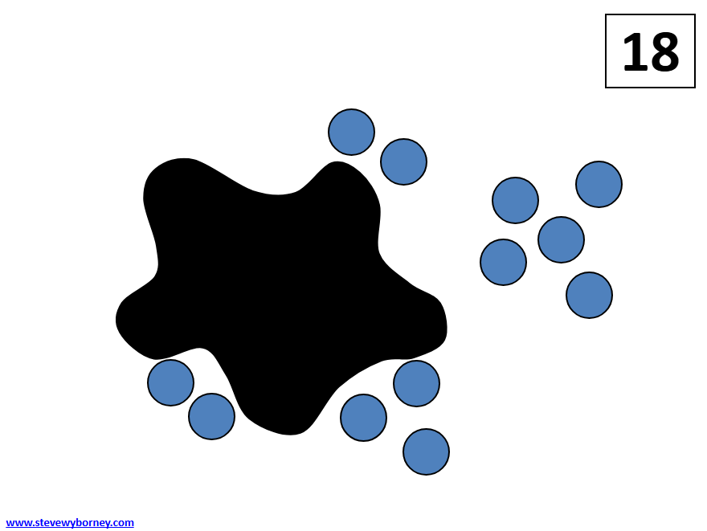
GRADE 4 COMPUTATIONAL FLUENCY
CLOSED QUESTIONS
ELEMENTARY MATH PROJECT
1. Here is a Splat! problem to solve. If there are 18 blue dots altogether, how many are hiding under the splat? Can you write the “fact family” of related equations that connect to this image?

Slide 54
GRADE 4 COMPUTATIONAL FLUENCY
CLOSED QUESTIONS
ELEMENTARY MATH PROJECT
2. Let’s review some addition and subtraction fact strategies.
a) Solve using a make-10 strategy (e.g., 7 + 6 = 7 + 3 + 3 = 10 + 3 = 13).
8 + 6 | 9 + 7
5 + 8 | 6 + 9

Slide 55
GRADE 4 COMPUTATIONAL FLUENCY
CLOSED QUESTIONS
ELEMENTARY MATH PROJECT
2. Let’s review some addition and subtraction fact strategies.
b) Solve using near doubles (e.g., 8 + 9 = 8 + 8 + 1 = 16 + 1 = 17).
6 + 7 | 8 + 9
5 + 6 | 9 + 10

Slide 56
GRADE 4 COMPUTATIONAL FLUENCY
CLOSED QUESTIONS
ELEMENTARY MATH PROJECT
2. Let’s review some addition and subtraction fact strategies.
c) Solve using think addition (e.g., 18 − 16 because 16 + 2 = 18)
13 − 9 | 14 − 12
20 − 17 | 15 − 8

Slide 57
GRADE 4 COMPUTATIONAL FLUENCY
CLOSED QUESTIONS
ELEMENTARY MATH PROJECT
2. Let’s review some addition and subtraction fact strategies.
d) Solve using a bridging-10 strategy (13 − 7 = 13 − 3 − 4 = 10 − 4 = 6)
12 − 4 | 15 − 8
14 − 9 | 19 − 12

Slide 58
GRADE 4 COMPUTATIONAL FLUENCY
CLOSED QUESTIONS
ELEMENTARY MATH PROJECT
2. Let’s review some addition and subtraction fact strategies.
e) Solve using a subtract from 10 strategy (e.g., 14 − 7 = 10 − 7 + 4 = 3 + 4 = 7)
12 − 5 | 15 − 8
13 − 9 | 17 - 9

Slide 59
GRADE 4 COMPUTATIONAL FLUENCY
CLOSED QUESTIONS
ELEMENTARY MATH PROJECT
3. Add using friendly numbers:
198 + 7
299 + 86
7 495 + 1 466
9 998 + 6 297

Slide 60
GRADE 4 COMPUTATIONAL FLUENCY
CLOSED QUESTIONS
ELEMENTARY MATH PROJECT
4. Subtract using compensation:
578 − 299
989 – 398
2 833 – 475
10 000 − 2 999

Slide 61
GRADE 4 COMPUTATIONAL FLUENCY
CLOSED QUESTIONS
ELEMENTARY MATH PROJECT
5. Use a place-value strategy to add or subtract:
845 + 32
1 584 + 215
786 – 63
3 454 − 221

Slide 62
GRADE 4 COMPUTATIONAL FLUENCY
CLOSED QUESTIONS
ELEMENTARY MATH PROJECT
6. Solve:
382 + 546
465 + 3940
943 – 748
6 200 − 4 197

Slide 63
GRADE 4 COMPUTATIONAL FLUENCY
CLOSED QUESTIONS
ELEMENTARY MATH PROJECT
7. Fill in the blank. Show your thinking. How can you check if your answer is correct?
3 299 + ___ = 10 000
___ − 2 500 = 1 750
8 000 = 4 899 + ___

Slide 64
GRADE 4 COMPUTATIONAL FLUENCY
CLOSED QUESTIONS
ELEMENTARY MATH PROJECT
8. Decide which equations are valid. Fix the ones that are not.
8 000 − 2 999 = 7 999 − 2 999 + 1
8 000 − 2 999 = (8 000 + 1) − (2 999 − 1)
8 000 − 2 999 = 7 999 − 2 999 − 1
8 000 − 2 999 = (8 000 − 1) − (2 999 − 1)

Slide 65
GRADE 4 COMPUTATIONAL FLUENCY
CLOSED QUESTIONS
ELEMENTARY MATH PROJECT
9. Which expression gives a result closest to 2 000?
1 467 + 768
812 + 1 193
2 853 − 493
5 190 − 2 592

Slide 66
GRADE 4 COMPUTATIONAL FLUENCY
CLOSED QUESTIONS
ELEMENTARY MATH PROJECT
10. Which is more:
4 − 1.9 or 1.6 + 0.35?
Explain or show your thinking.

Slide 67
GRADE 4 COMPUTATIONAL FLUENCY
CLOSED QUESTIONS
ELEMENTARY MATH PROJECT
11. Order the sums from least to greatest:
11.3 + 4.1, 9.9 + 5.23, 9 + 6.05, 5.3 + 9.7

Slide 68
GRADE 4 COMPUTATIONAL FLUENCY
CLOSED QUESTIONS
ELEMENTARY MATH PROJECT
12. Estimate 3.64 + 4.46 using the strategy indicated.
Which strategy is closest to the actual sum?
Round each number to the nearest whole number | Round each number to the nearest tenth
Front-end round each number | Front-end round only one number

Slide 69
GRADE 4 COMPUTATIONAL FLUENCY
CLOSED QUESTIONS
ELEMENTARY MATH PROJECT
13. Estimate 14.34 − 6.85 using the strategy indicated.
Which strategy is closest to the actual difference?
Round each number to the nearest whole number | Round each number to the nearest tenth
Front-end round each number | Front-end round only one number

Slide 70
GRADE 4 COMPUTATIONAL FLUENCY
CLOSED QUESTIONS
ELEMENTARY MATH PROJECT
14. Draw an area model for each multiplication sentence. Then solve using your model.
4 × 37
86 × 5
6 × 247
43 × 52
609 × 23

Slide 71
GRADE 4 COMPUTATIONAL FLUENCY
CLOSED QUESTIONS
ELEMENTARY MATH PROJECT
15. Fill in the blank to make each equation true.
4 × 23 = 4 × ____ + 4 × 3
5 × 321 = 5 × 300 + 5 × ____ + 5 × 1
56 ÷ 4 = 40 ÷ 4 + ____ ÷ 4
960 ÷ 8 = _____ ÷ 8 + 160 ÷ 8

Slide 72
GRADE 4 COMPUTATIONAL FLUENCY
CLOSED QUESTIONS
ELEMENTARY MATH PROJECT
16. Multiply. Show your strategy. Challenge: Use a variety of strategies.
23 × 6 | 8 × 401
9 × 247 | 16 × 45
99 × 38 | 302 × 15

Slide 73
GRADE 4 COMPUTATIONAL FLUENCY
CLOSED QUESTIONS
ELEMENTARY MATH PROJECT
17. Divide. Show your strategy. Challenge: Use a variety of strategies.
69 ÷ 3 | 96 ÷ 4
125 ÷ 5 | 560 ÷ 8
348 ÷ 6 | 910 ÷ 7

Slide 74
GRADE 4 COMPUTATIONAL FLUENCY
CLOSED QUESTIONS
ELEMENTARY MATH PROJECT
18. Calculate the following. Show your strategies. Challenge: Can you use a different strategy for each question?
48.5 + 21.9 | 31.2 + 7.98 | 58.21 - 23.4 | 8.6 - 2.95 | 24×37
46×25 | 348×15 | 256÷4 | 246÷3 | 948÷6

Slide 75
GRADE 4 COMPUTATIONAL FLUENCY
OPEN QUESTIONS
ELEMENTARY MATH PROJECT
19. Choose three questions:
a) 8+7 b) 28+17 c) 80+70
d) 258+37 e) 488+357 f) 8000+7000
What different strategies can you use to add these numbers?
How can you use one question to help you think about a different question?
How are the numbers related?
Show or record how you figured out the answers using at least two different strategies.

Slide 76
GRADE 4 COMPUTATIONAL FLUENCY
OPEN QUESTIONS
ELEMENTARY MATH PROJECT
20. Choose three questions:
a) 679+58 b) 236+474 c) 999+998
d) 4500+7250 e) 8999+3331
What different strategies can you use to add these numbers?
Show or record how you figured out the answers using at least two different strategies.

Slide 77
GRADE 4 COMPUTATIONAL FLUENCY
OPEN QUESTIONS
ELEMENTARY MATH PROJECT
21. Choose three questions:
a) 3×4 b) 4×8 c) 6×8 d) 4×16
e) 8×12 f) 16×12 g) 16×16
What different strategies can you use to multiply these numbers?
How can you use one question to help you think about a different question?
How are the numbers related?
Show or record how you figured out the answers using at least two different strategies.

Slide 78
GRADE 4 COMPUTATIONAL FLUENCY
OPEN QUESTIONS
ELEMENTARY MATH PROJECT
22. Choose three questions:
a) 12÷3 b) 18÷6 c) 36÷4 d) 72÷8
e) 80÷10 f) 160÷10 g) 160÷16
What different strategies can you use to divide these numbers?
How can you use multiplication to think about division?
Show or record how you figured out the answers using at least two different strategies.

Slide 79
GRADE 4 COMPUTATIONAL FLUENCY
OPEN QUESTIONS
ELEMENTARY MATH PROJECT
23. Choose at least three of these math equations to solve:
a) 59+___=82 b) 230+___=520
c) ___+90=285 d) 92 - ___=65
e) 951- ___=496 f) 948+___=2020
Use items to move around, drawings or mental math strategies.
Could you re-write the equation in a different way to help you think about it?
How does this make you think about how addition and subtraction are related?
How will you record and share your thinking?

Slide 80
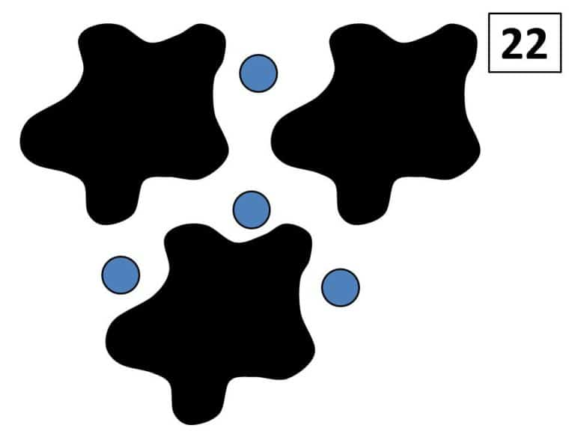
GRADE 4 COMPUTATIONAL FLUENCY
OPEN QUESTIONS
ELEMENTARY MATH PROJECT
24. Here is a Splat! problem to solve.
There are 22 blue dots altogether. Each black splat has the same number of blue dots under it. How many blue dots are under each splat?
Share how you solved this with a drawing or a video.
Create your own Splat! problem?

Slide 81
GRADE 4 COMPUTATIONAL FLUENCY
OPEN QUESTIONS
ELEMENTARY MATH PROJECT
25. Choose three of these math equations to solve:
a) 99 + ___ =175 b) 275 + 850= ___
c) 1000 + ___ =2500 d) 10 × ___ = 360
e) ___ × 20 = 480 f) 250 × ____= 1000
Use mental math strategies such as decomposing or compensating. Think about how addition and subtraction are related and how multiplication and division are related. How will you record and share your thinking?

Slide 82
GRADE 4 COMPUTATIONAL FLUENCY
OPEN QUESTIONS
ELEMENTARY MATH PROJECT
26. Choose three questions:
a) 100 – 38 b) 1000 – 273 c) 3000 – 1799
d) 5100 – 625 e) 7475 – 2850.
Solve each question using at least two different strategies.
How could an open number line show an “adding up” strategy?
Use numbers, symbols and/or words to represent your thinking.

Slide 83
GRADE 4 COMPUTATIONAL FLUENCY
OPEN QUESTIONS
ELEMENTARY MATH PROJECT
27. Choose an answer:
1.4 or 5.59 or 0.46
Can you think of three different subtraction (removal or find the difference) questions that have this answer. What materials like blocks, or tools like ten-frames, could help you with this task? Record your questions with pictures, numbers or words.

Slide 84
GRADE 4 COMPUTATIONAL FLUENCY
OPEN QUESTIONS
ELEMENTARY MATH PROJECT
28. Choose three questions:
a) 7.5 – 2.9 b) 6.3 – 4.89 c)1.75 – 0.97
d) 10.49 – 5.8 e) 49.05–24.99
Solve each question using at least two different strategies.
How could an open number line show an “adding up” strategy?
Use pictures, numbers, symbols and/or words.

Slide 85
GRADE 4 COMPUTATIONAL FLUENCY
OPEN QUESTIONS
ELEMENTARY MATH PROJECT
29. Solve each equation:
a) 3×5=___
b) 3×50= ____
c) 13×50= _____
How does the first question help you solve the other questions?
Show and describe your thinking using pictures, numbers, symbols and words.

Slide 86
GRADE 4 COMPUTATIONAL FLUENCY
OPEN QUESTIONS
ELEMENTARY MATH PROJECT
29. Solve each equation:
a) 3×5=___
b) 3×50= ____
c) 13×50= _____
How does the first question help you solve the other questions?
Show and describe your thinking using pictures, numbers, symbols and words.

Slide 87
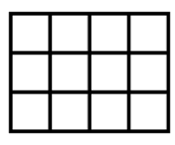
GRADE 4 COMPUTATIONAL FLUENCY
OPEN QUESTIONS
ELEMENTARY MATH PROJECT
30. An array is a rectangle of items in columns and rows.
Here is an array for the multiplication equation 3×4.
Solve at least three of these questions:
a) 2×16 b) 3×18 c) 8×8 d) 12×15 e) 15×21
Draw an array for each equation. What other multiplication questions or smaller arrays can you see within your large arrays? How do these smaller arrays help you to solve the multiplication question for the large arrays?

Slide 88
GRADE 4 COMPUTATIONAL FLUENCY
OPEN QUESTIONS
ELEMENTARY MATH PROJECT
31. Add or subtract one of the following sets (A or B) of decimal numbers:
4.3 + 2.8, 9.2 – 4.7
2.36 – 0. 97, 8.99 + 6.88 + 5.26
Show how you solved each question using diagrams, words and numbers. If you used a
specific strategy, name the strategy as well.

Slide 89
GRADE 4 COMPUTATIONAL FLUENCY
OPEN QUESTIONS
ELEMENTARY MATH PROJECT
32. Complete at least three of the following subtraction questions:
a) 4.9 - 2.8 b) 8.2 – 3.9 c) 4.00 – 2.85
d) 9.16 – 0.89 e) 8.59 - 1.08 - 2.5
Show how you solved each question using diagrams, words and numbers. If you used a
specific strategy, name the strategy as well.

Slide 90
GRADE 4 COMPUTATIONAL FLUENCY
OPEN QUESTIONS
ELEMENTARY MATH PROJECT
33. Complete at least three of the following addition questions:
a) 2.3 + 2.9 b) 5.5 + 4.7 c) 4.55 + 2.85
d) 4.93 + 0.47 e) 6.99 + 9.09 + 5.29
Show how you solved each question using diagrams, words and numbers. If you used a
specific strategy, name the strategy as well.

Slide 91
GRADE 4 COMPUTATIONAL FLUENCY
OPEN QUESTIONS
ELEMENTARY MATH PROJECT
34. Here is a math problem to solve. What strategies will you use to solve it? You could draw a picture, you could use mental math, decomposing or regrouping, or you could use
another strategy. Try more than one strategy and record your strategies and your solution. Share your reasoning to explain your solution.
Each box of oranges holds 24 oranges. A crate holds 12 boxes of oranges. If a market wanted to have 1000 oranges for a special sale, how many crates of oranges would they need to order? (Note: The market can only order the oranges by whole crates, not partial crates.)

Slide 92
GRADE 4 COMPUTATIONAL FLUENCY
OPEN QUESTIONS
ELEMENTARY MATH PROJECT
35. Here are some math problems to help us review what we have been learning about decimal numbers.
a) What whole numbers could you subtract to help you figure out 4.5 – 2.14?
b) What would you have to add to 3.8 to get to 5.13? How could you write that as an equation?
c) Draw a picture to show why 0.12 < 0.4.
What strategies will you use for each type of question? How does the type of question change which strategy you might use?
Pose your own math problem involving decimal numbers.

Slide 93
GRADE 4 COMPUTATIONAL FLUENCY
OPEN QUESTIONS
ELEMENTARY MATH PROJECT
36. Let’s think flexibly about multiplication. Write out the questions, answer the missing parts.
a) If 3×4 =12 then 6×4=____ and 3×8=___ because____________________.
b) If 16×12= 192 then 8×12=___ and 4×12=___ because ___________________.
c) If 20×12=240 then 2×12=_____ and 200×12=____ because _________________.

Slide 94
GRADE 4 COMPUTATIONAL FLUENCY
OPEN QUESTIONS
ELEMENTARY MATH PROJECT
37. Let’s think flexibly about division and the relationship between multiplication and
division. Write out the following questions and answer the missing parts.
a) If 24 ÷ 8 =3 then 24 ÷ 4=____ because ___________________.
b) If 15 ÷ 3= 5 then 5 ×___=15 and ___ × 5=15 because ___________________.
c) If 250÷10=25 then 10 × ___= 250 and 10 × ___= 500 because _________________.

Slide 95
GRADE 4 COMPUTATIONAL FLUENCY
OPEN QUESTIONS
ELEMENTARY MATH PROJECT
38. Choose one of the following math questions to inspire a math story problem. Pose your problem using words and numbers and draw a picture or diagram to show how you will
solve the problem. Choose an equation that will challenge your thinking.
a) 8 × 12 = ____ b) 92 ÷ 4 = ____
c) $2.75 + $19.78 = ____ d) $7.62 – ____ = $4.85
Extension: Rewrite your story problem to show a different meaning of the operation you chose. Explain what makes it different.

Slide 96
GRADE 4 COMPUTATIONAL FLUENCY
OPEN QUESTIONS
ELEMENTARY MATH PROJECT
39. Here is a math problem to solve:
I opened a package of seeds and planted 6 rows of seeds in the garden. Each row had 24 seeds. I planted some more in a pot. I used up all 170 seeds in the package of seeds. How many seeds did I plant in the pot?
What strategies will you use to answer the problem? Share your thinking.

Slide 97
GRADE 4 COMPUTATIONAL FLUENCY
OPEN QUESTIONS
ELEMENTARY MATH PROJECT
40. Choose two of the following math questions:
a) 2.8 + 1.7 b) 7.1 – 2.7
c) 2.17 + 3.98 d) 7.43 – 2.85
What different ways can you figure each question out? How does thinking about strategies with whole numbers help you solve these questions? Record and share at least two different ways for solving these questions.

Slide 98
GRADE 4 COMPUTATIONAL FLUENCY
OPEN QUESTIONS
ELEMENTARY MATH PROJECT
41. Pick two or more of the relationships below. Use pictures, numbers, words, and specific examples to explain each relationship.
Addition and subtraction
Multiplication and division
Multiplication and addition
Division and subtraction

Slide 99
GRADE 4 COMPUTATIONAL FLUENCY
OPEN QUESTIONS
ELEMENTARY MATH PROJECT
42. The answer is 480. What could the math question be?
Think of at least four different questions.
Can you think of a question for each operation (addition, subtraction, multiplication and division)?

Slide 100
GRADE 4 COMPUTATIONAL FLUENCY
OPEN QUESTIONS
ELEMENTARY MATH PROJECT
43. Pick one… Tell me what you know about 3 × 6 or 18 ÷ 3
Use words, pictures, numbers, symbols, and materials to represent your thinking.
How are the two options related?

Slide 101
GRADE 4 COMPUTATIONAL FLUENCY
OPEN QUESTIONS
ELEMENTARY MATH PROJECT
44. Describe a situation where you might estimate rather than calculating an exact answer.

Slide 102
GRADE 4 COMPUTATIONAL FLUENCY
OPEN QUESTIONS
ELEMENTARY MATH PROJECT
45. You have three estimates for 2,899 + 1,899:
a) 3,000 + 2,000
b) 2,900 + 1,900
c) 2,000 + 1,000
Describe the strategy that was used for each estimation. Rank them in order of accuracy to the actual sum. Which strategy do you like best and why?

Slide 103
GRADE 4 COMPUTATIONAL FLUENCY
OPEN QUESTIONS
ELEMENTARY MATH PROJECT
46. Subtracting numbers like 10 000 - 38 493 are challenging using the traditional stacking method. What is another way to think about this problem that makes it easier to solve?
Hint: Can we use a friendlier number than 10 000 so that we do not have to regroup?

Slide 104
GRADE 4 COMPUTATIONAL FLUENCY
OPEN QUESTIONS
ELEMENTARY MATH PROJECT
47. Show two ways to calculate 8 - 3.9. Which way do you prefer and why?

Slide 105
GRADE 4 COMPUTATIONAL FLUENCY
OPEN QUESTIONS
ELEMENTARY MATH PROJECT
48. Choose one:
Describe two different meanings of subtraction.
Describe two different meanings of division.
For each meaning, create a story problem related to your life or the community in which you live. How will you share your story problems?

Slide 106
GRADE 4 COMPUTATIONAL FLUENCY
OPEN QUESTIONS
ELEMENTARY MATH PROJECT
49. Explain how multiplication helps you to divide.
Use a specific example to help convey your ideas clearly.

Slide 107
GRADE 4 COMPUTATIONAL FLUENCY
OPEN QUESTIONS
ELEMENTARY MATH PROJECT
50. Create a “Which one doesn’t belong?” using equations. Can you think of a reason why each one does not belong?

Slide 108
GRADE 4 COMPUTATIONAL FLUENCY
OPEN QUESTIONS
ELEMENTARY MATH PROJECT
51. Create two or more story problems that can be solved by 24 × 6. Each story problem should demonstrate a different meaning of multiplication. Explain which meaning each problem shows.

Slide 109
GRADE 4 COMPUTATIONAL FLUENCY
OPEN QUESTIONS
ELEMENTARY MATH PROJECT
52. Create two or more story problems that can be solved by 246 ÷ 4. Each story problem should demonstrate a different meaning of division. Explain which meaning each problem shows.

Slide 110
ELEMENTARY MATH PROJECT
GRADE 4 PRACTICE QUESTIONS
PATTERNS & ALGEBRA

Slide 111
GRADE 4 PATTERNS & ALGEBRA
CLOSED QUESTIONS
ELEMENTARY MATH PROJECT
1. Fill in the missing numbers in the patterns below.
1 | 5
2
3 | 15
4
5
6 | 30
1 | 21
2 | 18
3
4 | 12
5
6

Slide 112
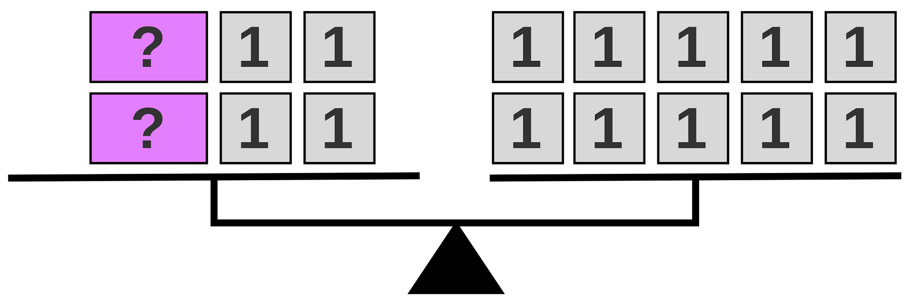
GRADE 4 PATTERNS & ALGEBRA
CLOSED QUESTIONS
ELEMENTARY MATH PROJECT
2. What number could be used to replace the question marks on the balance scale? Write an equation to represent the picture.

Slide 113
GRADE 4 PATTERNS & ALGEBRA
CLOSED QUESTIONS
ELEMENTARY MATH PROJECT
3. Fill in the missing numbers in the equations.
14 - ⬜️ = 7
⬜️ x 5 = 25
c) 36 = 9 + ⬜️

Slide 114
GRADE 4 PATTERNS & ALGEBRA
CLOSED QUESTIONS
ELEMENTARY MATH PROJECT
4. Eli is collecting eggs from his chickens. He collects 12 eggs to fill an egg carton. The first chicken has 4 eggs, the second chicken has 3 eggs and the third chicken has 1 egg. How many eggs must the fourth chicken have to fill the carton? Write an equation to represent the problem.

Slide 115
GRADE 4 PATTERNS & ALGEBRA
CLOSED QUESTIONS
ELEMENTARY MATH PROJECT
5. Darian wants to sort her beads into groups of 10. If she has 120 beads, how many boxes will she need to hold all the groups? Write an equation to represent the problem.

Slide 116
GRADE 4 PATTERNS & ALGEBRA
OPEN QUESTIONS
ELEMENTARY MATH PROJECT
6. a) Create an increasing pattern. Describe the pattern rule.
b) Create a decreasing pattern. Describe the pattern rule.

Slide 117
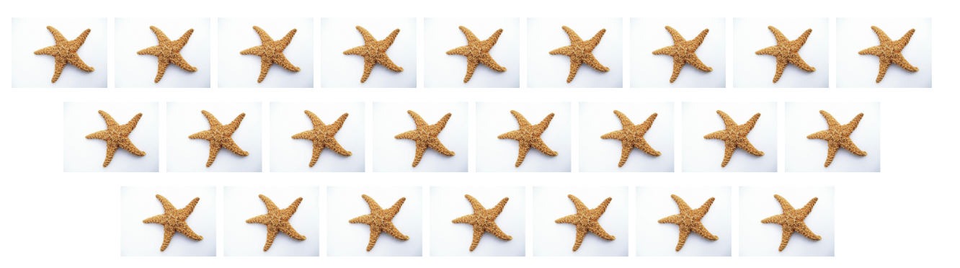
GRADE 4 PATTERNS & ALGEBRA
OPEN QUESTIONS
ELEMENTARY MATH PROJECT
7. Describe the patterns below. Draw step 4.
a)

Slide 118
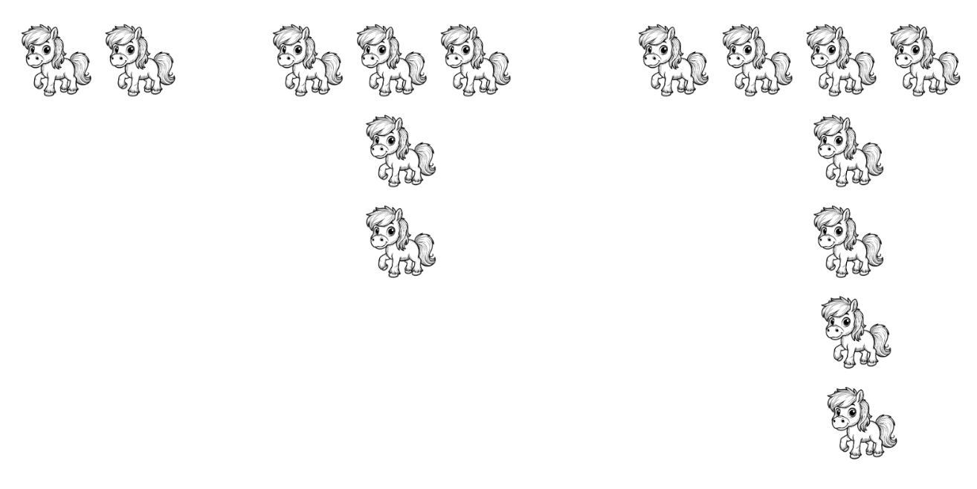
GRADE 4 PATTERNS & ALGEBRA
OPEN QUESTIONS
ELEMENTARY MATH PROJECT
7. Describe the patterns below. Draw step 4.
b)

Slide 119
GRADE 4 PATTERNS & ALGEBRA
OPEN QUESTIONS
ELEMENTARY MATH PROJECT
8. Create a pattern where the 3rd term has 9 objects.
Create a different pattern where the 3rd term is still 9.
Describe your patterns.

Slide 120
GRADE 4 PATTERNS & ALGEBRA
OPEN QUESTIONS
ELEMENTARY MATH PROJECT
9. Use a T-chart to predict the 10th term in the patterns above.

Slide 121
GRADE 4 PATTERNS & ALGEBRA
OPEN QUESTIONS
ELEMENTARY MATH PROJECT
10. Create a fact family that includes the number 12.

Slide 122
ELEMENTARY MATH PROJECT
GRADE 4 PRACTICE QUESTIONS
DATA & PROBABILITY

Slide 123
GRADE 4 DATA & PROBABILITY
CLOSED QUESTIONS
ELEMENTARY MATH PROJECT
1. You are rolling a regular 6-sided die. Use the words certain, impossible or possible to answer the questions.
You will get an even number.
You will get a number between 1 and 6.
You will get a 10.

Slide 124

GRADE 4 DATA & PROBABILITY
CLOSED QUESTIONS
ELEMENTARY MATH PROJECT
2. You are using this colour spinner.
Use the words unlikely, less likely, more likely or equally likely to answer the questions.
You will land on yellow five times in a row.
You will land on a warm colour (red, yellow pink) instead of a cool colour (green, turquoise, blue).
You will land on a primary colour (red, yellow, blue) instead of a secondary colour (green).

Slide 125
GRADE 4 DATA & PROBABILITY
OPEN QUESTIONS
ELEMENTARY MATH PROJECT
3. Explain how pictographs and bar graphs are similar and how they are different.

Slide 126
GRADE 4 DATA & PROBABILITY
OPEN QUESTIONS
ELEMENTARY MATH PROJECT
4. Create a pictograph using the data in the table below. Make each symbol worth more than one animal. What number is a good choice for the scale?
Animal | Number in the Group
chickens | 15
dogs | 3
horses | 6
cows | 12
cats | 1

Slide 127
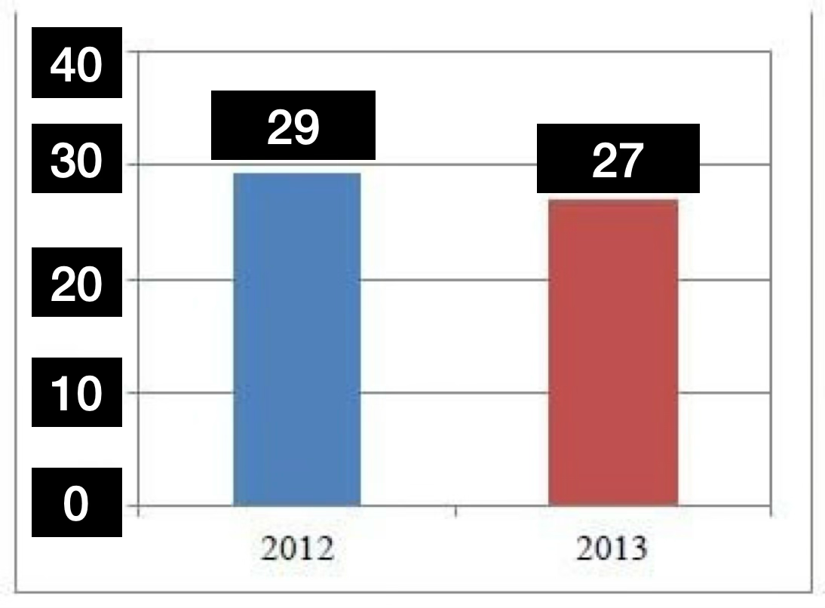
GRADE 4 DATA & PROBABILITY
OPEN QUESTIONS
ELEMENTARY MATH PROJECT
5. Analyze the graph below. What might be happening that would create the data? What title would you give the graph?

Slide 128
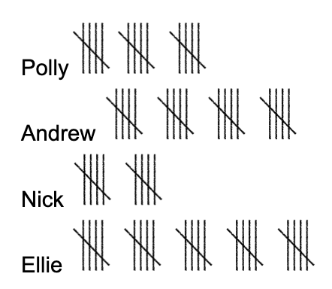
GRADE 4 DATA & PROBABILITY
OPEN QUESTIONS
ELEMENTARY MATH PROJECT
6. Four friends are practicing hitting baseballs. They record their hits using tally marks. Create a bar graph using the tally data below.

Slide 129
GRADE 4 DATA & PROBABILITY
OPEN QUESTIONS
ELEMENTARY MATH PROJECT
7. What are 3 statements that you can make about the data in the graph you created in question 6?

Slide 130
GRADE 4 DATA & PROBABILITY
OPEN QUESTIONS
ELEMENTARY MATH PROJECT
8. Write 3 different questions that you could ask to collect tallies in order to make a bar graph.

Slide 131
GRADE 4 DATA & PROBABILITY
OPEN QUESTIONS
ELEMENTARY MATH PROJECT
9. Make a chart for the numbers 0 to 12. Predict which numbers will happen the most often if you roll 2 dice and add the numbers together. Explain your predictions.

Slide 132
GRADE 4 DATA & PROBABILITY
OPEN QUESTIONS
ELEMENTARY MATH PROJECT
10. Bobby is doing a probability experiment. She has 6 coloured pieces in a bag. Without looking, she pulls out a piece, records the colour, and places it back into the bag. Then she repeats the experiment.
In her first 20 tries, she pulls out 11 yellow pieces, 6 blue pieces and 3 red pieces. Based on what she has pulled out so far, what do you predict is in the bag? Explain your reasoning.

Slide 133
ELEMENTARY MATH PROJECT
GRADE 4 PRACTICE QUESTIONS
MEASUREMENT & GEOMETRY

Slide 134

GRADE 4 MEASUREMENT & GEOMETRY
CLOSED QUESTIONS
ELEMENTARY MATH PROJECT
1. Identify which shapes have lines of symmetry. Draw the lines on the shapes that have them.

Slide 135
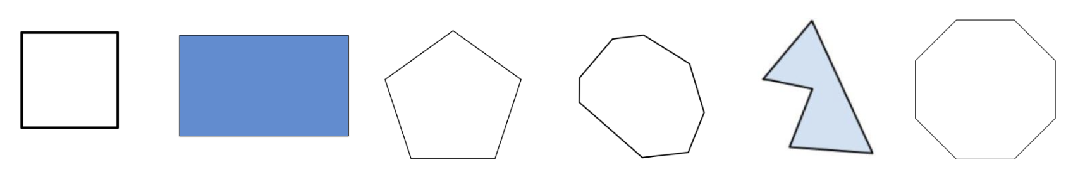
GRADE 4 MEASUREMENT & GEOMETRY
CLOSED QUESTIONS
ELEMENTARY MATH PROJECT
2. Sort the shapes below into regular and irregular shapes.

Slide 136
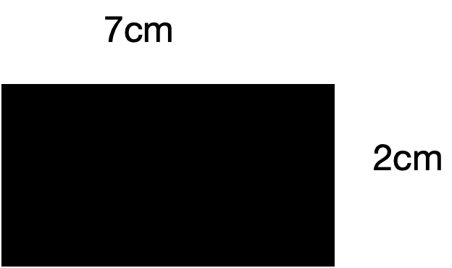
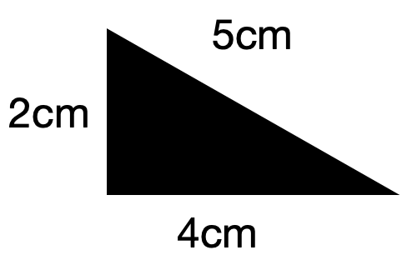
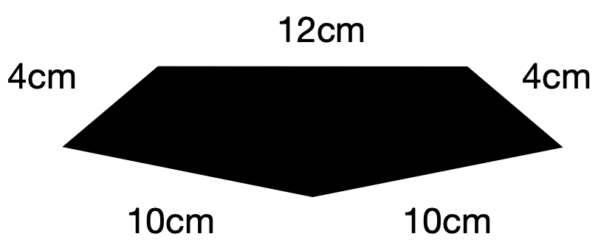
GRADE 4 MEASUREMENT & GEOMETRY
CLOSED QUESTIONS
ELEMENTARY MATH PROJECT
3. Find the perimeter of each shape below.

Slide 137

GRADE 4 MEASUREMENT & GEOMETRY
CLOSED QUESTIONS
ELEMENTARY MATH PROJECT
4. Complete the pictures below so that one is symmetrical and one is not.

Slide 138
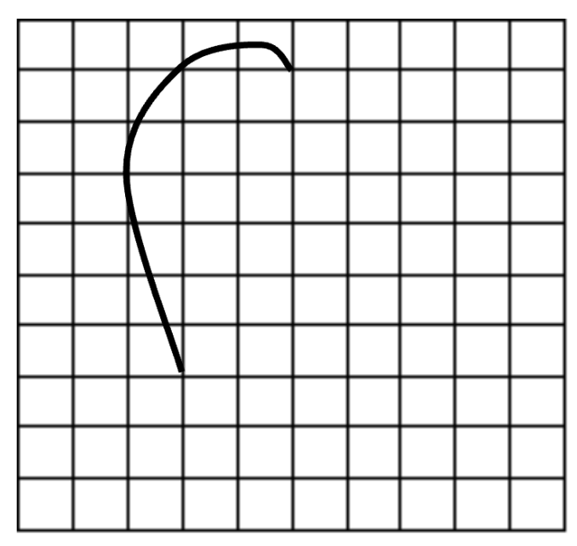
GRADE 4 MEASUREMENT & GEOMETRY
CLOSED QUESTIONS
ELEMENTARY MATH PROJECT
5. Complete the drawing so that it has at least one line of symmetry.

Slide 139
GRADE 4 MEASUREMENT & GEOMETRY
CLOSED QUESTIONS
ELEMENTARY MATH PROJECT
6. How does knowing the number of sides help us name shapes?
Give some examples.

Slide 140
GRADE 4 MEASUREMENT & GEOMETRY
CLOSED QUESTIONS
ELEMENTARY MATH PROJECT
7. Draw 4 different polygons.
Make 2 regular and 2 irregular.
Name each polygon and explain why it is regular or irregular.

Slide 141
GRADE 4 MEASUREMENT & GEOMETRY
CLOSED QUESTIONS
ELEMENTARY MATH PROJECT
8. Use pattern blocks.
a) Sort your pattern blocks into regular and irregular shapes.
b) Can you make a regular shape using only irregular pattern blocks? Draw the shapes you create.

Slide 142
GRADE 4 MEASUREMENT & GEOMETRY
CLOSED QUESTIONS
ELEMENTARY MATH PROJECT
9. Explain why you only need to know the length of one side to find the perimeter of a regular polygon.
Is the same true for irregular polygons?

Slide 143
GRADE 4 MEASUREMENT & GEOMETRY
CLOSED QUESTIONS
ELEMENTARY MATH PROJECT
10. Draw 4 shapes that have a perimeter of 48.

Slide 144
ELEMENTARY MATH PROJECT
GRADE 4 PRACTICE QUESTIONS
FINANCIAL LITERACY

Slide 145
GRADE 4 FINANCIAL LITERACY
CLOSED QUESTIONS
ELEMENTARY MATH PROJECT
1. Zaara is saving money for a new bike.
She makes $7 per week in allowance.
If the bike costs $100, how many weeks will it take Zaara to buy the bike?

Slide 146
GRADE 4 FINANCIAL LITERACY
CLOSED QUESTIONS
ELEMENTARY MATH PROJECT
2. Victor has a $50 bill.
He buys a video game for $29.99 and some batteries for $10.50.
The tax is $4.86.
Does he have enough money? If so, how much change will he receive?

Slide 147
GRADE 4 FINANCIAL LITERACY
CLOSED QUESTIONS
ELEMENTARY MATH PROJECT
3. Angie’s class has just done a Young Entrepreneurs Fair.
They are giving half the money to the SPCA.
Angie made a profit of $48.50.
How much money does she get to keep?

Slide 148
GRADE 4 FINANCIAL LITERACY
CLOSED QUESTIONS
ELEMENTARY MATH PROJECT
4. You are baking a cake for your mom’s birthday. You buy eggs for $6.50, flour for $5.89, sugar for $10.36 and butter for $9.00.
How much does the cake cost to make?
If a store bought cake costs $60, which cake is less expensive? By how much?

Slide 149
GRADE 4 FINANCIAL LITERACY
CLOSED QUESTIONS
ELEMENTARY MATH PROJECT
5. You are selling bracelets for $3.25 each at the farmer’s market. It costs you $30 in supplies to make 20 bracelets.
How many must you sell to make your money back?
How much will you make if you sell all 20?

Slide 150
GRADE 4 FINANCIAL LITERACY
OPEN QUESTIONS
ELEMENTARY MATH PROJECT
6. Molly goes grocery shopping with a $20 bill. She spends $12.50. Show 2 different ways that you could make change for Molly.

Slide 151
GRADE 4 FINANCIAL LITERACY
OPEN QUESTIONS
ELEMENTARY MATH PROJECT
7. Mika gets $100 for her birthday. She wants to save some of the money, donate some to charity and spend some on a shopping trip to the mall. How would you advise Mika to split up her money?
Explain your reasons.

Slide 152
GRADE 4 FINANCIAL LITERACY
OPEN QUESTIONS
ELEMENTARY MATH PROJECT
8. Would you rather:
Spend $60 on a new pair of shoes OR
Spend $30 on a new pair of shoes and save the other $30 in the bank?
Explain your reasoning.

Slide 153
GRADE 4 FINANCIAL LITERACY
OPEN QUESTIONS
ELEMENTARY MATH PROJECT
9. Sophie buys a bag of apples for $14.48 from Peter.
She pays with a $20 bill.
Peter gives her $6.52 in change.
Did he give her the correct amount? Explain or show how you know.

Slide 154
GRADE 4 FINANCIAL LITERACY
OPEN QUESTIONS
ELEMENTARY MATH PROJECT
10. Choose an item that you would like to buy. The cost must be less than $100.
Create a plan for how you could earn and save enough money to buy the item you want.

Slide 155
ELEMENTARY MATH PROJECT
GRADE 4 PRACTICE QUESTIONS
MIXED REVIEW

Slide 156
GRADE 4 MIXED REVIEW
CLOSED QUESTIONS
ELEMENTARY MATH PROJECT
1. Solve the following equations.
a) 54 = 35 - ⬜️
b) ⬜️ + 41 = 104
c) 24 = 12 x ⬜️
d) ⬜️ ÷ 4 = 4

Slide 157
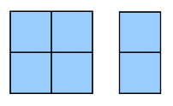
GRADE 4 MIXED REVIEW
CLOSED QUESTIONS
ELEMENTARY MATH PROJECT
2. The diagram represents ⅖ of the graham crackers in a serving.
What would one whole serving look like?

Slide 158
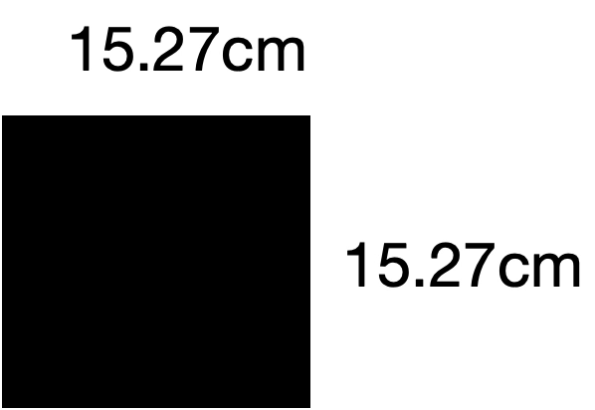
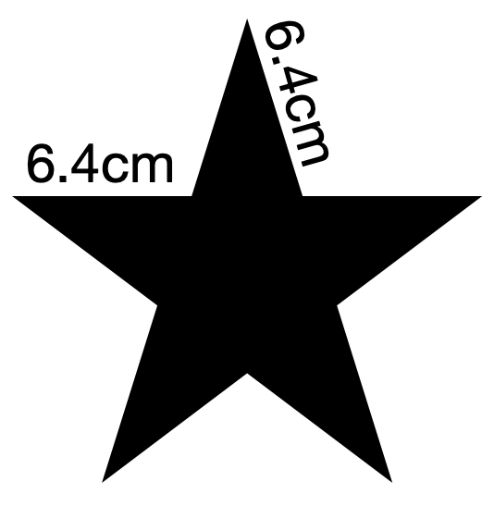
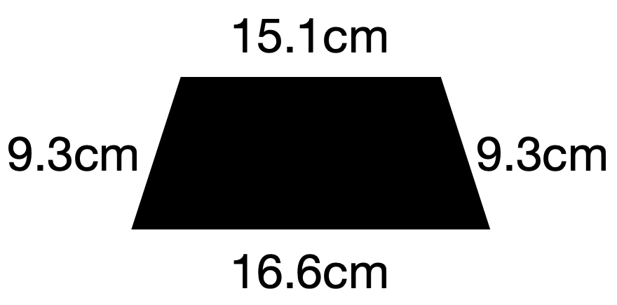
GRADE 4 MIXED REVIEW
CLOSED QUESTIONS
ELEMENTARY MATH PROJECT
3. Calculate the perimeter of the shapes.

Slide 159
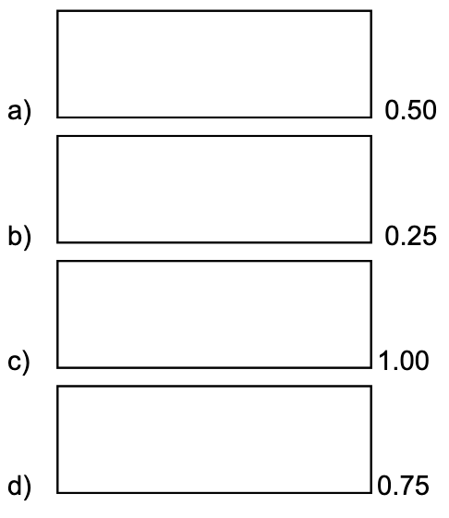
GRADE 4 MIXED REVIEW
CLOSED QUESTIONS
ELEMENTARY MATH PROJECT
4. Colour in the amount of the rectangle represented by the decimal. Write a fraction in lowest terms that is equivalent to the decimal.

Slide 160
GRADE 4 MIXED REVIEW
CLOSED QUESTIONS
ELEMENTARY MATH PROJECT
5. Order these numbers on a number line: 0, 1, 2, 0.5, 0.25, 0.56, ½, ¾

Slide 161
GRADE 4 MIXED REVIEW
CLOSED QUESTIONS
ELEMENTARY MATH PROJECT
6. Fill in the blanks:
8 + 7 = _____ + 5 = _____.
Share your answer with other students in your class. Did you all get the same answer? Which answer is correct and how do you know?

Slide 162
GRADE 4 MIXED REVIEW
OPEN QUESTIONS
ELEMENTARY MATH PROJECT
7. Create 3 fact families that use the number 36.
Use multiplication and division.

Slide 163
GRADE 4 MIXED REVIEW
OPEN QUESTIONS
ELEMENTARY MATH PROJECT
8. Name a fraction that is close to ½ but less than ½.
How close can you get?

Slide 164
GRADE 4 MIXED REVIEW
OPEN QUESTIONS
ELEMENTARY MATH PROJECT
9. Draw 3 different polygons. Make one regular and two irregular.
Name the shapes and identify if they are symmetrical or not.
Measure the length of the sides and calculate the perimeter of each shape.

Slide 165
GRADE 4 MIXED REVIEW
OPEN QUESTIONS
ELEMENTARY MATH PROJECT
10. You make the same amount of allowance each week. You want to buy a sweatshirt that costs $35.99. Decide on an amount of allowance and calculate how many weeks it will take you to buy the sweatshirt.

Slide 166
GRADE 4 MIXED REVIEW
OPEN QUESTIONS
ELEMENTARY MATH PROJECT
11. Look up when sunrise or sunset is for today or use the current time.
Record the time using the 12-hour clock system and the 24-hour clock system.
Draw a picture of an analogue clock to show this time.

Slide 167
GRADE 4 MIXED REVIEW
OPEN QUESTIONS
ELEMENTARY MATH PROJECT
12. You are trying to decide what to buy for your dog at the pet store. The options are: a squeak toy for $10.99, a chew toy for $7.50 or a bag of treats for $15.75.
Can you buy it all for $30. If so, how much change will you get?
If not, which items will you buy?

Slide 168
GRADE 4 MIXED REVIEW
OPEN QUESTIONS
ELEMENTARY MATH PROJECT
13. You have a tray of 12 brownies to share with your friends at a sleepover. How many friends could you have over and how would you share the brownies? Give at least 3 possibilities.

Slide 169
GRADE 4 MIXED REVIEW
OPEN QUESTIONS
ELEMENTARY MATH PROJECT
14. What strategies do you use to help recall that 8 ✕ 7 = 56?
Show at least two ways.

Slide 170
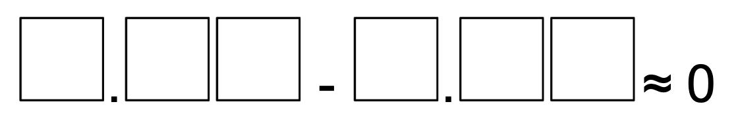
GRADE 4 MIXED REVIEW
OPEN QUESTIONS
ELEMENTARY MATH PROJECT
15. Use the digits 1 through 9 only once to fill in the boxes below so that the difference is as close to 0 as possible. What if it were as close to 1 as possible?

Slide 171
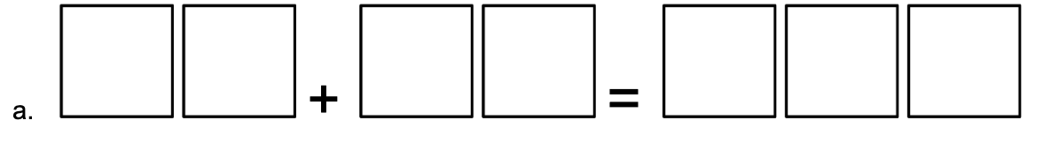
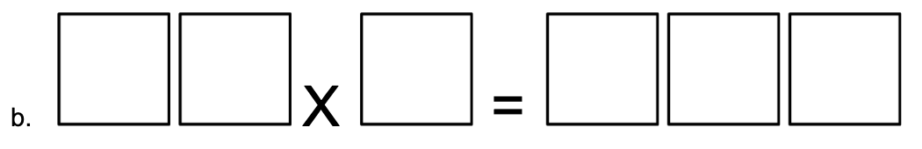
GRADE 4 MIXED REVIEW
OPEN QUESTIONS
ELEMENTARY MATH PROJECT
16. Insert digits in each box to make the equations true.

