Slide 1

ELEMENTARY MATH PROJECT
KINDERGARTEN PRACTICE QUESTIONS
DATA

Slide 2
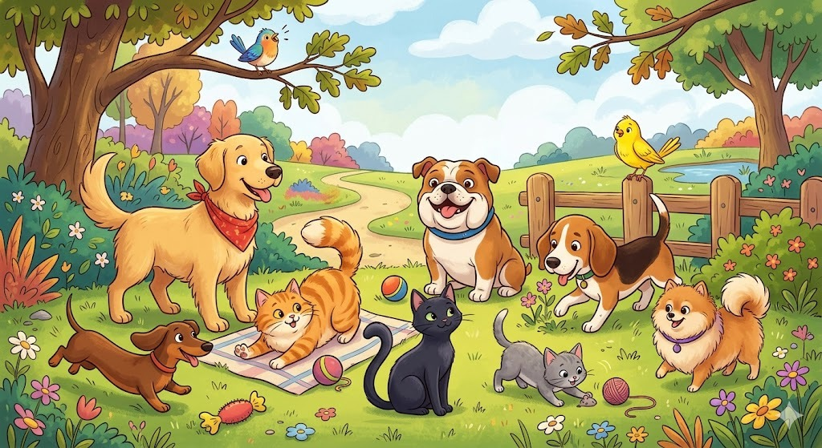
KINDERGARTEN DATA
CLOSED QUESTIONS
ELEMENTARY MATH PROJECT
1. Count the animals using a tally chart. Record your counting.
Animal | Tally
cats
dogs
birds

Slide 3
KINDERGARTEN DATA
CLOSED QUESTIONS
ELEMENTARY MATH PROJECT
2. Use animal shapes (or other counters, such as cutouts) to make a pictograph showing how many of each animal there in question 1.

Slide 4
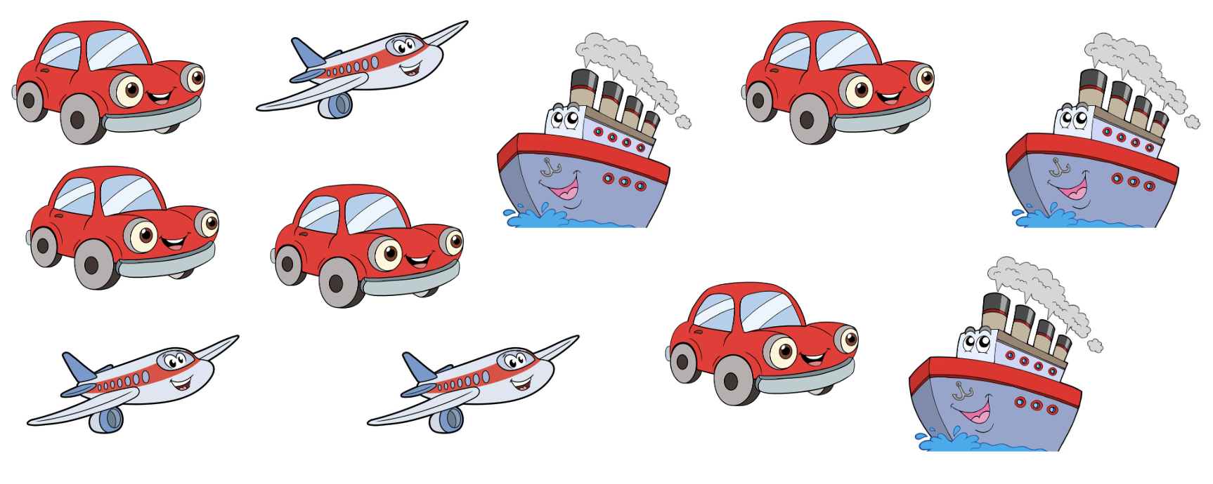
KINDERGARTEN DATA
CLOSED QUESTIONS
ELEMENTARY MATH PROJECT
3. Make a graph to represent how many cars and boats there are.
Cars | Boats

Slide 5
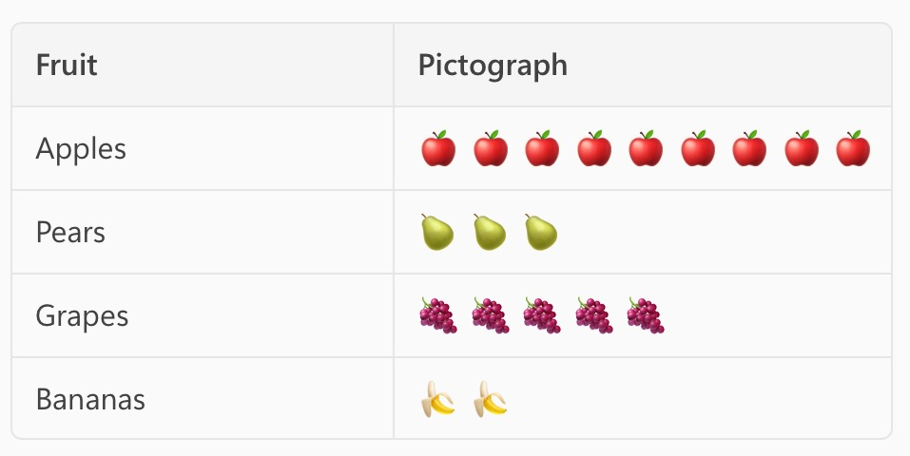
KINDERGARTEN DATA
CLOSED QUESTIONS
ELEMENTARY MATH PROJECT
4. Look at the following pictograph. Use it to answer
these questions:
How many types of fruit did the student record data for?
What fruit was the favourite?
How many more people liked grapes than pears?

Slide 6
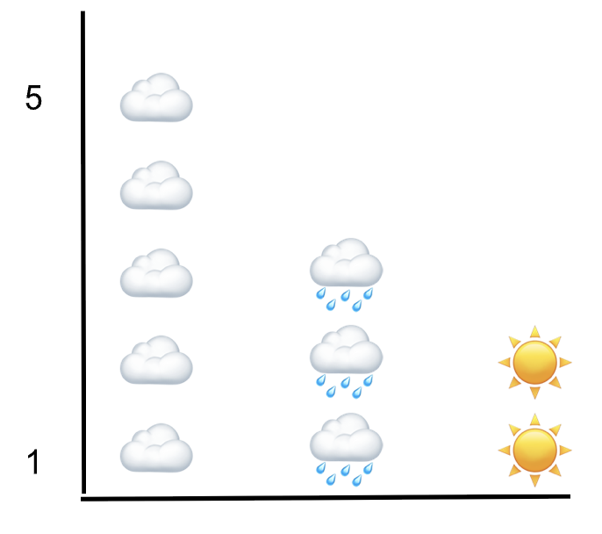
KINDERGARTEN DATA
OPEN QUESTIONS
ELEMENTARY MATH PROJECT
5. Describe what you think this graph could be measuring.

Slide 7
KINDERGARTEN DATA
OPEN QUESTIONS
ELEMENTARY MATH PROJECT
6. Choose three treats (Cookies, ice cream, popsicle, doughnut, popcorn, chips,...)
Draw a picture of each one at the top of the chart.
Ask you classmates which one they would rather have and record the results in your chart using tally’s

Slide 8
ELEMENTARY MATH PROJECT
KINDERGARTEN PRACTICE QUESTIONS
PROBABILITY

Slide 9
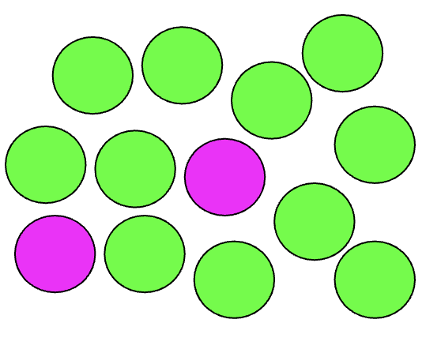
KINDERGARTEN PROBABILITY
CLOSED QUESTIONS
ELEMENTARY MATH PROJECT
1. Close your eyes and point at a ball.
Do you think it is likely going to be green or purple?

Slide 10
KINDERGARTEN PROBABILITY
CLOSED QUESTIONS
ELEMENTARY MATH PROJECT
2. Use the scale on the line to put down how certain or uncertain you are of these things happening Friday:
It is someone's birthday today.
Today is not Saturday.
I will use a pencil.

Slide 11
KINDERGARTEN PROBABILITY
CLOSED QUESTIONS
ELEMENTARY MATH PROJECT
3. Use the words likely or unlikely to describe each event:
Today we will read a book
Today you will see a tiger
Today you will see a car
Today it will snow
Today we will sing a song

Slide 12
KINDERGARTEN PROBABILITY
OPEN QUESTIONS
ELEMENTARY MATH PROJECT
4. Get two equal piles of similar objects - one pile of white rocks and one pile of black rocks, or 1 pile or yellow cubes and one pile of blue cubes.
Take some objects from each pile so that most of them are __________ (black or white)
If you wanted a white rock, which pile should you pick from?

Slide 13
KINDERGARTEN PROBABILITY
OPEN QUESTIONS
ELEMENTARY MATH PROJECT
5. Go outside. Look around.
Tell me something you see that you see that you thought you would see (likely).
Tell me something you see that you see that you thought you would not see (unlikely).

Slide 14
KINDERGARTEN PROBABILITY
OPEN QUESTIONS
ELEMENTARY MATH PROJECT
6. In this bag there is a piece of fruit.
How certain are you that it is a banana?
Tell me why you think that?

