Slide 1
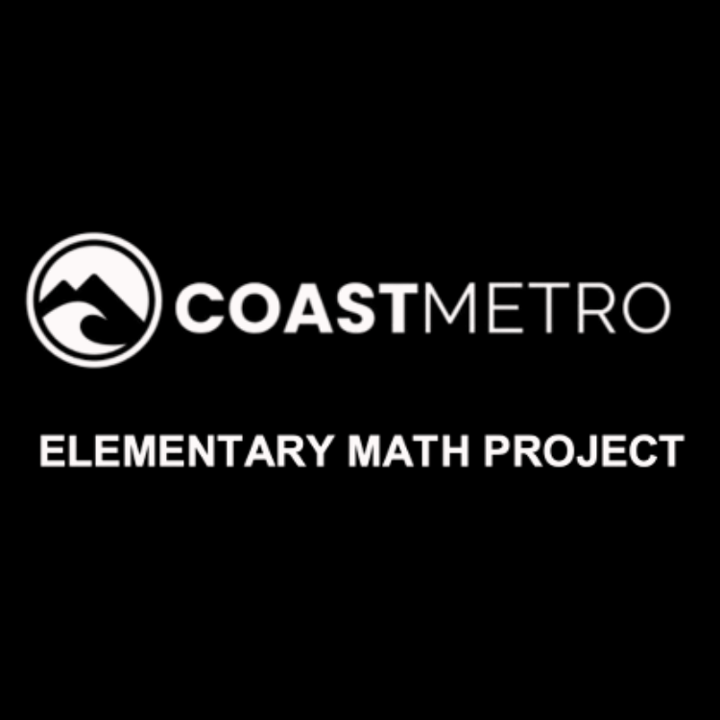
ELEMENTARY MATH PROJECT
KINDERGARTEN PRACTICE QUESTIONS
FINANCIAL LITERACY

Slide 2
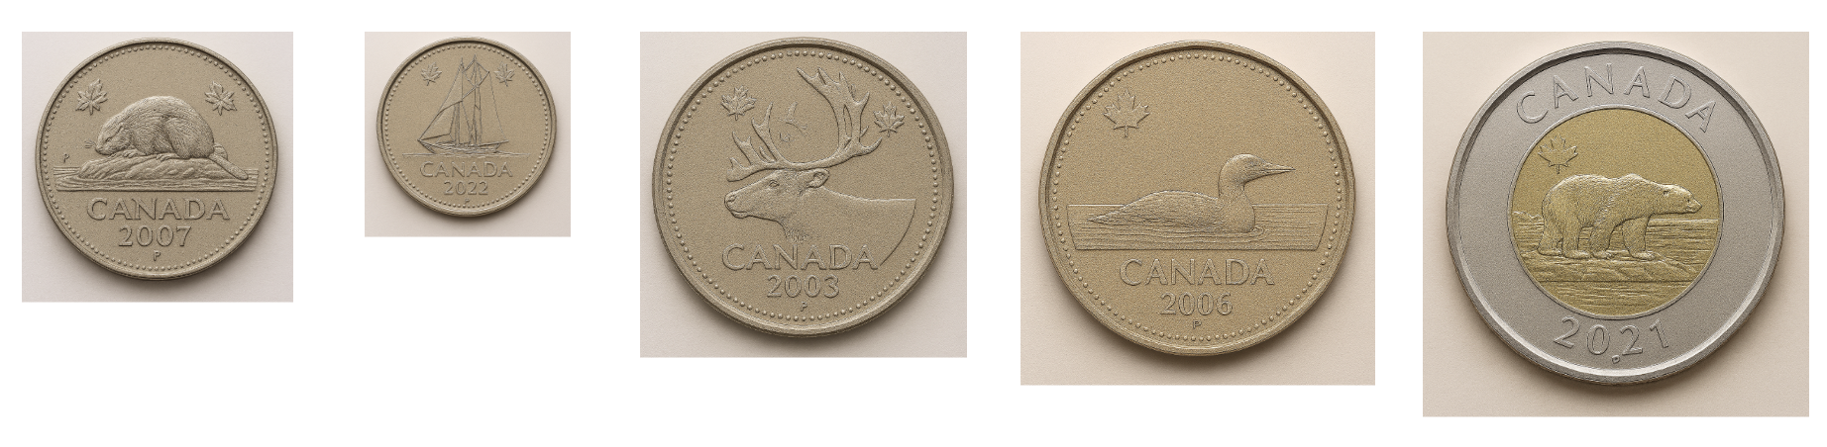
KINDERGARTEN FINANCIAL LITERACY
CLOSED QUESTIONS
ELEMENTARY MATH PROJECT
1. Cut the values and images out and have the students match them (students should also use the correct names, but do not have to be able to spell or read them). You can also use real coins, or manufactured plastic coins as well (play money)

Slide 3
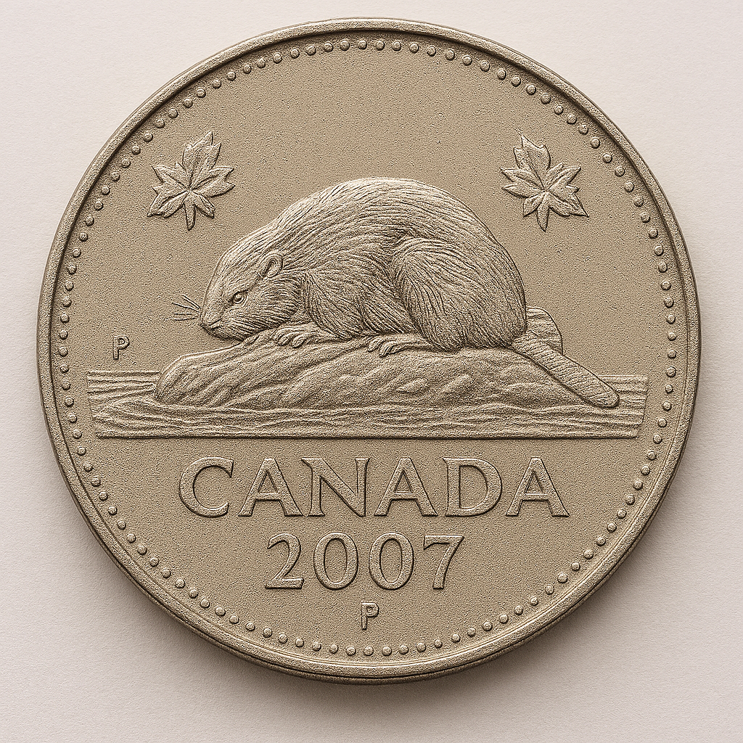
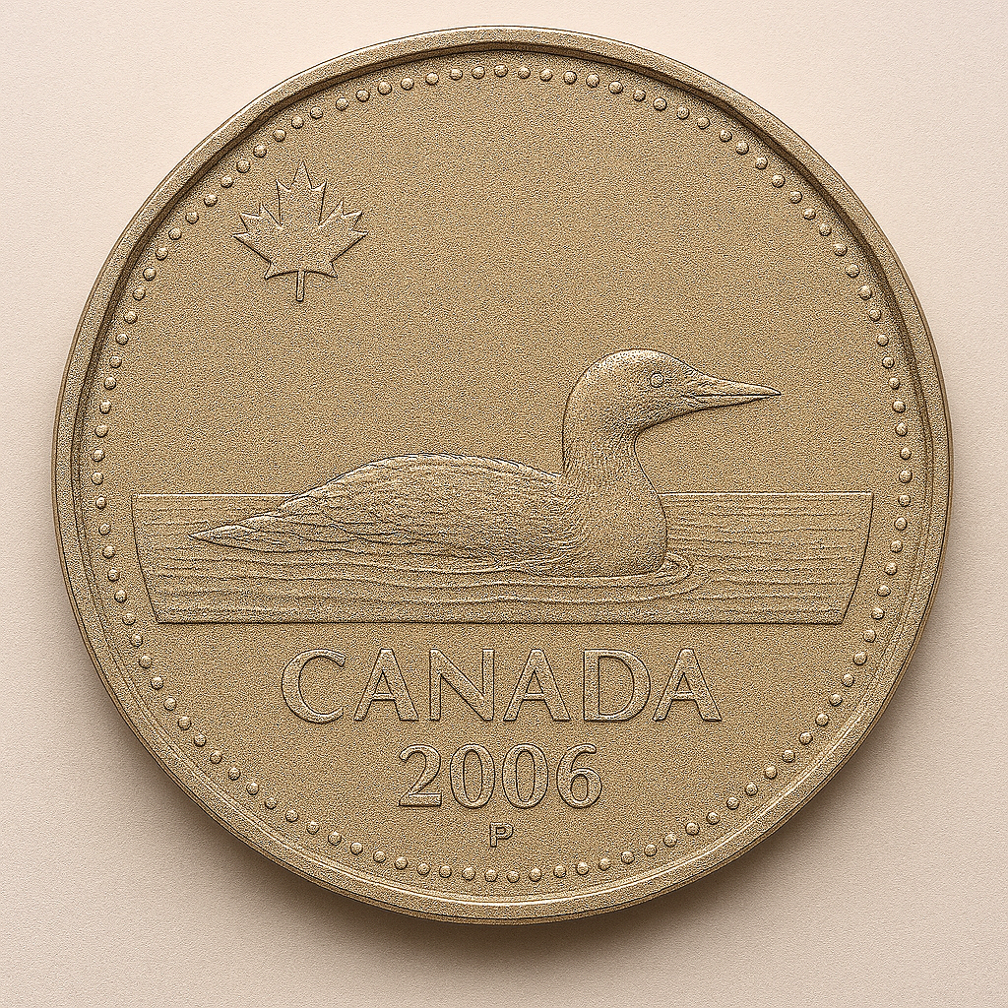
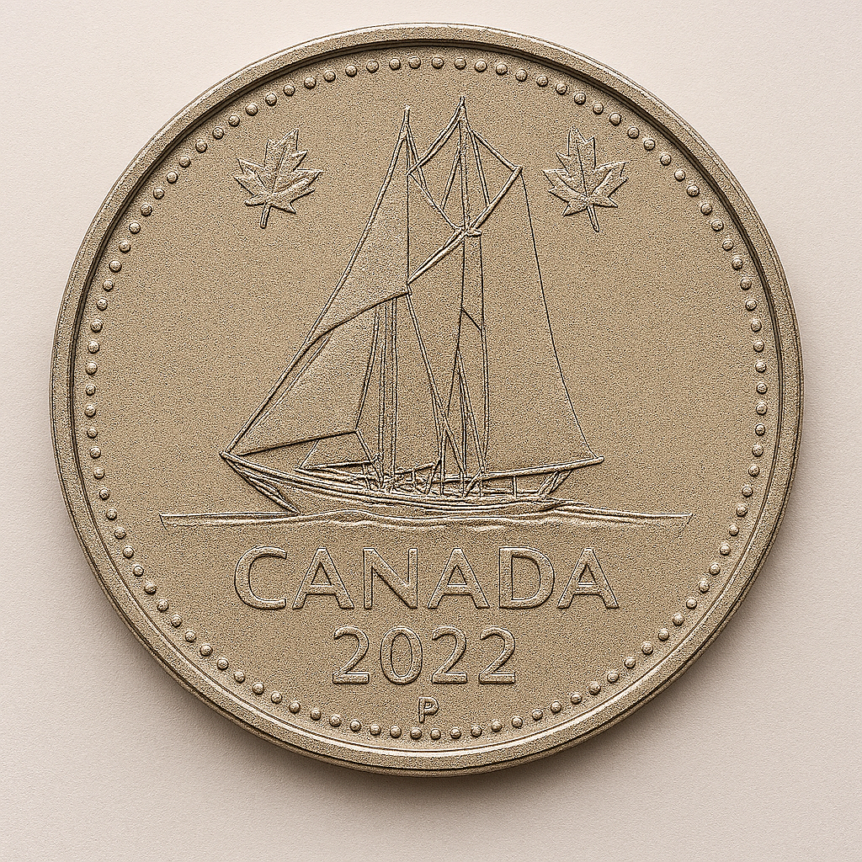
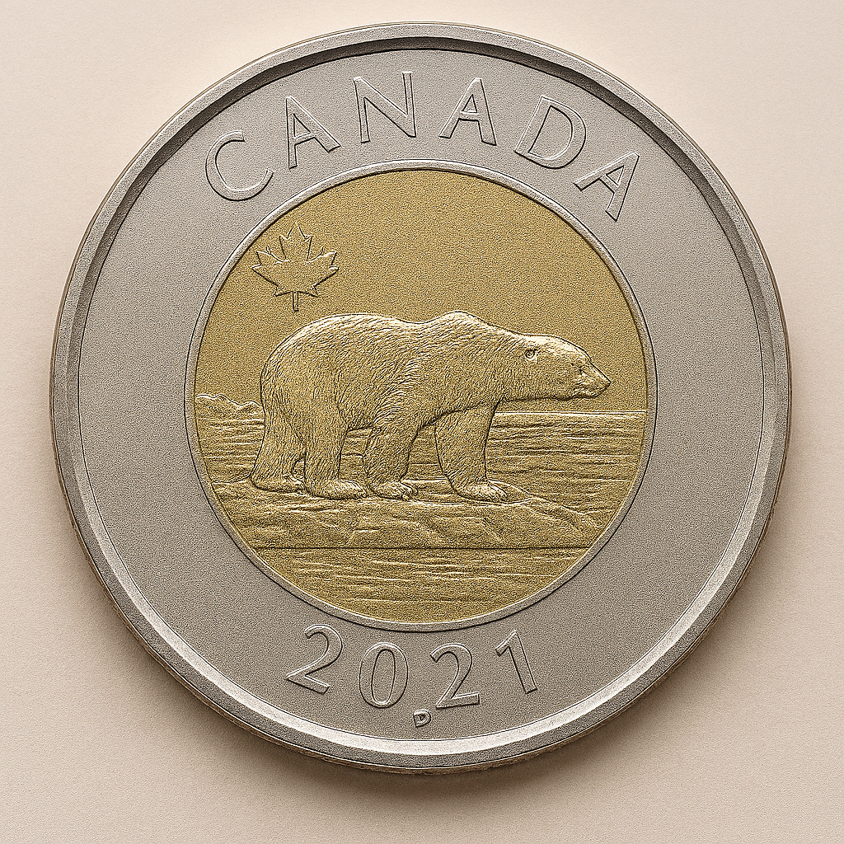
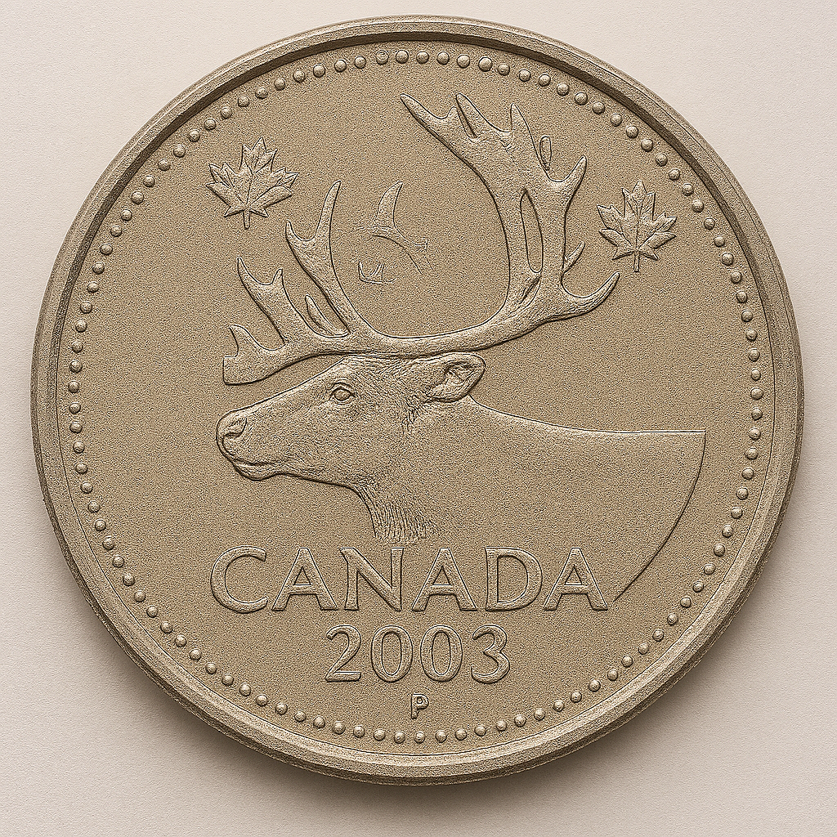
KINDERGARTEN FINANCIAL LITERACY
CLOSED QUESTIONS
ELEMENTARY MATH PROJECT
2. Tell me one thing about each of the Canadian coins.

Slide 4
KINDERGARTEN FINANCIAL LITERACY
CLOSED QUESTIONS
ELEMENTARY MATH PROJECT
3. You go to the bakery and buy a muffin for $3.00 and a juice for $2.00.
How much does this cost all together?

Slide 5
KINDERGARTEN FINANCIAL LITERACY
CLOSED QUESTIONS
ELEMENTARY MATH PROJECT
4. Would it be more correct to say that you want candy or that you need candy?
Would it be more correct to say that you want shoes or that you need shoes?

Slide 6
KINDERGARTEN FINANCIAL LITERACY
OPEN QUESTIONS
ELEMENTARY MATH PROJECT
5. Show how you can make 10 cents in two different ways.

Slide 7
KINDERGARTEN FINANCIAL LITERACY
OPEN QUESTIONS
ELEMENTARY MATH PROJECT
6. You have $5.00.
You can buy a toy, or you can buy lunch to eat at school.
Tell me which one you would pick.

Slide 8
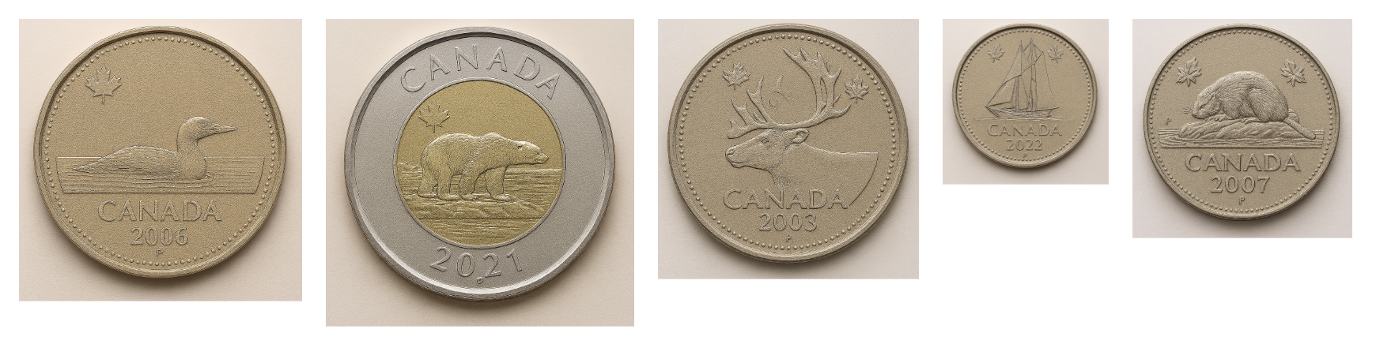
KINDERGARTEN FINANCIAL LITERACY
OPEN QUESTIONS
ELEMENTARY MATH PROJECT
7. Tell me which coin is your favourite?
Why is it your favourite?

