Slide 1
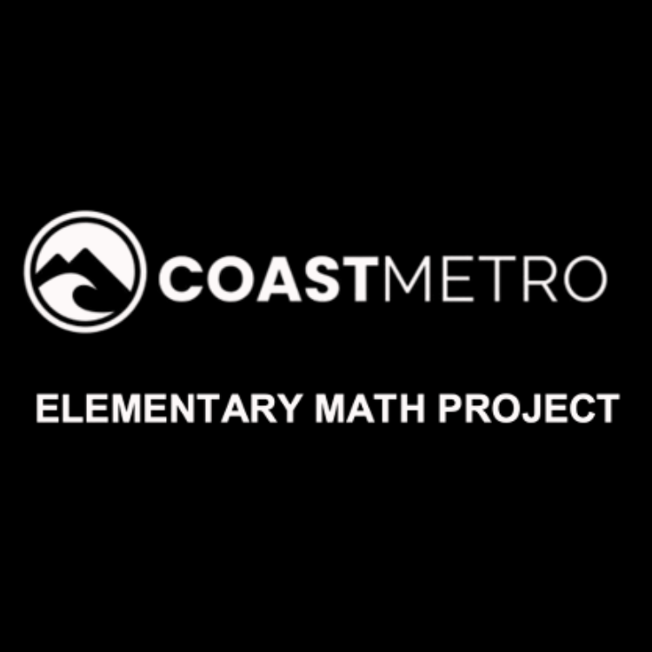
ELEMENTARY MATH PROJECT
KINDERGARTEN PRACTICE QUESTIONS
MEASUREMENT

Slide 2
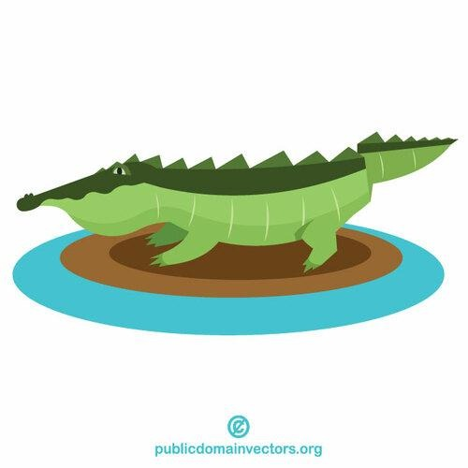
KINDERGARTEN MEASUREMENT
CLOSED QUESTIONS
ELEMENTARY MATH PROJECT
1. Use linking cubes or Unifix cubes to measure how long (from head to tail) this alligator is (number of blocks).

Slide 3
KINDERGARTEN MEASUREMENT
CLOSED QUESTIONS
ELEMENTARY MATH PROJECT
2. Without measuring, how many cubes long do you think the length of this pencil is?
Smallest possible length (fewest cubes) | My estimate for length | Biggest possible length (most cubes)

Slide 4

KINDERGARTEN MEASUREMENT
CLOSED QUESTIONS
ELEMENTARY MATH PROJECT
3. Which pencil is longer?

Slide 5
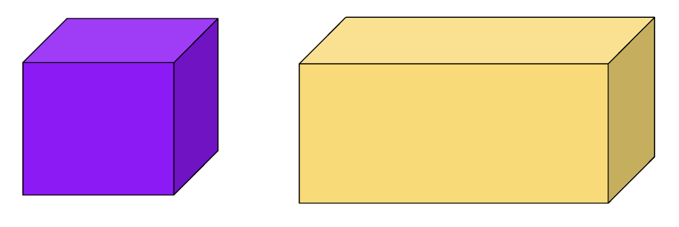
KINDERGARTEN MEASUREMENT
CLOSED QUESTIONS
ELEMENTARY MATH PROJECT
4. Which box would hold less water?

Slide 6
KINDERGARTEN MEASUREMENT
OPEN QUESTIONS
ELEMENTARY MATH PROJECT
5. Get a partner, and cut a piece of string (the string lengths should be different for each partner).
Each partner use the string to measure how tall a (book shelf, chair, desk, table,...) is.
Why did you get different numbers?

Slide 7
KINDERGARTEN MEASUREMENT
OPEN QUESTIONS
ELEMENTARY MATH PROJECT
6. Using a part of your body (length of a finger, fingertip to elbow, width of a hand) estimate the width of your desk.

Slide 8
KINDERGARTEN MEASUREMENT
OPEN QUESTIONS
ELEMENTARY MATH PROJECT
7. Find a person in class whose foot is longer than yours.

Slide 9
KINDERGARTEN MEASUREMENT
OPEN QUESTIONS
ELEMENTARY MATH PROJECT
8. Use a piece of string or rope to help you figure out about how far it is around a tree.

Slide 10
ELEMENTARY MATH PROJECT
KINDERGARTEN PRACTICE QUESTIONS
GEOMETRY

Slide 11
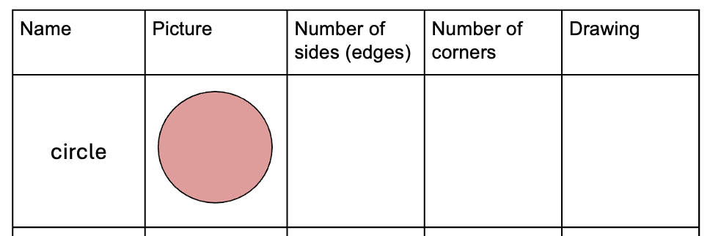
KINDERGARTEN GEOMETRY
CLOSED QUESTIONS
ELEMENTARY MATH PROJECT
1. Complete the chart for each shape (add more shapes for students ready for them - pentagon, hexagon, rhombus, oval/ellipse, kite, trapezoid,...)

Slide 12
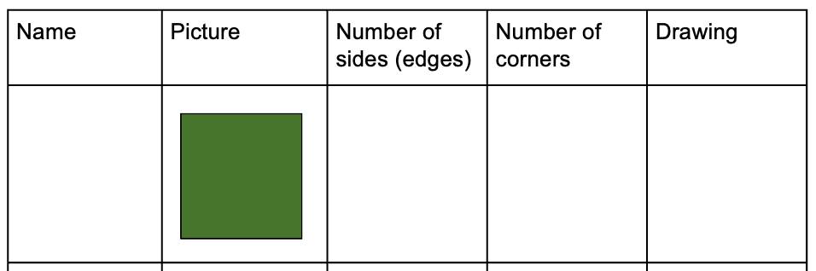
KINDERGARTEN GEOMETRY
CLOSED QUESTIONS
ELEMENTARY MATH PROJECT
1. Complete the chart for each shape (add more shapes for students ready for them - pentagon, hexagon, rhombus, oval/ellipse, kite, trapezoid,...)

Slide 13
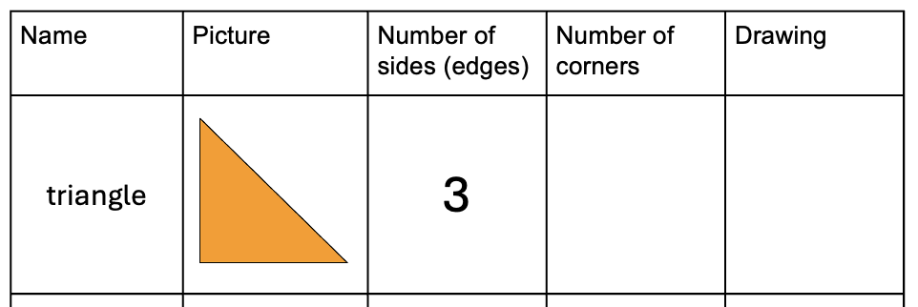
KINDERGARTEN GEOMETRY
CLOSED QUESTIONS
ELEMENTARY MATH PROJECT
1. Complete the chart for each shape (add more shapes for students ready for them - pentagon, hexagon, rhombus, oval/ellipse, kite, trapezoid,...)

Slide 14
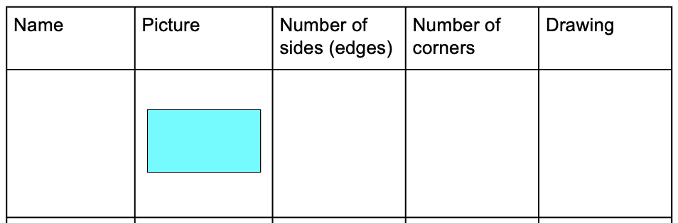
KINDERGARTEN GEOMETRY
CLOSED QUESTIONS
ELEMENTARY MATH PROJECT
1. Complete the chart for each shape (add more shapes for students ready for them - pentagon, hexagon, rhombus, oval/ellipse, kite, trapezoid,...)

Slide 15
KINDERGARTEN GEOMETRY
CLOSED QUESTIONS
ELEMENTARY MATH PROJECT
2. Choose a shape from the chart in question 1. Where do you see it in the classroom?

Slide 16

KINDERGARTEN GEOMETRY
CLOSED QUESTIONS
ELEMENTARY MATH PROJECT
3. Look at the following image.
Which shapes are similar? Which shapes are different?

Slide 17
KINDERGARTEN GEOMETRY
CLOSED QUESTIONS
ELEMENTARY MATH PROJECT
4. Tell me one thing about each of these objects (use a class set of geometric solids, they do not need to know the name for all of the solids):
Pyramid
Cube
Rectangular Prism
Sphere
Cylinder
Triangular prism

Slide 18

KINDERGARTEN GEOMETRY
OPEN QUESTIONS
ELEMENTARY MATH PROJECT
5. Cut this rectangle into two pieces. (Provide rectangles and scissors)
What can you tell me about the pieces you cut?

Slide 19

KINDERGARTEN GEOMETRY
OPEN QUESTIONS
ELEMENTARY MATH PROJECT
6. Choose 2 or more shapes from your tangram set.
Put them together to form a new shape.
Draw (or trace) the shape.
How many sides does it have?

Slide 20
KINDERGARTEN GEOMETRY
OPEN QUESTIONS
ELEMENTARY MATH PROJECT
7. How many different types of shapes with 4 sides can you draw?

