Slide 1
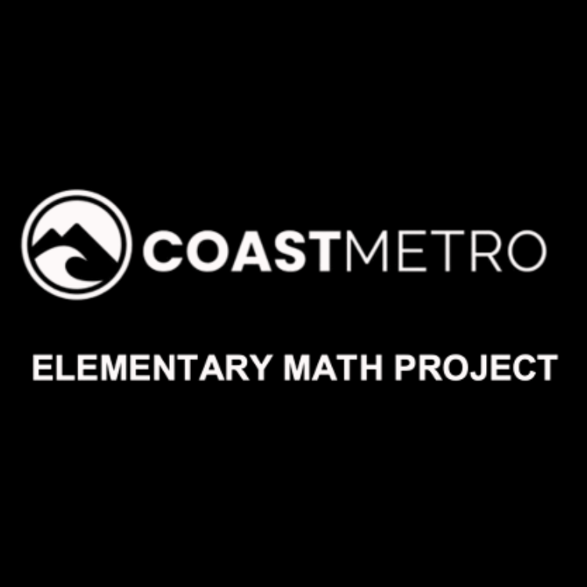
ELEMENTARY MATH PROJECT
KINDERGARTEN PRACTICE QUESTIONS
MIXED REVIEW

Slide 2
KINDERGARTEN MIXED REVIEW
ELEMENTARY MATH PROJECT
1. Show three ways to represent 5.

Slide 3
KINDERGARTEN MIXED REVIEW
ELEMENTARY MATH PROJECT
2. Draw an AB pattern.

Slide 4
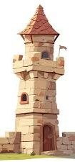
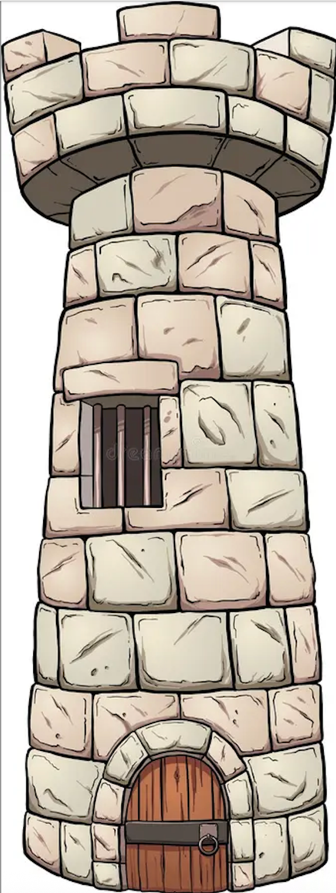
KINDERGARTEN MIXED REVIEW
ELEMENTARY MATH PROJECT
3. Circle the tower that is taller

Slide 5
KINDERGARTEN MIXED REVIEW
ELEMENTARY MATH PROJECT
4. Fill in the missing counting numbers.
1 2 3 _____ 5 6 _____ 8 _____ 10
Show ten using tally marks.

Slide 6
KINDERGARTEN MIXED REVIEW
ELEMENTARY MATH PROJECT
5. Show three ways to represent 7.

Slide 7
KINDERGARTEN MIXED REVIEW
ELEMENTARY MATH PROJECT
6. Draw an ABC pattern.

Slide 8

KINDERGARTEN MIXED REVIEW
ELEMENTARY MATH PROJECT
7. Draw more dots to make 10 in all.

Slide 9
KINDERGARTEN MIXED REVIEW
ELEMENTARY MATH PROJECT
8. Draw shapes with four straight sides.

Slide 10
KINDERGARTEN MIXED REVIEW
ELEMENTARY MATH PROJECT
9. Show three ways to represent 10.

Slide 11
KINDERGARTEN MIXED REVIEW
ELEMENTARY MATH PROJECT
10. Draw an ABB pattern.

Slide 12
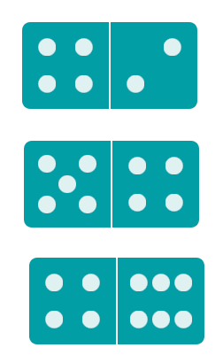

KINDERGARTEN MIXED REVIEW
ELEMENTARY MATH PROJECT
11. Count up the dots for each domino. Print how many for each domino.

Slide 13
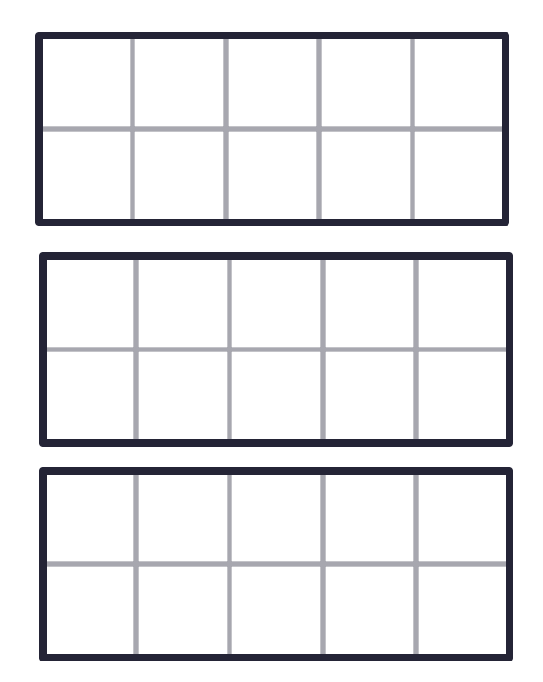
KINDERGARTEN MIXED REVIEW
ELEMENTARY MATH PROJECT
12. Make 8 in the ten frames in three different ways.

