Slide 1

ELEMENTARY MATH PROJECT
KINDERGARTEN PRACTICE QUESTIONS
NUMBER SENSE

Slide 2
KINDERGARTEN NUMBER SENSE
CLOSED QUESTIONS
ELEMENTARY MATH PROJECT
1. What comes next?
1, 2, 3, ___________, ____________, ______________

Slide 3
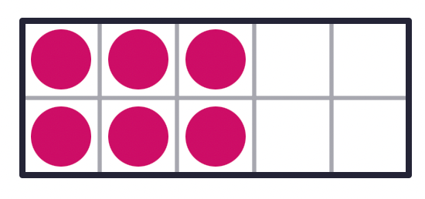
KINDERGARTEN NUMBER SENSE
CLOSED QUESTIONS
ELEMENTARY MATH PROJECT
2. How many dots are there?

Slide 4
KINDERGARTEN NUMBER SENSE
CLOSED QUESTIONS
ELEMENTARY MATH PROJECT
3. What numbers are missing?
1, 2, 3, _________, 5, 6, _________ 8

Slide 5

KINDERGARTEN NUMBER SENSE
CLOSED QUESTIONS
ELEMENTARY MATH PROJECT
4. How many dots are there?

Slide 6

KINDERGARTEN NUMBER SENSE
CLOSED QUESTIONS
ELEMENTARY MATH PROJECT
5. How many dots do you see? (Try not to count at first).
How do you see them?

Slide 7

KINDERGARTEN NUMBER SENSE
CLOSED QUESTIONS
ELEMENTARY MATH PROJECT
6. How many dots do you see? (Try not to count at first).
How do you see them?

Slide 8
KINDERGARTEN NUMBER SENSE
CLOSED QUESTIONS
ELEMENTARY MATH PROJECT
7. What number is closer to 5?
6 or 2
How do you know?

Slide 9
KINDERGARTEN NUMBER SENSE
CLOSED QUESTIONS
ELEMENTARY MATH PROJECT
8. In the number pairs, circle which number is the greatest.
a. 4 2
b. 3 7
c. 4 6

Slide 10
KINDERGARTEN NUMBER SENSE
CLOSED QUESTIONS
ELEMENTARY MATH PROJECT
9. Order these numbers from least to greatest:
8, 3, 7, 5, 2

Slide 11
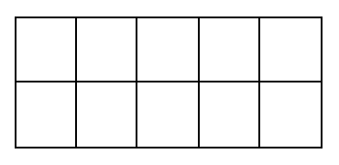
KINDERGARTEN NUMBER SENSE
CLOSED QUESTIONS
ELEMENTARY MATH PROJECT
10. Show one way to make 5 on a ten frame.

Slide 12
KINDERGARTEN NUMBER SENSE
CLOSED QUESTIONS
ELEMENTARY MATH PROJECT
11. Make the number 8 using tally marks

Slide 13
KINDERGARTEN NUMBER SENSE
CLOSED QUESTIONS
ELEMENTARY MATH PROJECT
12. Draw a picture that shows 5 of something.
Print the word for 10.

Slide 14
KINDERGARTEN NUMBER SENSE
CLOSED QUESTIONS
ELEMENTARY MATH PROJECT
13. Represent the number 7.
Dots | Tallies | Ten frames

Slide 15
KINDERGARTEN NUMBER SENSE
CLOSED QUESTIONS
ELEMENTARY MATH PROJECT
14. Draw to show two ways to decompose 5 into two parts.

Slide 16
KINDERGARTEN NUMBER SENSE
CLOSED QUESTIONS
ELEMENTARY MATH PROJECT
15. Use ten frames to show two ways to decompose 6 into parts.
________ and ________ ________ and ________

Slide 17
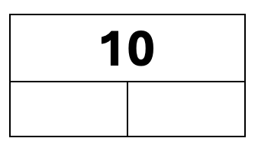
KINDERGARTEN NUMBER SENSE
CLOSED QUESTIONS
ELEMENTARY MATH PROJECT
16. Show two ways to decompose 10 into two parts

Slide 18
KINDERGARTEN NUMBER SENSE
OPEN QUESTIONS
ELEMENTARY MATH PROJECT
17. Grab about 5-10 small blocks, cubes, or counters.
What different ways could you count them?
Record your counts using pictures and numbers.

Slide 19
KINDERGARTEN NUMBER SENSE
OPEN QUESTIONS
ELEMENTARY MATH PROJECT
18. Count out 10 cubes or counters by ones.
What different ways can you organize the cubes or counters to count them?

Slide 20
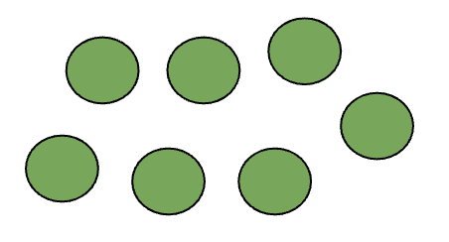
KINDERGARTEN NUMBER SENSE
OPEN QUESTIONS
ELEMENTARY MATH PROJECT
19. How many dots?
What different ways can you count them?

Slide 21
KINDERGARTEN NUMBER SENSE
OPEN QUESTIONS
ELEMENTARY MATH PROJECT
20. Find a small collection of items in your classroom like a basket of books or a jar of pencils.
About how many do you think there are?
Count to find out how many.
Is there a different way you could count them?

Slide 22
KINDERGARTEN NUMBER SENSE
OPEN QUESTIONS
ELEMENTARY MATH PROJECT
21. Grab a handful of crayons.
Estimate about how many there are.
Compare your handful with a classmate.
Who do you think has more?
Count and compare the numbers you each have.

Slide 23
KINDERGARTEN NUMBER SENSE
OPEN QUESTIONS
ELEMENTARY MATH PROJECT
22. Is 8 closer to 10 or 5? How do you know?
Share your thinking with a partner.

Slide 24
KINDERGARTEN NUMBER SENSE
OPEN QUESTIONS
ELEMENTARY MATH PROJECT
23. Look around your classroom.
What is there about 5 of?
What is there about 10 of?

Slide 25
KINDERGARTEN NUMBER SENSE
OPEN QUESTIONS
ELEMENTARY MATH PROJECT
24. Where in your classroom do you see numbers in order?
What about at home?

Slide 26
KINDERGARTEN NUMBER SENSE
OPEN QUESTIONS
ELEMENTARY MATH PROJECT
25. What different ways can you represent 4?
Think about using words, pictures, numbers, tallies, ten frames, etc.

Slide 27
KINDERGARTEN NUMBER SENSE
OPEN QUESTIONS
ELEMENTARY MATH PROJECT
26. What different ways can you decompose 5 into parts?
Use materials, pictures, numbers, ten frames, etc.

Slide 28
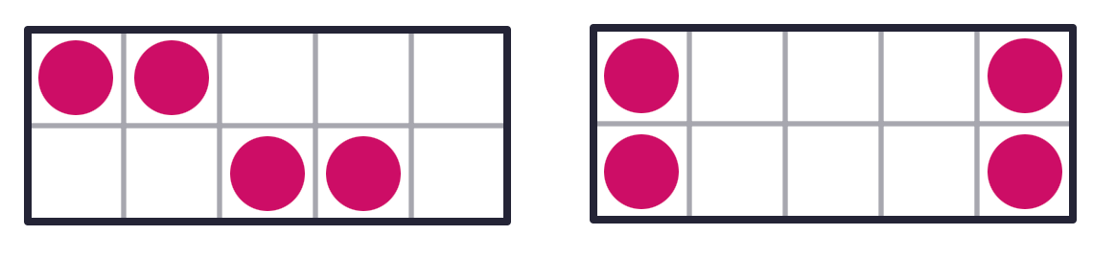
KINDERGARTEN NUMBER SENSE
OPEN QUESTIONS
ELEMENTARY MATH PROJECT
27. How are these representations of 4 the same?
How are they different?

Slide 29
KINDERGARTEN NUMBER SENSE
OPEN QUESTIONS
ELEMENTARY MATH PROJECT
28. What different ways can you represent 7?
Think about using words, pictures, numbers, tallies, ten frames, etc.

Slide 30
KINDERGARTEN NUMBER SENSE
OPEN QUESTIONS
ELEMENTARY MATH PROJECT
29. Get a collection of 5-10 items.
What different ways can you decompose the whole amount into parts?
How could you record all the different ways you find using pictures, numbers, and words.

Slide 31
ELEMENTARY MATH PROJECT
KINDERGARTEN PRACTICE QUESTIONS
COMPUTATIONAL FLUENCY

Slide 32

KINDERGARTEN COMPUTATIONAL FLUENCY
CLOSED QUESTIONS
ELEMENTARY MATH PROJECT
1. If there are 3 blue cubes, how many more to make 5?
Draw them.

Slide 33

KINDERGARTEN COMPUTATIONAL FLUENCY
CLOSED QUESTIONS
ELEMENTARY MATH PROJECT
2. Draw another way to make 5 with dots using two different colours.
One way to make 5 | Draw another way to make 5

Slide 34
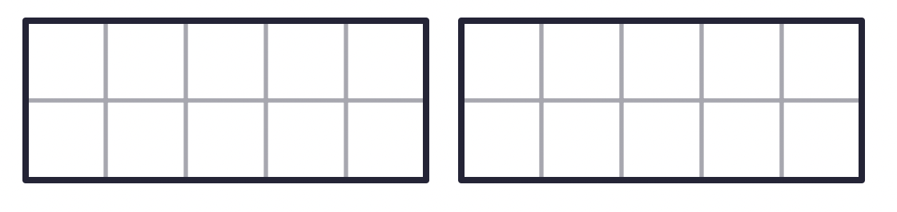
KINDERGARTEN COMPUTATIONAL FLUENCY
CLOSED QUESTIONS
ELEMENTARY MATH PROJECT
3. In each ten frame, show a different way to make 5.

Slide 35

KINDERGARTEN COMPUTATIONAL FLUENCY
CLOSED QUESTIONS
ELEMENTARY MATH PROJECT
4. What is 4 and 2 more? Draw 2 more and fill in the number sentence.
__________ and __________ is _____________

Slide 36
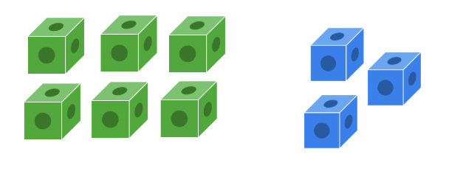
KINDERGARTEN COMPUTATIONAL FLUENCY
CLOSED QUESTIONS
ELEMENTARY MATH PROJECT
5. There are 6 green cubes and 3 blue cubes. When you combine them together, how many cubes are there?
__________ and __________ is ______________

Slide 37
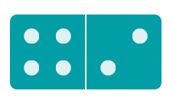

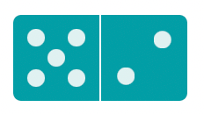
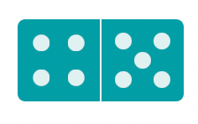
KINDERGARTEN COMPUTATIONAL FLUENCY
CLOSED QUESTIONS
ELEMENTARY MATH PROJECT
6. How many dots are on each domino? Start with the larger number of dots first and count on the smaller number of dots.
__________ | __________ | __________ | __________

Slide 38
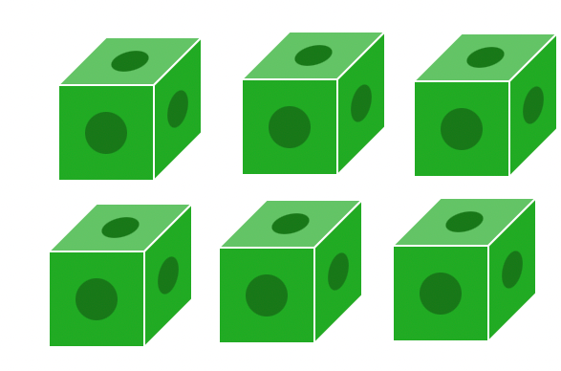
KINDERGARTEN COMPUTATIONAL FLUENCY
CLOSED QUESTIONS
ELEMENTARY MATH PROJECT
7. There are 6 green cubes.
If you remove/cross out 2 of them, how many green cubes will be left?
Print the number that will be left.
___________________

Slide 39
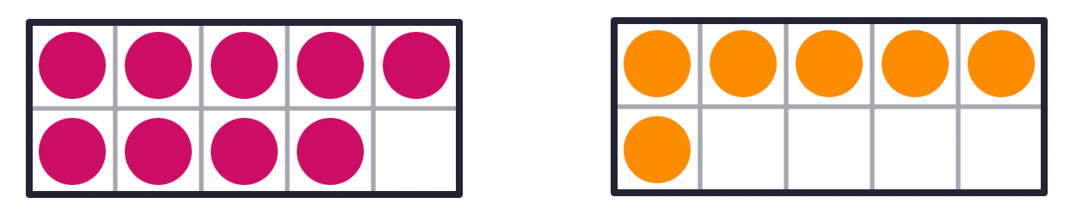
KINDERGARTEN COMPUTATIONAL FLUENCY
CLOSED QUESTIONS
ELEMENTARY MATH PROJECT
8. Fill in each ten frame to make 10.
______ and _____ is 10 ______ and _____ is 10

Slide 40
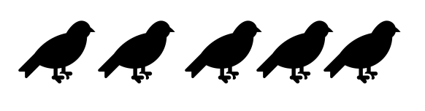
KINDERGARTEN COMPUTATIONAL FLUENCY
CLOSED QUESTIONS
ELEMENTARY MATH PROJECT
9. There are 5 birds and 2 fly away. How many birds are left?
Show how you solved the problem.

Slide 41
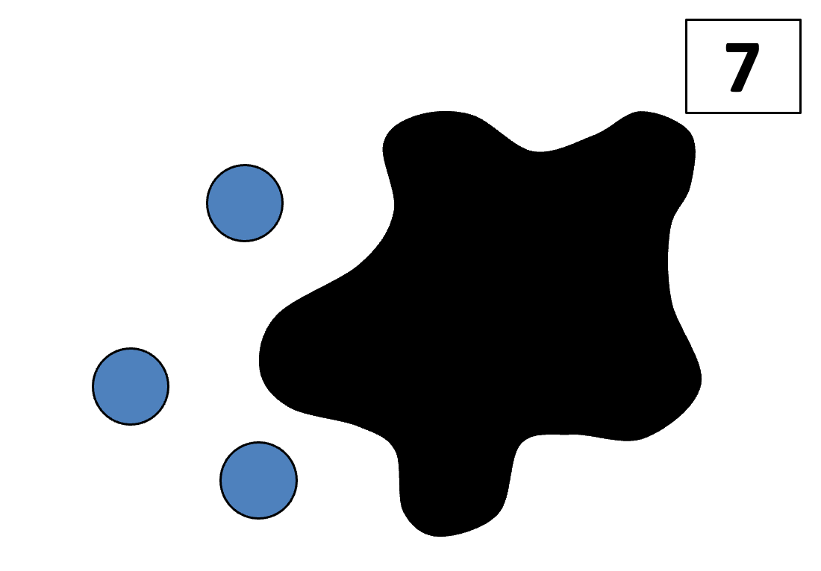
KINDERGARTEN COMPUTATIONAL FLUENCY
CLOSED QUESTIONS
ELEMENTARY MATH PROJECT
10. There are 7 blue dots. Some are under the Splat and some we can see. How many dots are under the Splat? How do you know?

Slide 42
KINDERGARTEN COMPUTATIONAL FLUENCY
CLOSED QUESTIONS
ELEMENTARY MATH PROJECT
11. Get 5 cubes or counters. What different ways can you make 5 using two or three parts? Draw three ways.

Slide 43
KINDERGARTEN COMPUTATIONAL FLUENCY
CLOSED QUESTIONS
ELEMENTARY MATH PROJECT
12. Get 5 cubes or counters. What different ways can you make 5 using three or four parts? Draw three ways.

Slide 44
KINDERGARTEN COMPUTATIONAL FLUENCY
CLOSED QUESTIONS
ELEMENTARY MATH PROJECT
13. How many different ways can you make or represent 5?

Slide 45
KINDERGARTEN COMPUTATIONAL FLUENCY
CLOSED QUESTIONS
ELEMENTARY MATH PROJECT
14. Draw pictures to show different ways to compose/make 6.

Slide 46
KINDERGARTEN COMPUTATIONAL FLUENCY
CLOSED QUESTIONS
ELEMENTARY MATH PROJECT
15. Get 7 cubes or counters.
Move the counters around to decompose 8 into smaller parts (two, three or four or more parts).
Draw different ways that you find.

Slide 47
KINDERGARTEN COMPUTATIONAL FLUENCY
CLOSED QUESTIONS
ELEMENTARY MATH PROJECT
16. There are two friends and they are sharing 8 cookies.
What different ways could they share them.
Use pictures, numbers and words to show your thinking.

Slide 48
KINDERGARTEN COMPUTATIONAL FLUENCY
CLOSED QUESTIONS
ELEMENTARY MATH PROJECT
17. Show at least three different ways to make 10 using two, three or four or more parts.
Use pictures and numbers.

Slide 49
KINDERGARTEN COMPUTATIONAL FLUENCY
CLOSED QUESTIONS
ELEMENTARY MATH PROJECT
18. I have a mixture of ten pieces of carrots and peas for my snack.
How many of each could I have?
What different ways can you think of?

Slide 50
KINDERGARTEN COMPUTATIONAL FLUENCY
CLOSED QUESTIONS
ELEMENTARY MATH PROJECT
19. What different ways can you make 7?
Use one ten frame for each way.

Slide 51
KINDERGARTEN COMPUTATIONAL FLUENCY
CLOSED QUESTIONS
ELEMENTARY MATH PROJECT
20. Draw/write a math story that has 10 things and some go missing.
Use your creative thinking.
Use numbers to label your drawings.

