Slide 1

ELEMENTARY MATH PROJECT
KINDERGARTEN PRACTICE QUESTIONS
PATTERNS

Slide 2


KINDERGARTEN PATTERNS
CLOSED QUESTIONS
ELEMENTARY MATH PROJECT
1. Continue the patterns below:
Start of the Pattern | What’s Next
1, 3, 1, 3, 1, 3…

Slide 3
KINDERGARTEN PATTERNS
CLOSED QUESTIONS
ELEMENTARY MATH PROJECT
2. Can you circle the part of the pattern that repeats (or name the pattern rule if they are able to)?
a.

Slide 4
KINDERGARTEN PATTERNS
CLOSED QUESTIONS
ELEMENTARY MATH PROJECT
2. Can you circle the part of the pattern that repeats (or name the pattern rule if they are able to)?
b. 1, 3, 1, 3, 1, 3

Slide 5
KINDERGARTEN PATTERNS
CLOSED QUESTIONS
ELEMENTARY MATH PROJECT
2. Can you circle the part of the pattern that repeats (or name the pattern rule if they are able to)?
c.

Slide 6

KINDERGARTEN PATTERNS
CLOSED QUESTIONS
ELEMENTARY MATH PROJECT
3. Sort these objects (circle which ones belong together).
Sort by colour
Sort by number of sides
Sort by size (small, medium, large)

Slide 7
KINDERGARTEN PATTERNS
OPEN QUESTIONS
ELEMENTARY MATH PROJECT
4. I’m thinking of a pattern that uses 2 shapes.
What could my pattern look like?

Slide 8
KINDERGARTEN PATTERNS
OPEN QUESTIONS
ELEMENTARY MATH PROJECT
5. I’m thinking of a pattern that uses 3 shapes.
Can you show two different patterns?

Slide 9
KINDERGARTEN PATTERNS
OPEN QUESTIONS
ELEMENTARY MATH PROJECT
6. Can you use some shapes (or other objects) to make something that isn’t a pattern?

Slide 10
KINDERGARTEN PATTERNS
OPEN QUESTIONS
ELEMENTARY MATH PROJECT
7. Find 10 rocks outside (or use any random objects from counting collections or story workshop, or other loose parts).
Can you sort them into two piles and tell me what rule you used to sort them?

Slide 11
ELEMENTARY MATH PROJECT
KINDERGARTEN PRACTICE QUESTIONS
ALGEBRA

Slide 12
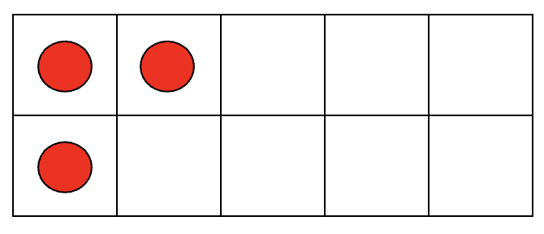
KINDERGARTEN ALGEBRA
CLOSED QUESTIONS
ELEMENTARY MATH PROJECT
1. Look at the image below.
How many circles are there?
What would you need to do to change it to 5?

Slide 13
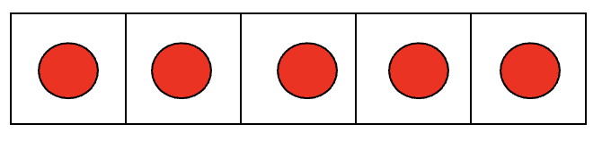
KINDERGARTEN ALGEBRA
CLOSED QUESTIONS
ELEMENTARY MATH PROJECT
2. Look at the image below.
How many circles are there?
What would you need to do to change it to 3?

Slide 14
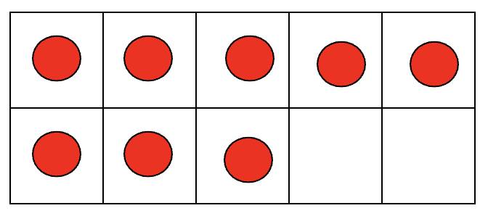
KINDERGARTEN ALGEBRA
CLOSED QUESTIONS
ELEMENTARY MATH PROJECT
3. Look at the image below.
How many circles are there?
What would you need to do to change it to 6?

Slide 15
KINDERGARTEN ALGEBRA
CLOSED QUESTIONS
ELEMENTARY MATH PROJECT
4. Count out 2 blocks (or linking cubes, or other objects).
How many more blocks (or linking cubes or other objects) do you need to get to 4?

Slide 16
KINDERGARTEN ALGEBRA
CLOSED QUESTIONS
ELEMENTARY MATH PROJECT
5. Count out 4 blocks (or linking cubes, or other objects).
How many more blocks (or linking cubes or other objects) do you need to get to 6?

Slide 17
KINDERGARTEN ALGEBRA
CLOSED QUESTIONS
ELEMENTARY MATH PROJECT
6. Count out 9 blocks (or linking cubes, or other objects).
How many more blocks (or linking cubes or other objects) do you need to get to 7?

Slide 18

KINDERGARTEN ALGEBRA
CLOSED QUESTIONS
ELEMENTARY MATH PROJECT
7. This scale is unbalanced - the sides are not equal. What could you add to the orange side to make it balanced:

Slide 19

KINDERGARTEN ALGEBRA
CLOSED QUESTIONS
ELEMENTARY MATH PROJECT
8. This scale is unbalanced - the sides are not equal. What could you take away from a side to make it balanced:

Slide 20
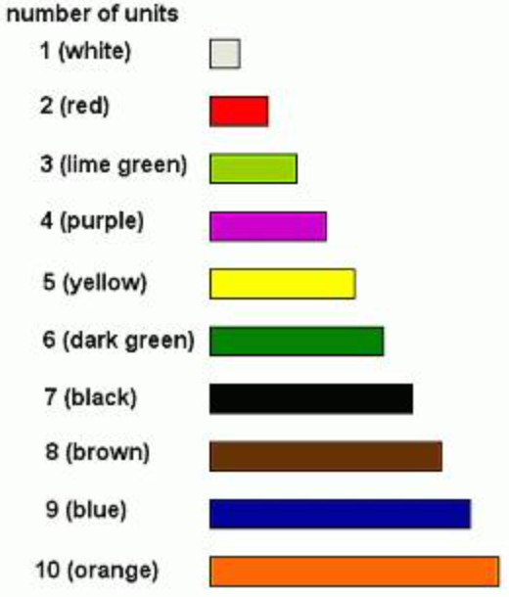
KINDERGARTEN ALGEBRA
OPEN QUESTIONS
ELEMENTARY MATH PROJECT
9. Use the Cuisenaire rods to show how you can make 4 (6, or any number).
Can you do it more than 1 way?

Slide 21
KINDERGARTEN ALGEBRA
OPEN QUESTIONS
ELEMENTARY MATH PROJECT
10. Count out 5 bears (or other counters, or objects). What would you do if you wanted more bears?
How many would you have? (What would if you wanted less bears? How many would you have?)

Slide 22

KINDERGARTEN ALGEBRA
OPEN QUESTIONS
ELEMENTARY MATH PROJECT
11. This scale is balanced - there is an equal number on each side.
a) How could you make the purple side more?
b) How could you make the orange side less?

Slide 23
KINDERGARTEN ALGEBRA
OPEN QUESTIONS
ELEMENTARY MATH PROJECT
11. This scale is balanced - there is an equal number on each side.
a) How could you make the purple side more?
b) How could you make the orange side less?

