Slide 1
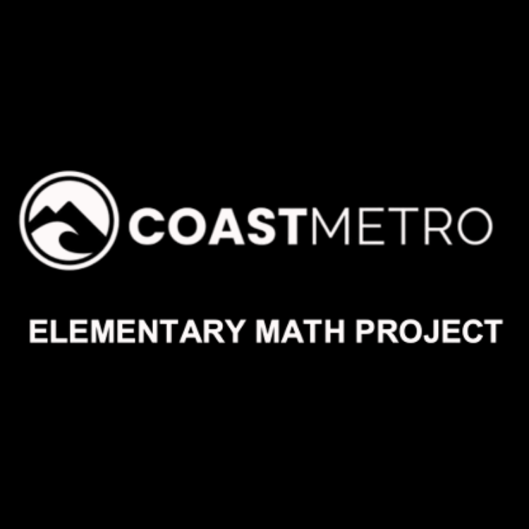
ELEMENTARY MATH PROJECT
KINDERGARTEN PRACTICE QUESTIONS
NUMBER SENSE

Slide 2
KINDERGARTEN NUMBER SENSE
CLOSED QUESTIONS
ELEMENTARY MATH PROJECT
1. What comes next?
1, 2, 3, ___________, ____________, ______________

Slide 3
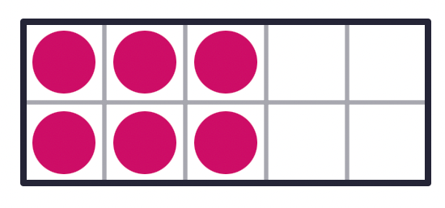
KINDERGARTEN NUMBER SENSE
CLOSED QUESTIONS
ELEMENTARY MATH PROJECT
2. How many dots are there?

Slide 4
KINDERGARTEN NUMBER SENSE
CLOSED QUESTIONS
ELEMENTARY MATH PROJECT
3. What numbers are missing?
1, 2, 3, _________, 5, 6, _________ 8

Slide 5

KINDERGARTEN NUMBER SENSE
CLOSED QUESTIONS
ELEMENTARY MATH PROJECT
4. How many dots are there?

Slide 6

KINDERGARTEN NUMBER SENSE
CLOSED QUESTIONS
ELEMENTARY MATH PROJECT
5. How many dots do you see? (Try not to count at first).
How do you see them?

Slide 7

KINDERGARTEN NUMBER SENSE
CLOSED QUESTIONS
ELEMENTARY MATH PROJECT
6. How many dots do you see? (Try not to count at first).
How do you see them?

Slide 8
KINDERGARTEN NUMBER SENSE
CLOSED QUESTIONS
ELEMENTARY MATH PROJECT
7. What number is closer to 5?
6 or 2
How do you know?

Slide 9
KINDERGARTEN NUMBER SENSE
CLOSED QUESTIONS
ELEMENTARY MATH PROJECT
8. In the number pairs, circle which number is the greatest.
a. 4 2
b. 3 7
c. 4 6

Slide 10
KINDERGARTEN NUMBER SENSE
CLOSED QUESTIONS
ELEMENTARY MATH PROJECT
9. Order these numbers from least to greatest:
8, 3, 7, 5, 2

Slide 11
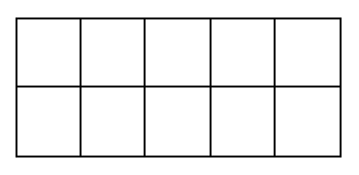
KINDERGARTEN NUMBER SENSE
CLOSED QUESTIONS
ELEMENTARY MATH PROJECT
10. Show one way to make 5 on a ten frame.

Slide 12
KINDERGARTEN NUMBER SENSE
CLOSED QUESTIONS
ELEMENTARY MATH PROJECT
11. Make the number 8 using tally marks

Slide 13
KINDERGARTEN NUMBER SENSE
CLOSED QUESTIONS
ELEMENTARY MATH PROJECT
12. Draw a picture that shows 5 of something.
Print the word for 10.

Slide 14
KINDERGARTEN NUMBER SENSE
CLOSED QUESTIONS
ELEMENTARY MATH PROJECT
13. Represent the number 7.
Dots | Tallies | Ten frames

Slide 15
KINDERGARTEN NUMBER SENSE
CLOSED QUESTIONS
ELEMENTARY MATH PROJECT
14. Draw to show two ways to decompose 5 into two parts.

Slide 16
KINDERGARTEN NUMBER SENSE
CLOSED QUESTIONS
ELEMENTARY MATH PROJECT
15. Use ten frames to show two ways to decompose 6 into parts.
________ and ________ ________ and ________

Slide 17
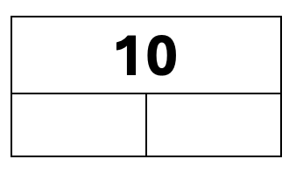
KINDERGARTEN NUMBER SENSE
CLOSED QUESTIONS
ELEMENTARY MATH PROJECT
16. Show two ways to decompose 10 into two parts

Slide 18
KINDERGARTEN NUMBER SENSE
OPEN QUESTIONS
ELEMENTARY MATH PROJECT
17. Grab about 5-10 small blocks, cubes, or counters.
What different ways could you count them?
Record your counts using pictures and numbers.

Slide 19
KINDERGARTEN NUMBER SENSE
OPEN QUESTIONS
ELEMENTARY MATH PROJECT
18. Count out 10 cubes or counters by ones.
What different ways can you organize the cubes or counters to count them?

Slide 20
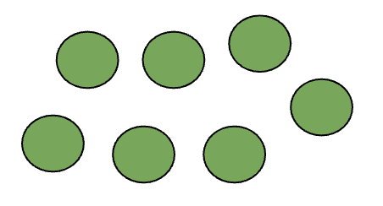
KINDERGARTEN NUMBER SENSE
OPEN QUESTIONS
ELEMENTARY MATH PROJECT
19. How many dots?
What different ways can you count them?

Slide 21
KINDERGARTEN NUMBER SENSE
OPEN QUESTIONS
ELEMENTARY MATH PROJECT
20. Find a small collection of items in your classroom like a basket of books or a jar of pencils.
About how many do you think there are?
Count to find out how many.
Is there a different way you could count them?

Slide 22
KINDERGARTEN NUMBER SENSE
OPEN QUESTIONS
ELEMENTARY MATH PROJECT
21. Grab a handful of crayons.
Estimate about how many there are.
Compare your handful with a classmate.
Who do you think has more?
Count and compare the numbers you each have.

Slide 23
KINDERGARTEN NUMBER SENSE
OPEN QUESTIONS
ELEMENTARY MATH PROJECT
22. Is 8 closer to 10 or 5? How do you know?
Share your thinking with a partner.

Slide 24
KINDERGARTEN NUMBER SENSE
OPEN QUESTIONS
ELEMENTARY MATH PROJECT
23. Look around your classroom.
What is there about 5 of?
What is there about 10 of?

Slide 25
KINDERGARTEN NUMBER SENSE
OPEN QUESTIONS
ELEMENTARY MATH PROJECT
24. Where in your classroom do you see numbers in order?
What about at home?

Slide 26
KINDERGARTEN NUMBER SENSE
OPEN QUESTIONS
ELEMENTARY MATH PROJECT
25. What different ways can you represent 4?
Think about using words, pictures, numbers, tallies, ten frames, etc.

Slide 27
KINDERGARTEN NUMBER SENSE
OPEN QUESTIONS
ELEMENTARY MATH PROJECT
26. What different ways can you decompose 5 into parts?
Use materials, pictures, numbers, ten frames, etc.

Slide 28
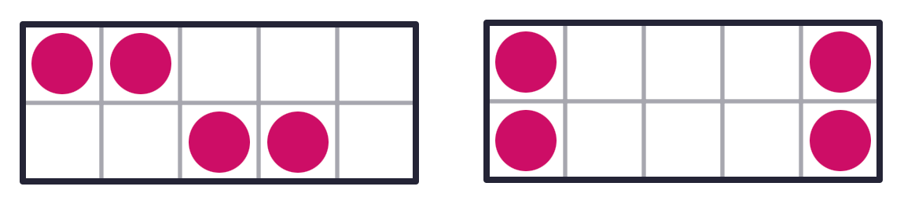
KINDERGARTEN NUMBER SENSE
OPEN QUESTIONS
ELEMENTARY MATH PROJECT
27. How are these representations of 4 the same?
How are they different?

Slide 29
KINDERGARTEN NUMBER SENSE
OPEN QUESTIONS
ELEMENTARY MATH PROJECT
28. What different ways can you represent 7?
Think about using words, pictures, numbers, tallies, ten frames, etc.

Slide 30
KINDERGARTEN NUMBER SENSE
OPEN QUESTIONS
ELEMENTARY MATH PROJECT
29. Get a collection of 5-10 items.
What different ways can you decompose the whole amount into parts?
How could you record all the different ways you find using pictures, numbers, and words.

Slide 31
ELEMENTARY MATH PROJECT
KINDERGARTEN PRACTICE QUESTIONS
COMPUTATIONAL FLUENCY

Slide 32

KINDERGARTEN COMPUTATIONAL FLUENCY
CLOSED QUESTIONS
ELEMENTARY MATH PROJECT
1. If there are 3 blue cubes, how many more to make 5?
Draw them.

Slide 33

KINDERGARTEN COMPUTATIONAL FLUENCY
CLOSED QUESTIONS
ELEMENTARY MATH PROJECT
2. Draw another way to make 5 with dots using two different colours.
One way to make 5 | Draw another way to make 5

Slide 34
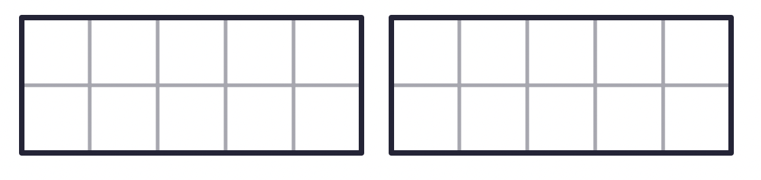
KINDERGARTEN COMPUTATIONAL FLUENCY
CLOSED QUESTIONS
ELEMENTARY MATH PROJECT
3. In each ten frame, show a different way to make 5.

Slide 35

KINDERGARTEN COMPUTATIONAL FLUENCY
CLOSED QUESTIONS
ELEMENTARY MATH PROJECT
4. What is 4 and 2 more? Draw 2 more and fill in the number sentence.
__________ and __________ is _____________

Slide 36
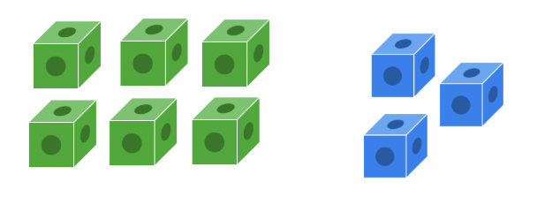
KINDERGARTEN COMPUTATIONAL FLUENCY
CLOSED QUESTIONS
ELEMENTARY MATH PROJECT
5. There are 6 green cubes and 3 blue cubes. When you combine them together, how many cubes are there?
__________ and __________ is ______________

Slide 37
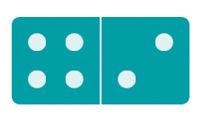

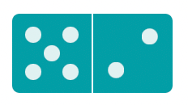
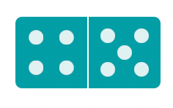
KINDERGARTEN COMPUTATIONAL FLUENCY
CLOSED QUESTIONS
ELEMENTARY MATH PROJECT
6. How many dots are on each domino? Start with the larger number of dots first and count on the smaller number of dots.
__________ | __________ | __________ | __________

Slide 38
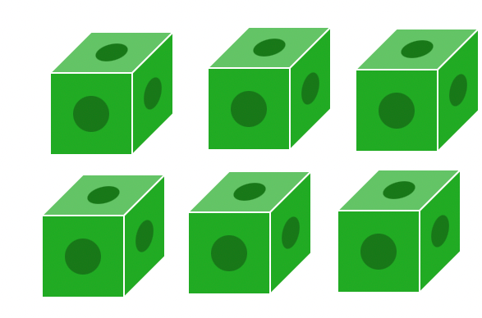
KINDERGARTEN COMPUTATIONAL FLUENCY
CLOSED QUESTIONS
ELEMENTARY MATH PROJECT
7. There are 6 green cubes.
If you remove/cross out 2 of them, how many green cubes will be left?
Print the number that will be left.
___________________

Slide 39
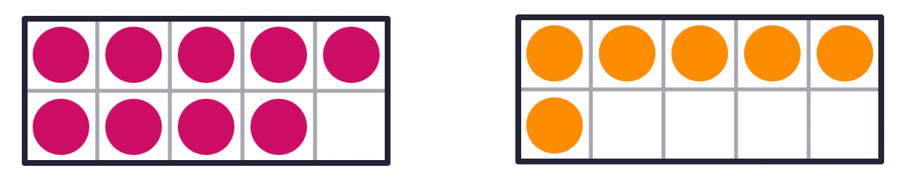
KINDERGARTEN COMPUTATIONAL FLUENCY
CLOSED QUESTIONS
ELEMENTARY MATH PROJECT
8. Fill in each ten frame to make 10.
______ and _____ is 10 ______ and _____ is 10

Slide 40
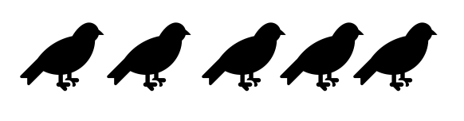
KINDERGARTEN COMPUTATIONAL FLUENCY
CLOSED QUESTIONS
ELEMENTARY MATH PROJECT
9. There are 5 birds and 2 fly away. How many birds are left?
Show how you solved the problem.

Slide 41
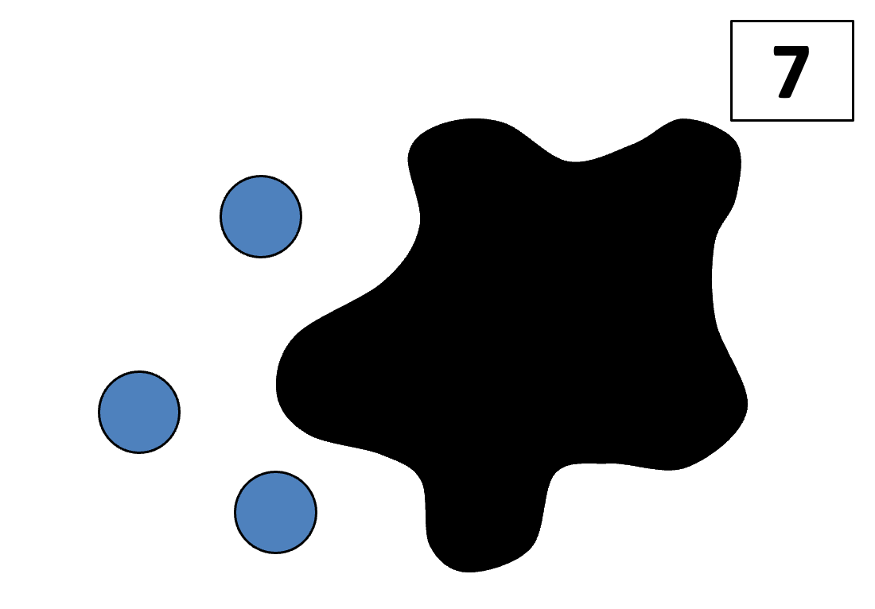
KINDERGARTEN COMPUTATIONAL FLUENCY
CLOSED QUESTIONS
ELEMENTARY MATH PROJECT
10. There are 7 blue dots. Some are under the Splat and some we can see. How many dots are under the Splat? How do you know?

Slide 42
KINDERGARTEN COMPUTATIONAL FLUENCY
CLOSED QUESTIONS
ELEMENTARY MATH PROJECT
11. Get 5 cubes or counters. What different ways can you make 5 using two or three parts? Draw three ways.

Slide 43
KINDERGARTEN COMPUTATIONAL FLUENCY
CLOSED QUESTIONS
ELEMENTARY MATH PROJECT
12. Get 5 cubes or counters. What different ways can you make 5 using three or four parts? Draw three ways.

Slide 44
KINDERGARTEN COMPUTATIONAL FLUENCY
CLOSED QUESTIONS
ELEMENTARY MATH PROJECT
13. How many different ways can you make or represent 5?

Slide 45
KINDERGARTEN COMPUTATIONAL FLUENCY
CLOSED QUESTIONS
ELEMENTARY MATH PROJECT
14. Draw pictures to show different ways to compose/make 6.

Slide 46
KINDERGARTEN COMPUTATIONAL FLUENCY
CLOSED QUESTIONS
ELEMENTARY MATH PROJECT
15. Get 7 cubes or counters.
Move the counters around to decompose 8 into smaller parts (two, three or four or more parts).
Draw different ways that you find.

Slide 47
KINDERGARTEN COMPUTATIONAL FLUENCY
CLOSED QUESTIONS
ELEMENTARY MATH PROJECT
16. There are two friends and they are sharing 8 cookies.
What different ways could they share them.
Use pictures, numbers and words to show your thinking.

Slide 48
KINDERGARTEN COMPUTATIONAL FLUENCY
CLOSED QUESTIONS
ELEMENTARY MATH PROJECT
17. Show at least three different ways to make 10 using two, three or four or more parts.
Use pictures and numbers.

Slide 49
KINDERGARTEN COMPUTATIONAL FLUENCY
CLOSED QUESTIONS
ELEMENTARY MATH PROJECT
18. I have a mixture of ten pieces of carrots and peas for my snack.
How many of each could I have?
What different ways can you think of?

Slide 50
KINDERGARTEN COMPUTATIONAL FLUENCY
CLOSED QUESTIONS
ELEMENTARY MATH PROJECT
19. What different ways can you make 7?
Use one ten frame for each way.

Slide 51
KINDERGARTEN COMPUTATIONAL FLUENCY
CLOSED QUESTIONS
ELEMENTARY MATH PROJECT
20. Draw/write a math story that has 10 things and some go missing.
Use your creative thinking.
Use numbers to label your drawings.

Slide 52
ELEMENTARY MATH PROJECT
KINDERGARTEN PRACTICE QUESTIONS
PATTERNS

Slide 53


KINDERGARTEN PATTERNS
CLOSED QUESTIONS
ELEMENTARY MATH PROJECT
1. Continue the patterns below:
Start of the Pattern | What’s Next
1, 3, 1, 3, 1, 3…

Slide 54
KINDERGARTEN PATTERNS
CLOSED QUESTIONS
ELEMENTARY MATH PROJECT
2. Can you circle the part of the pattern that repeats (or name the pattern rule if they are able to)?
a.

Slide 55
KINDERGARTEN PATTERNS
CLOSED QUESTIONS
ELEMENTARY MATH PROJECT
2. Can you circle the part of the pattern that repeats (or name the pattern rule if they are able to)?
b. 1, 3, 1, 3, 1, 3

Slide 56
KINDERGARTEN PATTERNS
CLOSED QUESTIONS
ELEMENTARY MATH PROJECT
2. Can you circle the part of the pattern that repeats (or name the pattern rule if they are able to)?
c.

Slide 57

KINDERGARTEN PATTERNS
CLOSED QUESTIONS
ELEMENTARY MATH PROJECT
3. Sort these objects (circle which ones belong together).
Sort by colour
Sort by number of sides
Sort by size (small, medium, large)

Slide 58
KINDERGARTEN PATTERNS
OPEN QUESTIONS
ELEMENTARY MATH PROJECT
4. I’m thinking of a pattern that uses 2 shapes.
What could my pattern look like?

Slide 59
KINDERGARTEN PATTERNS
OPEN QUESTIONS
ELEMENTARY MATH PROJECT
5. I’m thinking of a pattern that uses 3 shapes.
Can you show two different patterns?

Slide 60
KINDERGARTEN PATTERNS
OPEN QUESTIONS
ELEMENTARY MATH PROJECT
6. Can you use some shapes (or other objects) to make something that isn’t a pattern?

Slide 61
KINDERGARTEN PATTERNS
OPEN QUESTIONS
ELEMENTARY MATH PROJECT
7. Find 10 rocks outside (or use any random objects from counting collections or story workshop, or other loose parts).
Can you sort them into two piles and tell me what rule you used to sort them?

Slide 62
ELEMENTARY MATH PROJECT
KINDERGARTEN PRACTICE QUESTIONS
ALGEBRA

Slide 63
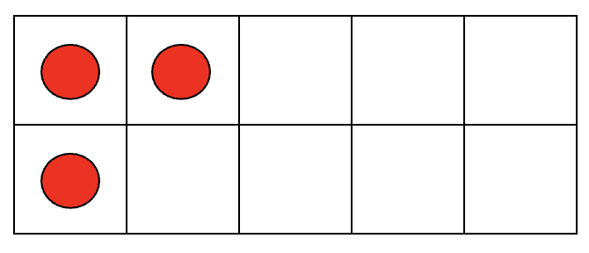
KINDERGARTEN ALGEBRA
CLOSED QUESTIONS
ELEMENTARY MATH PROJECT
1. Look at the image below.
How many circles are there?
What would you need to do to change it to 5?

Slide 64
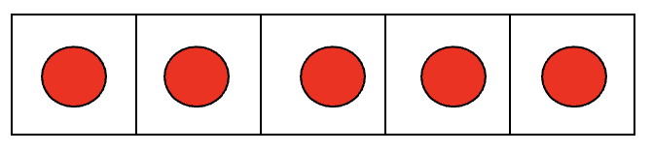
KINDERGARTEN ALGEBRA
CLOSED QUESTIONS
ELEMENTARY MATH PROJECT
2. Look at the image below.
How many circles are there?
What would you need to do to change it to 3?

Slide 65
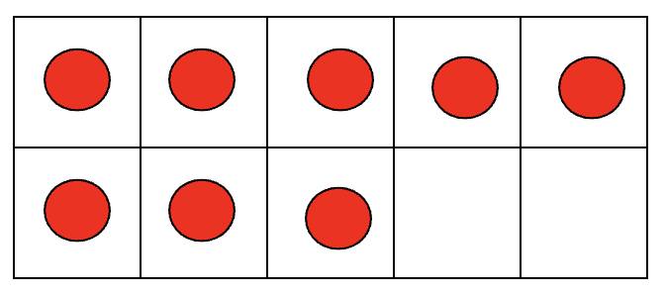
KINDERGARTEN ALGEBRA
CLOSED QUESTIONS
ELEMENTARY MATH PROJECT
3. Look at the image below.
How many circles are there?
What would you need to do to change it to 6?

Slide 66
KINDERGARTEN ALGEBRA
CLOSED QUESTIONS
ELEMENTARY MATH PROJECT
4. Count out 2 blocks (or linking cubes, or other objects).
How many more blocks (or linking cubes or other objects) do you need to get to 4?

Slide 67
KINDERGARTEN ALGEBRA
CLOSED QUESTIONS
ELEMENTARY MATH PROJECT
5. Count out 4 blocks (or linking cubes, or other objects).
How many more blocks (or linking cubes or other objects) do you need to get to 6?

Slide 68
KINDERGARTEN ALGEBRA
CLOSED QUESTIONS
ELEMENTARY MATH PROJECT
6. Count out 9 blocks (or linking cubes, or other objects).
How many more blocks (or linking cubes or other objects) do you need to get to 7?

Slide 69

KINDERGARTEN ALGEBRA
CLOSED QUESTIONS
ELEMENTARY MATH PROJECT
7. This scale is unbalanced - the sides are not equal. What could you add to the orange side to make it balanced:

Slide 70

KINDERGARTEN ALGEBRA
CLOSED QUESTIONS
ELEMENTARY MATH PROJECT
8. This scale is unbalanced - the sides are not equal. What could you take away from a side to make it balanced:

Slide 71
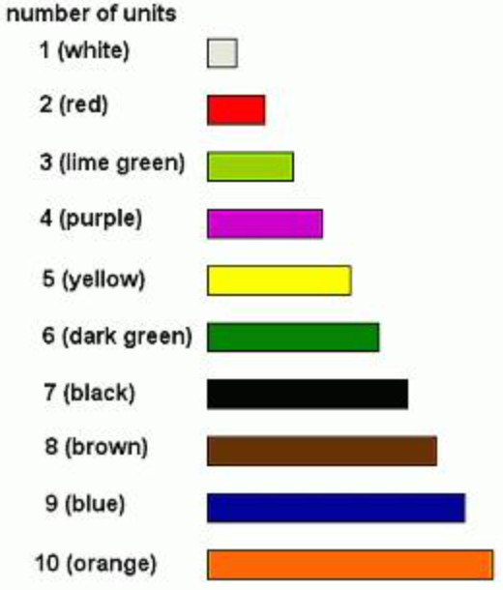
KINDERGARTEN ALGEBRA
OPEN QUESTIONS
ELEMENTARY MATH PROJECT
9. Use the Cuisenaire rods to show how you can make 4 (6, or any number).
Can you do it more than 1 way?

Slide 72
KINDERGARTEN ALGEBRA
OPEN QUESTIONS
ELEMENTARY MATH PROJECT
10. Count out 5 bears (or other counters, or objects). What would you do if you wanted more bears?
How many would you have? (What would if you wanted less bears? How many would you have?)

Slide 73

KINDERGARTEN ALGEBRA
OPEN QUESTIONS
ELEMENTARY MATH PROJECT
11. This scale is balanced - there is an equal number on each side.
a) How could you make the purple side more?
b) How could you make the orange side less?

Slide 74
KINDERGARTEN ALGEBRA
OPEN QUESTIONS
ELEMENTARY MATH PROJECT
11. This scale is balanced - there is an equal number on each side.
a) How could you make the purple side more?
b) How could you make the orange side less?

Slide 75
ELEMENTARY MATH PROJECT
KINDERGARTEN PRACTICE QUESTIONS
DATA

Slide 76
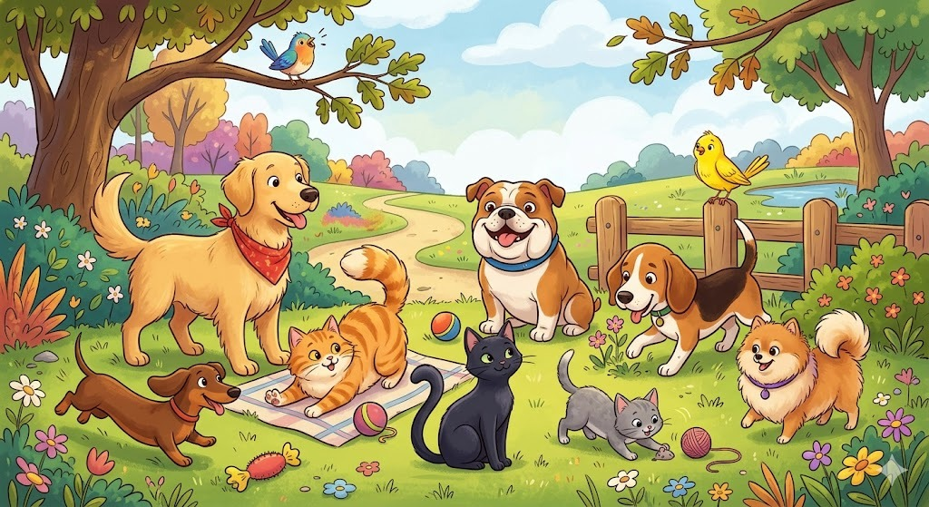
KINDERGARTEN DATA
CLOSED QUESTIONS
ELEMENTARY MATH PROJECT
1. Count the animals using a tally chart. Record your counting.
Animal | Tally
cats
dogs
birds

Slide 77
KINDERGARTEN DATA
CLOSED QUESTIONS
ELEMENTARY MATH PROJECT
2. Use animal shapes (or other counters, such as cutouts) to make a pictograph showing how many of each animal there in question 1.

Slide 78
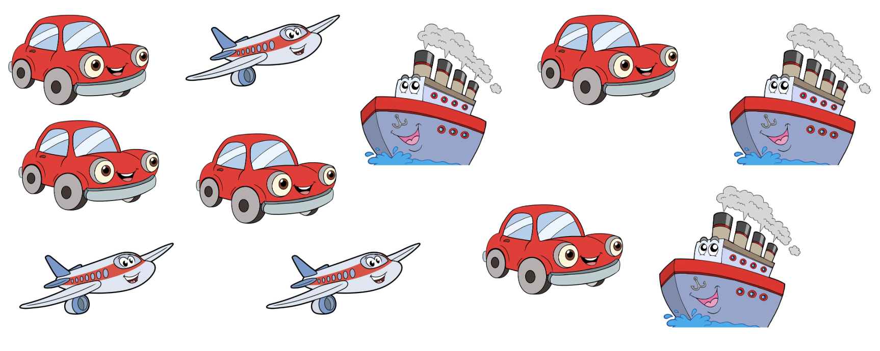
KINDERGARTEN DATA
CLOSED QUESTIONS
ELEMENTARY MATH PROJECT
3. Make a graph to represent how many cars and boats there are.
Cars | Boats

Slide 79
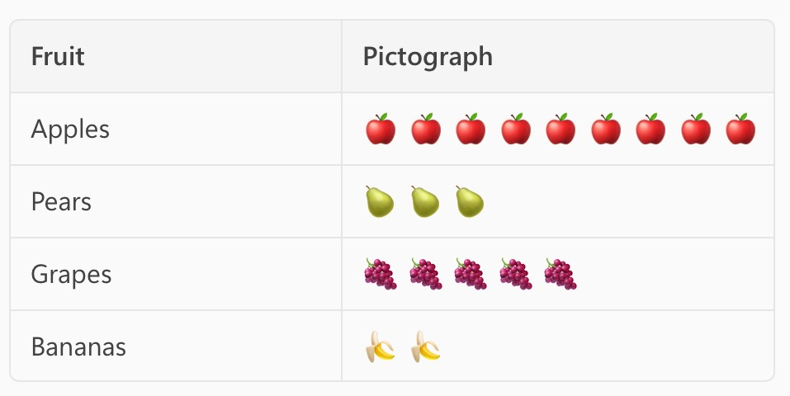
KINDERGARTEN DATA
CLOSED QUESTIONS
ELEMENTARY MATH PROJECT
4. Look at the following pictograph. Use it to answer
these questions:
How many types of fruit did the student record data for?
What fruit was the favourite?
How many more people liked grapes than pears?

Slide 80
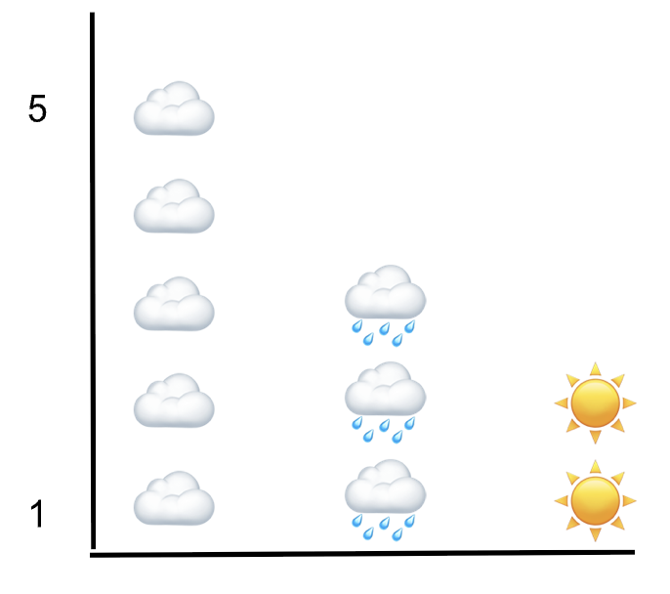
KINDERGARTEN DATA
OPEN QUESTIONS
ELEMENTARY MATH PROJECT
5. Describe what you think this graph could be measuring.

Slide 81
KINDERGARTEN DATA
OPEN QUESTIONS
ELEMENTARY MATH PROJECT
6. Choose three treats (Cookies, ice cream, popsicle, doughnut, popcorn, chips,...)
Draw a picture of each one at the top of the chart.
Ask you classmates which one they would rather have and record the results in your chart using tally’s

Slide 82
ELEMENTARY MATH PROJECT
KINDERGARTEN PRACTICE QUESTIONS
PROBABILITY

Slide 83
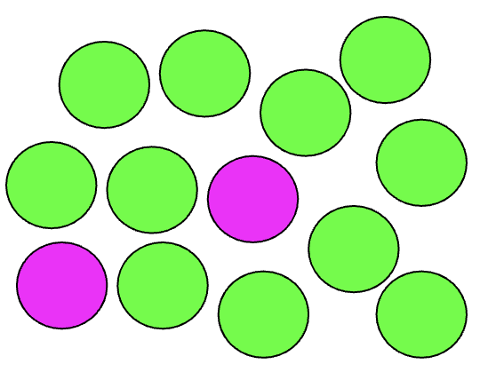
KINDERGARTEN PROBABILITY
CLOSED QUESTIONS
ELEMENTARY MATH PROJECT
1. Close your eyes and point at a ball.
Do you think it is likely going to be green or purple?

Slide 84
KINDERGARTEN PROBABILITY
CLOSED QUESTIONS
ELEMENTARY MATH PROJECT
2. Use the scale on the line to put down how certain or uncertain you are of these things happening Friday:
It is someone's birthday today.
Today is not Saturday.
I will use a pencil.

Slide 85
KINDERGARTEN PROBABILITY
CLOSED QUESTIONS
ELEMENTARY MATH PROJECT
3. Use the words likely or unlikely to describe each event:
Today we will read a book
Today you will see a tiger
Today you will see a car
Today it will snow
Today we will sing a song

Slide 86
KINDERGARTEN PROBABILITY
OPEN QUESTIONS
ELEMENTARY MATH PROJECT
4. Get two equal piles of similar objects - one pile of white rocks and one pile of black rocks, or 1 pile or yellow cubes and one pile of blue cubes.
Take some objects from each pile so that most of them are __________ (black or white)
If you wanted a white rock, which pile should you pick from?

Slide 87
KINDERGARTEN PROBABILITY
OPEN QUESTIONS
ELEMENTARY MATH PROJECT
5. Go outside. Look around.
Tell me something you see that you see that you thought you would see (likely).
Tell me something you see that you see that you thought you would not see (unlikely).

Slide 88
KINDERGARTEN PROBABILITY
OPEN QUESTIONS
ELEMENTARY MATH PROJECT
6. In this bag there is a piece of fruit.
How certain are you that it is a banana?
Tell me why you think that?

Slide 89
ELEMENTARY MATH PROJECT
KINDERGARTEN PRACTICE QUESTIONS
MEASUREMENT

Slide 90
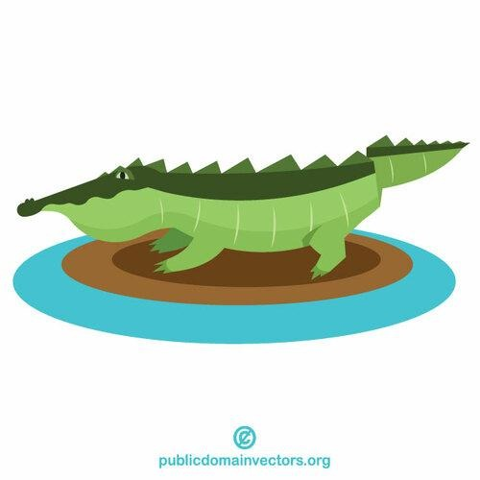
KINDERGARTEN MEASUREMENT
CLOSED QUESTIONS
ELEMENTARY MATH PROJECT
1. Use linking cubes or Unifix cubes to measure how long (from head to tail) this alligator is (number of blocks).

Slide 91
KINDERGARTEN MEASUREMENT
CLOSED QUESTIONS
ELEMENTARY MATH PROJECT
2. Without measuring, how many cubes long do you think the length of this pencil is?
Smallest possible length (fewest cubes) | My estimate for length | Biggest possible length (most cubes)

Slide 92

KINDERGARTEN MEASUREMENT
CLOSED QUESTIONS
ELEMENTARY MATH PROJECT
3. Which pencil is longer?

Slide 93
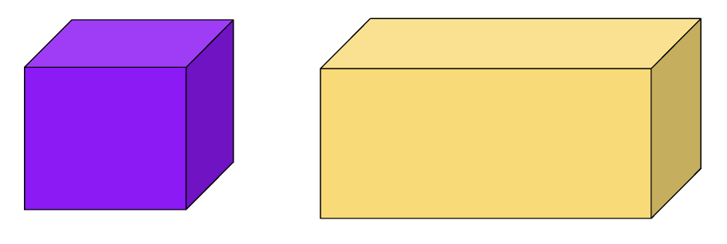
KINDERGARTEN MEASUREMENT
CLOSED QUESTIONS
ELEMENTARY MATH PROJECT
4. Which box would hold less water?

Slide 94
KINDERGARTEN MEASUREMENT
OPEN QUESTIONS
ELEMENTARY MATH PROJECT
5. Get a partner, and cut a piece of string (the string lengths should be different for each partner).
Each partner use the string to measure how tall a (book shelf, chair, desk, table,...) is.
Why did you get different numbers?

Slide 95
KINDERGARTEN MEASUREMENT
OPEN QUESTIONS
ELEMENTARY MATH PROJECT
6. Using a part of your body (length of a finger, fingertip to elbow, width of a hand) estimate the width of your desk.

Slide 96
KINDERGARTEN MEASUREMENT
OPEN QUESTIONS
ELEMENTARY MATH PROJECT
7. Find a person in class whose foot is longer than yours.

Slide 97
KINDERGARTEN MEASUREMENT
OPEN QUESTIONS
ELEMENTARY MATH PROJECT
8. Use a piece of string or rope to help you figure out about how far it is around a tree.

Slide 98
ELEMENTARY MATH PROJECT
KINDERGARTEN PRACTICE QUESTIONS
GEOMETRY

Slide 99
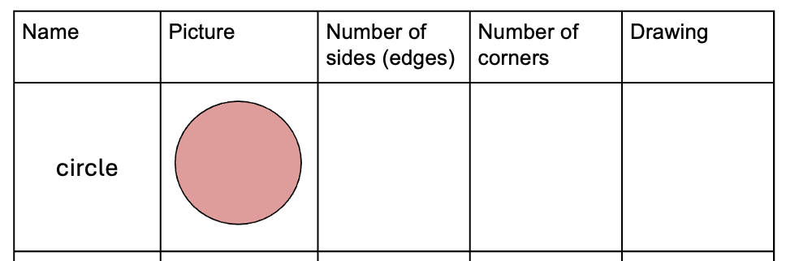
KINDERGARTEN GEOMETRY
CLOSED QUESTIONS
ELEMENTARY MATH PROJECT
1. Complete the chart for each shape (add more shapes for students ready for them - pentagon, hexagon, rhombus, oval/ellipse, kite, trapezoid,...)

Slide 100
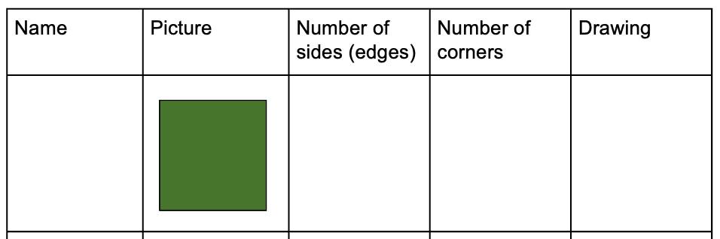
KINDERGARTEN GEOMETRY
CLOSED QUESTIONS
ELEMENTARY MATH PROJECT
1. Complete the chart for each shape (add more shapes for students ready for them - pentagon, hexagon, rhombus, oval/ellipse, kite, trapezoid,...)

Slide 101
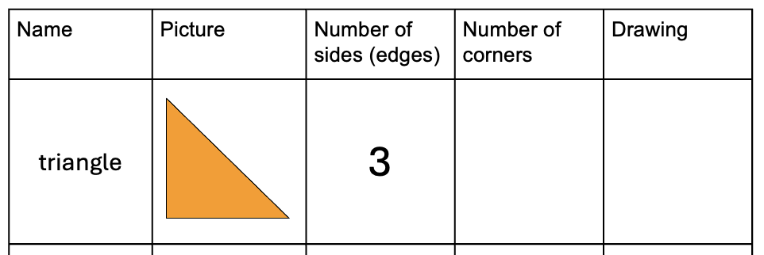
KINDERGARTEN GEOMETRY
CLOSED QUESTIONS
ELEMENTARY MATH PROJECT
1. Complete the chart for each shape (add more shapes for students ready for them - pentagon, hexagon, rhombus, oval/ellipse, kite, trapezoid,...)

Slide 102
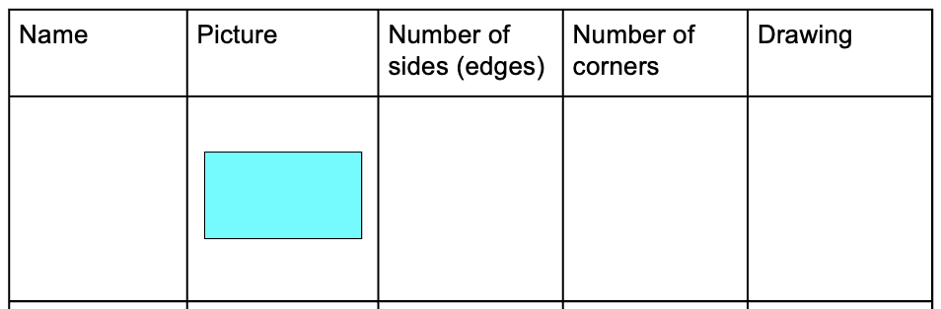
KINDERGARTEN GEOMETRY
CLOSED QUESTIONS
ELEMENTARY MATH PROJECT
1. Complete the chart for each shape (add more shapes for students ready for them - pentagon, hexagon, rhombus, oval/ellipse, kite, trapezoid,...)

Slide 103
KINDERGARTEN GEOMETRY
CLOSED QUESTIONS
ELEMENTARY MATH PROJECT
2. Choose a shape from the chart in question 1. Where do you see it in the classroom?

Slide 104

KINDERGARTEN GEOMETRY
CLOSED QUESTIONS
ELEMENTARY MATH PROJECT
3. Look at the following image.
Which shapes are similar? Which shapes are different?

Slide 105
KINDERGARTEN GEOMETRY
CLOSED QUESTIONS
ELEMENTARY MATH PROJECT
4. Tell me one thing about each of these objects (use a class set of geometric solids, they do not need to know the name for all of the solids):
Pyramid
Cube
Rectangular Prism
Sphere
Cylinder
Triangular prism

Slide 106

KINDERGARTEN GEOMETRY
OPEN QUESTIONS
ELEMENTARY MATH PROJECT
5. Cut this rectangle into two pieces. (Provide rectangles and scissors)
What can you tell me about the pieces you cut?

Slide 107

KINDERGARTEN GEOMETRY
OPEN QUESTIONS
ELEMENTARY MATH PROJECT
6. Choose 2 or more shapes from your tangram set.
Put them together to form a new shape.
Draw (or trace) the shape.
How many sides does it have?

Slide 108
KINDERGARTEN GEOMETRY
OPEN QUESTIONS
ELEMENTARY MATH PROJECT
7. How many different types of shapes with 4 sides can you draw?

Slide 109
ELEMENTARY MATH PROJECT
KINDERGARTEN PRACTICE QUESTIONS
FINANCIAL LITERACY

Slide 110
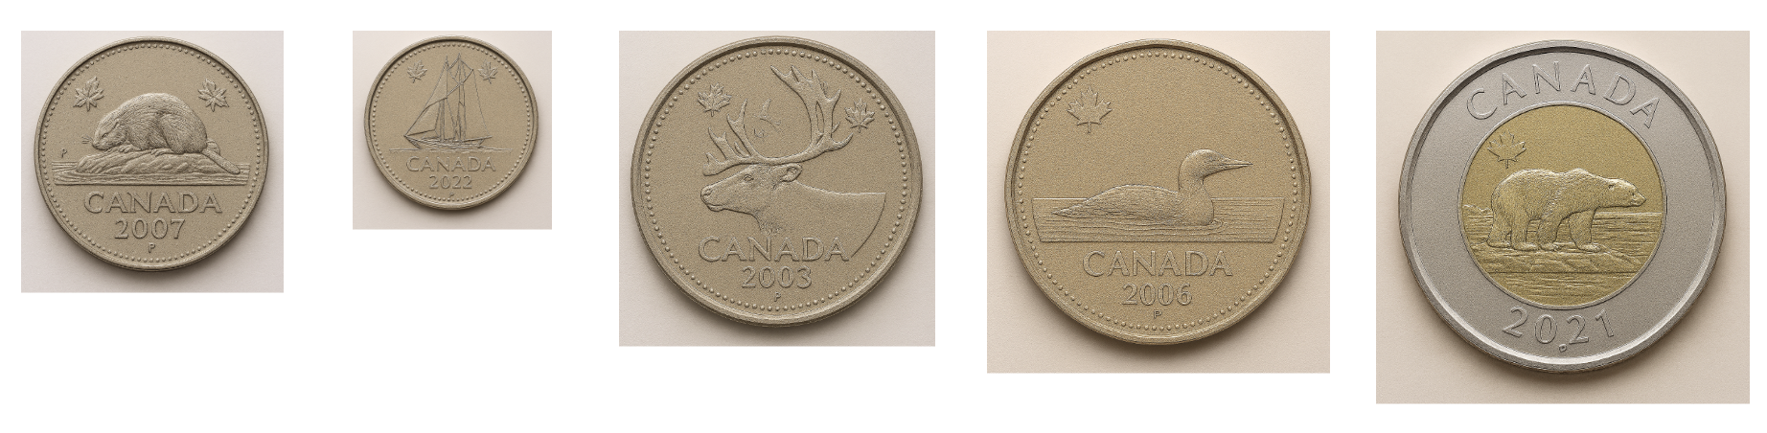
KINDERGARTEN FINANCIAL LITERACY
CLOSED QUESTIONS
ELEMENTARY MATH PROJECT
1. Cut the values and images out and have the students match them (students should also use the correct names, but do not have to be able to spell or read them). You can also use real coins, or manufactured plastic coins as well (play money)

Slide 111
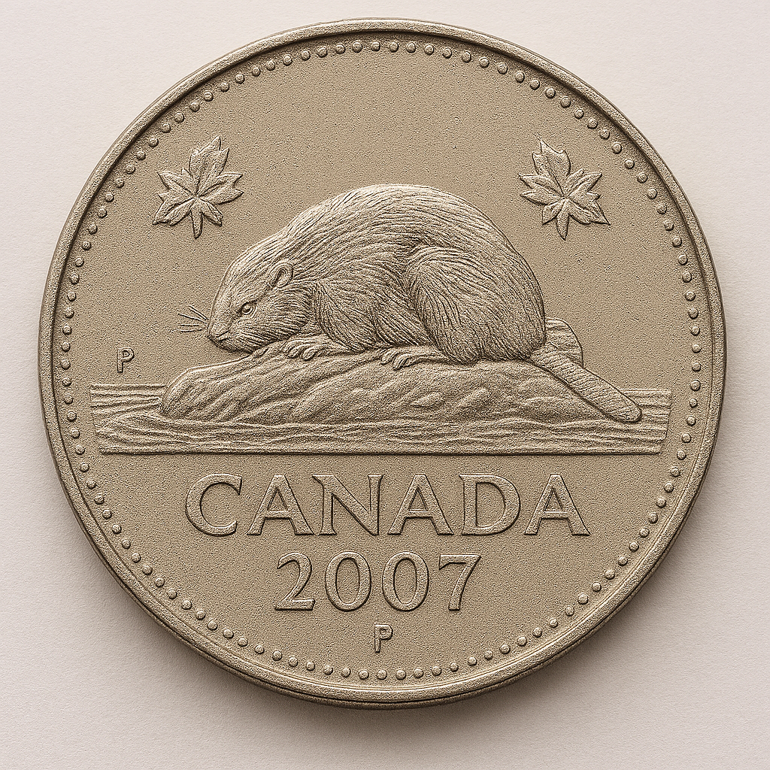
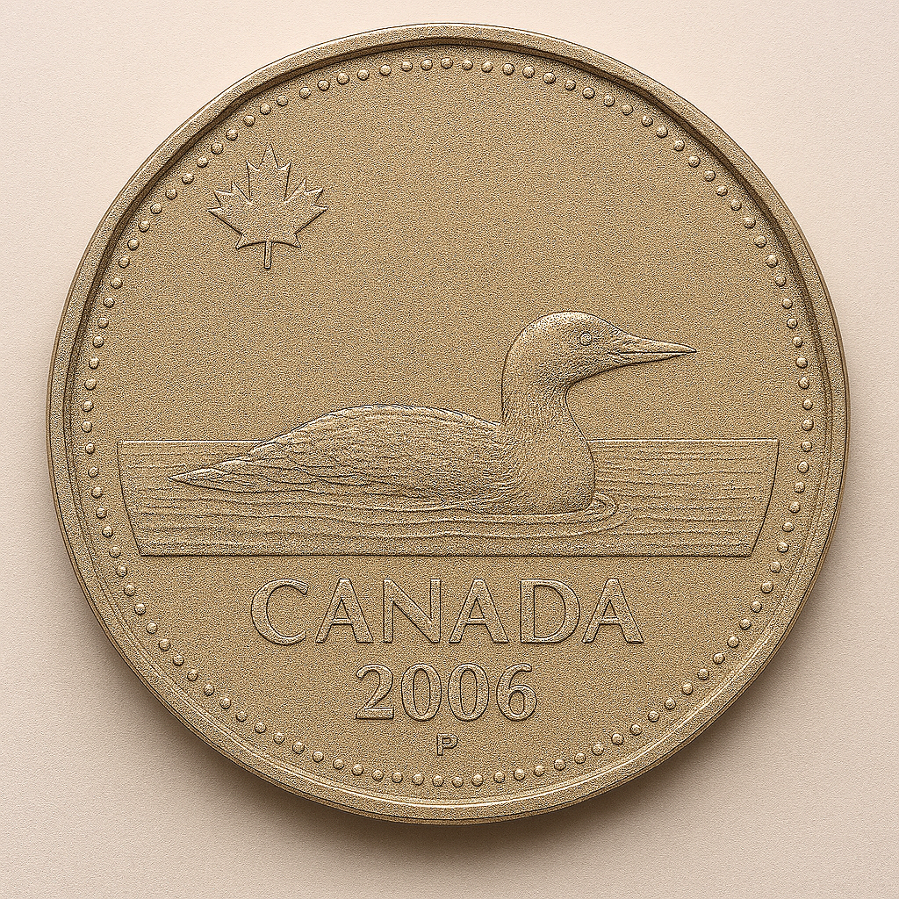
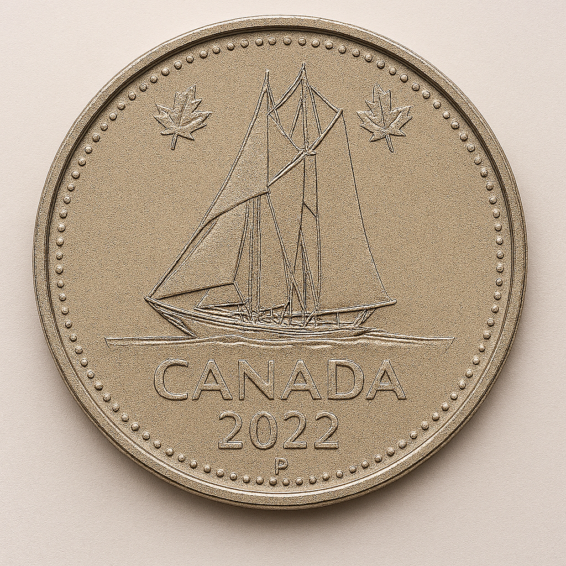
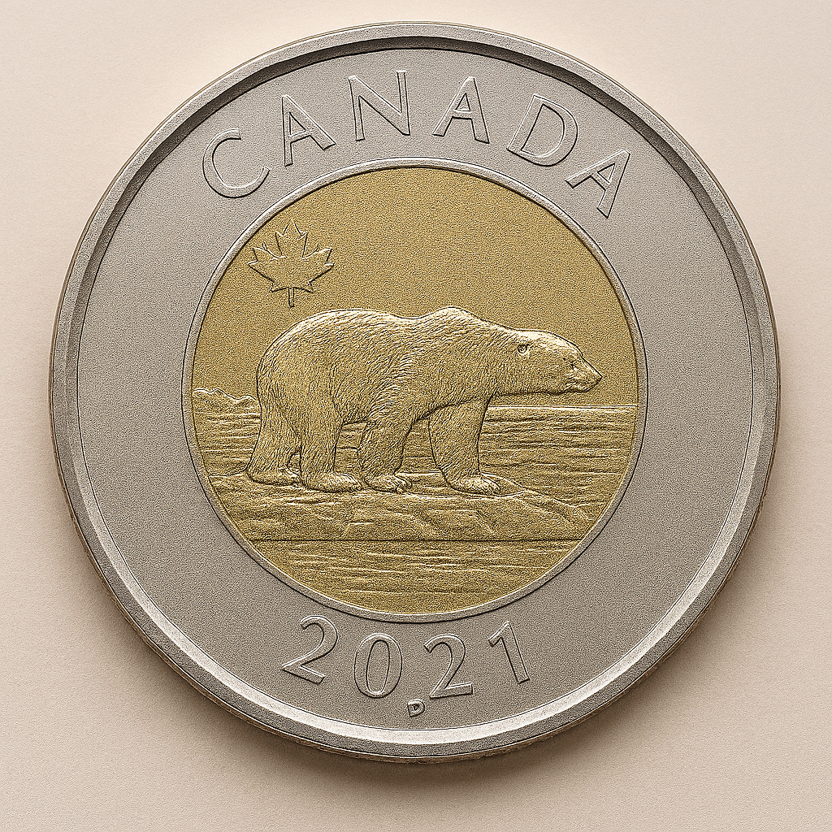
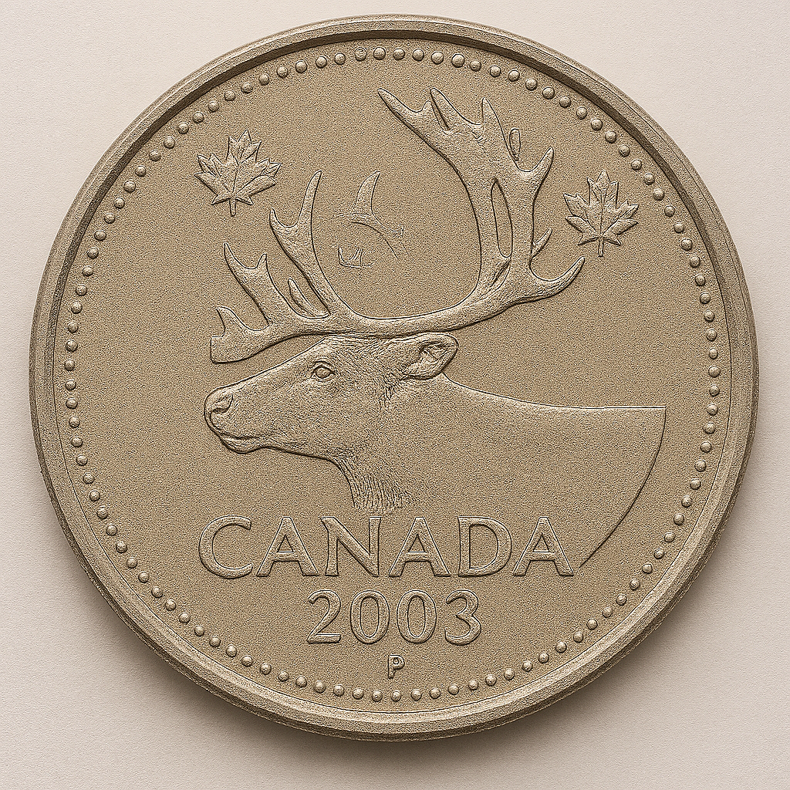
KINDERGARTEN FINANCIAL LITERACY
CLOSED QUESTIONS
ELEMENTARY MATH PROJECT
2. Tell me one thing about each of the Canadian coins.

Slide 112
KINDERGARTEN FINANCIAL LITERACY
CLOSED QUESTIONS
ELEMENTARY MATH PROJECT
3. You go to the bakery and buy a muffin for $3.00 and a juice for $2.00.
How much does this cost all together?

Slide 113
KINDERGARTEN FINANCIAL LITERACY
CLOSED QUESTIONS
ELEMENTARY MATH PROJECT
4. Would it be more correct to say that you want candy or that you need candy?
Would it be more correct to say that you want shoes or that you need shoes?

Slide 114
KINDERGARTEN FINANCIAL LITERACY
OPEN QUESTIONS
ELEMENTARY MATH PROJECT
5. Show how you can make 10 cents in two different ways.

Slide 115
KINDERGARTEN FINANCIAL LITERACY
OPEN QUESTIONS
ELEMENTARY MATH PROJECT
6. You have $5.00.
You can buy a toy, or you can buy lunch to eat at school.
Tell me which one you would pick.

Slide 116
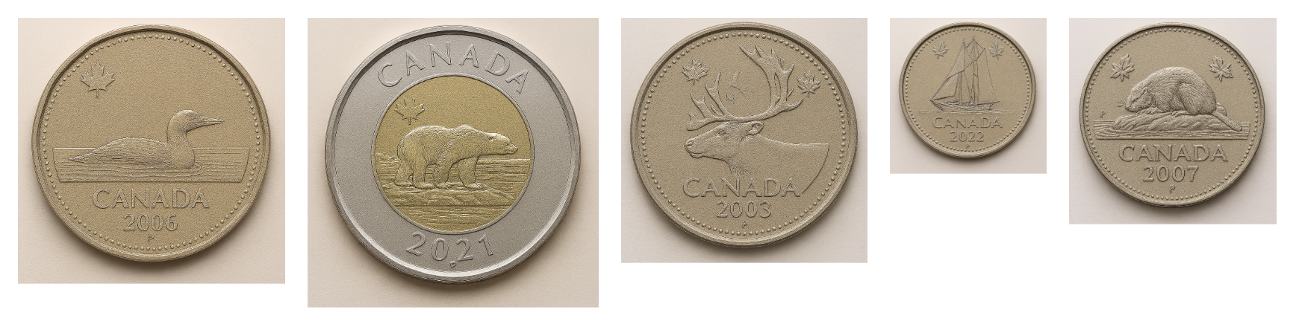
KINDERGARTEN FINANCIAL LITERACY
OPEN QUESTIONS
ELEMENTARY MATH PROJECT
7. Tell me which coin is your favourite?
Why is it your favourite?

Slide 117
ELEMENTARY MATH PROJECT
KINDERGARTEN PRACTICE QUESTIONS
MIXED REVIEW

Slide 118
KINDERGARTEN MIXED REVIEW
ELEMENTARY MATH PROJECT
1. Show three ways to represent 5.

Slide 119
KINDERGARTEN MIXED REVIEW
ELEMENTARY MATH PROJECT
2. Draw an AB pattern.

Slide 120
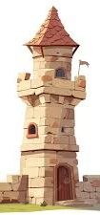
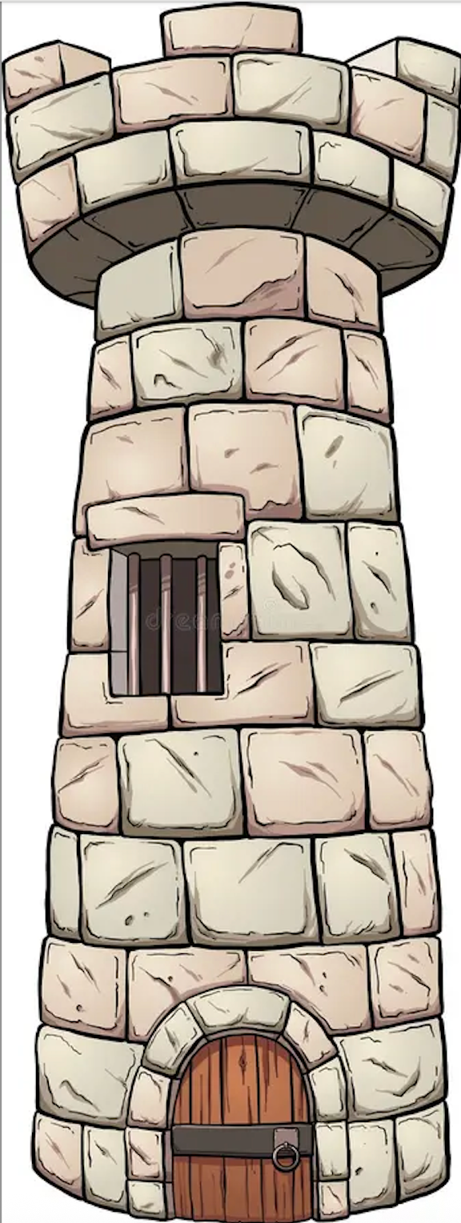
KINDERGARTEN MIXED REVIEW
ELEMENTARY MATH PROJECT
3. Circle the tower that is taller

Slide 121
KINDERGARTEN MIXED REVIEW
ELEMENTARY MATH PROJECT
4. Fill in the missing counting numbers.
1 2 3 _____ 5 6 _____ 8 _____ 10
Show ten using tally marks.

Slide 122
KINDERGARTEN MIXED REVIEW
ELEMENTARY MATH PROJECT
5. Show three ways to represent 7.

Slide 123
KINDERGARTEN MIXED REVIEW
ELEMENTARY MATH PROJECT
6. Draw an ABC pattern.

Slide 124

KINDERGARTEN MIXED REVIEW
ELEMENTARY MATH PROJECT
7. Draw more dots to make 10 in all.

Slide 125
KINDERGARTEN MIXED REVIEW
ELEMENTARY MATH PROJECT
8. Draw shapes with four straight sides.

Slide 126
KINDERGARTEN MIXED REVIEW
ELEMENTARY MATH PROJECT
9. Show three ways to represent 10.

Slide 127
KINDERGARTEN MIXED REVIEW
ELEMENTARY MATH PROJECT
10. Draw an ABB pattern.

Slide 128
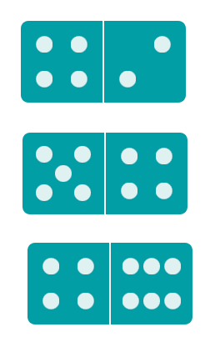

KINDERGARTEN MIXED REVIEW
ELEMENTARY MATH PROJECT
11. Count up the dots for each domino. Print how many for each domino.

Slide 129
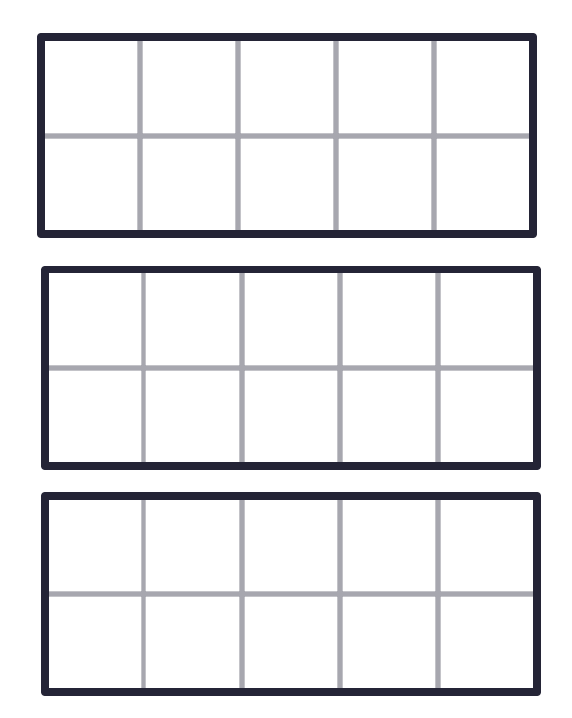
KINDERGARTEN MIXED REVIEW
ELEMENTARY MATH PROJECT
12. Make 8 in the ten frames in three different ways.

